Slide 1
Inflammation and repair
Dr Shaesta Naseem
1-10-11

Slide 2
Gross and histopathology

Slide 3
1- Fibrinous pericarditis

Slide 4
Organ: Pericardium Dx: Fibrinous Inflammation

Slide 5
ACUTE FIBRINOUS PERICARDITIS

Slide 6
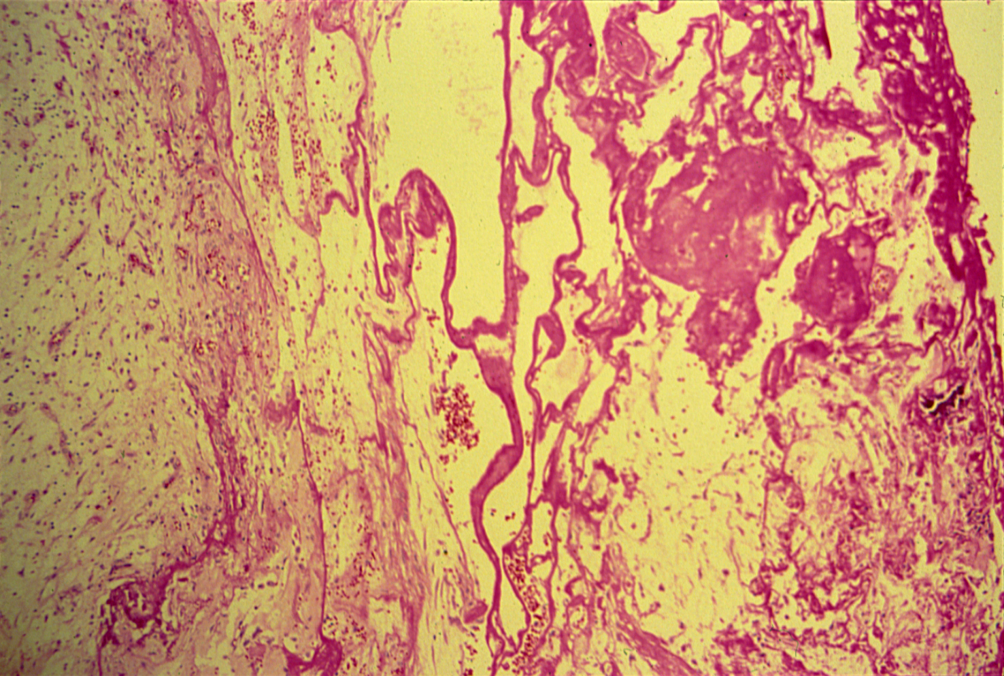

Slide 7
Fibrinous Pericarditis: Section of Heart shows:
The pericardium is distorted by thick irregular layer of pinkish fibrinous exudate with some red cells and inflammatory cells.
The subpericardial layer is thickened by edema and shows dilated blood vessels, chronic inflammatory cells.

Slide 8
2- Acute appendicitis

Slide 9
ACUTE APPENDICITIS
Notes:
What is the white junk coating the surface?

Slide 10
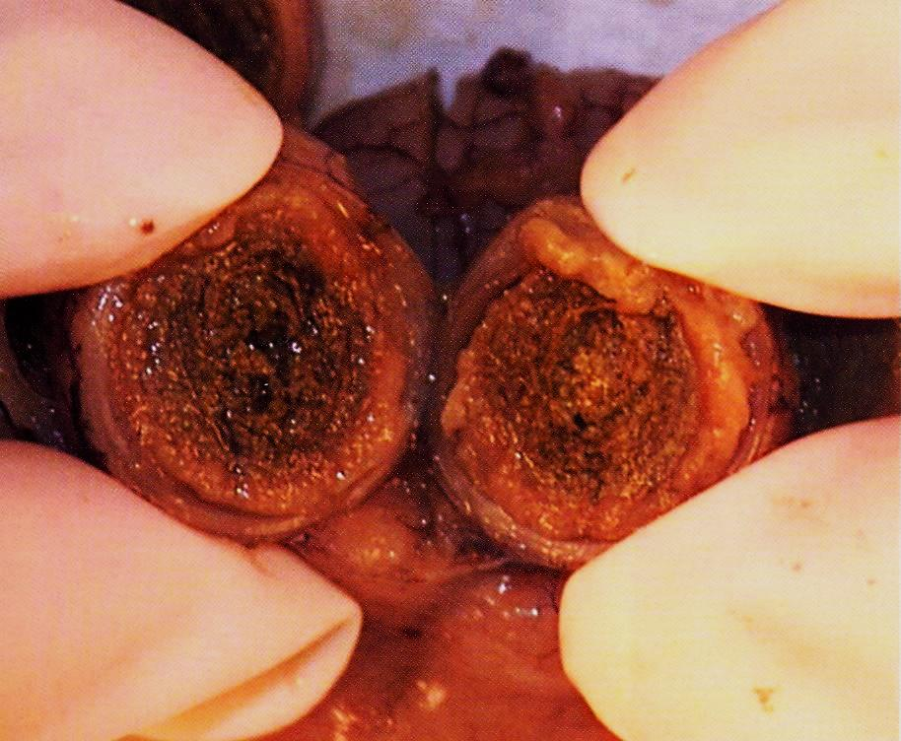

Slide 11
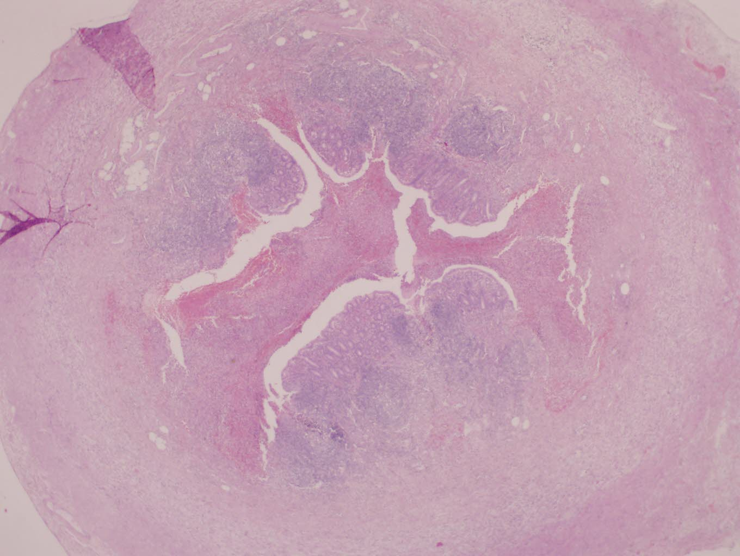
ACUTE APPENDICITIS

Slide 12
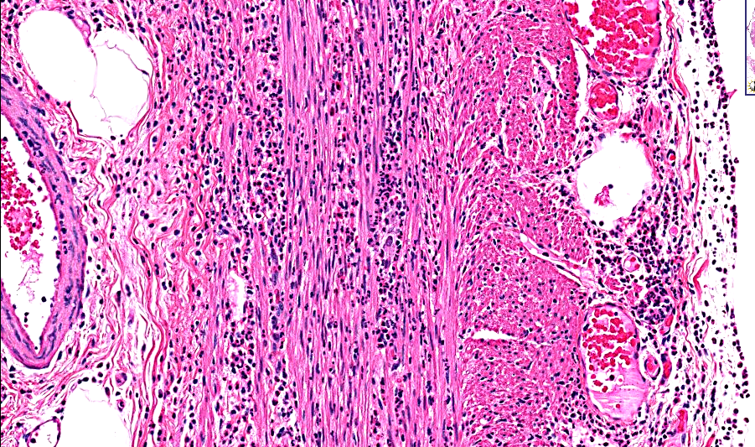
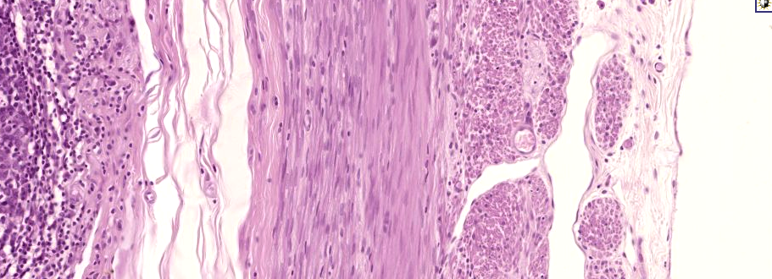
Notes:
The presence of neutrophils invading the muscularis is the diagnostic criteria needed to diagnosis or confirm, acute appendicitis!

Slide 13
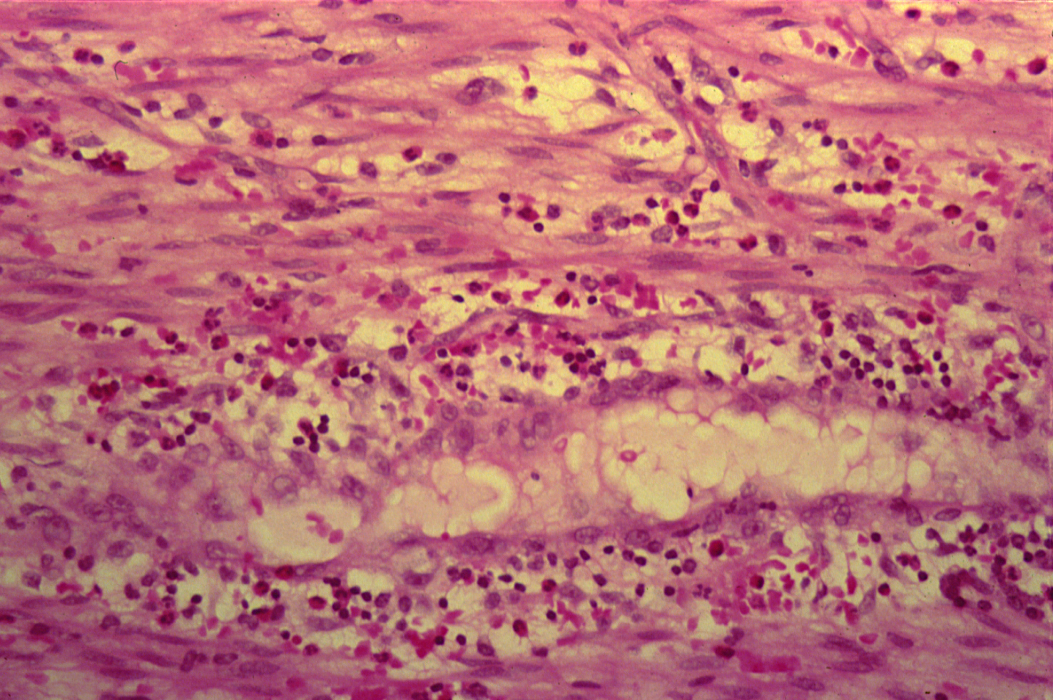
ACUTE APPENDICITIS

Slide 14
Acute Suppurative appendicitis: Cross Section of Appendix shows:
Accumulation of inflammatory exudate and pus cells in the lumen and the mucosa is ulcerated.
All layers of the appendix wall show edema, dilated and congested blood vessels and infiltration by many neutrophils.
Fibrino-purulent exudate is present on the serosal surface.

Slide 15
3-Skin pilonidal sinus

Slide 16
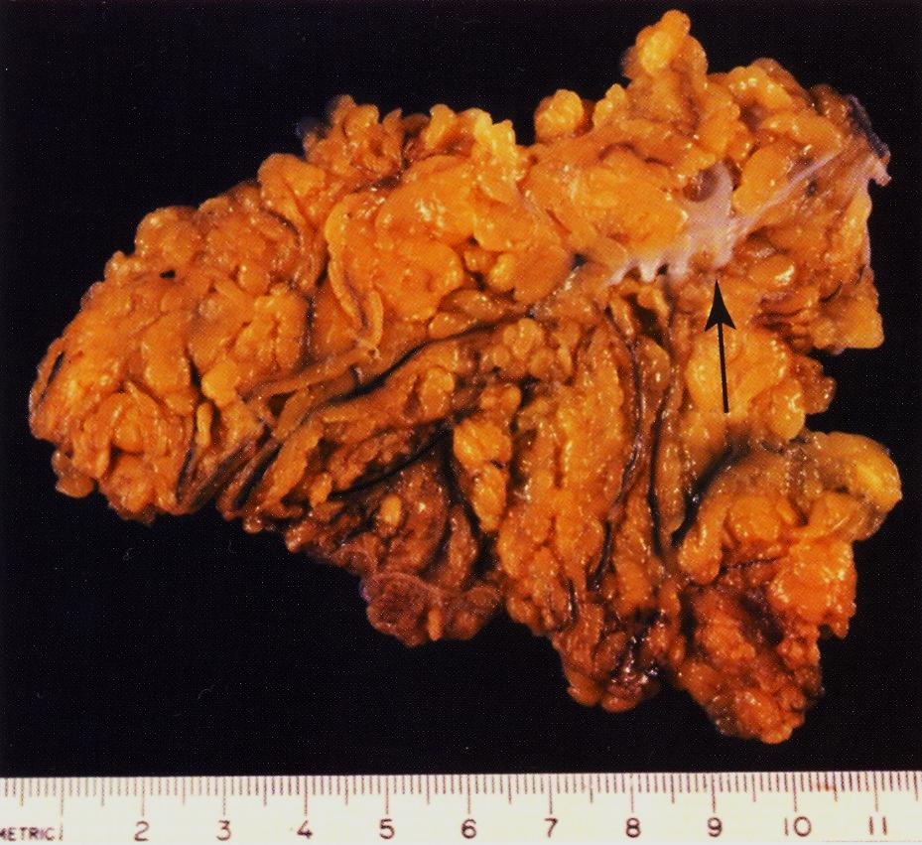

Slide 17
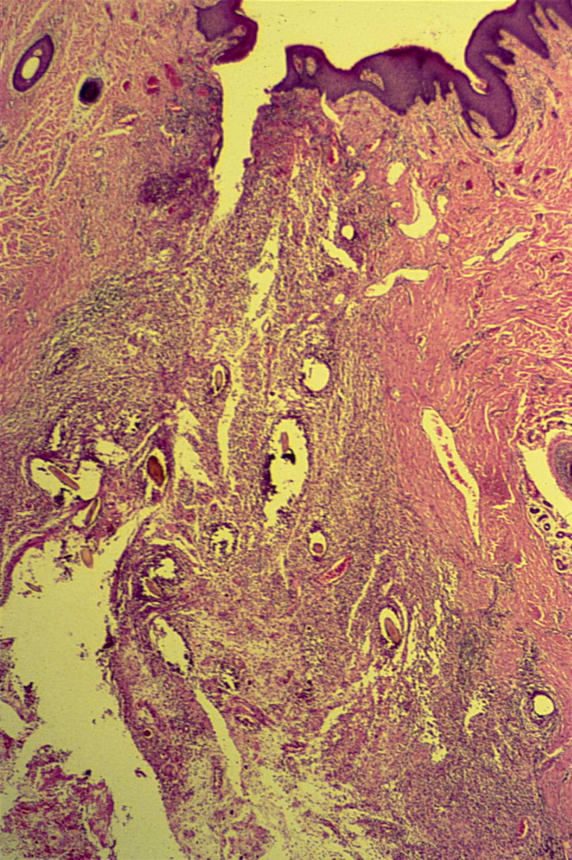
FOREIGN BODY REACTION (PILONIDAL SINUS)

Slide 18
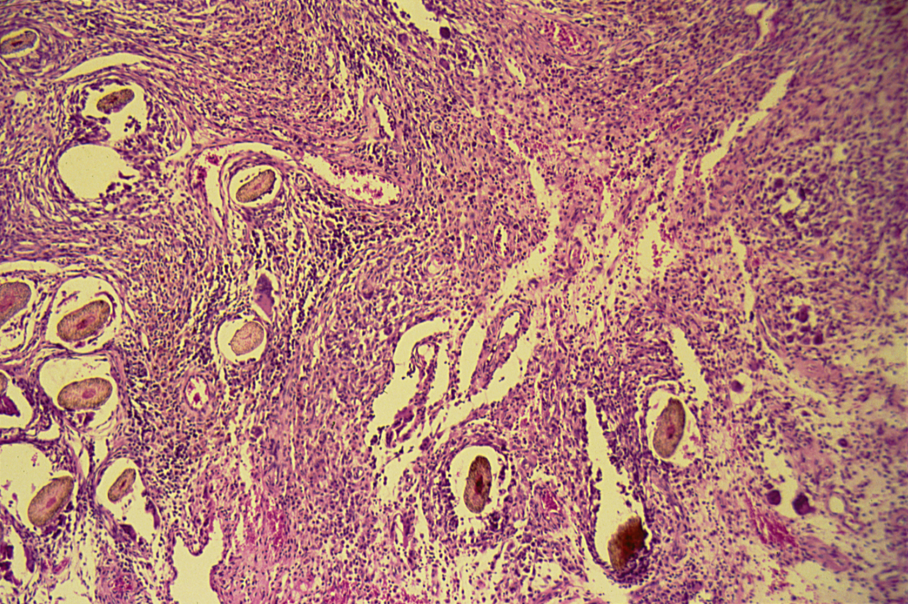
FOREIGN BODY REACTION (PILONIDAL SINUS)

Slide 19
Foreign Body reaction (Pilonidal sinus): Section of Skin Shows:
A sinus tract lined by an inflammatory granulation tissue in the dermis .
The lumen of sinus and wall contain large number of hair shafts with foreign body giant cells, lymphocytes , macrophages & neutrophils.

Slide 20
4-Chronic cholecystitis with stones

Slide 21
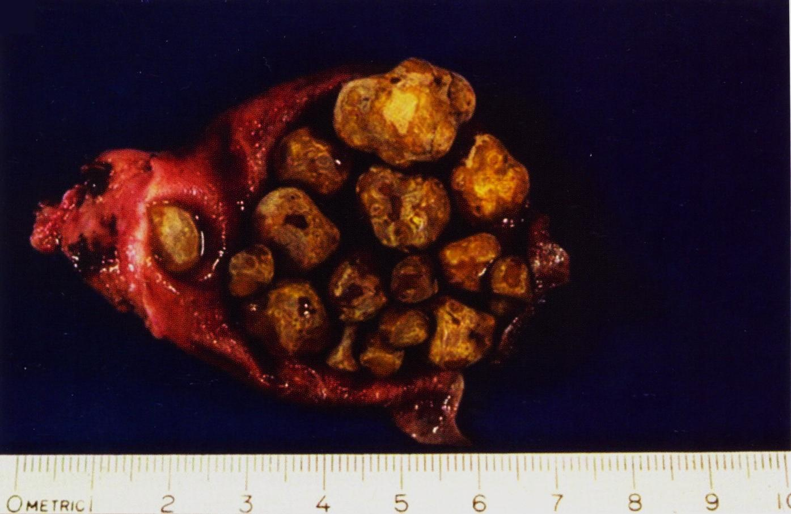

Slide 22
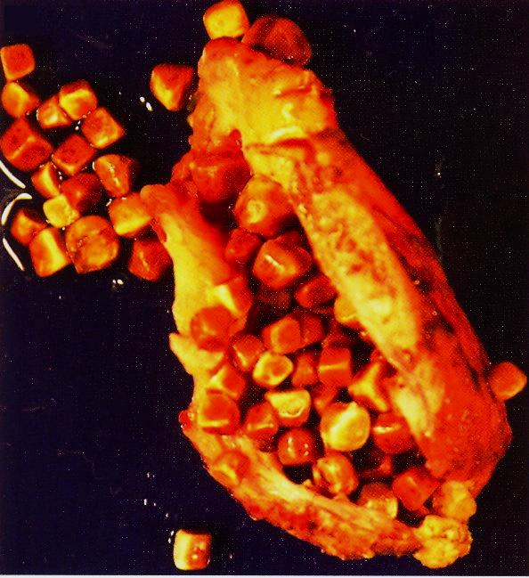

Slide 23
5-Bronchiectasis

Slide 24
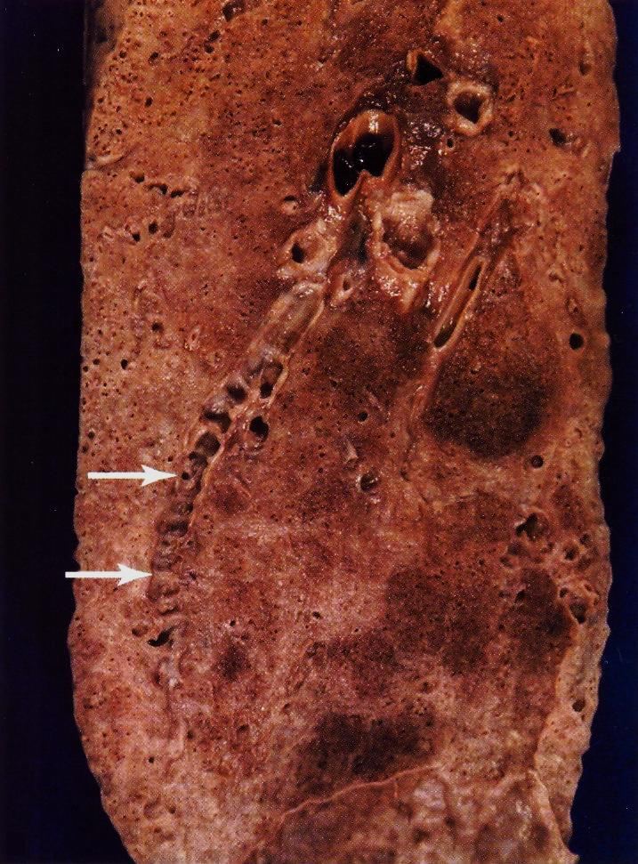

Slide 25
6- Brain abscess

Slide 26
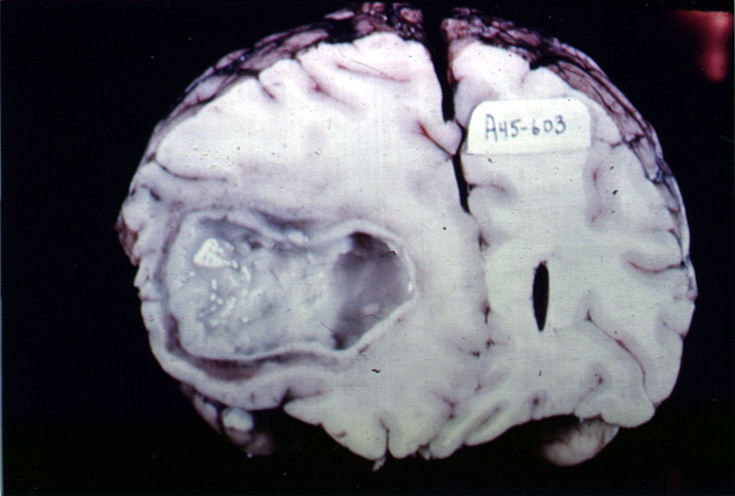

Slide 27
7- Pyemic abscesses of the kidney

Slide 28
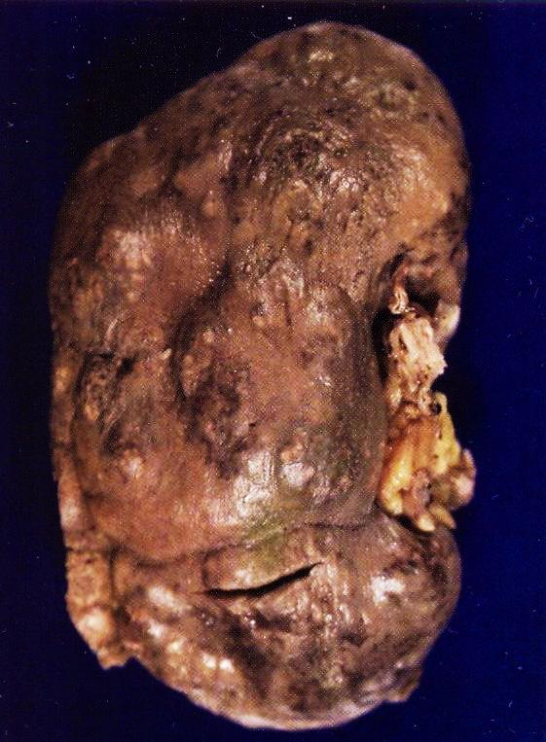

Slide 29
8- Granulation tissue

Slide 30
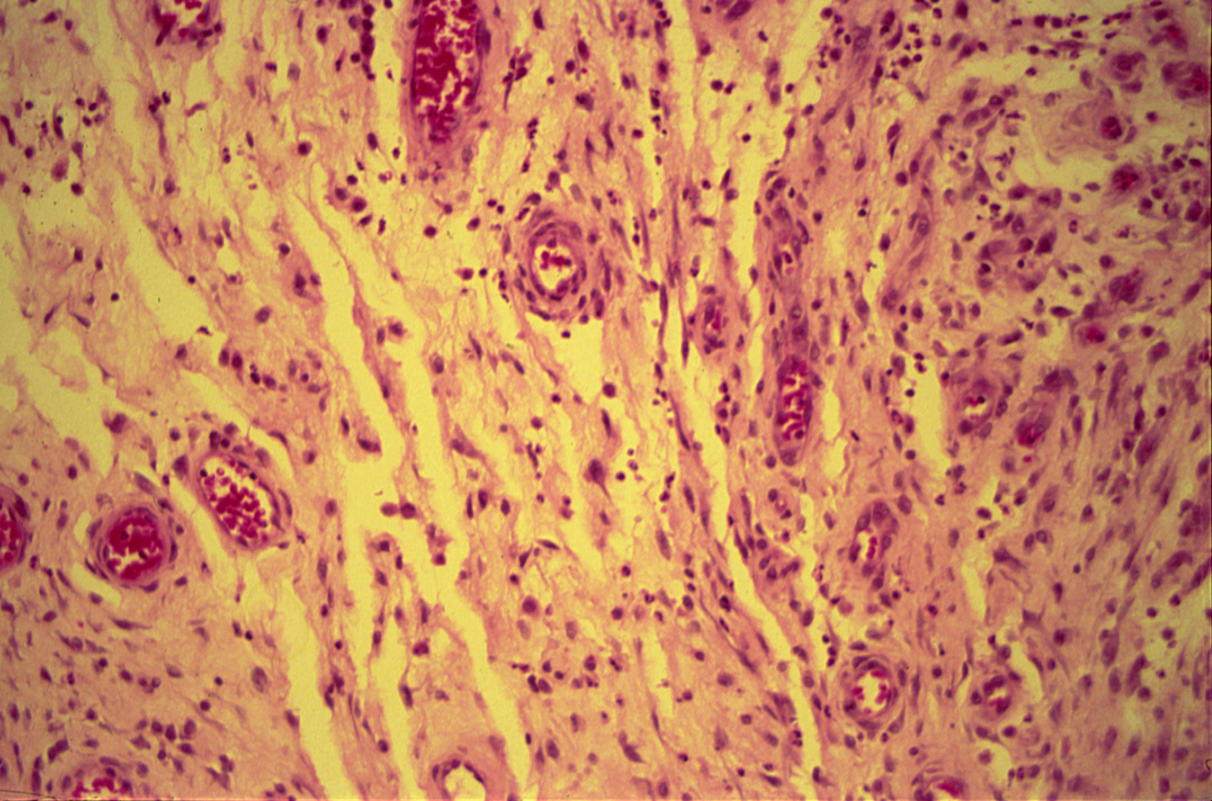
GRANULATION TISSUE

Slide 31
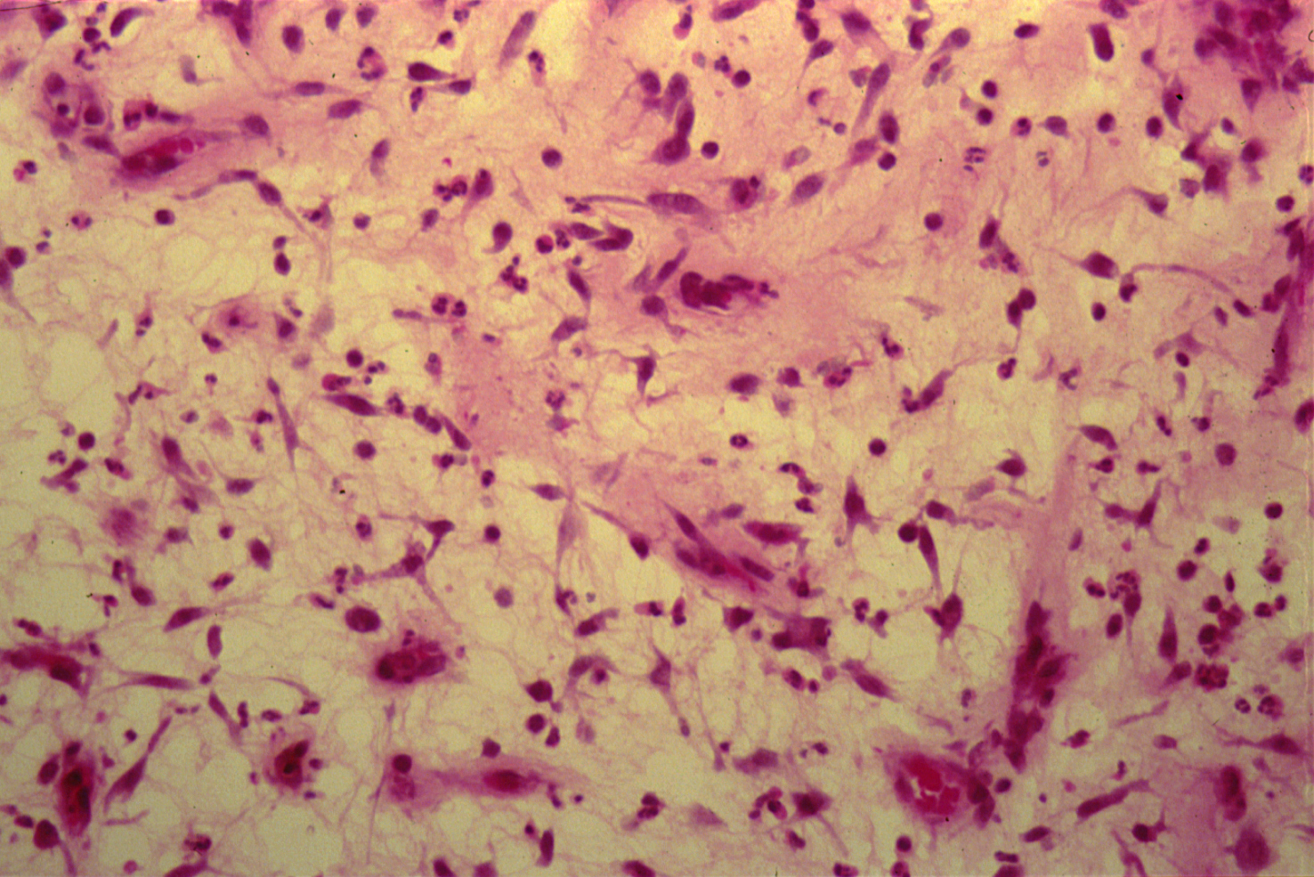
GRANULATION TISSUE

Slide 32
Granulation Tissue: Section of fragments of edematous, loose connective tissue shows:
Many small newly formed capillaries lined by plump endothelial cells.
Proliferation of fibroblasts is seen.
Inflammatory cells including macrophages, lymphocytes, plasma cells and neutrophils in the oedematous stroma.
Pink homogenous collagen fibres may be identified.

