Slide 1
Neoplasia Practical –malignant tumors
Dr Shaesta Naseem Zaidi
20-11-11

Slide 2
1- Squamous cell carcinoma of the skin

Slide 3
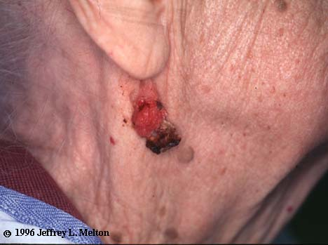

Slide 4
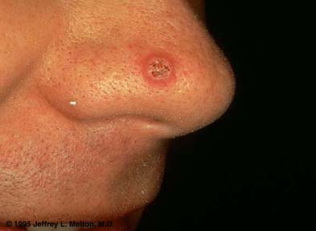

Slide 5
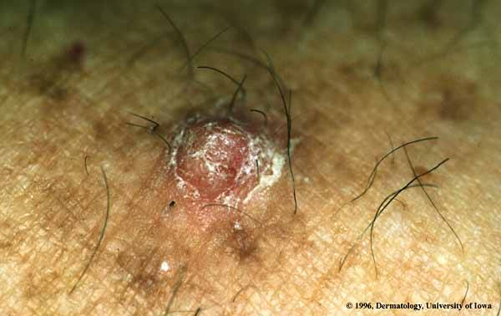
Notes:
Actinic keratosis vs. squamous cell carcinoma

Slide 6
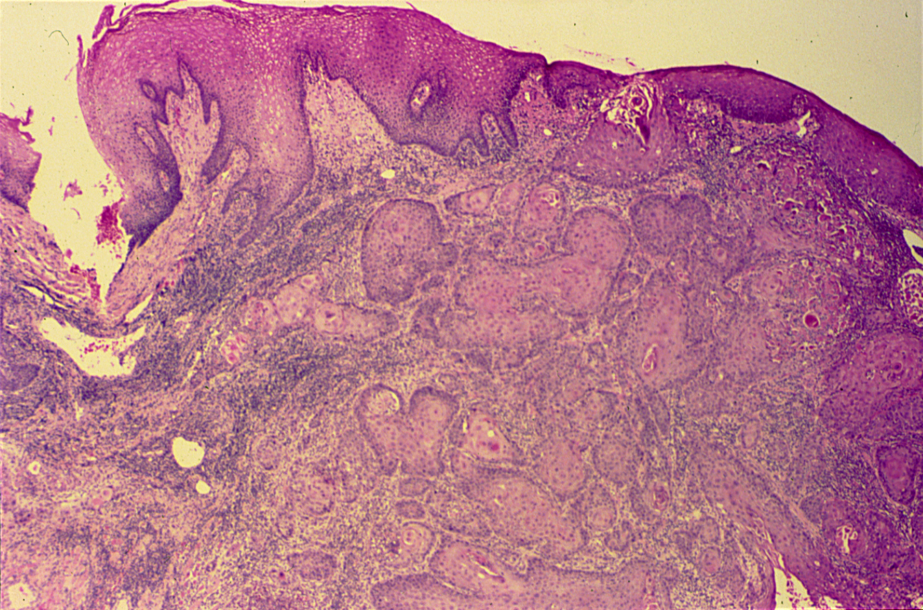
SQUAMOUS CELL CARCINOMA (SKIN)

Slide 8
SCC

Slide 9
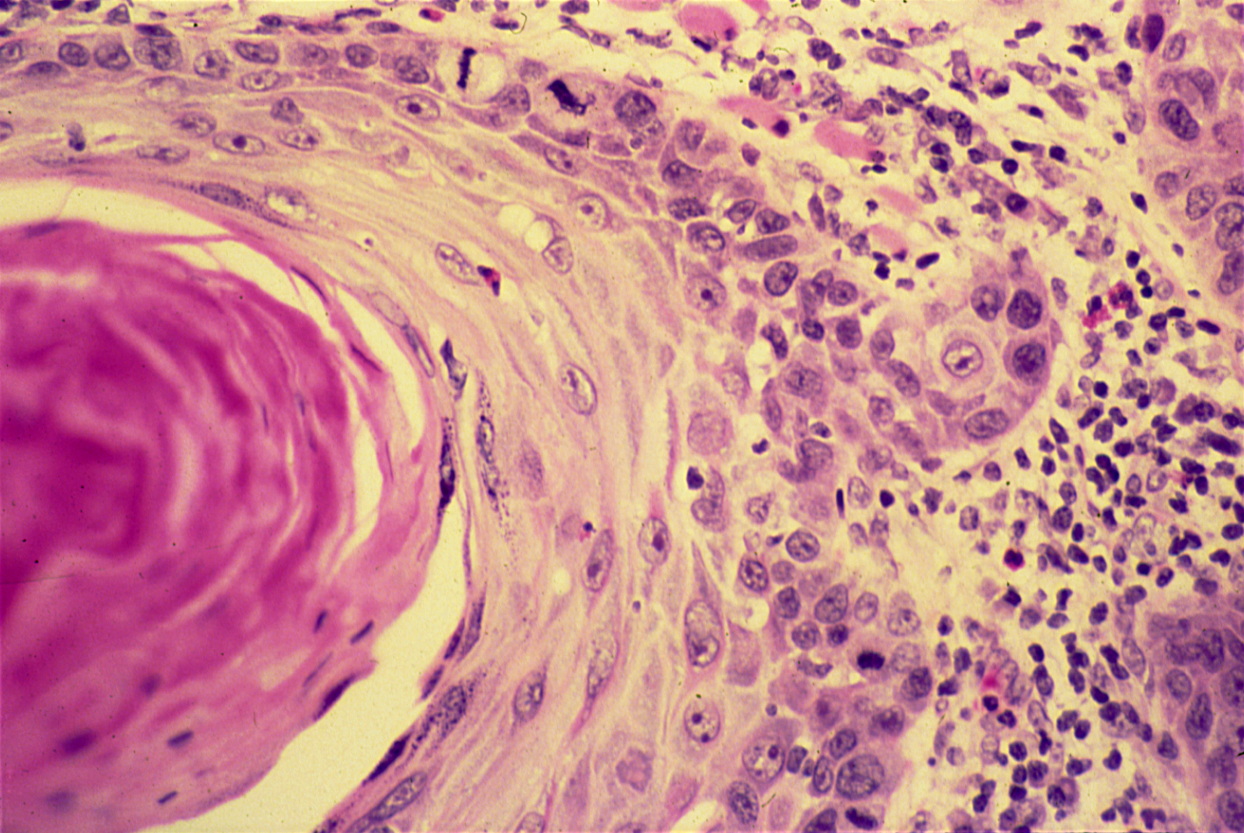
SQUAMOUS CELL CARCINOMA

Slide 10
Squamous cell carcinoma of the skin : Section of the skin shows an ulcer covered by inflammatory exudate .
The dermis is infiltrated by masses of well differentiated neoplastic squamous cells which are separated by fibrous tissue stroma with chronic inflammatory cells .
Tumor cells show pleomorphism, hyperchromasia and mitotic figures .
Pinkish laminated keratin pearls (epithelial cell nests) are present in the center of some cell masses .

Slide 11
2- Carcinoma of the breast

Slide 12
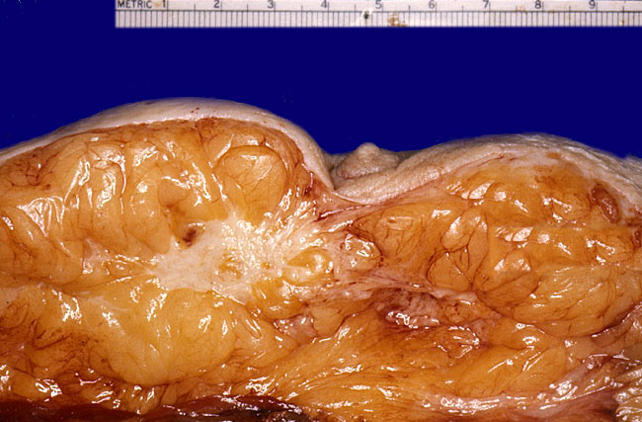

Slide 13
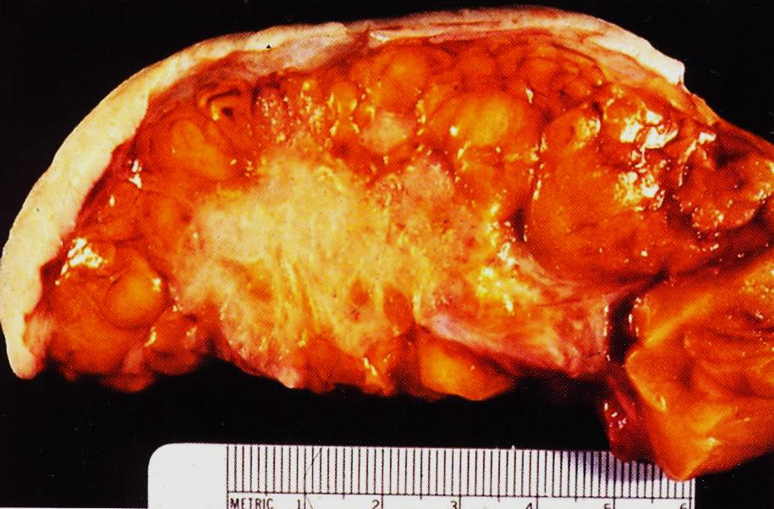

Slide 14
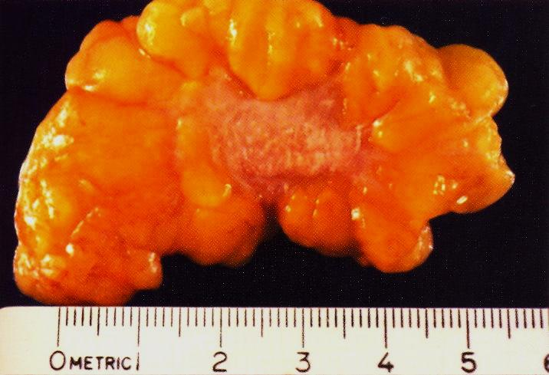

Slide 15
3- Carcinoma of the esophagus

Slide 16
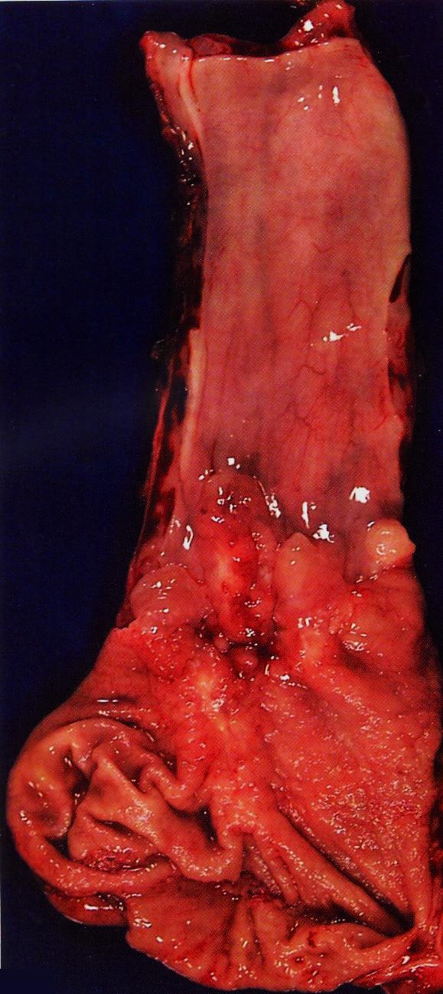

Slide 17
4- Adenocarcinoma of the large intestine

Slide 18
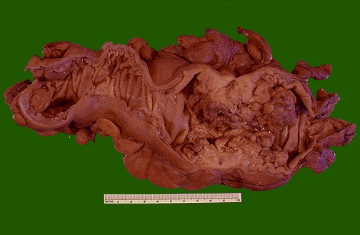
Organ: Colon Dx: adenocarcinoma

Slide 20
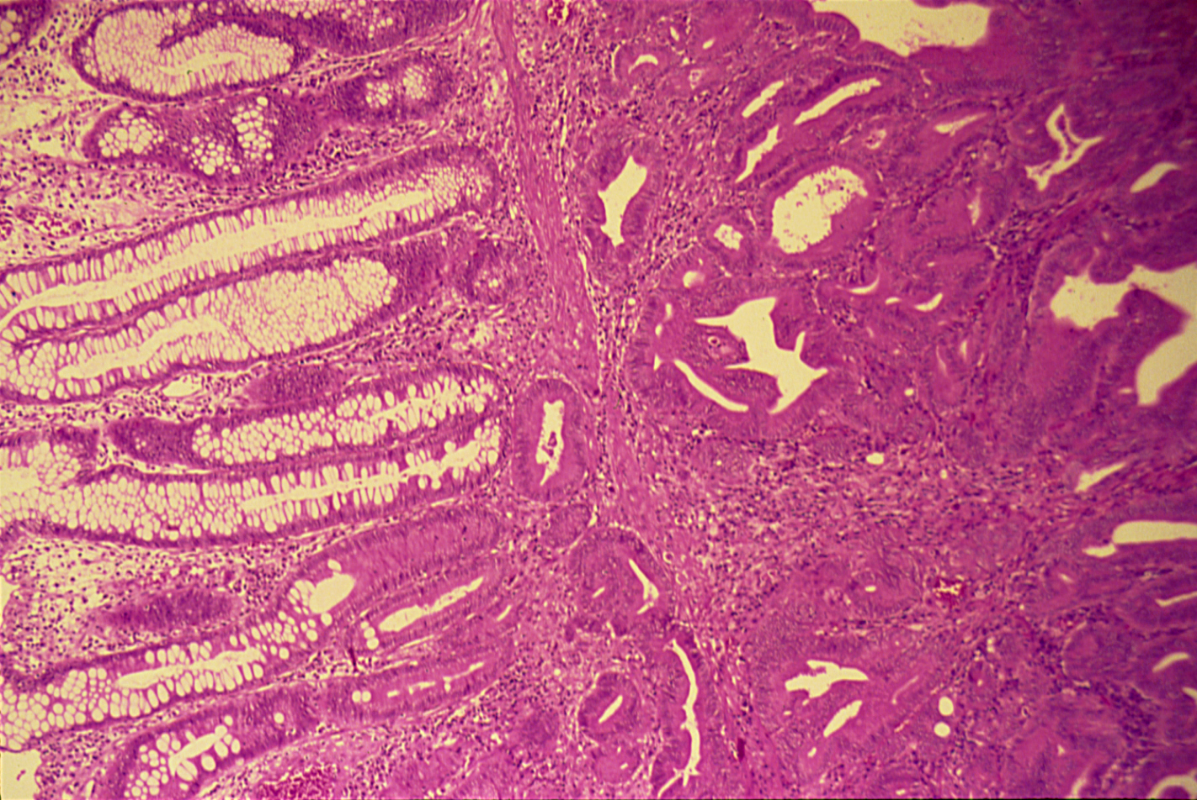

Slide 21
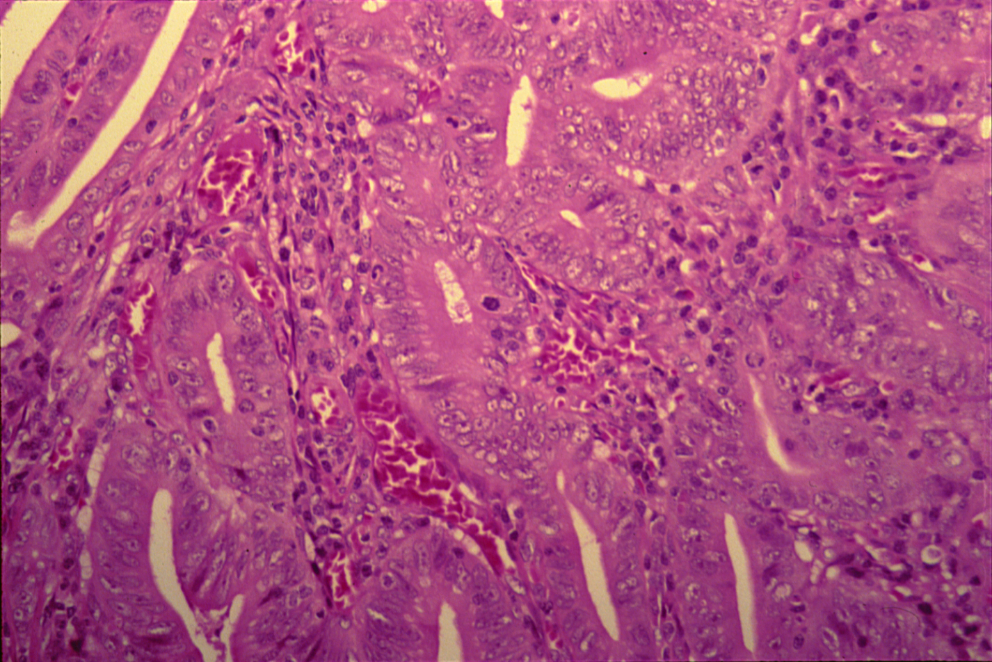
ADENOCARCINOMA (COLON)

Slide 22
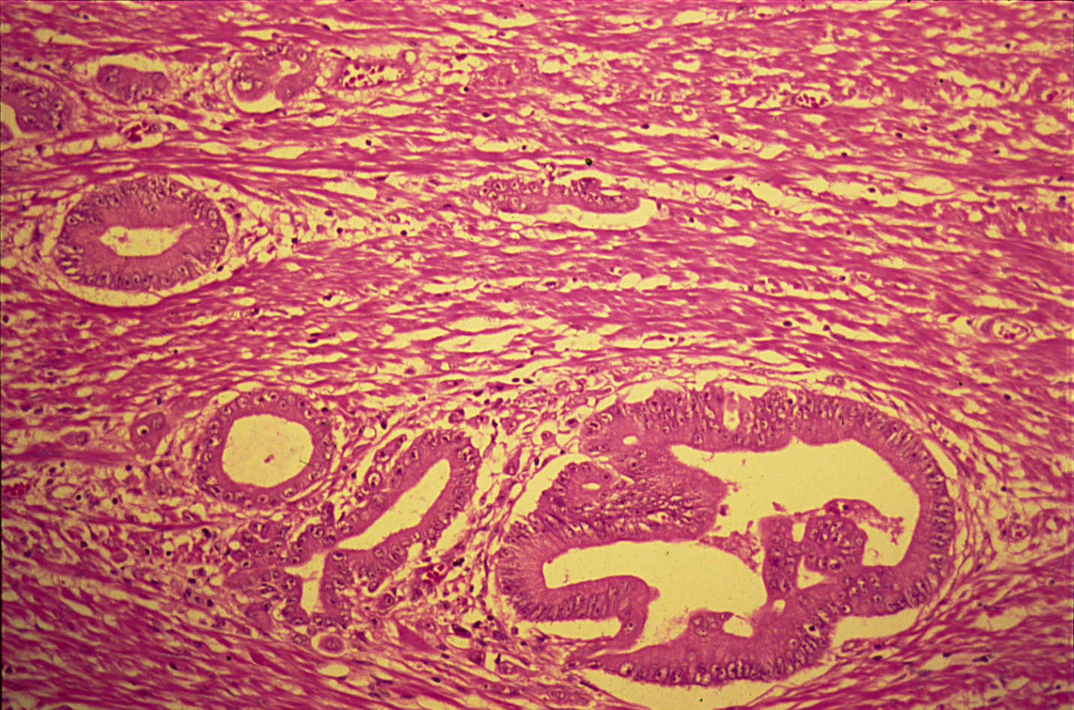

Slide 23
Adenocarcinoma of the large intestine: Section of large intestine shows:
A tumor mass at one end, and a normal mucosa on the other side:
Tumor consists of crowded irregular malignant acini separated by thin fibrovascular stroma.
The acini are lined by one or several layers of neoplastic cells with papillary projection showing pleomorphism, hyperchromasia and few mitoses.
Muscle coat is invaded by neoplastc glands.

Slide 24
5- Fibrosarcoma

Slide 25
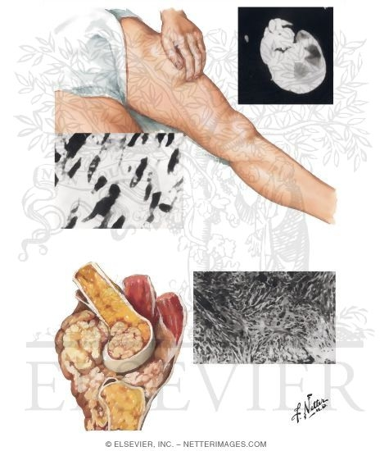

Slide 26
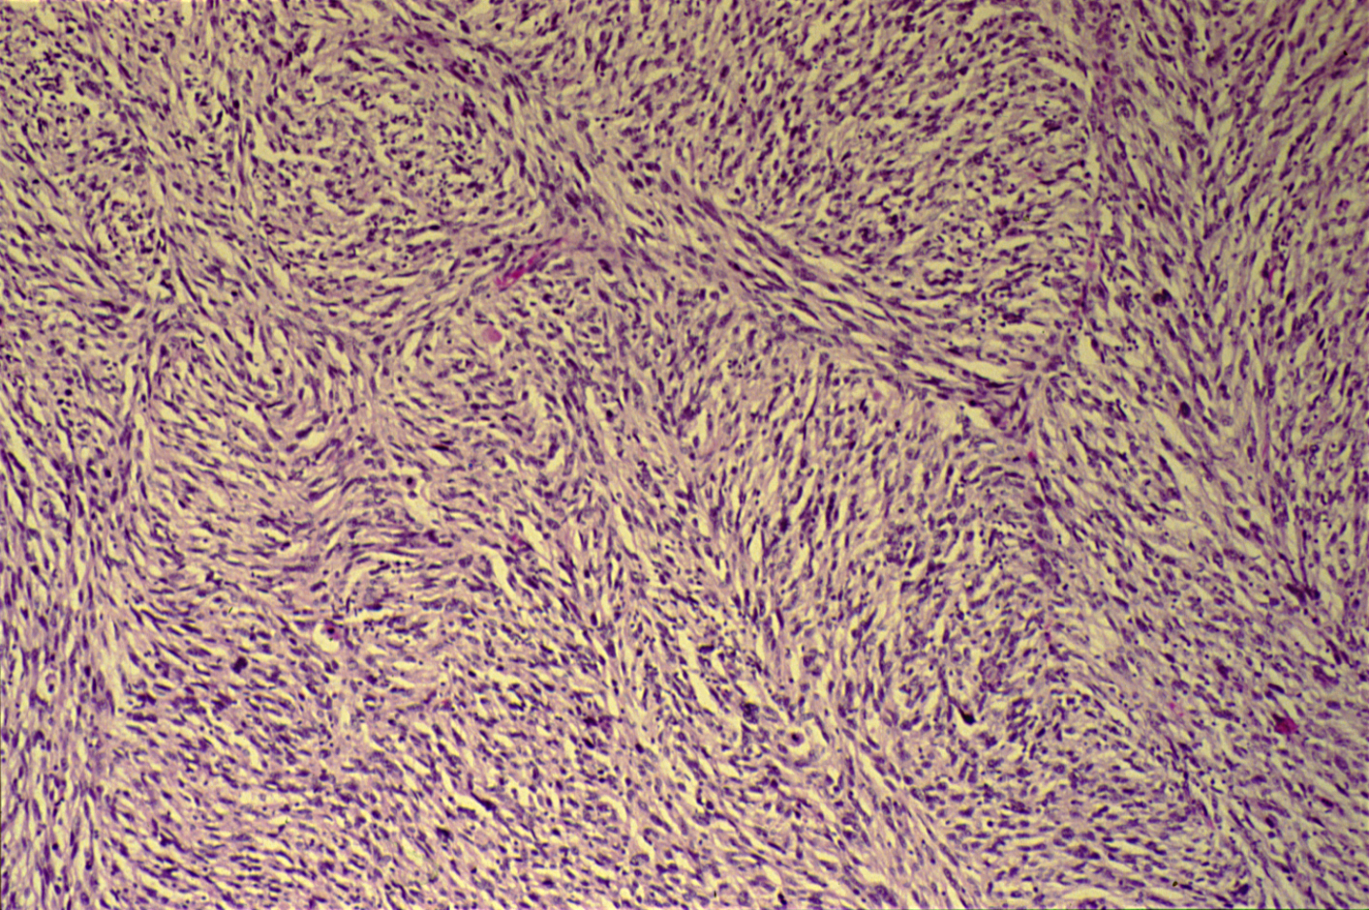

Slide 27
FIBROSARCOMA (SOFT TISSUE)

Slide 28
Fibrosarcoma: Section of the tumour shows:
The tumour consist of interlacing bundles of pelomorphic spindle shaped cells with areas of haemorrhage and necrosis.
The cells show marked variation in size and shape, nuclear hyperchromatism with tumour giant cells formation and many mitoses.

