Slide 1
Neoplasia
Dr Shaesta Naseem Zaidi
14-11-11

Slide 2
Benign tumors Gross and histopathology

Slide 3
1- Adenomatous polyp of rectum / colon

Slide 4
Organ: Colon Dx: adenoma

Slide 5

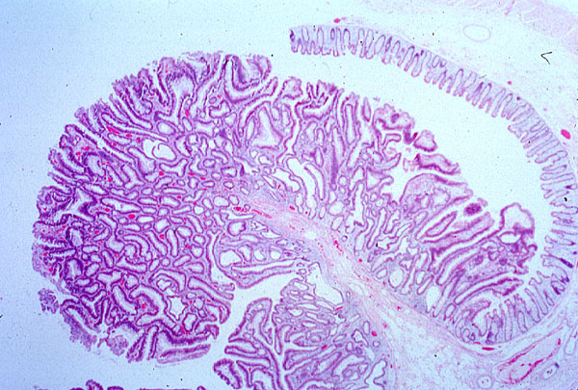
Tubular adenoma, colon

Slide 6
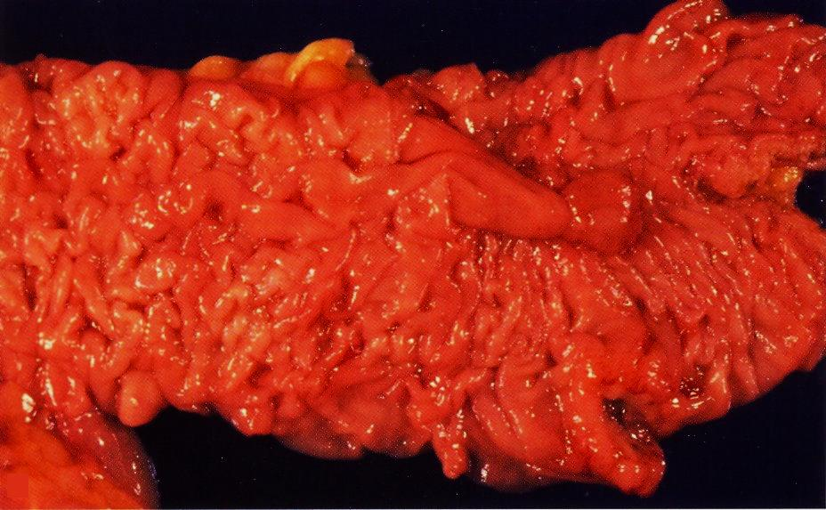
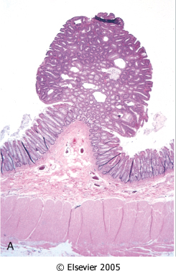

Slide 7
2- Lipoma

Slide 8
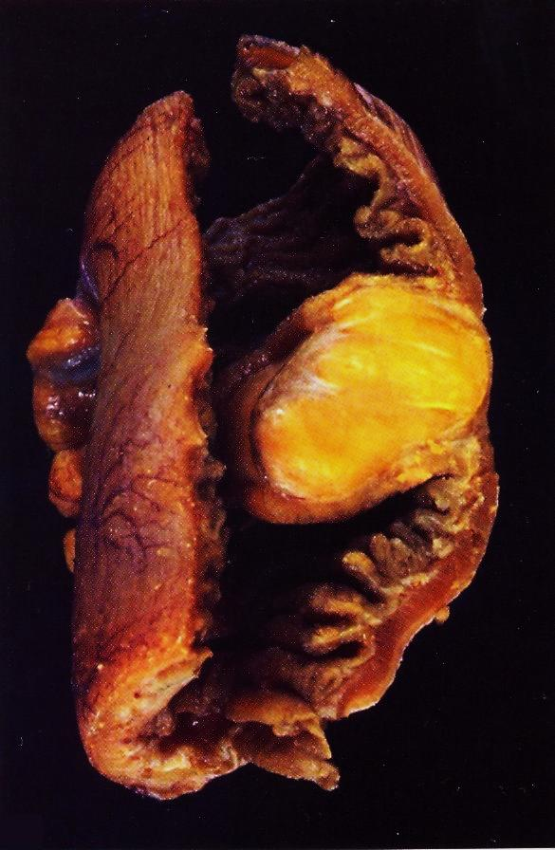
Lipoma of small intestine

Slide 9
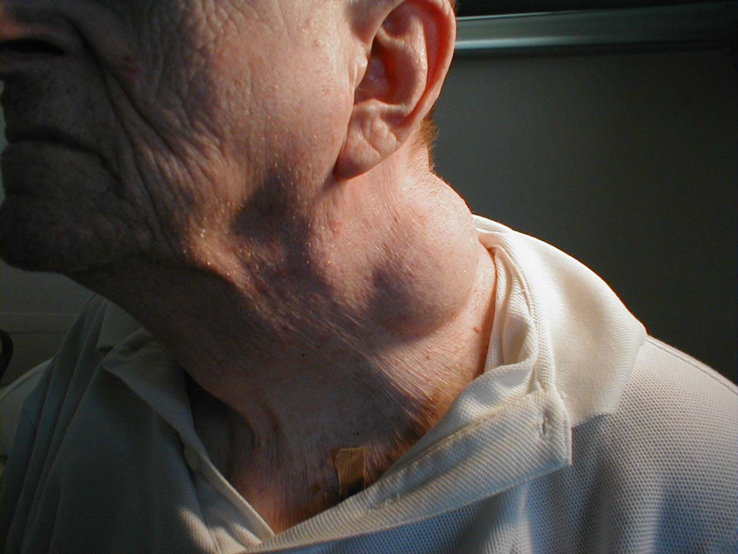
2-Lipoma of the neck
Benign, slow growing, subcutaneous skin growth. In this case, the lipoma is rather large and located in the neck region. On palpation, these are soft, nontender, and freely mobile.

Slide 10
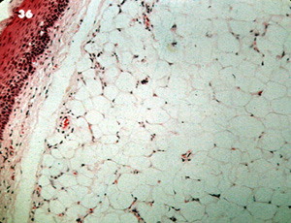
Subcutaneous lipoma
Lipoma

Slide 11
Lipoma
Benign, well-circumscribed tumor of
well-differentiated adipocytes
Most common type of benign soft
tissue tumor
Usually subcutaneous, any site of
adipose tissue
In adult MC site: upper back, neck, shoulder
Resemble normal adipose tissue
Subtypes: angiolipoma, spindle cell lipoma

Slide 12
3- Intradermal nevus

Slide 13
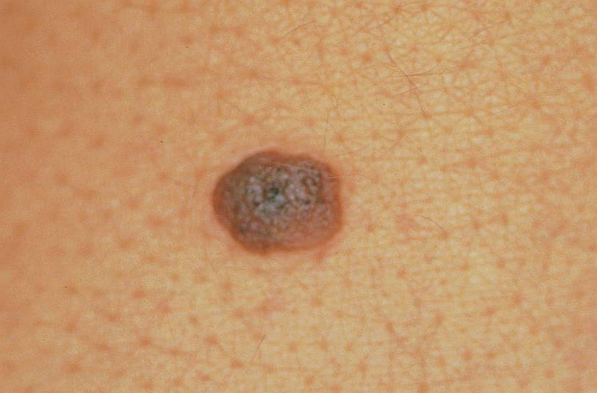
Notes:
Intradermal nevus

Slide 14
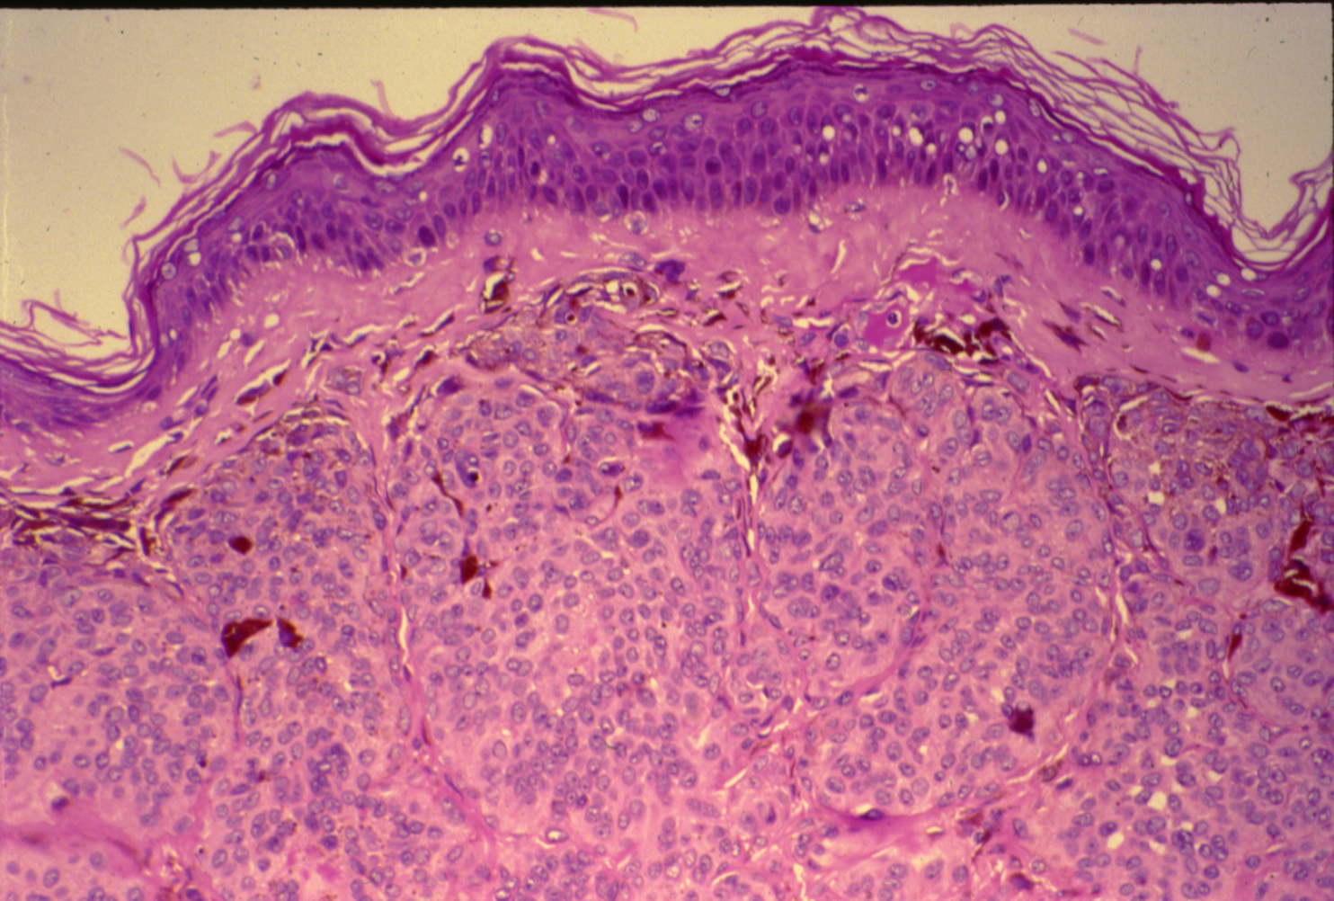
NEVUS (SKIN)

Slide 15
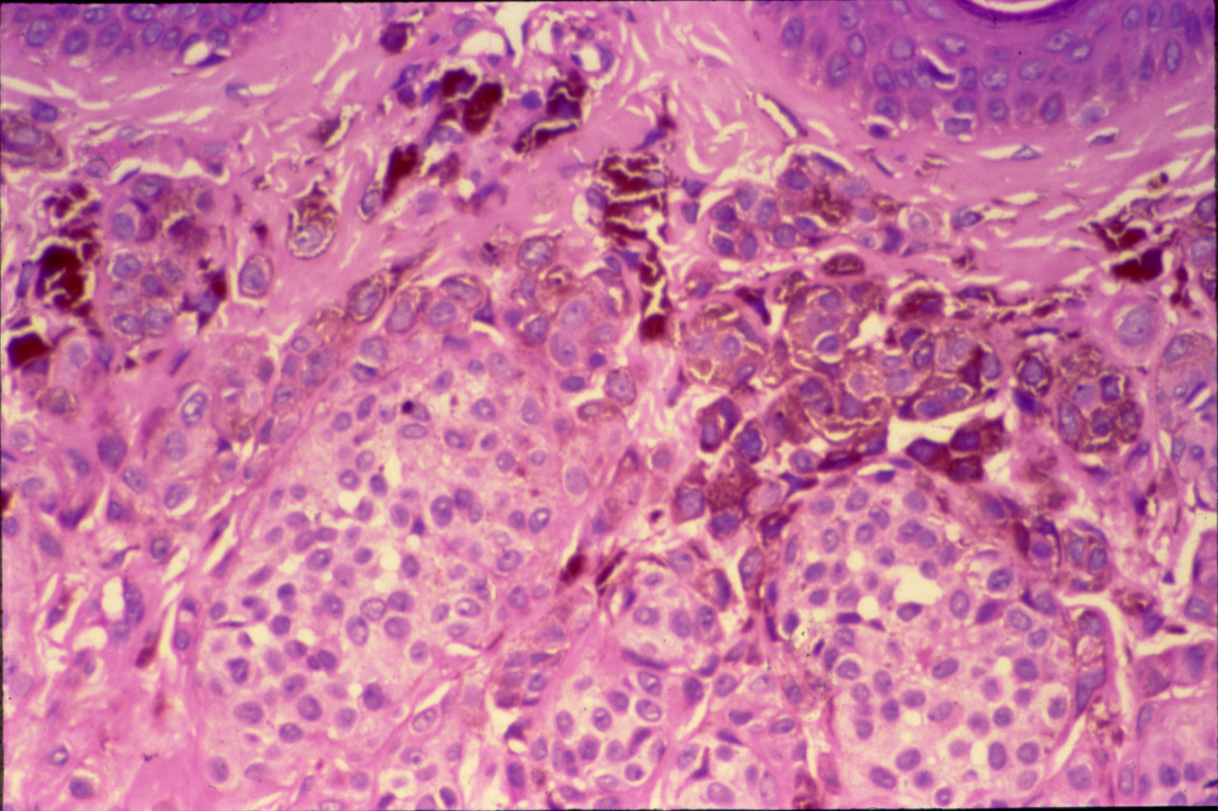
NEVUS (SKIN)

Slide 16
Nevus:
Section of Skin shows:
Nests and clusters of small round or spindle shaped nevus cells with few melanophages in the upper dermis.
The cells contain varying amount of brown melanin pigment.

Slide 17
4- Multiple uterine leiomyomata

Slide 18
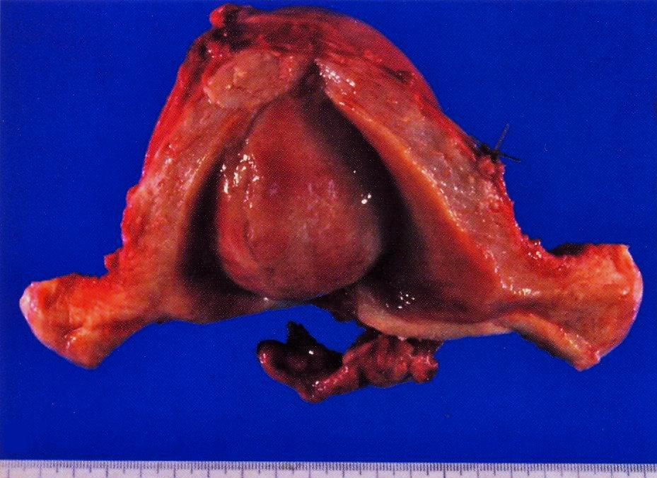

Slide 19


Slide 20
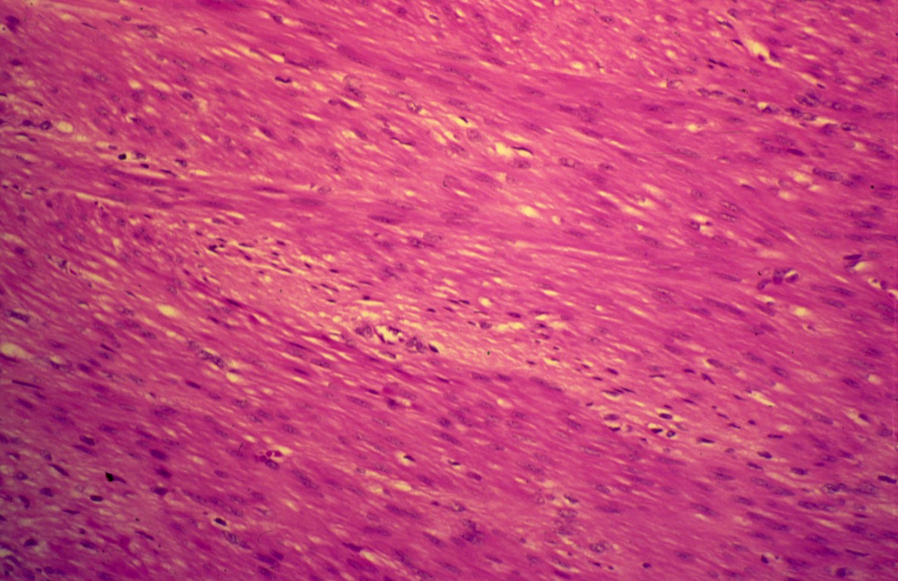
LEIOMYOMA (UTERINE)

Slide 21
Leiomyoma:
Section of tumour shows:
A well demarcated tumour mass in the muscle coat of uterus without a definite capsule.
Tumour consists of interlacing bundles of smooth muscle and fibrous tissue.
The muscle cells are spindle shaped with elongated nuclei and eosinophilic cytoplasm.

Slide 22
5- Chondroma

Slide 23
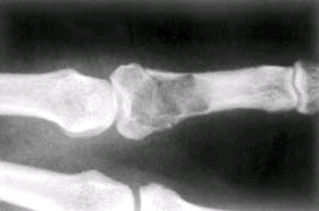
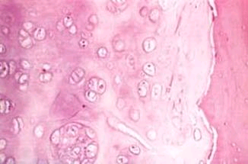
CHONDROMA
Chondroma vs. EN-chondroma
PURE Hyaline Cartilage
MULTIPLE enchondromas = Ollier’s dis.

Slide 24
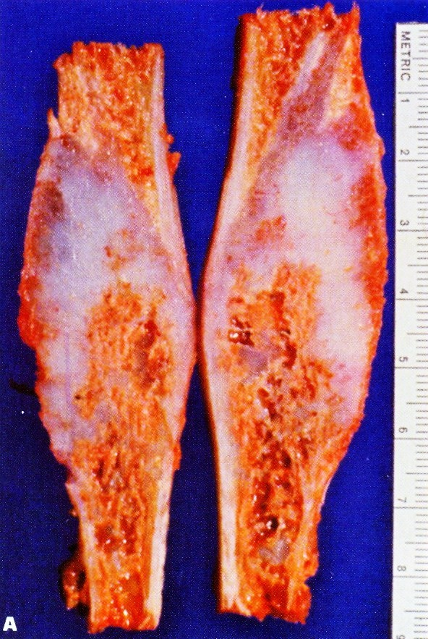
Enchondroma of the fibula

Slide 25
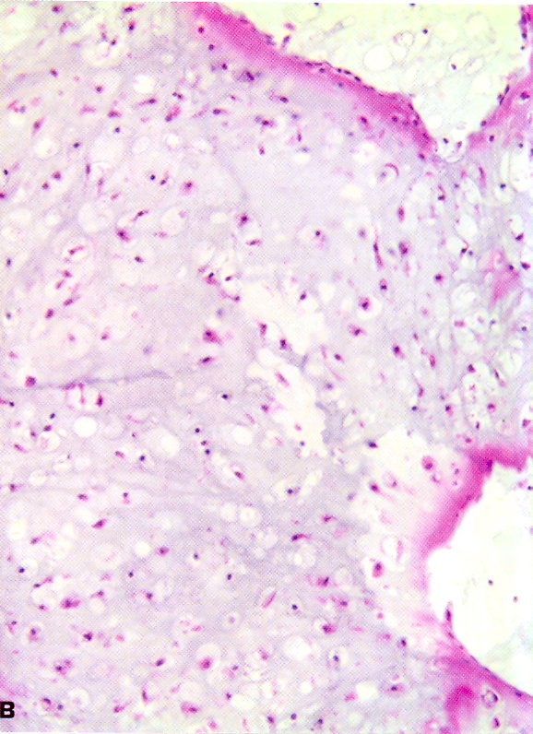
Enchondroma of the fibula

Slide 26
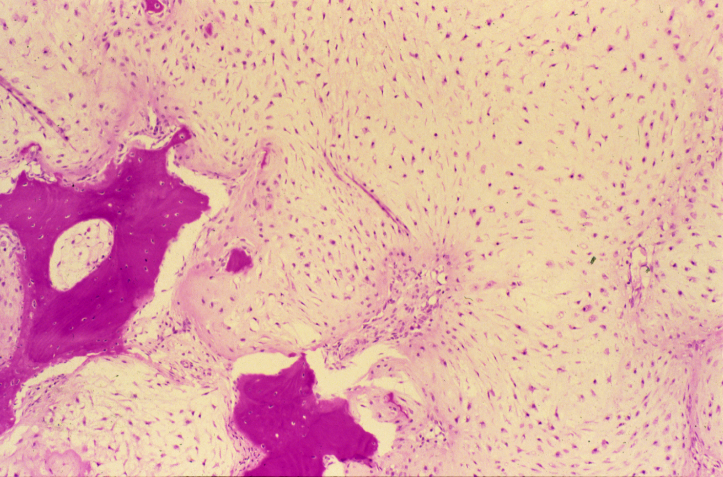
CHONDROMA OF BONE

Slide 27
Chondroma:
Section of tumour shows:
Lobules of mature cartilage separated by thin trabeculae of fibrous tissue with blood vessels.
Lobules consists of mature cartilage cells irregularly distributed through pale blue homogenous matrix and are contained within the lacunar spaces singly, in pairs or in tetrads.
Few bony trabeculae are included in the tumour.

Slide 28
6- Hemangioma

Slide 29
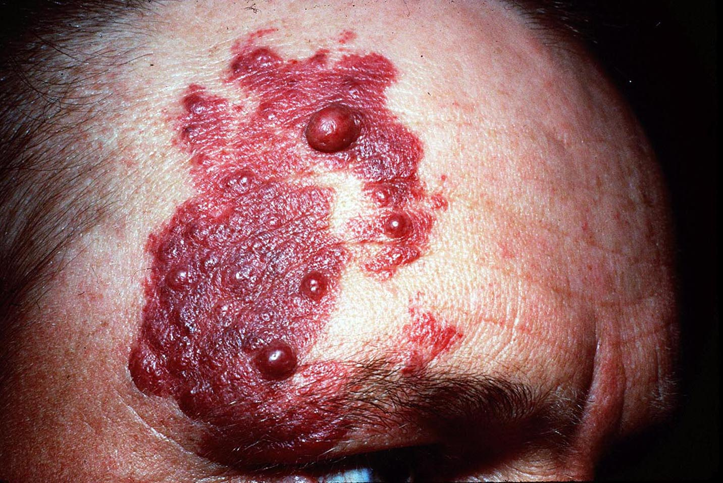

Slide 30
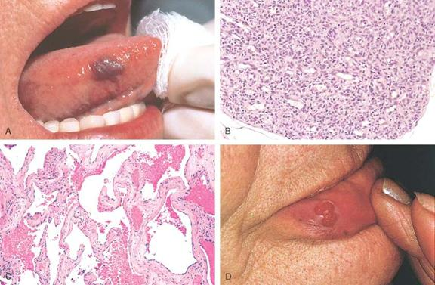

Slide 31
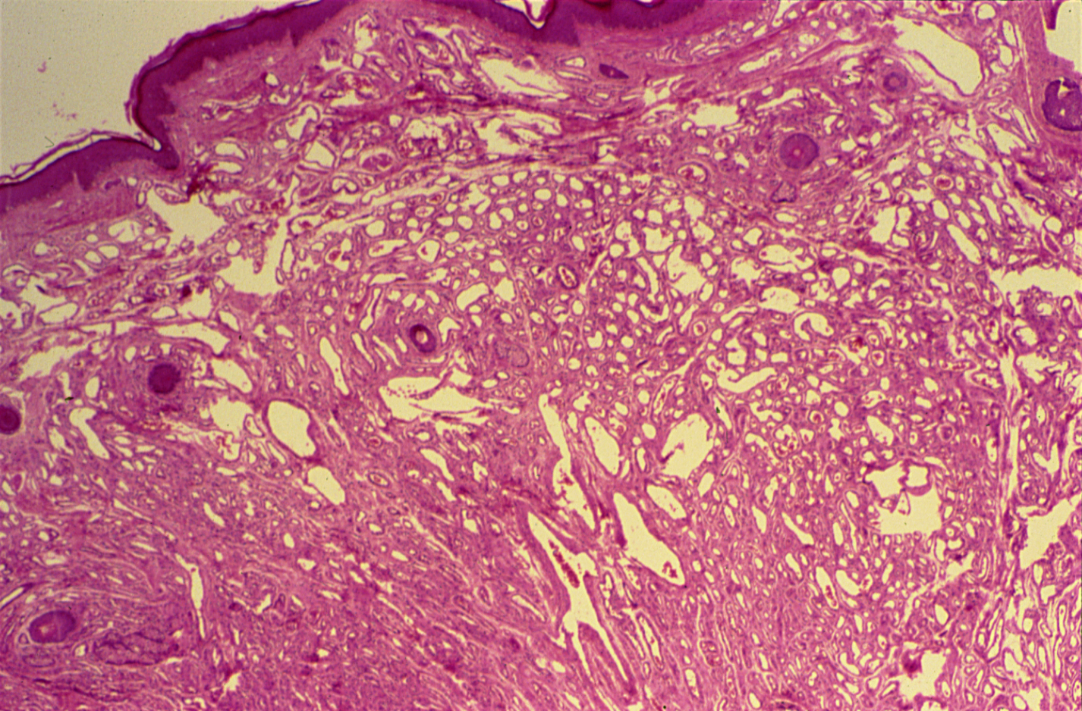
HAEMANGIOMA (SKIN)

Slide 32
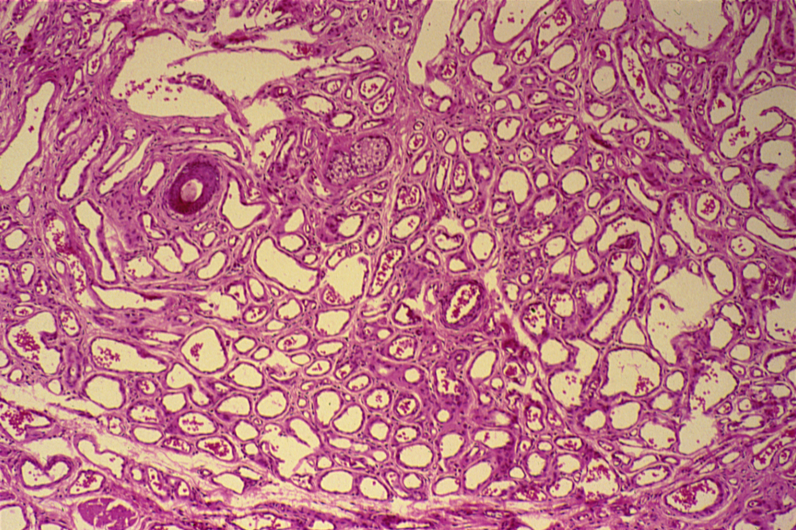
HAEMANGIOMA

Slide 33
Haemangioma:
Section of skin shows:
A tumour mass in the dermis which consists of large number of vascular spaces of varying shapes and sizes separated by connective tissue stroma.
Vascular spaces are lined by the flattened endothelial cells and some contain blood.
Delicate connective tissue stroma separated the capillary vascular spaces.

Slide 34
7- Fibroadenoma of the breast

Slide 35
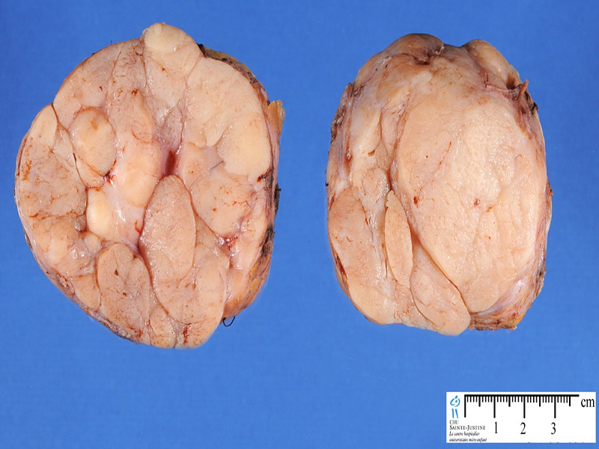
7- FIBROADENOMA OF THE BREAST

Slide 36
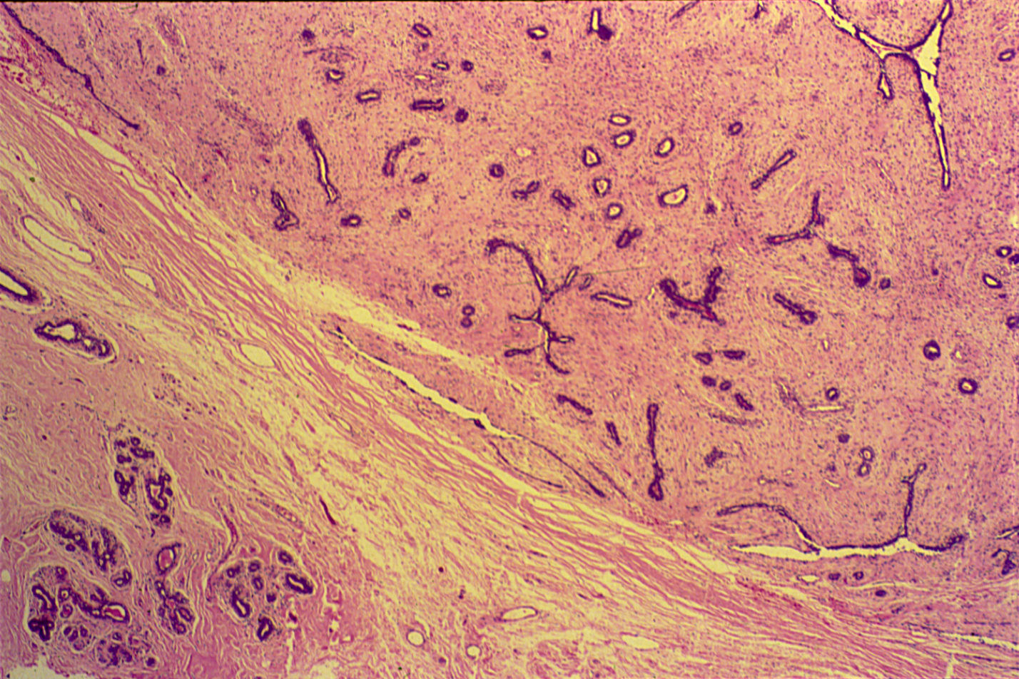
FIBROADENOMA OF THE BREAST

Slide 37
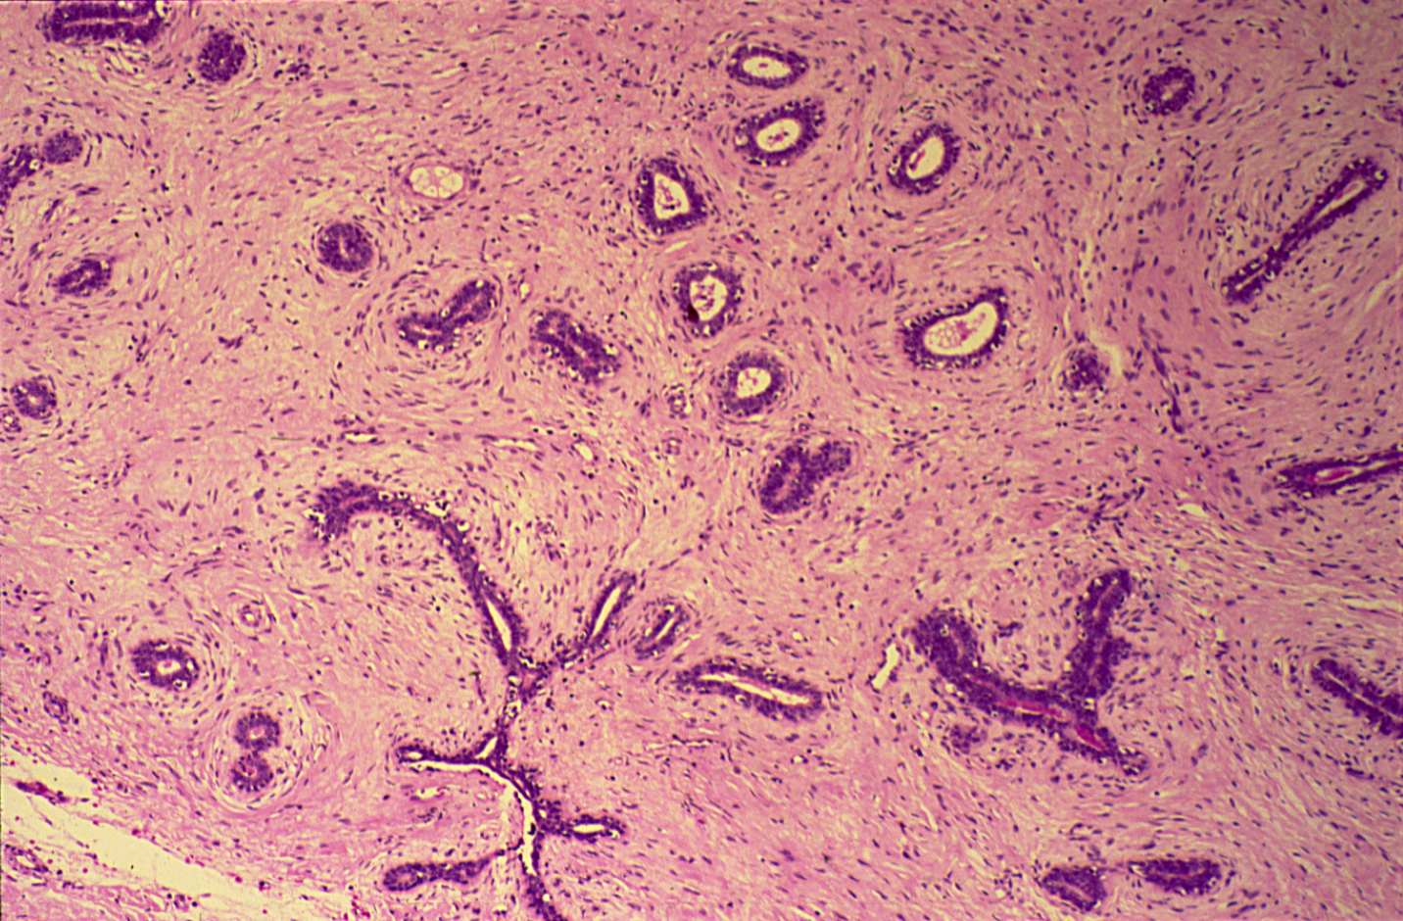
FIBROADENOMA OF THE BREAST

Slide 38
Fibroadenoma of the Breast:
Section shows breast tumour:
A tumour shows proliferation of both glandular tissue and fibrous tissue.
(a) Proliferation fibrous tissue is invaginating the ducts causing elongation, compression and distortion of the ducts which have slit-like lumen (intracanalicular).
(b) At places fibrous tissue is arranged around the ducts (pericanalicular) and does not invaginate.

Slide 39
8- Teratoma , dermoid cyst of the ovary

Slide 40
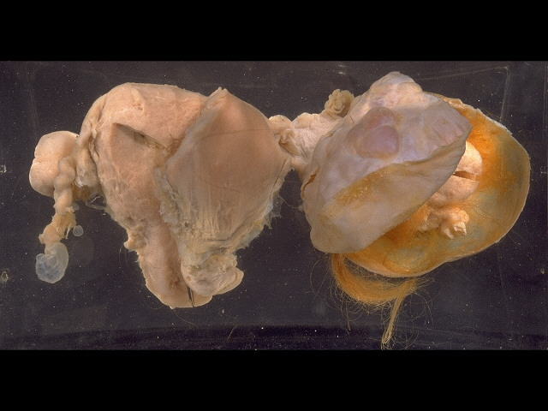

Slide 41
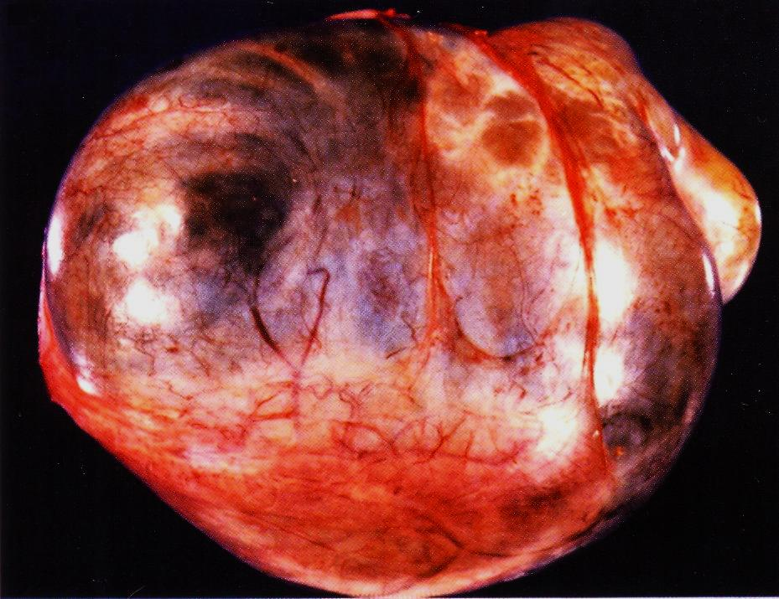

Slide 42


Slide 43

DERMOID CYST OF THE OVARY
(BENIGN CYSTIC TERATOMA OF THE OVARY)

Slide 44
Dermoid cyst of the ovary: section of the cyst wall shows:
Stratified Squamous epithelium with underlying appendages (sweat glands, sebaceous glands, hair follicles) columnar ciliated epithelium, mucous and serous glands and structures from other germ layers such as bone and cartilage, lymphoid tissue, smooth muscle and large area of brain tissue containing neurons and glial cells.

