Slide 1
Introduction to
Evidence Based Medicine
Dr. Yaser Adi MD, MPH, MSc HTA
Senior Researcher
Sheikh Abdullah S BaHamdan’s Research Chair for EBHC-KT
College of Medicine, King Saud University
Notes:
#Good morning/afternoon and
#Welcome to the EBM lecture
#My name is Yaser Adi from sheik abdullah salem bahamdan chair for evidence based health care and knowledge translation
#Previously, I mean over a year ago I was a senior Researcher at Warwick Medical school, UK.
#I am hoping that the standard of medical students at KSU should not be any less than the standard here.
# I do hope that you will enjoy the session

Slide 2
Aim
To introduce you to the
EBM/EBHC concept
Notes:
The aim (what I am hoping for , the goal of the presentation) of this presentation is to introduce you to the basics in EBM/EBHC for the purpose of this lecture you may say the two terms are the same, although the term EBHC is wider than EBM

Slide 3
Objectives
How to be successful in you career
Explain the components of EBM
Describe the methods used in EBM
Benefits of EBM
Hierarchy of evidence
Some exercises to illustrate the practical use of EBM
Notes:
# How am I going to get the aim, well it is through the following objectives (the point by point that I would like to cover in this short presentation)

Slide 4
To be successful in the job you do need …
Two things...
What are they?
Notes:
# Give a few second for the question to sink in then ..
# A clue ...two words that both start with the letter C?
These two , Do not come naturally, they need work to get them, need dedication, and patience
# Think of driving a car
what does it need to be a good driver?

Slide 5
Competence
Is the ability to perform a specific task successfully.
Incompetence is the (opposite)
Notes:
# Some say the two words are the shahadatain , yes it is true but having said shahadatain would make you or should make you having these two things.
#Training to get you up to standard (competence) if you have the training to drive a car that does not make you necessarily confident at the start
# in UK is one doctor has been found to be incompetent, eg medical negligence , will be struck from the general medical council (GMC)
# Enough training to get you up to the task (six years training in Medicine) . theory, road signs, regulations.,
40 hours learning practical driving in real road situations.

Slide 6
Confidence
A belief in yourself that you can do this job and do it well
Notes:
You have to feel you are able to drive and drive safely (confidence)
#Competence Is the ability to perform a specific task successfully
Incompetence is the (opposite)
#Confidence doesn't come out of nowhere. It's a result of something... hours and days and weeks and years of constant work and dedication.
#A belief in yourself that you can do it and do it well

Slide 7
Competence & Confidence
Notes:
You need both C & C otherwise you are not doing your potential

Slide 8
How are We going to be both
Competent & confident in
Medical education?
Notes:
Dedication
Training
Patience
Interaction with those in the field

Slide 9
There is a boring method of education
Filling the empty vessel

Slide 10
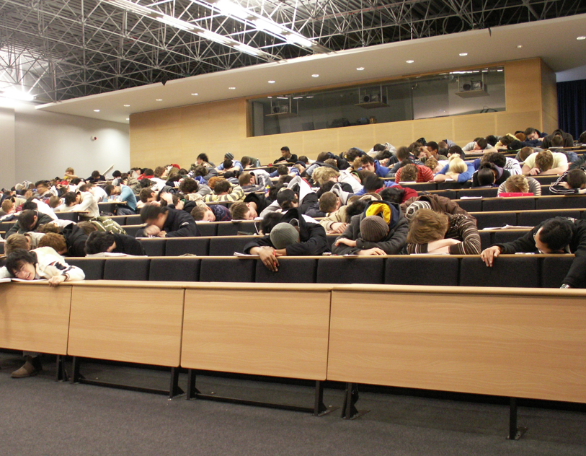
The results
Notes:
A little green flower in isolation.
Short term results>>>

Slide 11


There is also an interesting learning method
Learning is a natural process:
Teaching is facilitation of growth
Notes:
This is the method that you are aiming for in the university level you are no longer at secondary schools….
Teachers are:
A growth facililtator☺
You take responsibility of firther learning with the help from the supervisor, mentor, facilitator, whatever you call him

Slide 12
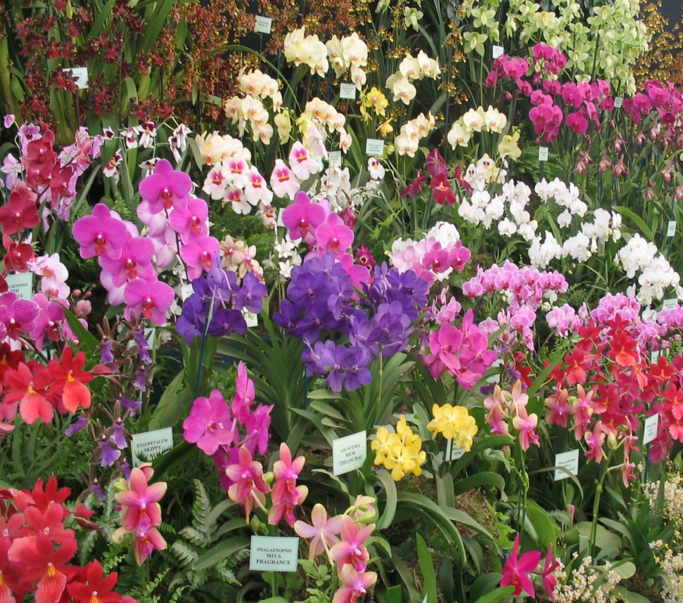
The difference is…
Notes:
Compare! Which do you prefer?
#Quite remarkable
#Good results
#fresh colourful
#Nice
#attractive
#appealing
#and lovely

Slide 13
What is Evidence based medicine (EBM)?
Pubmed in 1992=1
Pubmed in 2011= 72,208
Google = 14,200,000
Google scholar= 1,350,000
Notes:
# How many of you have heard this term before the lecture today?
#Hands up if you really have heard about EBM before. I am not going to mark you down if you raised hands.
pubmed in 1992=1
Pubmed in 2011= 72,208 on Thursday
The term in 1992 was unheard of before 1990s I have tried Google this weekend= 14,200,000
Google scholar= 1,350,000

Slide 14
Word.. By.. word
Evidence:
A thing or things helpful in forming a conclusion or judgment
Medicine:
The art and science of the diagnosis, treatment, and prevention of disease and the maintenance of good health
Notes:
# knowing the meaning of words, does not tell the full story of the term EBM

Slide 15
Definition of EBM
  “ Evidence-Based Medicine (EBM/EBHC) is the integration of:
  the best research evidence with
  clinical expertise and
  patient values.”
  David Sackett 2000
Notes:
by best research evidence we mean clinically relevant research, often from the basic sciences of medicine, but especially from patient centered clinical research into the accuracy and precision of diagnostic tests (including the clinical examination), the power of prognostic markers, and the efficacy and safety of therapeutic, rehabilitative, and preventive regimens. New evidence from clinical research both invalidates previously accepted diagnostic tests and treatments and replaces them with new ones that are more powerful, more accurate, more efficacious, and safer.
by clinical expertise we mean the ability to use our clinical skills and past experience to rapidly identify each patient's unique health state and diagnosis, their individual risks and benefits of potential interventions, and their personal values and expectations.
by patient values we mean the unique preferences, concerns and expectations each patient brings to a clinical encounter and which must be integrated into clinical decisions if they are to serve the patient.

Slide 16
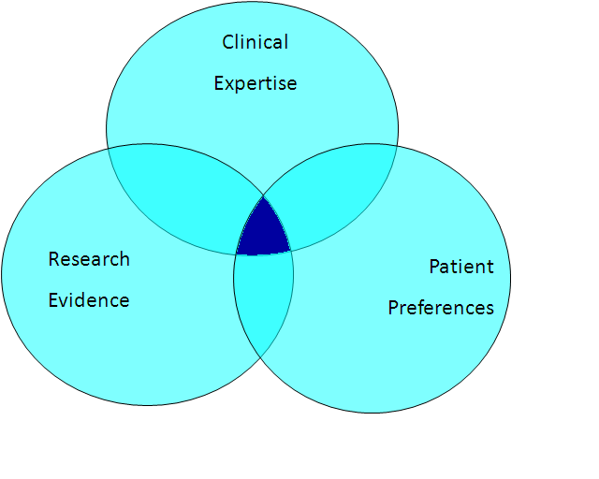
The three components of EBM
Notes:
#Evidence treatment or therapy, diagnosis, causation of benefit or harm, prognosis
#Skills to rapidly identify patient’s health status, advise on risk and benefit potential intervention
#Patients preference, worries, expectations and values
If the three are not all there , this is not EBM, is that ok?
See the blue Sackett book and listen to Sackett interview

Slide 17
How Much Modern Medicine is Evidence-Based?
Notes:
http://theness.com/neurologicablog/index.php/how-much-modern-medicine-is-evidence-based/
Following on the heels of recent news that many drugs prescribed by doctors (and sold by pharmacies) lack an FDA approval, how many people are aware that LESS THAN FIFTY PERCENT (50%) of western medical practice is based on valid scientific evidence and some experts estimate that number is low as FIFTEEN PERCENT (15%).

Slide 18
The methods used in EBM are based on logic

Slide 19
EBM 5 “A”s
Asking Answerable Question
Accessing current best evidence
Appraising the evidence
Applying it
Assessing
Notes:
# Will go through them one by one

Slide 20
Asking: Formulate a focused clinical question (PICO)
P Patient
I Intervention
C Comparison
O Outcome
Notes:
P-Who am I interested in? what condition(s)
I- What is the intervention?
C- How is the intervention being compared?
O- What are the outcomes of the intervention that I am going to look for ? Mortality, morbidity, quality of life EQD5:
mobility,
self care,
usual activities,
pain and
anxiety
Will have this discussed lated in the exercise in a minute

Slide 21
Accessing: the evidence through
Pubmed/ Medline
Cochrane collaboration
Others
Notes:
Where do you find the answer ? Internet? Books ? Health news in Daily news paper?
Where do you find the answer ? Internet? Books ? Health news in Daily news paper?

Slide 22
Appraising the evidence
To critically appraise the evidence
to assess how rigorous the
methods used were
Notes:
Where do you find the answer ? Internet? Books ? Health news in Daily news paper?
#Scientifically sound?
#Could the result have happened due to other reasons
#Is it due to chance, use of statistics
Coffee and lung cance, confounding is smoking

Slide 23
Applying
Integrating the research, results with clinical expertise and patience values

Slide 24
Assessing
How the EBM process has helped for caring for our patients
Notes:
Would emb work in better health for all ?

Slide 25
The benefits of EBM 1
Daily need for up-to-date reliable information
Inadequacy of traditional sources
Disparity between our clinical skills
(vs) up-to-date knowledge
Develop skills for life long learning
Notes:
our daily need for valid information about diagnosis, prognosis, therapy and prevention (up to 5 times per in-patientii and twice for every 3 out-patientsiii).
the inadequacy of traditional sources for this information because they are out-of-date (textbooksiv), frequently wrong (expertsv), ineffective (didactic continuing medical educationvi) or too overwhelming in their volume and too variable in their validity for practical clinical use (medical journalsvii).
the disparity between our diagnostic skills and clinical judgement, which increase with experience, and our up-to-date knowledgeviii and clinical performanceix, which decline.
our inability to afford more than a few seconds per patient for finding and assimilating this evidencex, or to set aside more than half an hour per week for general reading and studyxi
the development of strategies for efficiently tracking down and appraising evidence (for its validity and relevance)xii.
the creation of systematic reviews and concise summaries of the effects of health care (epitomized by the Cochrane Collaborationxiii).
the creation of evidence-based journals of secondary publication (that publish the 2% of clinical articles that are both valid and of immediate clinical usexiv).
the creation of information systems for bringing the foregoing to us in seconds.
the identification and application of effective strategies for life-long learning and for improving our clinical performancexv.

Slide 26
Benefits of EBM 2
Patient satisfaction
Clinician’s fulfillment
Healthier nation

Slide 27
Ok, We have found the evidence but how good is this evidence?
The Hierarchy of Evidence list …
  Systematic Review
  RCT
  Others
Notes:
SR is considered the best then rct then others
The lowest is the opinion of someone who is famous!

Slide 28
Imagine you have a relative with a serious condition
You would not be happy if… the doctor skills are:
☹ not up-to-date with the knowledge
☹ does not listen to the patient’s concern, worries and expectations

Slide 29
Exercise 1: Questions
What are the questions you want to ask
if you or someone you care for has diabetes mellitus DM type II ?
Notes:
2 minutes
DM II in adult mainly and does not require insulin initially

Slide 30
Questions are related to...
Therapy
Diagnostics
Causation
Prognosis

Slide 31
Exercises 2 Effectiveness of Tonsillectomy . How to find the answer?

Slide 32
Google it?
About 1,640,000 results !!!

Slide 33
Exercises 2 Effectiveness of Tonsillectomy . How to find the answer?
How do we frame the question (PICO)?
Where do we search first?
Notes:
Calc how common?
Although tonsillectomy is performed less often than it once was, it is still among the most common surgical procedures performed in children in the United States. In 1959, 1.4 million tonsillectomies/177,829,000 rate= 7.8 in 1000 were performed in the United States. This number had dropped to 260,000 by 1987/242,289000 rate= 1 in 1000, when it was the 24th most common indication for hospital admission. Indications have evolved from being primarily related to infections to being more commonly caused by obstruction.
http://emedicine.medscape.com/article/872119-overview#a0199
Pico find it
P Children with chronic or recurrent acute tonsillitis in We go first to CLB
I Tonsillectomy
C? no tonsillectomy
O? recurrence of episodes, risk of surgery
CLB

Slide 34
Asking: Formulate a focused clinical question (PICO)
P Patient
I Intervention
C Comparison
O Outcome
Notes:
In children with chronic or acute tonsillitis, is tonsillectomy more effective compared with no surgery in terms of reducing sore throat?
P-Who am I interested in? what condition(s)
I- What is the intervention?
C- How is the intervention being compared?
O- What are the outcomes of the intervention that I am going to look for ? Mortality, morbidity, quality of life EQD5:
mobility,
self care,
usual activities,
pain and
anxiety
Will have this discussed lated in the exercise in a minute

Slide 35
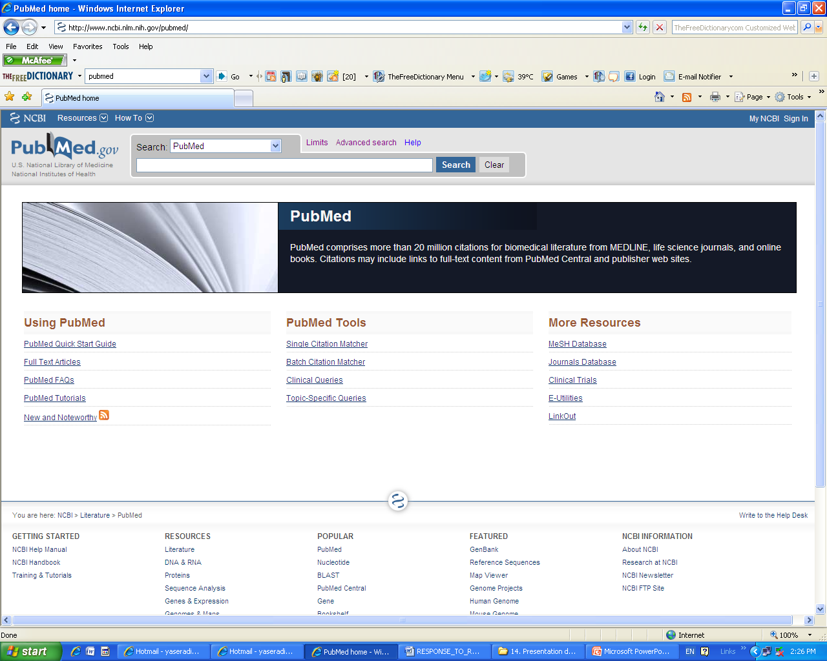
“Home” pubmed looks like this n= more than 21 million citations

Slide 36
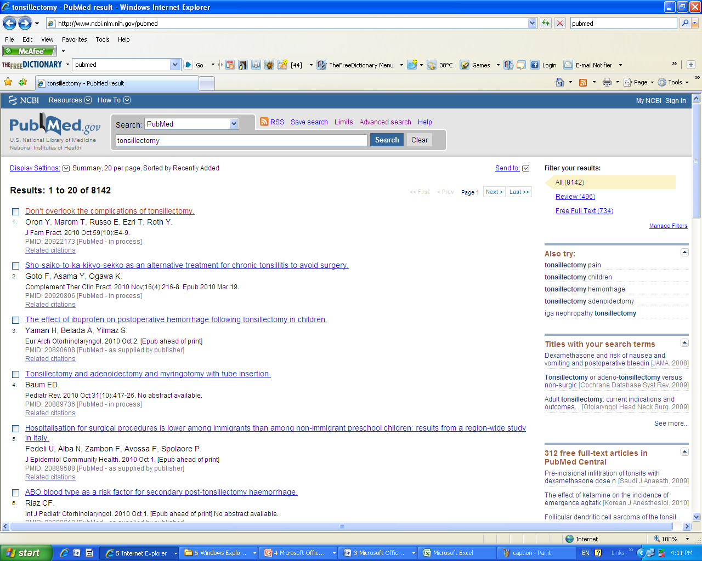
Tonsillectomy in Pubmed n= 8520
Notes:
We search pubmed if there is no CLB reviews on the required topic
tonsillectomy in pubmed

Slide 37
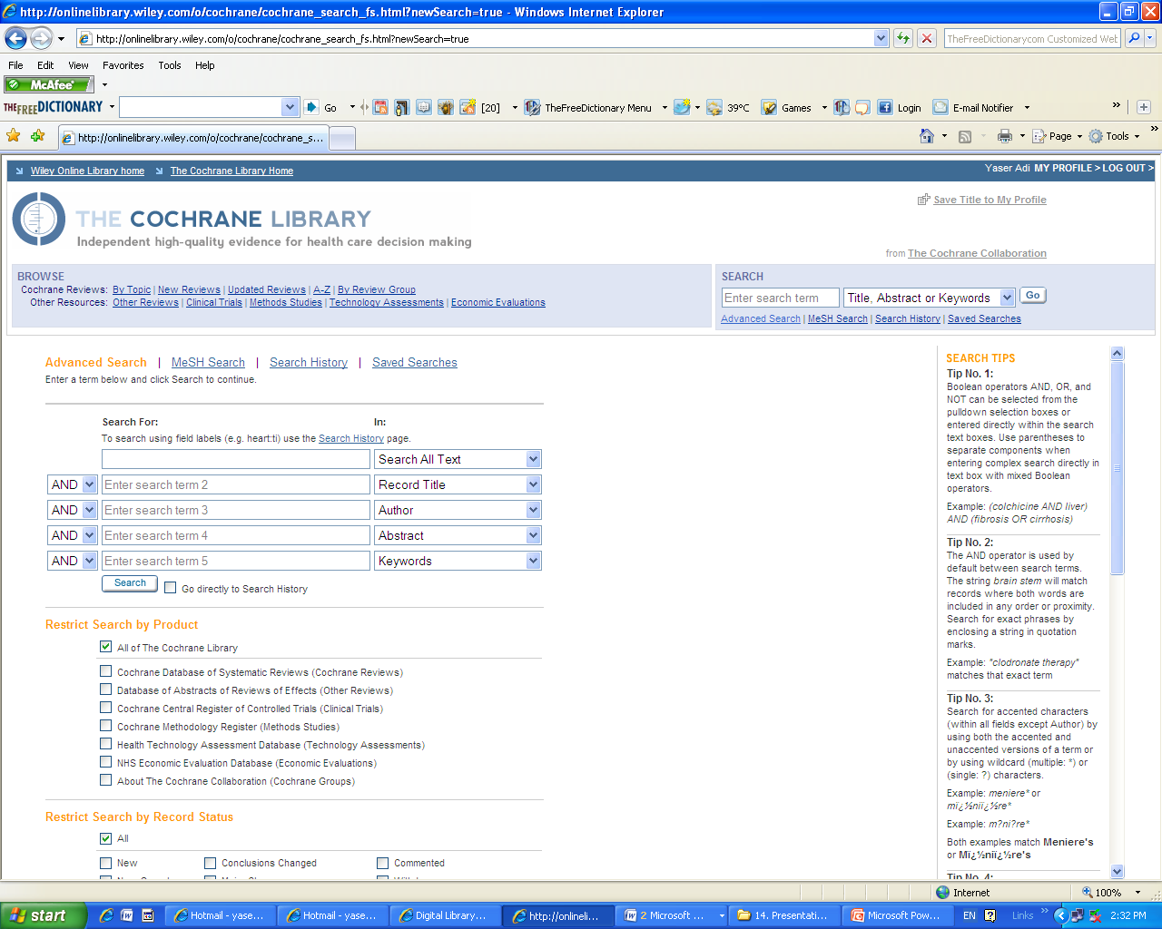
Cochrane library looks like this…

Slide 38
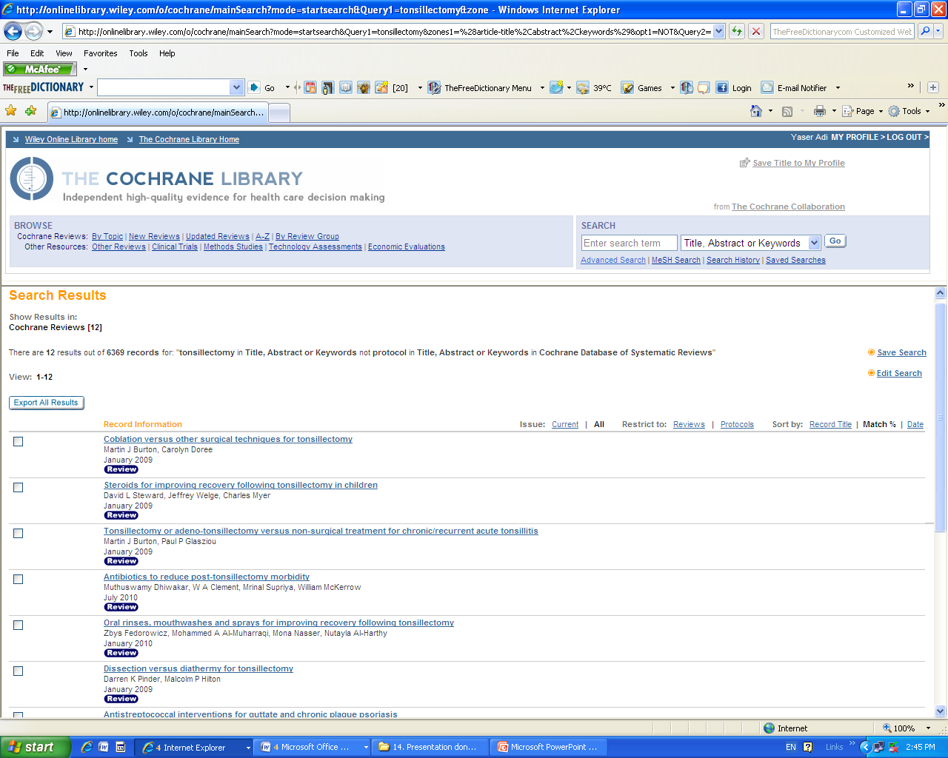
Number of systematic reviews for tonsillectomy in CLB n= 37

Slide 39
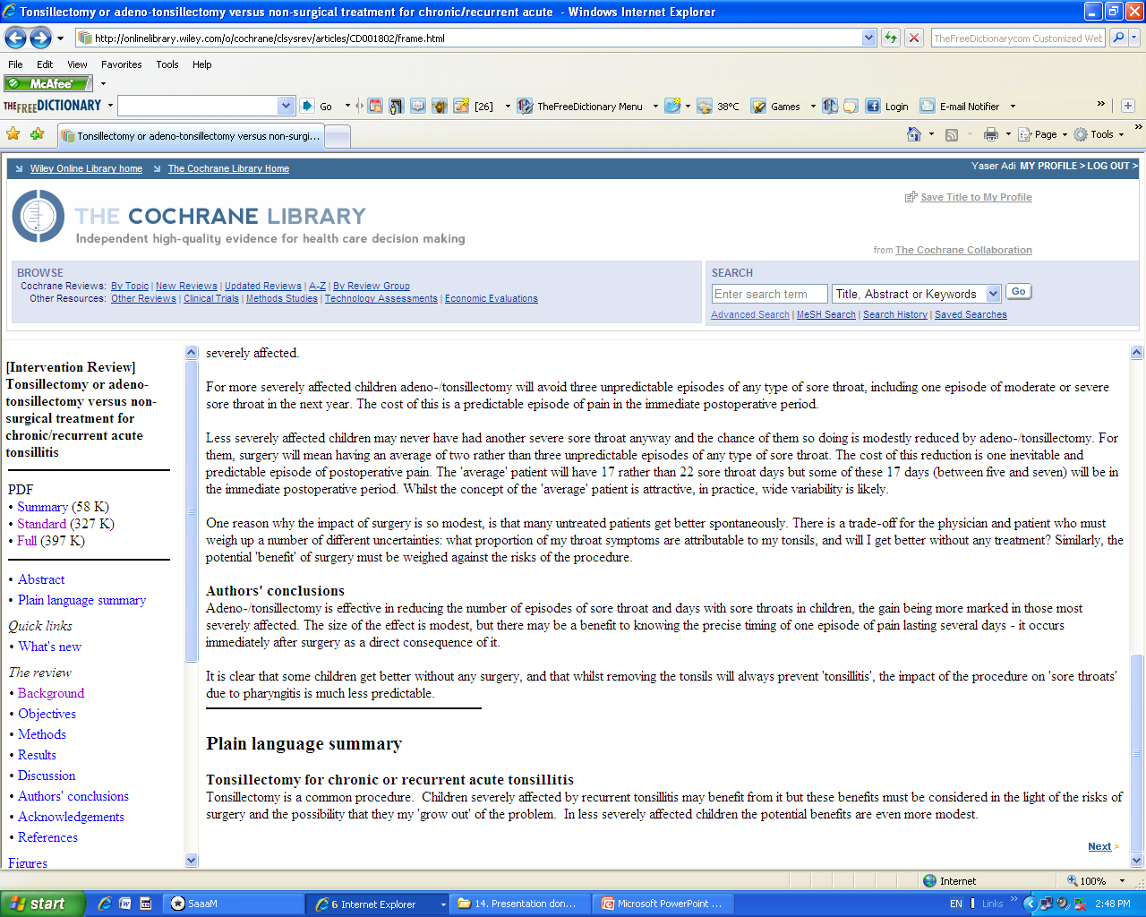
Tonsillectomy systematic review

Slide 40
Authors’ conclusions
“Children severely affected by recurrent tonsillitis may benefit (17 vs 22 sore throat days) from it but these benefits must be considered in the light of the risks of surgery and the possibility that they my ’grow out’ of the problem…”
Notes:
Outcomes, recurrence of episodes
Sore throat
Risk of surgery
Follow up only up to 1 year ☹
This review includes five studies: four undertaken in children (719 participants) and one in adults (70 participants). Good information about the effects of tonsillectomy is only available for children and for effects in the first year following surgery.
Children were divided into two subgroups: those who are severely affected (based on specific criteria which are often referred to as the 'Paradise criteria') and those less severely affected.
For more severely affected children adeno-/tonsillectomy will avoid three unpredictable episodes of any type of sore throat, including one episode of moderate or severe sore throat in the next year. The cost of this is a predictable episode of pain in the immediate postoperative period.
Less severely affected children may never have had another severe sore throat anyway and the chance of them so doing is modestly reduced by adeno-/tonsillectomy. For them, surgery will mean having an average of two rather than three unpredictable episodes of any type of sore throat. The cost of this reduction is one inevitable and predictable episode of postoperative pain. The 'average' patient will have 17 rather than 22 sore throat days but some of these 17 days (between five and seven) will be in the immediate postoperative period. Whilst the concept of the 'average' patient is attractive, in practice, wide variability is likely.
One reason why the impact of surgery is so modest, is that many untreated patients get better spontaneously. There is a trade-off for the physician and patient who must weigh up a number of different uncertainties: what proportion of my throat symptoms are attributable to my tonsils, and will I get better without any treatment? Similarly, the potential 'benefit' of surgery must be weighed against the risks of the procedure.
Authors' conclusions
Adeno-/tonsillectomy is effective in reducing the number of episodes of sore throat and days with sore throats in children, the gain being more marked in those most severely affected. The size of the effect is modest, but there may be a benefit to knowing the precise timing of one episode of pain lasting several days - it occurs immediately after surgery as a direct consequence of it.
It is clear that some children get better without any surgery, and that whilst removing the tonsils will always prevent 'tonsillitis', the impact of the procedure on 'sore throats' due to pharyngitis is much less predictable.
Plain language summary
Top of page
Abstract
Plain language summary
Tonsillectomy for chronic or recurrent acute tonsillitis
Tonsillectomy is a common procedure. Children severely affected by recurrent tonsillitis may benefit from it but these benefits must be considered in the light of the risks of surgery and the possibility that they my 'grow out' of the problem. In less severely affected children the potential benefits are even more modest.
In less severely affected children the potential benefits are even more modest”. In Conclusion

Slide 41
Complications of Tonsillectomy in 14%
General anesthesia
Hospital infections
Hemorrhage needs treatment in 3.5%
Pain
Dehydration
Revision tonsillectomy
Notes:
14% there were complications related to surgery of one sort or another
General anaesthesia
Hospital infections
Hemorrhage Hemorhage requires treatment to control in 3.5%
Pain
Dehydration
Revision tonsillectomy

Slide 42
Exercise 3 Magic treatment for “cold”
A friend sent this advert by an email with several contacts of people cured. “85% who used it have cured in less than 3 days”.
Do you recommend it to a relative of yours?
Yes or no and …why ?
Notes:
Pico think of

Slide 43
Unjustified statement because:
(P) Who are these people with “cold” young , elderly, fit?
(I ) What is this treatment made of?
(C) No comparison, placebo effect
(O) The “cure in less than 3 days” the cold could have been a self-limited without any treatment, 15% not cured may be dead because of a toxic effect!

Slide 44
Summary
Evidence-based medicine is a systematic approach to care for your patients
EBM requires Skills that are needed to integrate the available evidence with clinical experience and patient concern
EBM skills will provide a frame work for life-long learning.

Slide 45

http://ebhc-kt.ksu.edu.sa
Notes:
Come to us for questions

