Slide 1
SMALL GROUP TEACHING/LEARNING RATIONALE & PRINCIPLES.
STUDY SKILLS COURSE
MEDICAL EDUCATION DEPARTMENT
COLLEGE OF MEDICINE

Slide 2
CONTENTS: (Two Parts)
Part-1: Rationale & Principles
Part-2: Tips & Process

Slide 3
CONTENTS: (Part-1)
Introduction
Why small group teaching / learning
Structures
How to work in a small
Conclusion

Slide 4
Objectives of the Session
At the end, we will be able to describe/define:
The characteristics & objectives of SGTL
The role of SGTL in your reform U/G
curriculum
The process of SGTL (Problem-based)
How learning issues can be generated from a clinical scenario

Slide 5
Some Important Phrases
Teaching is not talking, & learning is not listening, only.
Teaching is the art of aiding discovery.

Slide 6
Everything doesn’t have to happen at the front of the classroom.

Slide 7
The Goals of learning belong to the learner.
Learning occurs as a results of the activity in which the learner, not the teacher, engages.

Slide 8
It is not possible to teach anyone anything. It is only possible to arrange for someone to learn.
Tell me, I hear. Show me, I remember. Involve me, I understand.

Slide 9
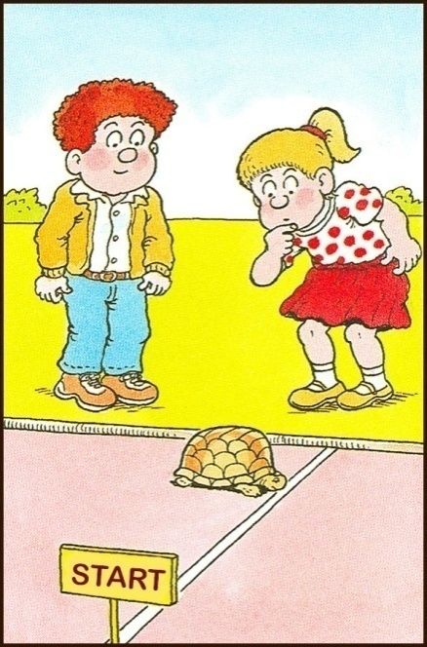
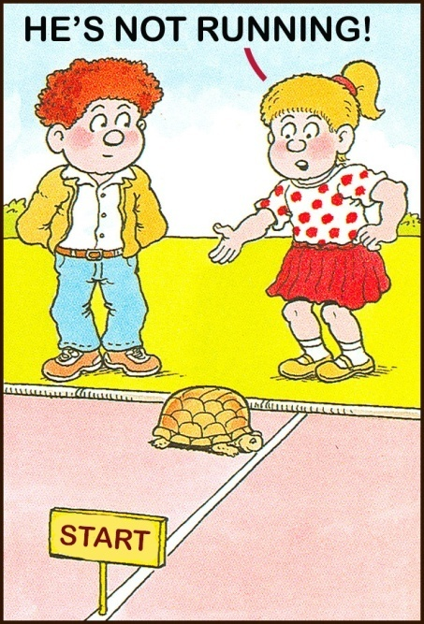
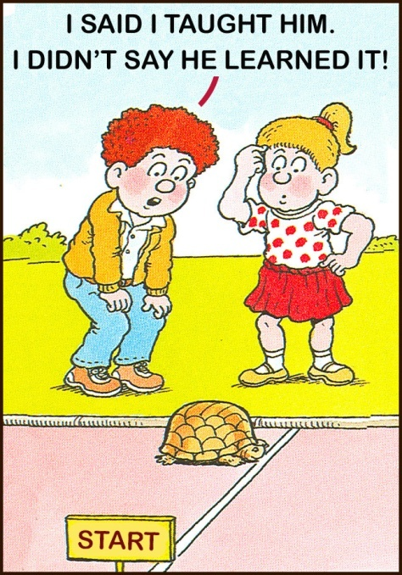

Slide 10
“ By separating teaching from learning, we have teachers who do not listen and student who do not talk” Palmar P.

Slide 11
TEACHING & LEARNING??
Teaching: Transferring the information to learners?
Learning: Acquiring & receiving the information.
We as teachers could:
Guide
Facilitate
Motivate

Slide 12
What is learning??

Slide 13
Learning The process of acquisition of new knowledge, skills, attitudes, values, behaviours, preferences, understanding. It is NOT only knowledge

Slide 14
Curriculum change - Why?
Too much information - too little time
The need to foster the skills for self-directed & life-long learning

Slide 15
Small Group Learning

Slide 16
Definition: Small group learning
A group of learners demonstrating three common characteristics;
Active participation
A specific task
And reflection
Jones RW

Slide 17
CURRENT TREND IN MEDICAL EDUCATION
Patient centered
Systematic teaching approach
Multi-Professional Approach
Focus on the clinical setting
Reflective practice
Early introduction to clinical practice

Slide 18
SGTL TYPES: DEPENDS ON MANY FACTORS:
Education objectives
Size of the group
Available time
Personnel
Facilities

Slide 19
SMALL GROUP TEACHING:
PBL /Case-based discussion
Tutorial
Workshop
Brain-storming session
Simulations
Clinical teaching

Slide 20
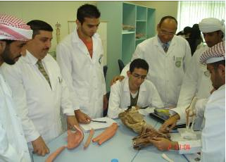

Slide 21
EFFECTIVE NUMBER OF SMALL GROUP MEMBER?
Increased number of more brains
Increased number of less participation

Slide 22
ADVANTAGES:
Student centered
Self-directed
Active learning and participation
Expression of ideas
Reflection
Deep learning
Identifying learning needs
Life-long learning

Slide 23
ESSENTIAL SKILLS, ACQUIRED:
Task prioritization
Time management
Team work
Group dynamic
Interpersonal relationship/ Skills
Leadership
Effective communication
Self confidence

Slide 24
STRUCTURES:
Leader / Chairperson
Reporter / Scribe
Members / Participants
Facilitator/Tutor

Slide 25
OBJECTIVES OF THE PROBLEM-BASE Learning
To develop:
Knowledge - basic and clinical content in context
Skills - scientific reasoning, critical appraisal, information literacy, the skills of self-directed, life-long learning
Attitudes - value of teamwork, inter-personal skills, and psychosocial issues

Slide 26
Facilitator roles:
Ground rules
Clarity of the task
Be sure they are talking to each other
Assign leader, scribe, and other members
Listen and watch the group
Find out dominators / silent
Bring the group back if they are away from the learning objectives

Slide 27
Conclusions
New Trends
Student Centre
Self Directed
Integrated
Deep Learning

Slide 28
SMALL GROUP TEACHING/LEARNING
Part-2: Tips & Process

Slide 29
“Tutor ”
Traditional Teaching
“Students”

Slide 30
“Tutor ”
SGT & L
“Students”

Slide 31
ROLE OF ALL SMALL GROUP MEMBERS:
Chairperson/Leader
Reporter/Scribe
Members / Participants
Facilitators/Tutor

Slide 32
Introduction to the group and the Case
Tutor
Ground Roles?
What we will do & how?
Clear objectives
Students

Slide 33
Starting the Case discussion (Session 1)
What do we know
What do we need to know
Discuss & list learning issues
Organize who does what
Students
Tutor

Slide 34
An important part of CBD is the learning between sessions

Slide 35
Case-based Discussion Schedule for Foundation Block
Case-1 : Introduction Review Process
Case-2: Introduction Review Process
Case-3: Introduction Review Process
Case-4: Introduction Review Process
3 Hr.
Case-2: Feedback
Case-3: Feedback
Case-4: Feedback
Case1 Feedback
Wk1
Wk2
Wk3
Wk4
Weekly schedule 1 case over 2 sessions, Two sessions a week

Slide 36
Show version
Tutorial Part 2 Reporting Back
Recap case
Discuss in a logical order
Avoid mini-lectures
Interact/Question each other
Move to next page or case
Students
Tutor

Slide 37
CHARACTERISTIC OF THE CBD PROCESS
Based on clinical cases
Students come in “cold” to the first session
Students determine the learning issues
Sessions are open – ended to allow learning in the interval
The tutor is a facilitator – not necessarily an “expert”, except in the process

Slide 38
“A Typical Case”
Opening Scenario
History of present illness
Past history, family history, social context
Physical examination
Investigations
Management
Each step may lead back to a previous step, as well as leading to the next step

Slide 39
CHARACTERISTICS OF THE CASES
Relevant, realistic, logical
Cases are characterized by “progressive disclosure”
- story unfolds, step-by-step
- introduce unanticipated issues
- narrative provokes discussion leading to next step

Slide 40
-Session Breaks – At the end of the first session
Students leave with enough to work - issues essential for all - individual issues

Slide 41
The process of CBD
- the roles of students vs. tutor -
Students’ determination of their own “level of ignorance” (Learning Issues), by themselves,
is fundamental to this type of teaching & learning

Slide 42
The process of CBD
- the roles of students vs. tutor -
The facilitator’s role is to prompt, guide and question, when necessary, to ensure that predetermined learning issues (the tutor guide) are identified, researched and discussed

Slide 43
Evaluation - several levels -
Of the group - after each case - how did we do?
Of the student
- Self-assessment - comprehensives, web page
- Formative - tutor comments
- Summative - satisfactory/unsatisfactory
(Evaluation Form)
Of the tutor - submitted to the Med Ed Dept Off

Slide 44
Evaluation *5% of Total Marks How??*

Slide 45
EVALUATION
Absent = Unsatisfactory
Let colleagues/tutor know if you are sick and won’t make it to a session

Slide 46
CHARACTERISTICS OF A GOOD STUDENT
Prompt and present for all sessions.

Slide 47
CHARACTERISTICS OF A GOOD CBD TUTOR
A knowledge of the process of CBD
Commitment to student-directed learning
Ability to generate a non-threatening environment while still acting to promote discussion and critical thinking.
Willingness to make constructive evaluation of student and group performance

Slide 48
CONCLUSION

Slide 49
PBL - an iterative process
Read the problem
Brainstorm- hypothesize
Research-Learn (2 days)
Identify learning issues
EVALUATE
Return-Reread-Report-Review
Next page

Slide 50
??
THANK YOU
STUDY SKILLS COURSE
MEDICAL EDUCATION DEPARTMENT
COLLEGE OF MEDICINE

