Slide 1
SMALL GROUP TEACHING/LEARNING RATIONALE & PRINCIPLES.
STUDY SKILLS COURSE
MEDICAL EDUCATION DEPARTMENT
COLLEGE OF MEDICINE

Slide 2
CONTENTS: (Two Parts)
Part-1: Rationale & Principles
Part-2: Tips & Process

Slide 3
CONTENTS: (Part-1)
Introduction
Why small group teaching / learning
Structures
How to work in a small
Conclusion

Slide 4
Objectives of the Session
At the end, we will be able to describe/define:
The characteristics & objectives of SGTL
The role of SGTL in your reform U/G
curriculum
The process of SGTL (Case-based)
How learning issues can be generated from a clinical scenario

Slide 5
Some Important Phrases
Teaching is not talking, & learning is not listening, only.
Teaching is the art of aiding discovery.

Slide 6
Everything doesn’t have to happen at the front of the classroom.

Slide 7
The Goals of learning belong to the learner.
Learning occurs as a results of the activity in which the learner, not the teacher, engages.

Slide 8
It is not possible to teach anyone anything. It is only possible to arrange for someone to learn.
Tell me, I hear. Show me, I remember. Involve me, I understand.

Slide 9
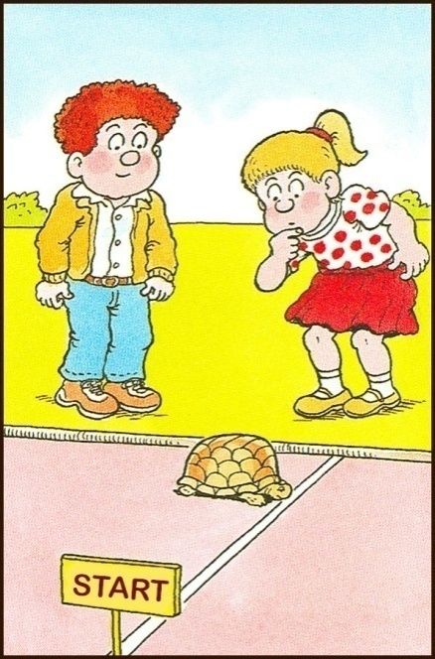
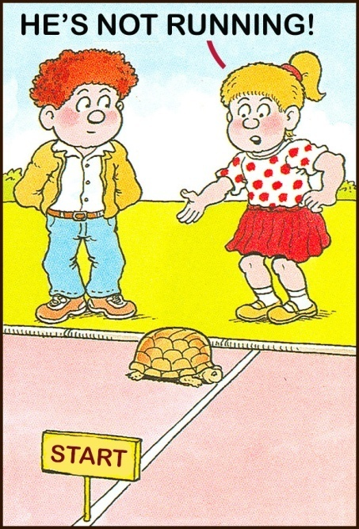
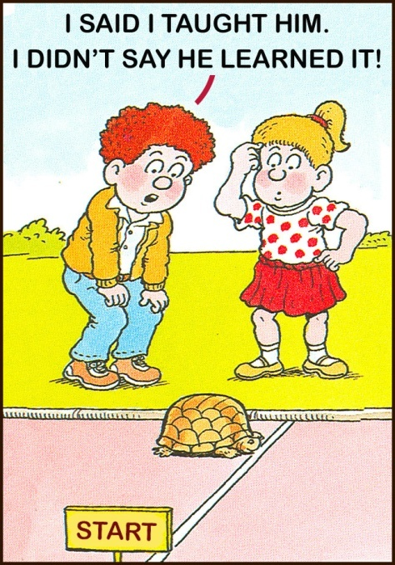

Slide 10
TEACHING & LEARNING??
Teaching: Transferring the information to learners?
Learning: Acquiring & receiving the information.
We as teachers could:
Guide
Facilitate
Motivate

Slide 11
What is learning?? The process of acquisition of new knowledge, skills, attitudes, values, behaviours and preferences. It is NOT only knowledge

Slide 12
Curriculum change - Why?
Too much information - too little time
The need to foster the skills for self-directed & life-long learning

Slide 13
Small Group Learning

Slide 14
Definition: Small group learning
A group of learners demonstrating three common characteristics;
Active participation
A specific task
And reflection
Jones RW

Slide 15
SGTL TYPES: DEPENDS ON MANY FACTORS:
Education objectives
Size of the group
Available time
Personnel
Facilities

Slide 16
SMALL GROUP TEACHING:
PBL /Case-based discussion
Tutorial
Workshop
Brain-storming session
Simulations
Clinical teaching

Slide 17
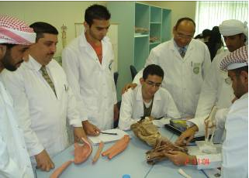

Slide 18
ADVANTAGES:
Student centered
Self-directed
Active learning and participation
Expression of ideas
Reflection
Deep learning
Identifying learning needs
Life-long learning

Slide 19
ESSENTIAL SKILLS, ACQUIRED:
Task prioritization
Time management
Team work
Group dynamic
Interpersonal relationship/ Skills
Leadership
Effective communication
Self confidence

Slide 20
STRUCTURES:
Leader / Chairperson
Reporter / Scribe
Members / Participants
Facilitator/Tutor

Slide 21
OBJECTIVES OF THE CASE-BASED DISC.
To develop:
Knowledge - basic and clinical content in context
Skills - scientific reasoning, critical appraisal, information literacy, the skills of self-directed, life-long learning
Attitudes - value of teamwork, inter-personal skills, and psychosocial issues

Slide 22
Facilitator roles:
Ground rules
Clarity of the task
Be sure they are talking to each other
Assign leader, scribe, and other members
Listen and watch the group
Find out dominators / silent
Bring the group back if they are away from the learning objectives

Slide 23
Conclusions
New Trends
Student Centre
Self Directed
Integrated
Deep Learning

Slide 24
SMALL GROUP TEACHING/LEARNING
Part-2: Tips & Process

Slide 25
“Tutor ”
Traditional Teaching
“Students”

Slide 26
“Tutor ”
SGT & L
“Students”

Slide 27
ROLE OF ALL SMALL GROUP MEMBERS:
Chairperson/Leader
Reporter/Scribe
Members / Participants
Facilitators/Tutor

Slide 28
Introduction to the group and the Case
Tutor
Ground Roles?
What we will do & how?
Clear objectives
Students

Slide 29
Starting the Case discussion (Session 1)
What do we know
What do we need to know
Discuss & list learning issues
Organize who does what
Students
Tutor

Slide 30
An important part of ( case based discussion) CBD is the learning between sessions

Slide 31
Case-based Discussion Schedule for Foundation Block
Case-1 : Introduction Review Process
Case-2: Introduction Review Process
Case-3: Introduction Review Process
Case-4: Introduction Review Process
3 Hr.
Case-2: Feedback
Case-3: Feedback
Case-4: Feedback
Case1 Feedback
Wk1
Wk2
Wk3
Wk4
Weekly schedule 1 case over 2 sessions, Two sessions a week

Slide 32
Show version
Tutorial Part 2 Reporting Back
Recap case
Discuss in a logical order
Avoid mini-lectures
Interact/Question each other
Move to next page or case
Students
Tutor

Slide 33
CHARACTERISTIC OF THE CBD PROCESS
Based on clinical cases
Students come in “cold” to the first session
Students determine the learning issues
Sessions are open – ended to allow learning in the interval
The tutor is a facilitator – not necessarily an “expert”, except in the process

Slide 34
“A Typical Case”
Opening Scenario
History of present illness
Past history, family history, social context
Physical examination
Investigations
Management
Each step may lead back to a previous step, as well as leading to the next step

Slide 35
CHARACTERISTICS OF THE CASES
Relevant, realistic, logical
Cases are characterized by “progressive disclosure”
- story unfolds, step-by-step
- introduce unanticipated issues
- narrative provokes discussion leading to next step

Slide 36
-Session Breaks – At the end of the first session
Students leave with enough to work - issues essential for all - individual issues

Slide 37
The process of CBD
- the roles of students vs. tutor -
Students’ determination of their own “level of ignorance” (Learning Issues), by themselves,
is fundamental to this type of teaching & learning

Slide 38
The process of CBD
- the roles of students vs. tutor -
The facilitator’s role is to guide and question, when necessary, to ensure that predetermined learning issues (the tutor guide) are identified, researched and discussed

Slide 39
Evaluation - several levels -
Of the group - after each case - how did we do?
Of the student
- Self-assessment - comprehensives, web page
- Formative - tutor comments
- Summative - satisfactory/unsatisfactory
(Evaluation Form)
Of the tutor - submitted to the Med Ed Dept Off

Slide 40
Evaluation *5% of Total Marks How??*

Slide 41
EVALUATION
Absent = Unsatisfactory
Let colleagues/tutor know if you are sick and won’t make it to a session

Slide 42
CHARACTERISTICS OF A GOOD CBD TUTOR
A knowledge of the process of CBD
Commitment to student-directed learning
Ability to generate a non-threatening environment while still acting to promote discussion and critical thinking.
Willingness to make constructive evaluation of student and group performance

Slide 43
CONCLUSION

Slide 44
CBD - an iterative process
Read the problem
Brainstorm- hypothesize
Research-Learn (2 days)
Identify learning issues
EVALUATE
Return-Reread-Report-Review
Next page

Slide 45
THANK YOU
STUDY SKILLS COURSE
MEDICAL EDUCATION DEPARTMENT
COLLEGE OF MEDICINE

