Slide 1

Time Management
Learning Skills Course
Dept of medical education
College of Medicine

Slide 2
Objectives
At the end of this session, WE will be able to:
Identify the importance of TM
Plan OUR schedules effectively
Enumerate Time wasters
Identify procrastination signs & tackle it

Slide 3
Contents
Introduction
Importance of TM
Daily schedules planning
Time wasters
Procrastination
Take home messeges

Slide 4

What did you do yesterday?
We need one volunteer on the board. [5 minutes]
Dear colleague, tell us how did you consume your time yesterday [the whole day, bed to bed] ?

Slide 5
Time management important?
Time cannot be bought, stored or stopped - every second that passes is gone forever and can never be recovered or re-used
"Perhaps the most valuable result of any work is the ability to make yourself do the things that you have to do, whether you like it or not."—
Thomas Huxley

Slide 6
لماذا لا نفكر بأهمية الوقت؟
إن التفكير بالأشياء الملموسة مثل السيارات والبيوت أسهل من التفكير بالوقت وذلك لأن لها قيمة
ولكن لأن الوقت غير مرئي وغير قابل للمس فهو لا يحظى بالاحترام الكافي ، فلو سرق شخص مجوهرات منك فإنك ستنزعج وتخبر الشرطة عن الجريمة ولكن سرقة الوقت في العادة لا تعتبر حتى جنحة

Slide 7
أهمية الوقت في حياة المسلم
عن معاذ بن جبل رضي الله عنه قال قال رسول الله صلى الله عليه وسلم " لن تزول قدما عبد يوم القيامة حتى يسأل عن أربع:
    عن عمره فيما أفناه
    وعن شبابه فيما أبلاه
    وعن ماله من أين اكتسبه وفيما أنفقه
    وعن علمه ماذا عمل به؟ "
عن ابن عباس رضي الله عنهما قال قال رسول الله صلى الله عليه وسلم " نعمتان مغبون فيهما كثير من الناس: الصحة والفراغ “

Slide 8
The Basic Rule
Time can't be managed, time is uncontrollable
We can only manage ourselves and our use of time

Slide 9
Learners’ basic principles
1- Identify "Best Time" for Studying
2- Study Difficult Subjects First
3- Use Distributed Learning and Practice
4- Make Sure the Surroundings are Conducive to Studying
5- Make Room for Entertainment and Relaxation
6- Make Sure you Have Time to Sleep and Eat Properly
7- Try to Combine Activities
- Define high and low periods of attention and
concentration
- Are you morning person" or a "night person“
- When you are fresh, you can process information
more quickly and save time as a result
- Study in shorter time blocks with short breaks
between to avoid fatigue
- While you are taking a break, the brain is still
processing the information
- This will allow you to reduce distractions which can
"waste time.“
- You need to have a social life, yet, you need to
have a balance in your life
- Sleep is often an activity that learners use as their
time management "bank“
- When they need a few extra hours for studying,
they withdraw a few hours of sleep

Slide 10
How busy are you?
Because we are not concentrating on the right things
To succeed, we must concentrate on:
1. The results to be achieved, not on being busy
2. Setting priorities, which is vital
The aims to ensure that we concentrate our effort on the high payoff tasks

Slide 11
Plan your time
Everyone has 24 hours each day & 168 hours each week
We must use this time to eat, sleep, work, relax, exercise, attend class, and study
It requires planning to get the most from these hours
It requires self-discipline and control until the behavioral changes becomes an everyday habit
Remember, plans and schedules for managing time are useless if one does not follow them

Slide 12
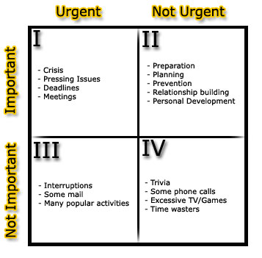
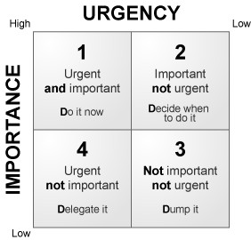
Plan your time – Cont.
People don't plan to fail but a lot of people do fail to plan."
To Do List:
- Break things down into small steps
- Like a child cleaning his/her room
- Do the ugliest thing first

Slide 13
Plan your time – Cont.
Daily Schedules:
- Engagement books
- Palm Computers or PPC
- A piece of poster board tacked to a wall
- 3 x 5 index cards
Once you decide upon the style, the next step is construction
Allow spaces for each hour, even ½ hour for a busy schedule
First, put down all of the necessities; classes, work, meals, etc.
Then block in your study time. Schedule study for a time when you are most alert and energized.

Slide 14
Once scheduling becomes a habit, you will discover that:
“It is easier to find something to do with extra time then to find extra time to do something.”

Slide 15
Effective Scheduling Review
Keep a calendar and include all your activities
Keep weekly and daily schedules & review your schedule daily
Keep a long-term schedule (one yr., four yrs.) and plan ahead
Take into account the learning style when developing a study schedule. Select the times when you are most alert and the most appropriate place for you to study
When setting up your schedule, organize tasks in order of priority
Spread work out over a week period.
Plan ahead your computer access needs and avoid time of heavy user traffic

Slide 16
Crisis Management
It can lead to situations such as:
1- High levels of stress
2- A disrupted private life
3- Tiredness
4- Failure of projects

Slide 17
Assess your task!!
Is the task urgent & important?
yes
yes
Do you need to complete it today?
Take immediate action
A
No
Allocate time to complete it
Is the task urgent or important?
yes
Does it has a definite deadline?
yes
B
No
No
Set realistic deadline for it
Is the task necessary?
yes
Save the task for quiet time
C
No
Discard

Slide 18
Stress Management
Being more in control of what you do
Being productive, and secure in your daily tasks
Enjoying what you do
Giving your-self more quality time to relax and enjoy life outside work
Hear me now, Believe me Later…

Slide 19
Common Time Wasters
Interruption
Procrastination
Acting with incomplete information
Crisis management
Unclear communication
Inadequate technical knowledge
Unclear objectives and priorities
Lack of planning
Stress and fatigue
Inability to say "No"
Personal disorganization

Slide 20
Why don't people manage their time?
They don't know about it
They are too lazy to plan
They enjoy the adrenaline buzz of meeting tight deadlines
They enjoy crisis management
Failing to plan is planning to fail

Slide 21

how long should I study?
The rule-of-thumb in college
To spend two hours studying for every one hour in class each week

Slide 22
Summary
Time can't be managed
We can only manage ourselves and our use of time
Planning
Urgent v/s Important

Slide 23
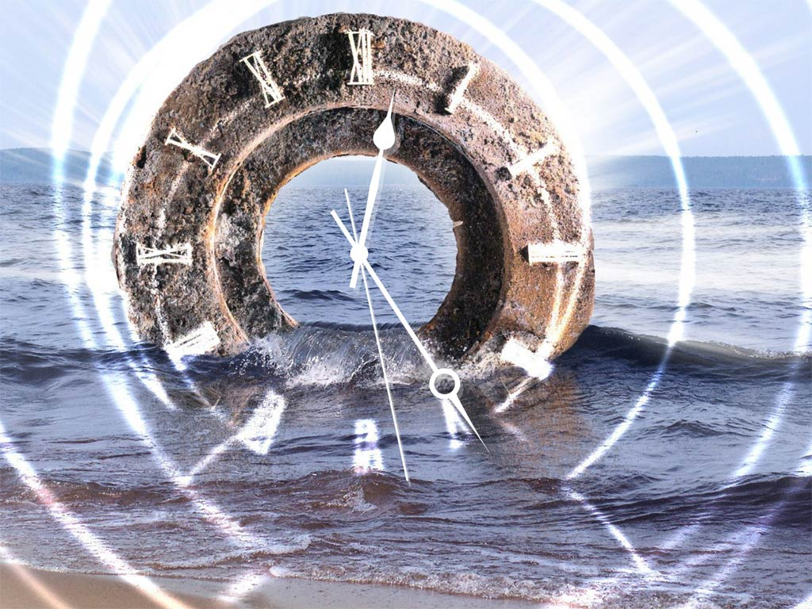
Questions !!
T
H
A
N
K
Y
O
U

