Slide 1
Introduction to Evidence-Based Medicine
Dr Hayfaa A.A Wahbi
Assistant Professor, Chair of Evidence Based Medicine and Knowledge translation

Slide 2
What are you expecting to learn in the medical college?
Notes:
The goal behind the first questions is to get the students to reach the conclusion that medicine is about diagnosis treatment and prognosis in addition to communication skills. The goal of the second question is to get the students to reach the conclusion that medicine is not static knowledge and it is developing

Slide 3
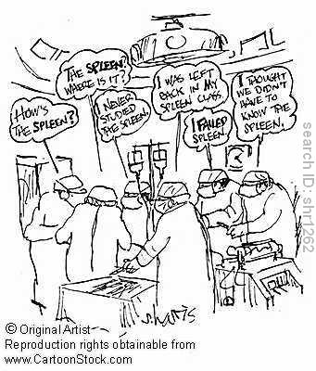
Definitely not This

Slide 4
What are you expecting to learn in the medical college?
You are expected to know how to diagnose illness and disease, how to prevent and treat them and how to communicate to the patients the expected outcome of your treatment.
Do you think that the knowledge you will gain in the
diagnosis and treatment of pneumonia الالتهاب الرئوي) is the same that medical students received 50 years ago?
30 years ago?
15years ago?
5 years ago?
Notes:
The goal behind the first questions is to get the students to reach the conclusion that medicine is about diagnosis treatment and prognosis in addition to communication skills. The goal of the second question is to get the students to reach the conclusion that medicine is not static knowledge and it is developing

Slide 5
It is definitely not the same knowledge …
But what is the time limit for knowledge to be updated?
We don’t know ….this is why we should always ask the question about the best tool to diagnose the disease and the best treatment options for this specific patient.
Notes:
The discussion will lead the students to get to the conclusion that to update their medical knowledge they have to ask a question about any intervention (diagnostic investigation or treatment) they are requesting for the patient.

Slide 6
Where do you think you can get this information and knowledge from?
Medical text books…
In most of the cases these contain the same information you gained during your medical education.. They take long time up to 10 years to be updated.
Internet, medical journals, specialized medical databases
Notes:
This question will stimulate the students to think about where from to get the information to update their medical knowledge and to the second step in the 5 steps of EBM (searching for evidence).

Slide 7
What are the electronic databases for medical sciences?
Are websites for titles, abstracts and in sometimes full text articles published in the medical journals and are updated on a daily bases. They provide published information on all branches of medicine. Example of the such database is the MedLine http://www.ncbi.nlm.nih.gov/PubMed
Notes:
Students will be introduced to one of databases which is pubmed

Slide 8
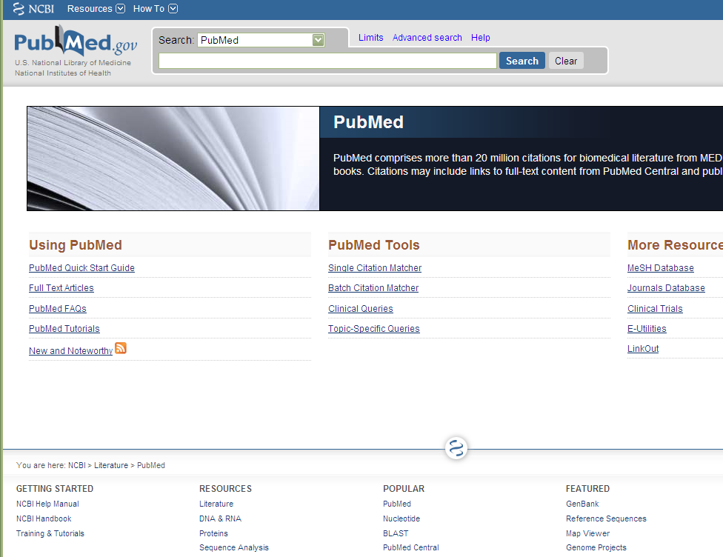

Slide 9
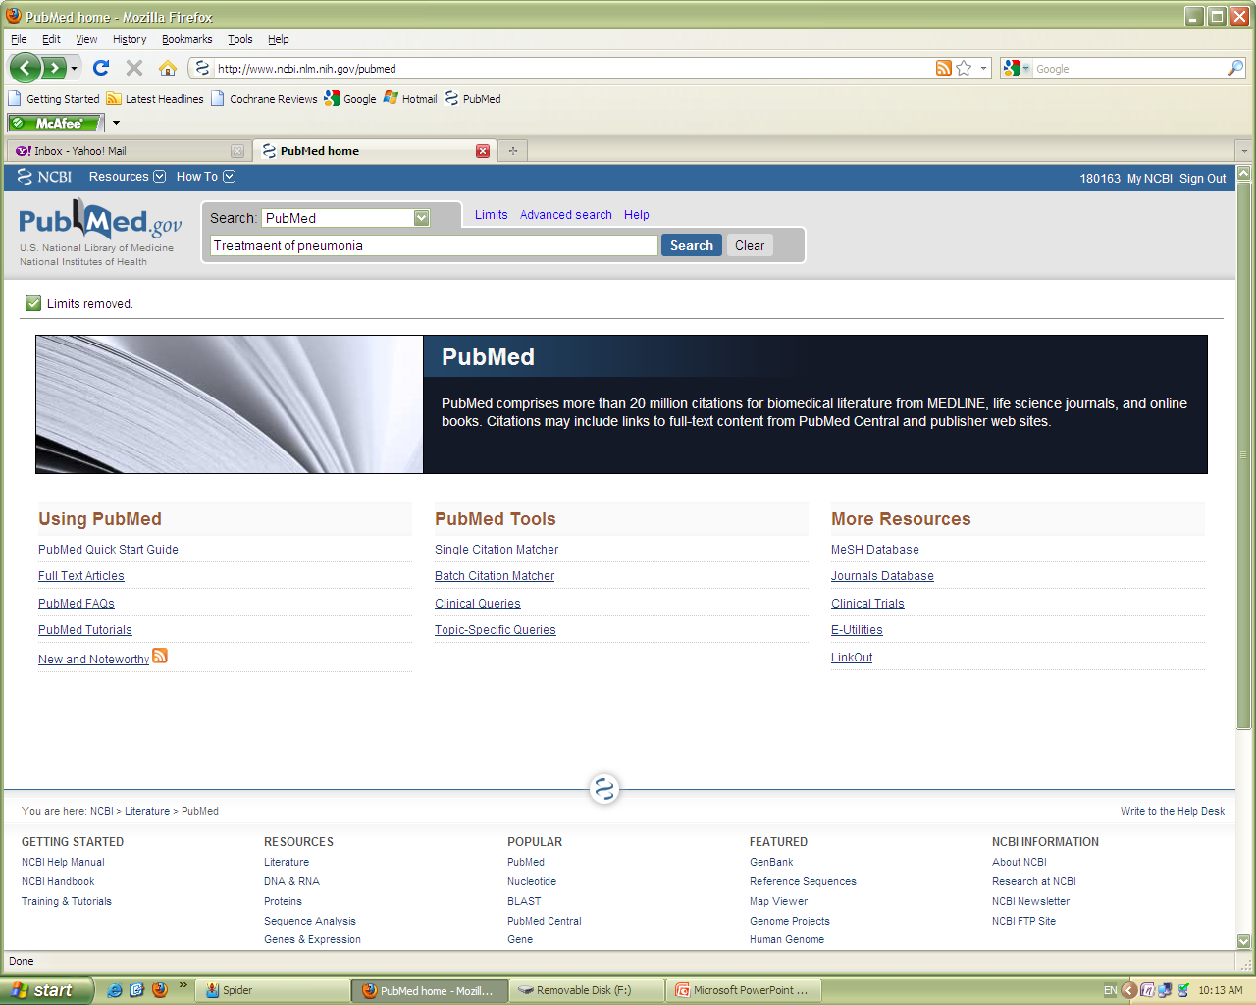

Slide 10
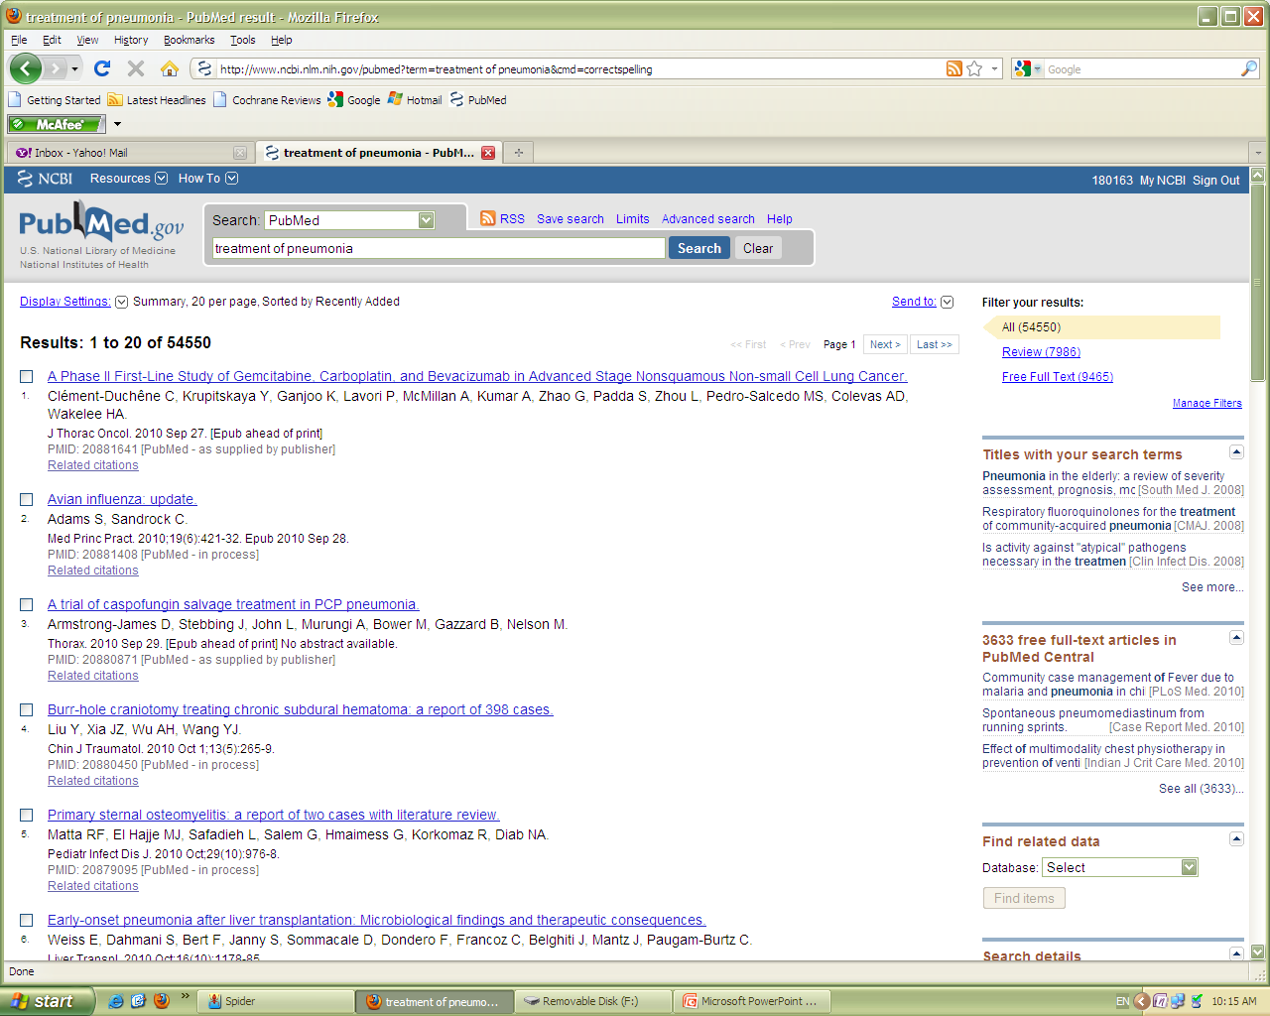
Notes:
The number of retrieved articles will be utilized to highlight the concept the PICOS and the importance of the critical appraisal

Slide 11
Do you think all the 54550 articles retrieved by the search are relevant to your patient with pneumonia?
Of course not your patient might be a child or an adult or an elderly to say the least

Slide 12
How can we reduce the number of articles we get from the search?
To describe the patient we want to manage in more details
To include the investigation or the treatment we want to request for the patient
and in some cases compare it to another one
To include the outcome we are looking for.
And the proper study design for the question
PICOS
Notes:
An example of the PICO will be given here.

Slide 13
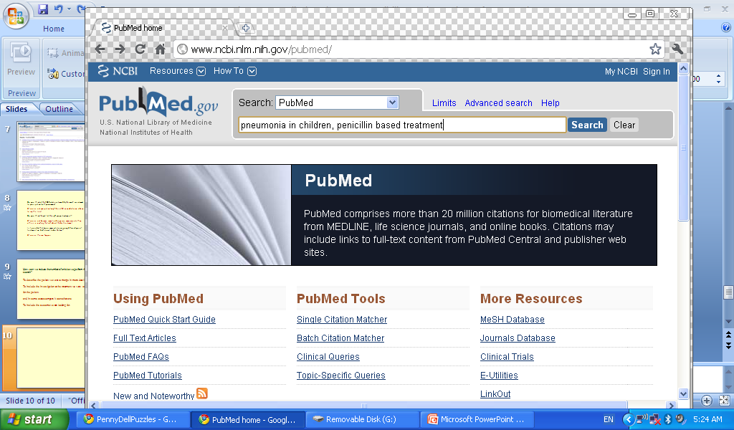

Slide 14
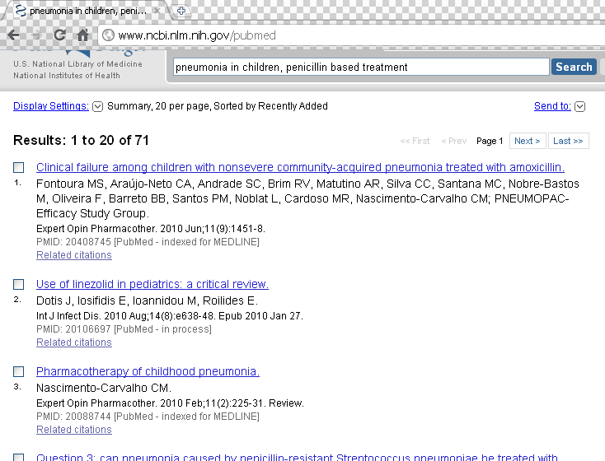
Notes:
The students are given a demonstration about how to narrow their search.

Slide 15
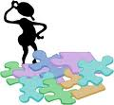
Do you think all the 71 retrieved articles tell the right proper treatment?
Of course not because some trial designs are more accurate than others in reaching the truth about the best treatment

Slide 17
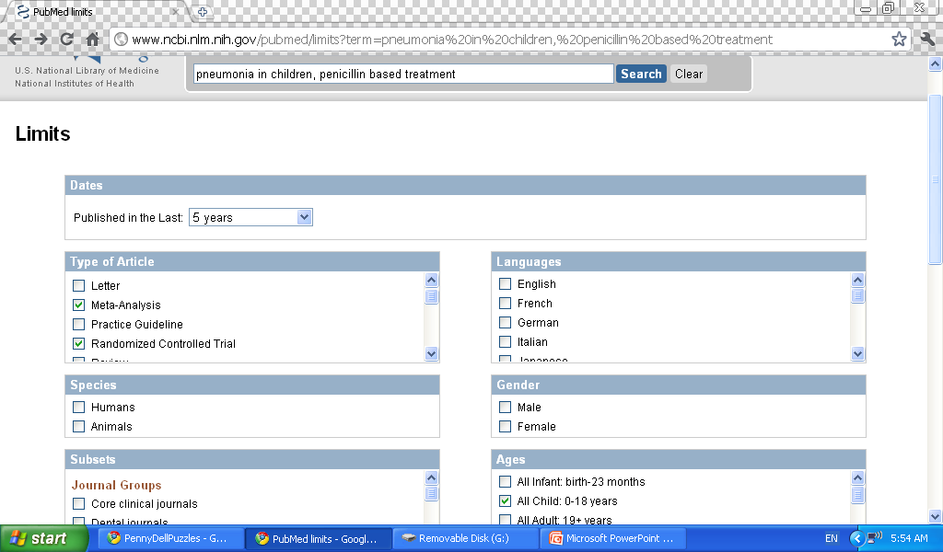

Slide 18
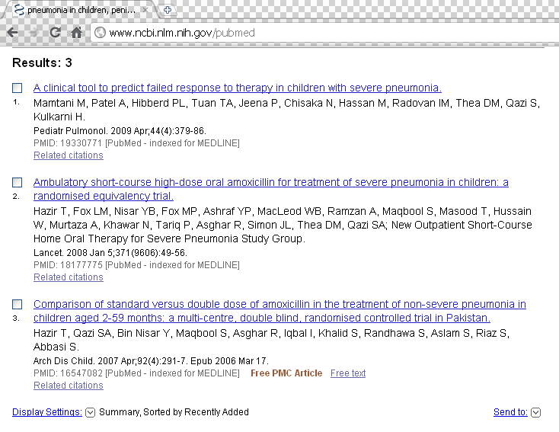

Slide 19
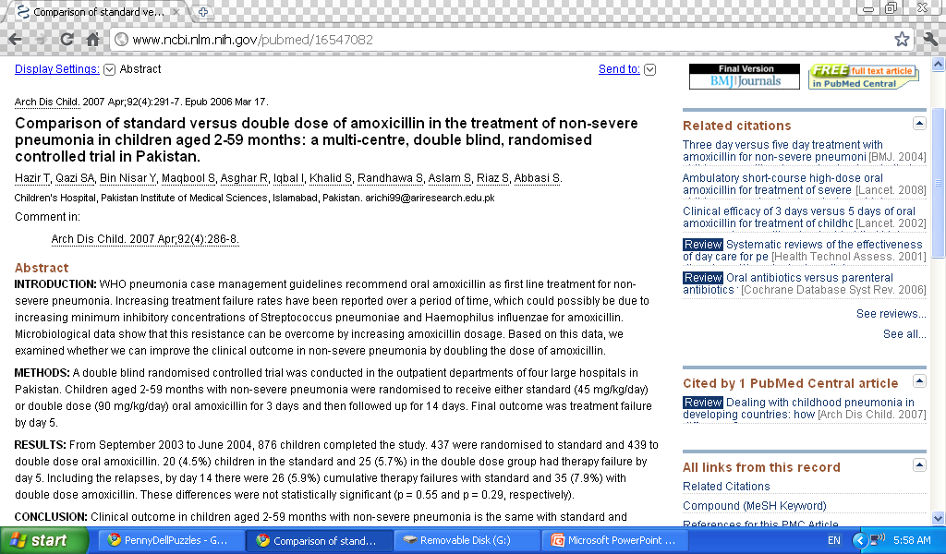

Slide 20
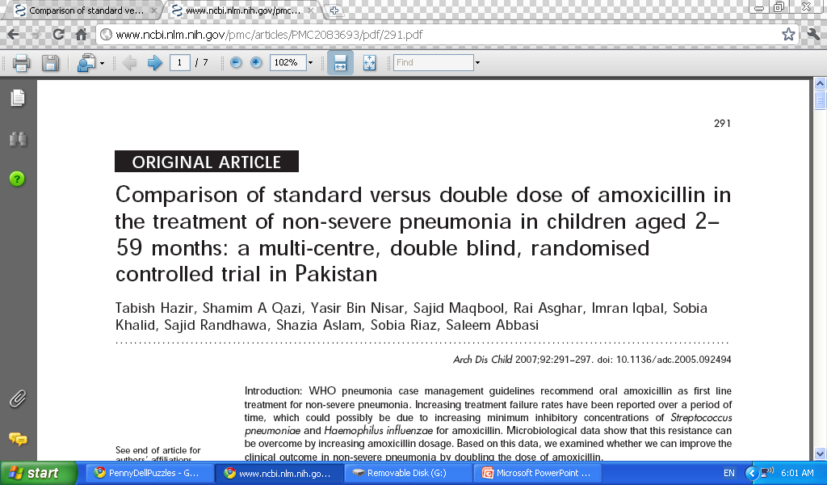

Slide 21
Do you think that this article tells the right proper treatment for your patient?
Most probably it does..because it retrieved by applying your PICOS.
But is it possible that the trial was not well conducted?
Of course this can happen

Slide 22
How can we differentiate between a well conducted and not a so well conducted trial?
By looking closely at the article and the results using certain tools known as critical appraisal tools.
Notes:
At this point I suggest that we give them an example of a work sheet of therapy with very brief summary about what critical appraisal is.

Slide 23
The trial is well conducted and the treatment is very effective….Can I try that on my patient now….!!

Slide 24
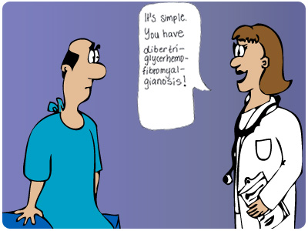
Well…Not Yet ..
What if your patient is allergic to amoxicillin…!!!
Notes:
This slide will introduce the students to the concept of considering the individual patient’s circumstances more examples will be given for considering patients’ opinion and values.

Slide 25
We can summarize our practice of medicine so far in 5 steps

Slide 26
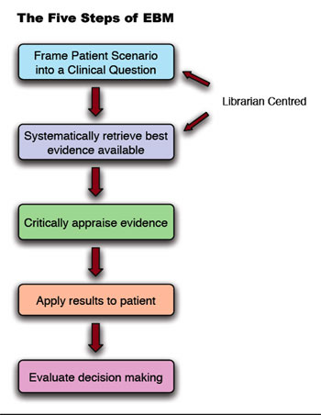

Slide 27
Patient
Concerns
Best research
evidence
Clinical
Expertise
EBM

Slide 28
"Evidence-based medicine (EBM) is the integration of best research evidence with clinical expertise and patient values…
When these three elements are integrated, clinicians and patients form a diagnostic and therapeutic alliance which optimizes clinical outcomes and quality of life."
The EBM subcommittee of the OU-COM Curriculum Advisory Committee (CAC) has adopted the definition of evidence-based medicine (EBM) developed by David Sackett, M.D., and colleagues (2000, p. 1):

