Slide 1
Professionalism
For Medical Students
Dr. Nada Al-Yousefi
Family and Community Medicine Department
College of Medicine, KSU

Slide 2
Think of some Excellent Teachers who Influenced your Learning.
Mention Some of Their Qualities and Attributes

Slide 3
OBJECTIVES
Define Professionalism.
Identify some professional and unprofessional behaviors.

Slide 4
CONTENTS
What is professionalism?
What are Unprofessional behaviors?
How can we learn it?
How can we Assess it?

Slide 5
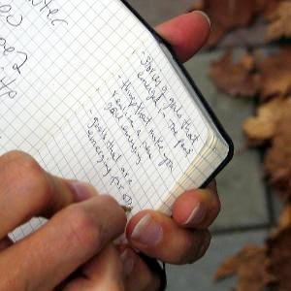
What does professionalism means to you?
Take two minutes and write down your thoughts … as a definition or description
Notes:
An occupation requiring specialized knowledge and often long and intensive academic preparation
Conforming to the technical or ethical standards of a profession
For the medical student, professionalism means aspiring to an ideal and constantly reflecting on one’s personal behaviour and attitudes with respect to that ideal.

Slide 6
What is Professionalism?
It is not easy to define a profession, but it is likely to have all or Some of the following characteristics:
It is a vocation that implies service to others.
It has a distinctive knowledge base which is kept up to date.
It determines its own standards.
It has a special relationship with those whom it serves e.g. patients.
It has particular ethical principles

Slide 7
http://www.afmc.ca/pages/professionalism/1CruessSlides.ppt Accessed July 2007

Slide 8
Professionalism in Curriculum
General Medical Council 1993
AAMC Medical School Objectives Project (MSOP) 1999
ACGME Outcomes Project 2000
Can-MEDS 2000
KSU medical College Outcomes 2009

Slide 9
WHAT MEDICAL COLLEGES WANT?
Proficiency
Communication skills
Interpersonal skills
Confidence
Critical thinking & problem solving skills
Flexibility
Self motivation
Leadership
Teamwork

Slide 10
Professionalism
Professionalism is a term which embodies numerous qualities of physicians as public servants.

Slide 11
Professionalism
“Constituting those attitudes and behaviors that serve to maintain others interest above physician Self-interest”
The American Board of Internal Medicine (ABIM)

Slide 12
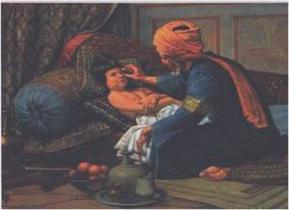
الطبيب المسلم مهنيٌ بطبعه
”إن الله يحب إذا عمل أحدكم عملا أن يتقنه“
”و إذا ذبحتم فأحسنوا الذبحة “

Slide 13
'Project Professionalism' (ABIM, 2001)
Identified six key elements of professionalism:
1- Altruism
2- Accountability
3- Excellence
4- Duty
5- Honor and integrity
6- Respect for others

Slide 14
ALTRUISM
The essence of professionalism. The best interest of the patients, not self-interest, is the rule.
Notes:
Main Characteristics of professional conduct

Slide 15
ACCOUNTABILITY
Required at many levels
individual patients, society and the profession.

Slide 16
EXCELLENCE
Entails a conscientious effort to exceed normal expectations and make a commitment to life-long learning.

Slide 17
“It will become increasingly difficult for professions to sustain the policy that qualification is for life. Most professionals need to make a commitment to lifelong learning”.
Professor Eraut.

Slide 18
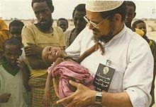
DUTY
The free acceptance of a commitment to service.

Slide 19
HONOUR AND INTEGRITY
The consistent regard for the highest standards of behaviour and refusal to violate one’s personal and professional codes.
Notes:
الشرف والنزاهة

Slide 20
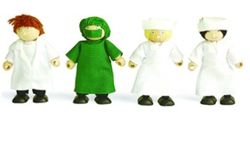
RESPECT FOR OTHERS
Like patients and their families, other physician and professional colleagues such as nurses, medical students, residents, subspecialty fellows.

Slide 21
آداب الطالب في نفسه
تحل بالمروءة.
التمتع بخصال الرجولة.
هجر الترف.
الإعراض عن مجالس اللغو.
الإعراض عن الهيشات.
التحلي بالرفق.
التأمل.
الثبات والتثبت.
العلم عبادة:
"إنما الأعمال بالنيات".
كن على جادة السلف الصالح.
الزم خشية الله.
دوام المراقبة.
خفض الجناح ونبذ الخيلاء والكبرياء.
القناعة والزهادة.
التحلي برونق العلم.
Notes:
الاحترام

Slide 22
أدب الطالب مع معلّمه
رعاية حرمة المعلم
رأس مالك أيها الطالب من معلمك
نشاط المعلم في درسه
الكتابة عن المعلم حال الدرس والمذاكرة

Slide 23
آدابُ الزمالة
احذر قرين السوء
الطبيعة نقالة والطباع سراقة والصاحب ساحب
تخير من يعينك على مطلبك ويقربك إلى ربك ويوافقك على شريف غرضك ومقصدك
الصديق أقسام:
صديق منفعة
صديق لذة
صديق فضيلةٍ

Slide 24
آداب الطالب في حياته العلمية
اللجوء إلى الله تعالى في الطلب والتحصيل
الأمانة العلمية
الصدق
جنة الطالب
قول (لا أدري)
المحافظة على رأس مالك (ساعات عمرك)
إجمام النفس
حسن السؤال
المناظرة بلا مماراة
مذاكرة العلم
كبر الهمة في العلم
النهمة في الطلب
الرحلة للطلب
حفظ العلم كتابة
تعاهد المحفوظات:
إذا كان القرآن الميسر للذكر يذهب إذا لم يتعاهد فما ظنك بغيره من العلوم!
استكمال أدوات كل فن
"الَّذِينَ آَتَيْنَاهُمُ اْلكِتَابَ يَتْلونَهُ حَقَّ تِلَاوَتِهِ"

Slide 25
نواقض هذه الحلية
إفشاء السر.
نقل الكلام من قول إلى آخرين.
الصلف واللسانة.
كثرة الكلام.
الدخول في حديث بين اثنين.
الحقد.
الحسد.
سوء الظن.
مجالسة المبتدعة.
نقل الخطى إلى المحارم.

Slide 26
The concept of professionalism includes the following values
Honesty
Trust
Service
Commitment
Communication
Accountability
Life-long learning

Slide 27
Signs and Symptoms
ABIM, (2001) describes unprofessional behaviour in terms of seven broad categories of 'signs and symptoms‘:
Abuse of power
Arrogance
Greed
Misrepresentation
Impairment
Lack of conscientiousness
Conflicts in interests

Slide 28
Signs and Symptoms
Abuse of powerإساءة استخدام السلطة (abuse while interacting with patients and colleagues; bias and sexual harassment; and breach of confidentiality).
Arrogance الغطرسة(offensive display of superiority and self-importance).
Greedالجشع (when money becomes the driving force).
Notes:
إساءة استخدام السلطة
غطرسة جشع

Slide 29
Signs and Symptoms
Misrepresentation الاحتيال(lying, which is consciously failing to tell the truth; and fraud, which is conscious misrepresentation of material fact with the intent to mislead).
Impairment الضعف(any disability that may prevent the physician from discharging his/her duties).

Slide 30
Signs and Symptoms
Lack of conscientiousness انعدام الضمير (failure to fulfill responsibilities).
Conflicts in interestsتعارض المصالح (self-promotion/ advertising or unethical collaboration with industry; acceptance of gifts; and misuse of services – overcharging, inappropriate treatment or prolonging contact with patients).

Slide 31
Defining Un-professional Behaviors
What specific behaviors are unprofessional in:
classroom and
clinical settings?
For teachers & students

Slide 32
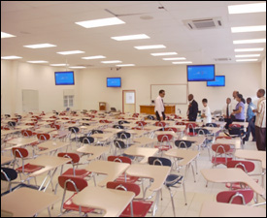
Examples of Unprofessional Behaviors
Classroom Setting-Students
Notes:
Arriving for class late and/or leaving early
Being unprepared for group sessions
Not completing assigned tasks
Disrupting class sessions
Failing to attend scheduled class sessions
Cheating on an exam
Cheating attendace

Slide 33
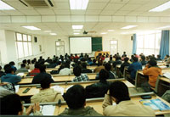
Examples of Unprofessional Behaviors
Classroom Setting-Students
Notes:
Using Mobile Phone during class
Chatting during class
Focusing on the test vs. learning
Prejudging content in advance.
Intolerance of the opinions of others
Entitlement and inappropriate demands

Slide 34
Examples of Unprofessional Behaviors
Classroom Setting-Faculty
Notes:
Plagiarism
Judgmental attitude or favoritism
Coming late
Not giving breaks
Sloppy handouts and syllabi
Abusive behavior
Using Mobile Phone during class

Slide 35
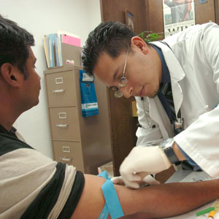
Examples of Unprofessional Behaviors
Clinical Setting-Students
Notes:
Coming late to schedule clinics
Dressing inappropriately
Avoiding work and/or responsibilities
Exhibiting little empathy for patients
Demonstrating lack of sensitivity to patients’ cultural backgrounds
Not protecting patient confidentiality

Slide 36
Examples of Unprofessional Behaviors
Clinical Setting: Faculty
Notes:
Coming late to schedule clinics
Failing to attend scheduled sessions
Showing favoritism
Using inappropriate language or behavior
Using “isms-”-sexism, ageism, racism
Asking learners to perform personal tasks, for example, picking up laundry

Slide 37
How professionalism can be implemented?

Slide 38
Professionalism and Curriculum Design
Professionalism
Approach to Task
Performance
Of Task

Slide 39
Attitudes, ethical understanding and
Legal responsibility
Medical informatics
Decision making skills and clinical
Reasoning and judgment
Patient management
Professionalism
Basic, Social and
clinical sciences
Approach to task
Patient investigation
Performance
Of task
Clinical Skills
Practical procedures
Personal Development
Health promotion and
Disease prevention
Role of the doctor within the health service and community

Slide 40
Professionalism
Role of the doctor within the health service
Understanding of the health care system
Understanding of clinical responsibilities
Appreciation of doctor as researcher
Appreciation of doctor as mentor or teacher
Appreciation of doctor as manager including quality control
Team working
Personal Development
Lifelong Learner
Self awareness
Self confidence
Self regulation
Self care
Self control
Personal time management
Motivation
Achievement drive
Commitment
initiative
Career choice

Slide 41
How professionalism can be taught?

Slide 42
How Students Learn Professional values?
Some bring to medical college with them
Some learn through the formal curriculum
Some learn from role models

Slide 43
How can We Teach Professionalism?
Role Modeling
Bed Side Teaching
Simulated Patients
Small Group Cases Discussions

Slide 46
How can professionalism be Assessed?

Slide 47
Performance or hands on assessment
Portfolios
Does
Written, Oral or
Computer based assessment
Shows how
Professionalism
Knows how
Knows
Miller’s Triangle

Slide 48
How can We Assess Professionalism?
Peer Evaluation
Patient Surveys
Staff evaluations
Professionalism Portfolio (self evaluation)
360 degree evaluation

Slide 49
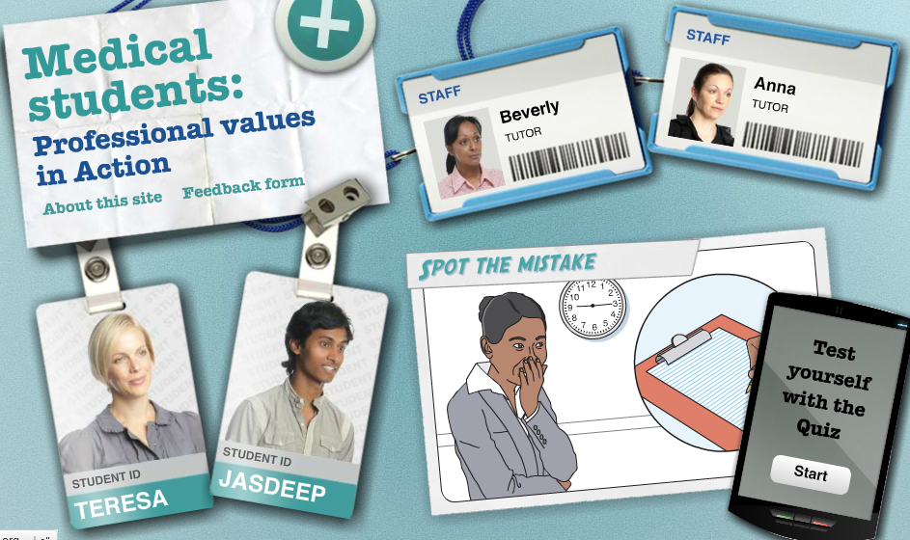

Slide 50
Final Word
“There is a tendency to underemphasize the personal characteristics… , because they are harder to measure, and to overemphasize the more easily measured indices of academic achievement”
Cohen (2002)

Slide 51
Take Home Messages
Professionalism should be part of the formal curriculum
Professionalism must be taught and assessed
Professionalism must be relevant to the society it serves

Slide 52
”وَأَحْسِنُوا إِنَّ اللَّهَ يُحِبُّ الْمُحْسِنِين“
Dress your….
Give your ….
Speak your ….
Listen your ….
Work your ….
nalyousefi@ksu.edu.sa
BEST

