Slide 1
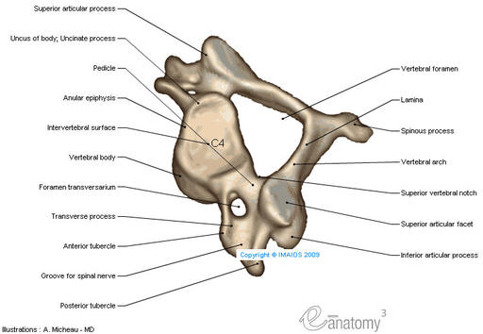
CERVICAL VERTEBRAE

Slide 2
Objectives
By the end of this lecture the student should be able to:
Describe the 7 cervical vertebrae, (typical & atypical).
Describe the joints between the cervical vertebrae.
Describe the movement which occur in the region of the cervical vertebrae.
List the structures which connect 2 adjacent vertebrae together.

Slide 3
CERVICAL SPINES
They are 7 in number.
All characterized by presence of foramen transversarium in the transverse process.
They are classified into:
1- Typical: 3rd , 4th ,5th & 6th.
2- Atypical: 1st, 2nd and 7th.

Slide 4
TYPICAL
CERVICAL VERTEBRAE
C3, C4, C5 & C 6
The body is small, longer horizontally than antero-posteriorly
Its spinous processes is short and bifid.
The transverse processes has a foramen transversarium, through which the vertebral arteries & veins pass.
The vertebral foramen is large & triangular

Slide 5
TYPICAL
CERVICAL VERTEBRAE
C3, C4, C5 & C 6
The superior articular processes:
Have a facets that face upward & backward.
The inferior articular processes:
Have a facets that, face downward and forward.
The transverse process has 2 tubercles one infront and one behind the transverse foramen.

Slide 6
ATYPICAL
C1-
ATLAS
It has No body, No spine.
It has 2 lateral masses connected together by small anterior arch & long posterior arch.
Each lateral mass has articular surfaces on its upper and lower aspects.
The upper articular surface is kidney-shaped articulates with occipital condyles of the skull.
It forms the Atlanto-Occipital joints.
This joint allows you to nod “say Yes”.

Slide 7
The inferior articular surface of the atlas is circular and articulates with the axis. It forms the 2 lateral Atlanto-Axial joints.
This joint together with one median joint between the dens of axis and the anterior small arch of atlas, they allow you to “Say No “ lateral rotation of the face.
AXIS

Slide 8
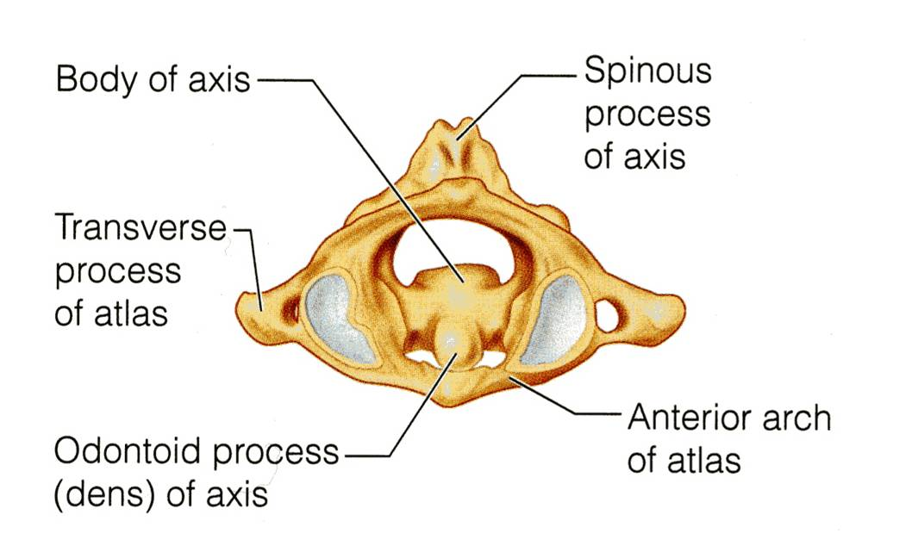
AXIS- C 2
It acts as a pivot for the rotation of the atlas (and the skull) above.
It has a large upright peg-like odontoid process, or dens, which projects upward from the superior surface of the body.
Actually it represents the body of the atlas that has fused with the axis.

Slide 9
7th CERVICAL VERTEBRA OR Cervica Prominens
It has the longest spinous process which is not bifid.
It is the first spine to be felt subcutaneously in the root of the the back of the neck.
The transverse process is large while its foramen transversaium is small and may be absent, and does not transmit the vertebral artery.

Slide 10
Joints of Cervical Vertebrae
Atlanto-Occipital joints:
Synovial joints between the occipital condyles of skull and the upper facets on the lateral mass of the atlas.

Slide 11
The Atlanto-occipital joints are synovial joints between the occipital condyles, and the facets on the superior surfaces of the lateral masses of the atlas below.
atlas
axis
L
P
A
M
Sagittal cut

Slide 12
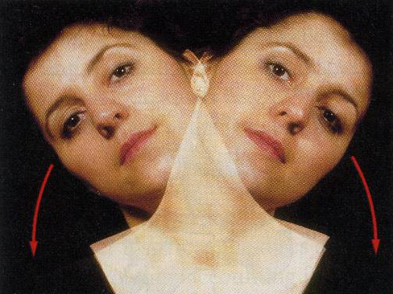
MOVEMENTS IN THE ATLANTO-OCCIPITAL JOINT
The joints are capable of:
Flexion,
Extension, and
Lateral flexion;
They do not rotate.

Slide 13
ATLANTO-AXIAL JOINTS
The Atlanto-axial joints are three synovial joints:
One median, between the odontoid process and the anterior arch of atlas.
The other two lateral are between the lateral masses of the atlas and superior facets on the body of the axis.

Slide 14
MOVEMENTS
Extensive rotation of the atlas and the skull (and thus of the head on the axis).
That is to say NO

Slide 15
JOINTS OF THE VERTEBRAL COLUMN BELOW THE AXIS
JOINTS BETWEEN
TWO VERTEBRAL BODIES

Slide 16
I- Synovial joints between their articular processes
II- Cartilaginous joints between their bodies .
With exception of the first two cervical vertebrae, the other cervical vertebrae articulate with each other by means of:

Slide 17
I- Intervertebral disc
The upper and lower surfaces of the bodies of 2 adjacent vertebrae are covered by thin plates of hyaline cartilage.
Between the plates of hyaline cartilage is an intervertebral disc of fibrocartilage.
The collagen fibers of the disc strongly connect the bodies of the two vertebrae.

Slide 18
JOINTS BETWEEN TWO VERTEBRAL ARCHES

Slide 19
The joints between two vertebral arches consist of synovial joints between the superior and inferior articular processes of adjacent vertebrae.
The articular facets are covered with hyaline cartilage, and the joints are surrounded by a capsule.

Slide 20
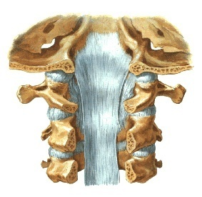
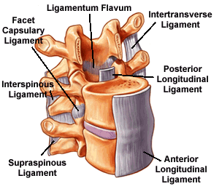
L I G A ME N T S
The anterior and posterior longitudinal ligaments run as continuous bands along the anterior & posterior surfaces of the vertebral bodies.
These ligaments hold the vertebrae firmly together but at the same time permit a small amount of movement to take place.

Slide 21
OTHER LIGAMENTS
Supraspinous ligament:
It runs between the tips of adjacent spines.
Interspinous ligament:
It connects adjacent spines.
Ligamentum flavum:
It connects the laminae of adjacent vertebrae.

Slide 22
Intertransverse ligaments:
They run between adjacent transverse processes.

Slide 23
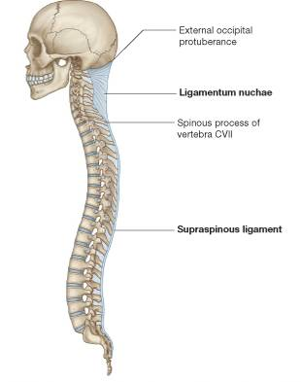
LIGAMENTUM NUCHAE
In the cervical region, the Supraspinous and Interspinous ligaments are greatly thickened to form the strong ligamentum nuchae.
It extends from the spine of the 7th cervical vertebra to the external occipital protuberance of the skull, with its anterior border being strongly attached to the cervical spines in between.

Slide 24
Summary
The cervical vertebrae are 7 in number, classified into typical & atypical vertebrae.
All the typical vertebrae have a bifid spinous processes.
Atypical vertevrae (1,2,7) :
1st (Atlas) : has no body or spine, has short anterior arch and long posterior arch.
2nd (Axis): has odontoid process (dens).
7th (Cervica Prominens) : has longest not bifid spinous process, which can be felt subcutaneously.
Atlanto-Occipital joints are : 2 synovial joints, the function : flexion and extension, This joint allows you to say “Yes”.
Atlanto-Axial joints are : 3 synovial joints, the function : extensive rotation, this joint allows you to say “ No”.

Slide 25
Summary
JOINTS BELOW THE AXIS are : I- Synovial joints between their articular processes.
II- Cartilaginous joints between their bodies ( intervertebral disc of fibrocartilage).
Ligaments of cervical vertebrae :
Supraspinous ligament, between tips of spines.
Interspinous ligament, between adjacent spines.
Supraspinous & Interspinous ligaments are thickened to form ligamentum nuchae.
Ligamentum flavum, between laminae.
Intertransverse ligaments, between transverse processes.

Slide 26
THANK YOU

