Slide 1
MUSCLES OF THE BACK
Dr. Ahmed Fathalla Ibrahim
&
Dr. Zeenat Zaidi

Slide 2
OBJECTIVES
At the end of the lecture, students should be able to:
Distinguish between the different groups of back muscles.
Compare between groups of back muscles as regard their nerve supply and action.
List the back muscles of each group.
Describe the attachments of each muscle of the superficial group, as well as, its nerve supply and action.
Describe the triangles of back and their clinical significance.

Slide 3
BACK MUSCLES
They are organized into 3 groups:
Deep group: attached to & move vertebral column & head.
Intermediate group: attached to ribs, serve respiratory functions.
Superficial group: attached to & involved in movements of upper limb.
Extrinsic muscles:
not develop in the back
supplied by anterior rami of spinal nerves.
Intrinsic muscles:
develop in the back
supplied by posterior rami of spinal nerves

Slide 4
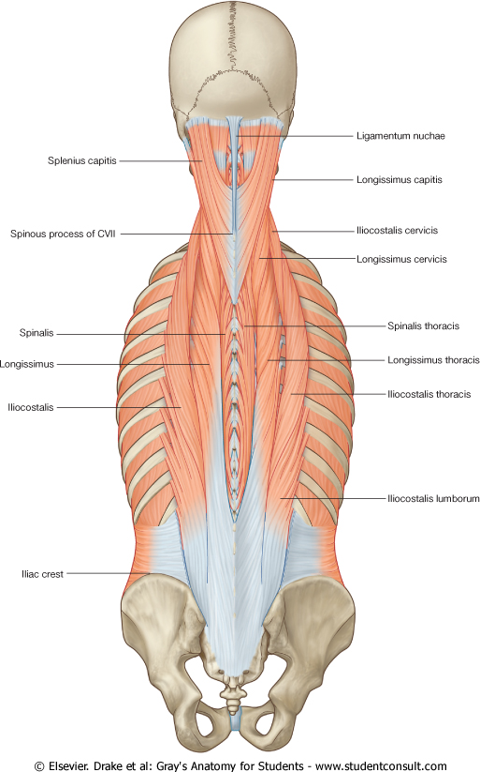
DEEP GROUP OF BACK MUSCLES
They extend from sacrum to skull.
They include extensors and rotators of head & vertebral column.
Their tone is responsible for maintenance of normal curvature of vertebral column.
The largest muscle of this group is “erector spinae” which is formed of 3 vertical columns (from lateral to medial: iliocostalis, longissimus & spinalis).
(Note the length and attachment of the muscle fibers)

Slide 5
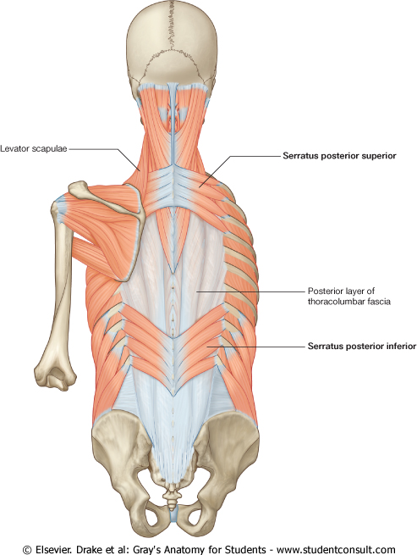
INTERMEDIATE GROUP OF BACK MUSCLES
It is separated from the deep group by thoracolumbar fascia. It includes:
Serratus posterior superior (rib elevator).
Serratus posterior inferior (rib depressor).
Nerve supply: anterior rami of thoracic spinal nerves.

Slide 6
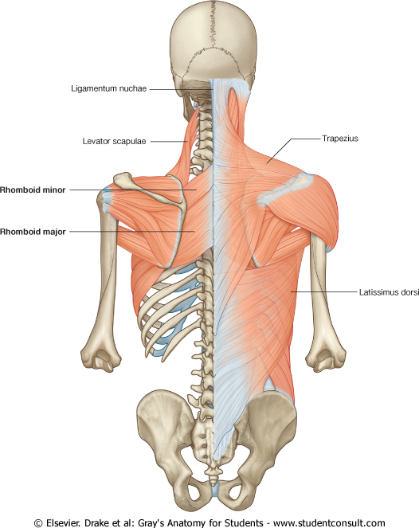
SUPRERFICIAL GROUP OF BACK MUSCLES
Includes two sets of muscles:
Muscles connecting vertebral column to scapula (move scapula through shoulder girdle joints) & include:
Trapezius.
Levator scapulae.
Rhomboid minor.
Rhomboid major.
Muscle connecting vertebral column to humerus (move humerus through shoulder joint), & include:
Latissimus dorsi.
2
1
3
4

Slide 7
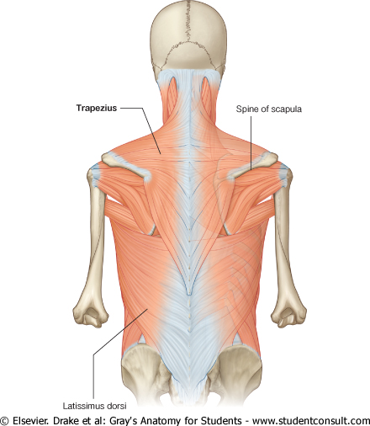
TRAPEZIUS
Origin: Spines of cervical & thoracic vertebrae
Insertion: lateral 1/3 of clavicle + acromion & spine of scapula.
Action: rotation of scapula during abduction of humerus above horizontal.
Upper fibers: elevate scapula.
Middle fibers: retract scapula
Lower fibers: depress scapula.
Nerve supply: Spinal part of accessory (11th cranial) nerve.
Action
Insertion
Origin

Slide 8
LEVATOR SCAPULAE RHOMBOID MINOR & MAJOR
Origin:
Levator scapulae: cervical transverse processes
Rhomboid minor & major: thoracic spines
Insertion: medial border of scapula.
Nerve supply: dorsal scapular nerve.
Actions:
Levator scapulae: elevates scapula.
Rhomboid minor & major: retract scapula.
Insertion

Slide 9
LATISSIMUS DORSI
Origin: spines of thoracic vertebrae.
Insertion: bicipital groove of humerus.
Nerve supply: thoracodorsal nerve.
Actions: extension, adduction & medial rotation of humerus (arm, shoulder joint).
Insertion
Origin

Slide 10
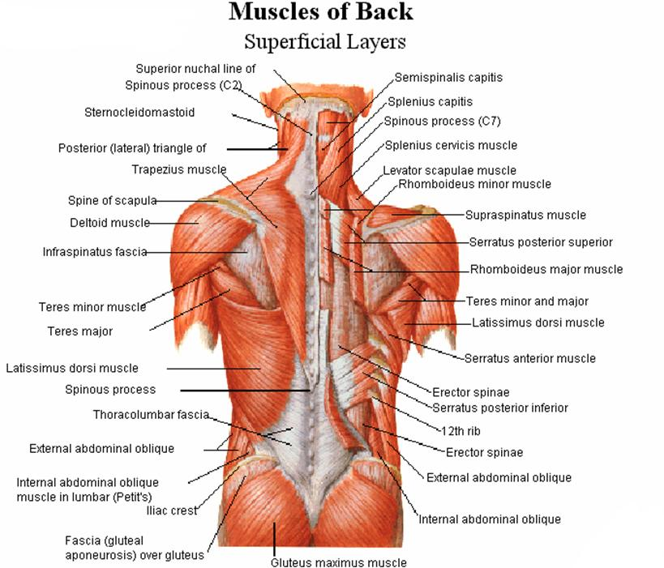
MUSCULAR TRIANGLES OF BACK
Auscultatory Triangle:
Boundaries: latissimus dorsi, trapezius, and medial border of scapula.
Site where breath sounds are most easily heard with a stethoscope.
Lumbar Triangle: (Triangle of Petit)
Boundaries : latissimus dorsi, posterior border of external oblique muscle of the abdomen, and iliac crest.
Site of an abdominal hernia; or where pus may emerge from the abdominal wall.

Slide 11
SUMMARY
BACK MUSCLES:
Deep group: attached to & moves vertebral column, supplied by posterior rami of spinal nerves.
Intermediate group: attached to & moves ribs, supplied by anterior rami of spinal nerves.
Superficial group:
- Origin: vertebral column.
- Insertion: scapula (EXCEPT latissimus dorsi: humerus).
- Action: moves scapula (EXCEPT latissimus dorsi: moves humerus).
- Nerve supply: anterior rami of spinal nerves through brachial plexus (EXCEPT trapezius: 11th cranial nerve).

Slide 12
QUESTION 1
Which one of the following muscles of back that rotates the humerus medially ?
Trapezius.
Latissimus dorsi.
Rhomboid major.
Serratus posterior superior.

Slide 13
QUESTION 2
Regarding back muscles, which one of the following statements is correct?
All back muscles are supplied by posterior rami of spinal nerves.
Muscles of intermediate group move vertebral column.
Muscles of superficial group are involved in upper limb movements.
Muscles of deep group serve respiratory functions.

Slide 14
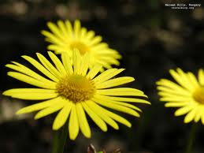
THANK YOU

