Slide 1
PELVIS & SACRUM
Dr. Jamila El-Medany
Dr. Essam Eldin Salama

Slide 2
Learning Objectives
At the end of the lecture, the students should be able to :
Describe the bony structures of the pelvis.
Describe in detail the hip bone, the sacrum, and the coccyx.
Describe the boundaries of the pelvic inlet and outlet.
Identify the structures forming the pelvic walls.
Identify the articulations of the bony pelvis.
List the major differences between the male and female pelvis.
List the different types of female pelvis.

Slide 3
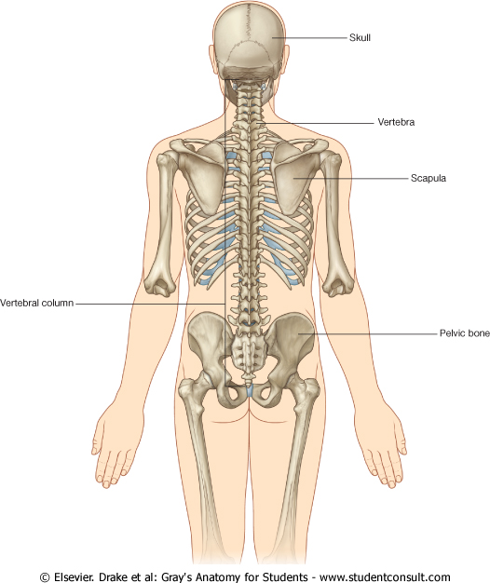
BONY PELVIS
It provides a strong, stable connection between the trunk and lower extremities.
Its Main Functions are:
Transmit the weight of the body from the vertebral column to the femurs.
Contain, support and protect the pelvic viscera.
Provide attachment to trunk and lower limb muscles.

Slide 4
Pelvic Girdle
Its bones are large & heavy.
Bearing weight is their most important function.
The total weight of the upper body rests on the pelvis.
It is composed of (4) Bones:
Two Hip Bones.
Sacrum.
Coccyx.

Slide 5
Hip Bone
It is a large irregular bone.
It is formed by the fusion of three boness:
Ilium
Ischium
Pubis.
They are joined at the deep socket (Acetabulum)

Slide 6
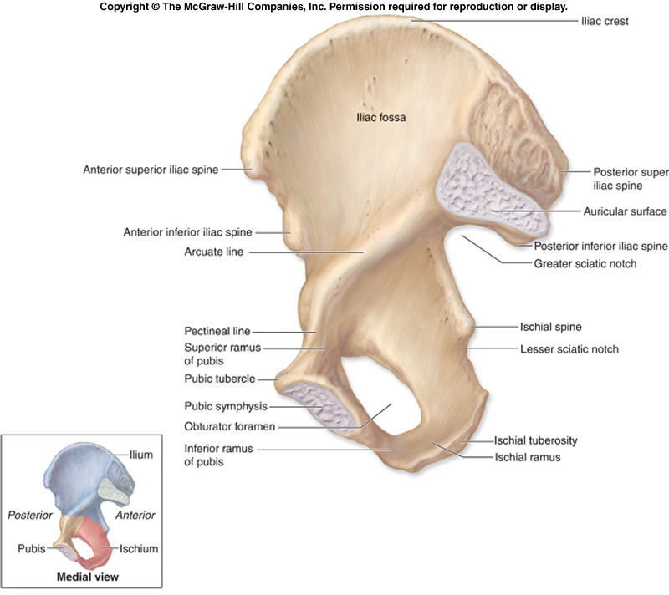
Ilium
The Upper Flattened Part of the hip bone.
It Possesses:
Iliac Crest: it is an important anatomical landmark below the waist.
It runs between the Anterior and Posterior Superior Iliac Spines.
Below are the corresponding Anterior and Posterior Inferior Iliac Spines.
The outer surface is rough and has gluteal lines.
On the inner surface:
Iliac Fossa (forms false pelvis)
Aauricular surface( for articulation with the sacrum).
Iliopectinial Line: runs Downwards &
Forwards (separates between the False & the True pelvis) .
.

Slide 7
Pubis
Forms the Anterior & inferior part.
Has :
Body; bears the Pubic Crest and Pubic Tubercle.
Two pubic Rami: Superior & Inferior, bounding the Obturator Foramen (for passage of blood vessels & nerves into the anterior part of the thigh) it is closed partially by the obturator membrane.

Slide 8
Ischium
Forms the Inferior and Posterior part.
It has:
Ischial Tuberosity:
It is a roughened area that receives body weight in sitting.
Ischial Spine:
Superior to the tuberosity, it is important especially in pregnant women.
Greater sciatic notch:
Allows sciatic nerve & vessels to pass from pelvis to thigh.
Lesser sciatic notch: allow vessels & nerves to pass from pelvis to perinium.

Slide 9
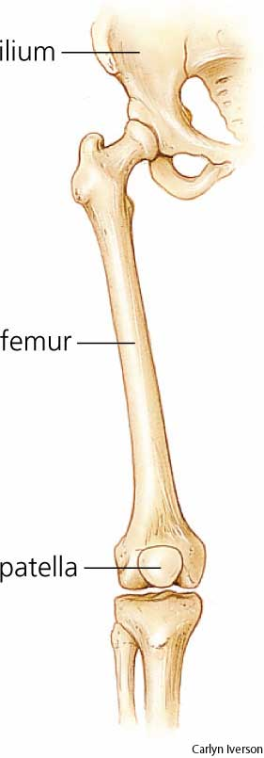
Articulations of Hip Bone
1. Symphysis Pubis:
A Cartilagenous joint between the two pubic bones
(2) Sacroiliac Joints
Strong synovial joints, between the auricular surfaces of ilium and sacrum.
Transmit the weight of the body from vertebral column to the bony pelvis.
(3) Hip Joint:
The outer surface articulates at the acetabulum with the head of femur

Slide 10
Sacrum
A Single Wedge shaped bone (consists of Five rudimentary vertebrae fused together)
Sacral Promontory:
The anterior and upper margin
It is tilted forward forming the lumbosacral angle.
The anterior and posterior surfaces possess on each side (4 ) Sacral Foramina.
The fused vertebral foramina form the Sacral Canal.
Its lower limit is the Sacral Hiatus .

Slide 11
Coccyx
Consists of (4) vertebrae fused together forming a single Triangular piece

Slide 12
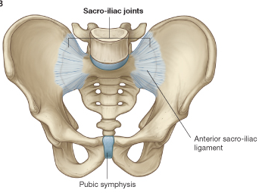
Articulations of Sacrum
Lumbsacral joint:
The upper border articulates with the 5th Lumber vertebra
Sacrococcygeal joint:
The inferior part articulates with the Coccyx
Sacroiliac joints:
Lateral with the Hip bones.

Slide 13
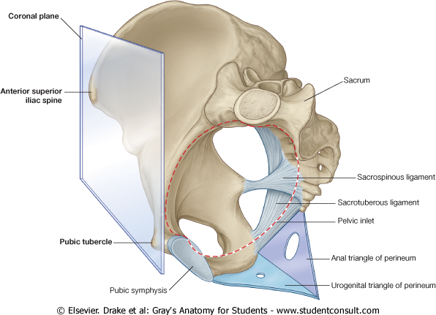
Orientation of the Pelvis
It is the Correct Position of the bony pelvis relative to the trunk:
1.The front of the Symphysis pubis and the Anterior Superior iliac spines lie in the same vertical plane.
2. The pelvic surface of the Symphysis pubis faces upward and backward.
3.The anterior surface of the Sacrum is directed forward and downward.

Slide 14
Subdivisions of the Pelvis
It is divided by the Pelvic Brim (Pelvic Inlet) into:
True pelvis.
False pelvis.

Slide 15
False pelvis
Lies superior to the pelvic brim.
Enclosed by the Fossae of the iliac bones
Forms the inferior region of the abdominal cavity.
Houses the Inferior abdominal organs

Slide 16
True Pelvis
Lies inferior to the pelvic brim.
Encloses the pelvic cavity.
Contains the pelvic organs.
It has :
Inlet
Outlet.
Pelvic walls

Slide 17
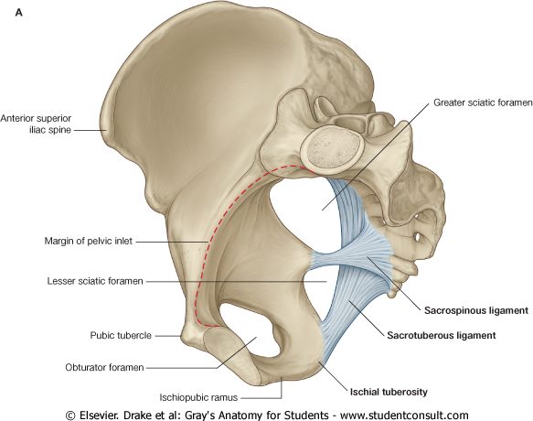
Pelvic Inlet (pelvic Brim)
Bounded by:
Sacral promontory
Iliopectineal lines.
Symphysis pubis.

Slide 18
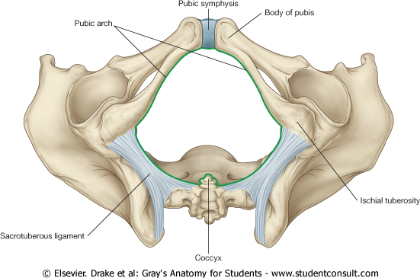
Pelvic Outlet
Bounded by:
Coccyx
Ischial tuberosities.
Pubic arches.

Slide 19
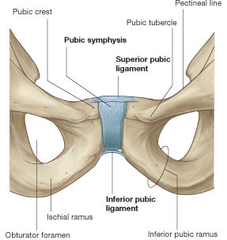
Pelvic Walls
Formed by bones and ligaments&
Lined with muscles, and covered with fascia.
Anterior Wall :
Posterior surfaces of bodies of pubic bones.
Pubic rami.
Symphysis pubis.
Posterior Wall :
Sacrum and Coccyx
Piriformis muscles, and their covering of parietal pelvic fascia

Slide 20
Lateral Pelvic Wall
Hip bone below the pelvic inlet.
Obturator membrane.
Sacrotuberus and sacrospinus ligaments.
Obturator internus muscle and the covering fascia.

Slide 21
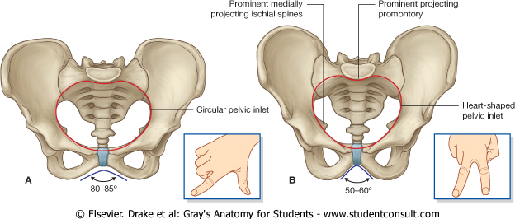
Male
Female
False pelvis | deep | shallow
Pubic arch |  | More rounded & pubic angle greater
Pelvic inlet | Heart shaped | Oval or rounded
Pelvic outlet |  | Larger
Ischial tuberosities | Turned in | Everted
Ischial spines |  | Shorter & farther apart
Pelvic cavity |  | Roomer

Slide 22
Sacrum
F
Length |  | Shorter
Breadth |  | Wider
Curvature |  | Less Curved
M

Slide 23
Male / Female Pelvis
Female
Male
Pelvic Inlet
Pelvic Outlet
Pelvic Cavity
Pubic Arch

Slide 24
Types of Obstetrical Female Pelvis
(1) Gynaecoid.
(2) Anthropoid.
(3) Android.
(4) Platypelloid.
(2)
(3)
(1)
(4)

Slide 25
Thank you

