Slide 1
ANTERIOR & MEDIAL COMPARTMENTS OF THIGH
Dr. Ahmed Fathalla Ibrahim
&
Dr. Zeenat Zaidi

Slide 2
OBJECTIVES
At the end of the lecture, students should be able to:
List the name of muscles of anterior compartment of thigh.
Describe the anatomy of muscles of anterior compartment of thigh regarding: origin, insertion, nerve supply and actions.
List the name of muscles of medial compartment of thigh.
Describe the anatomy of muscles of medial compartment of thigh regarding: origin, insertion, nerve supply and actions.

Slide 3
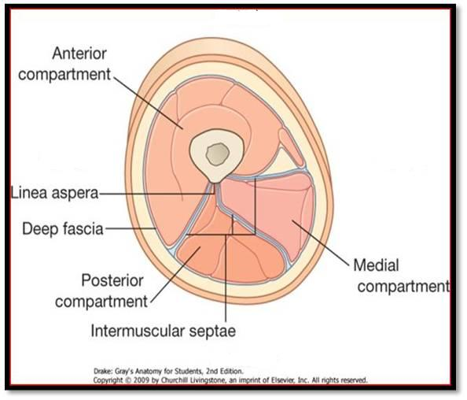
The thigh is divided into 3 compartments
by 3 intermuscular septa (extending from deep fascia into femur)

Slide 4
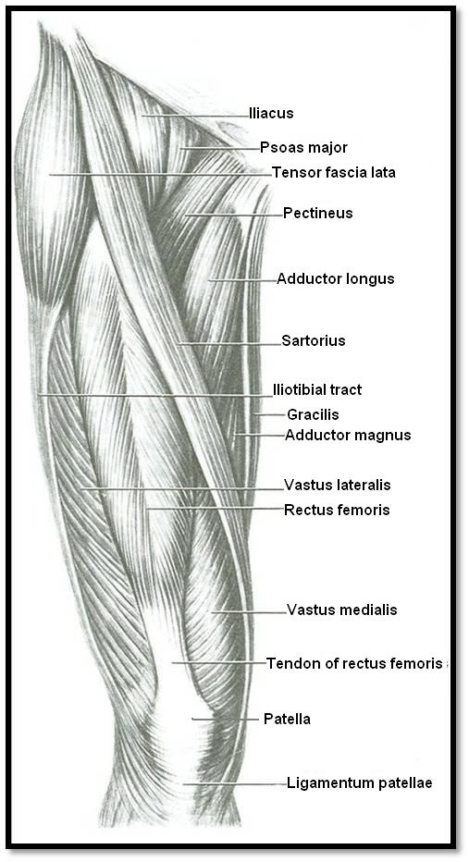
CONTENTS
Medial Compartment
Adductors of hip:
1. Adductor longus
2. Adductor brevis
3. Adductor part of
adductor magnus
4. Gracilis
Nerve supply:
Obturator nerve
Anterior Compartment
Flexors of hip:
1. Sartorius
2. Pectineus
3. psoas major
4. Iliacus
Extensors of knee:
1. Rectus femoris
2. Vastus lateralis
3. Vastus medialis
4. Vastus intermedius
(deep to rectus femoris)
Nerve supply:
Femoral nerve
4
3
2
(deep to adductor longus)
1
1
3
4
2
1
Posterior Compartment
Flexors of knee & extensors of hip:
Hamstrings
Nerve supply:
Sciatic nerve
3
These 4 muscles form the Quadriceps femoris

Slide 5
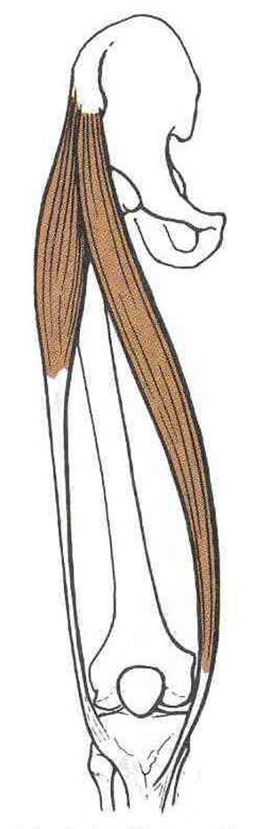
Sartorius
ORIGIN
Anterior superior iliac spine
ACTION
(TAILOR’S POSITION)
Flexion, abduction & lateral rotation of hip joint
Flexion of knee joint
S
INSERTION
Upper part of medial surface of tibia

Slide 6
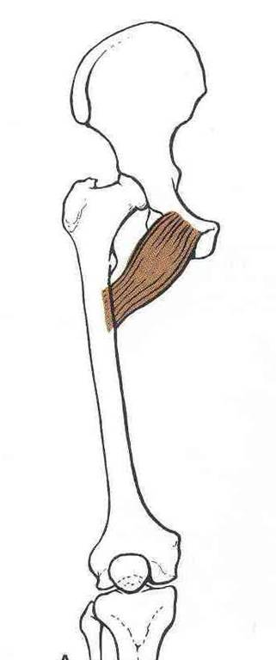
Pectineus
ACTION:
Flexion & adduction of hip joint
ORIGIN:
Superior pubic ramus
INSERTION:
Back of femur (below lesser trochanter)

Slide 7
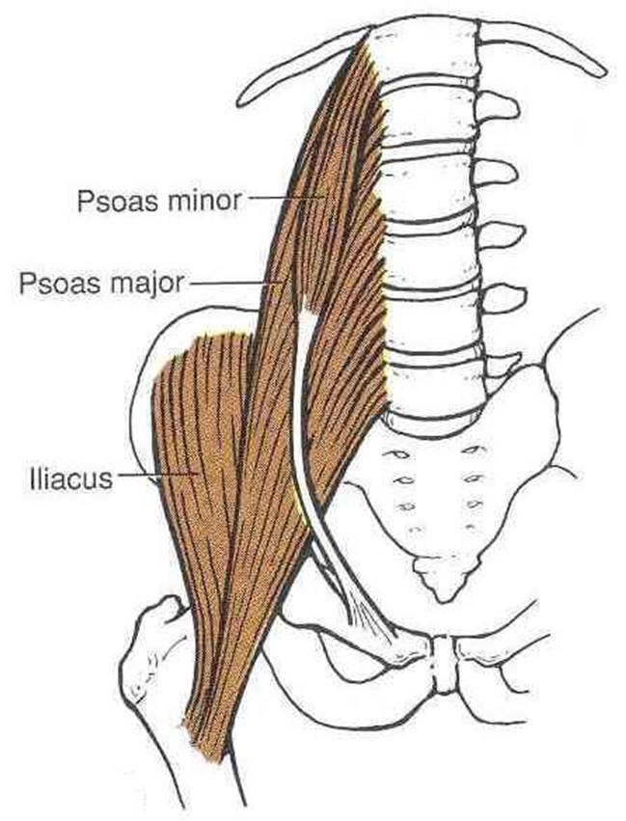
Iliacus & Psoas major (Iliopsoas)
ORIGIN:
Psoas major: T12 & lumbar vertebrae
Iliacus: Iliac fossa
ACTION:
Flexion of hip joint
INSERTION:
Lesser trochanter of femur
In less than 50 percent of humans the psoas major is accompanied by the psoas minor. When present, it is located in front of the psoas major muscle.

Slide 8
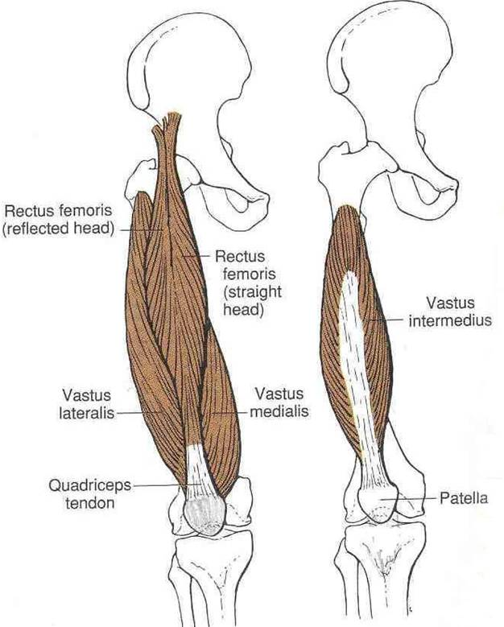
Quadriceps Femoris
ORIGIN:
Rectus femoris: Anterior inferior iliac spine
Vastus intermedius:
Front of shaft of femur
Vastus medialis:
Posterior border of femur
Vastus lateralis:
Posterior border of femur

Slide 9
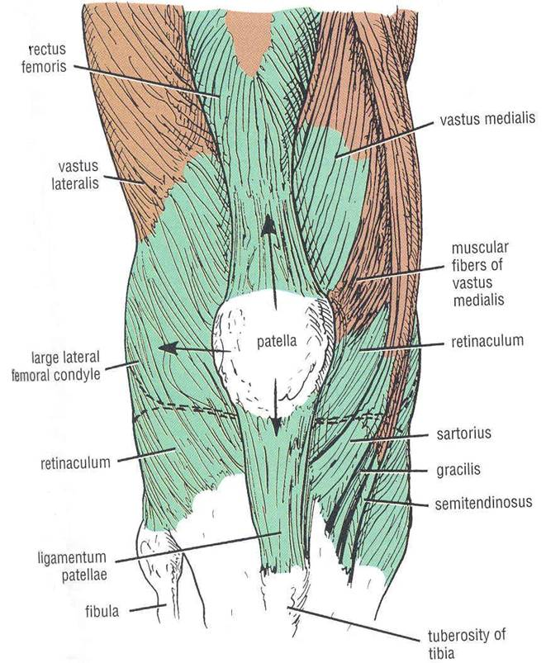
Quadriceps Femoris
INSERTION:
Into PATELLA
(Patella is a sesamoid bone)
From patella into TUBEROSITY OF TIBIA through Ligamentum Patellae (Patellar Ligament)
ACTION:
Extension of knee joint

Slide 10
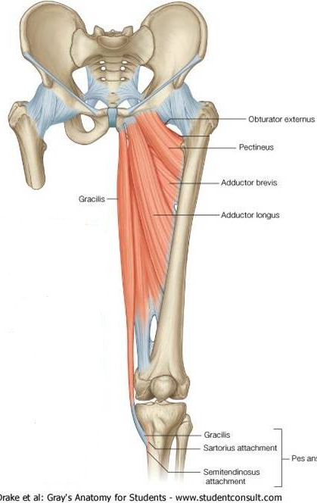
Medial Compartment of Thigh
MUSCLES:
Adductor longus
Adductor brevis
Adductor magnus (Adductor portion)
Gracilis
ACTION:
ADDUCTION OF HIP JOINT
N.B.: Gracilis also flexes knee joint
NERVE SUPPLY:
OBTURATOR NERVE
2
1
4
3
Adductor magnus
(Adductor portion)
Adductor magnus
(Hamstring portions)

Slide 11
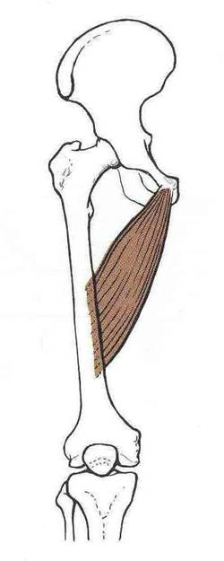
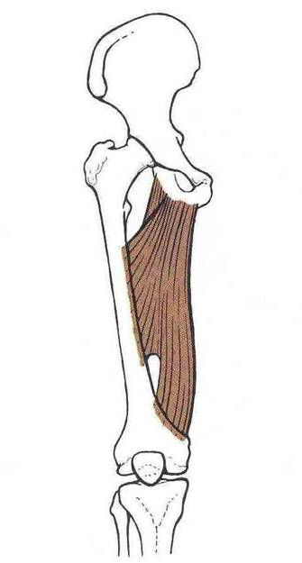
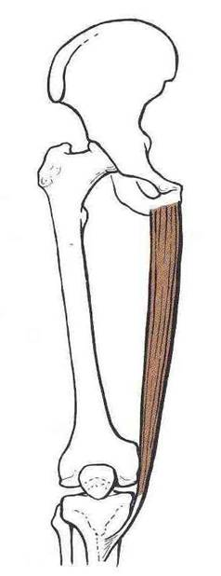
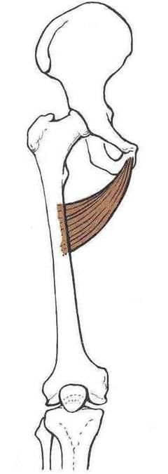
Origin
Inferior pubic ramus
Ischial ramus
Body of pubis
Body of pubis
Inferior pubic ramus
Adductor magnus
(adductor portion)
Gracilis
Adductor longus
Adductor brevis
Insertion
Upper part of medial
surface of tibia
(behind sartorius)
Posterior border of femur (Linea Aspera)

Slide 12
Thank You

