Slide 1
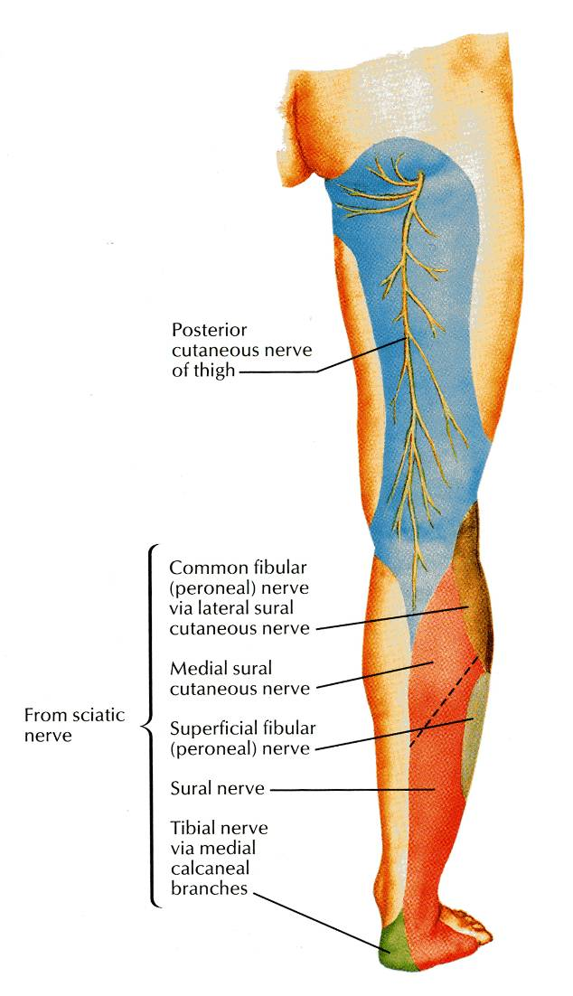
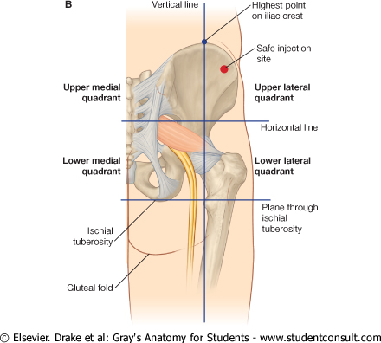
GLUTEAL REGION & BACK OF THIGH

Slide 2
OBJECTIVES
At the end of this lecture, the student should be able to identify :
Contents of gluteal region:
Groups of Glutei muscles and small muscles (Lateral Rotators).
Nerves & vessels.
Foramina : 1-Greater Sciatic Foramen.
2-Lesser Sciatic Foramen.
Back of thigh : Hamstring muscles.

Slide 3
CONTENTS
I - Muscles:
A- GLUTEI:
Gluteus maximus
Gluteus medius
Gluteus minimus
B- GROUP OF SMALL MUSCLES (Lateral Rotators) :
Piriformis
Obturator internus
Superior gemellus
Inferior gemellus
Quadratus femoris

Slide 4
CONTENTS
II – NERVES:
(all from sacral plexus):
Sciatic nerve.
Superior gluteal n.
Inferior gluteal n.
Post. cutaneous n. of thigh.
Nerve to obturator internus.
Nerve to quadratus femoris.
Pudendal nerve.

Slide 5
CONTENTS
III - VESSELS:
(all from internal iliac vessels):
Superior gluteal
Inferior gluteal
Internal pudendal vessels.

Slide 6
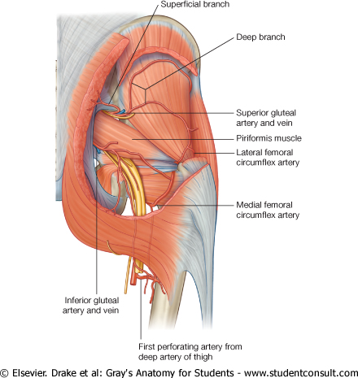
Greater sciatic foramen
Greater sciatic notch of hip bone is transformed into foramen by sacrotuberous & sacrospinous ligaments.
Structures passing through Greater sciatic foramen :
Piriformis muscle.
Above piriformis :
Superior gluteal nerves & vessels.
Below piriformis :
Inferior gluteal nerves & vessels.
Sciatic nerve.
Posterior cutaneous nerve of thigh.
Nerve to quadratus femoris.
Nerve to obturator internus.
Pudendal N.
Internal pudendal vessels.

Slide 7
Lesser sciatic foramen :
Lesser sciatic notch of hip bone is transformed into foramen by Sacrotuberous & sacrospinous ligaments.
Structures passing through Lesser sciatic foramen :
Tendon of obturator internus.
Nerve to obturator internus.
Pudendal nerve.
Internal pudendal vessels.

Slide 8
Glutei Muscles
ORIGINS
Gluteus minimus:
Anterior part of the gluteal surface of ilium
Gluteus medius:
Middle part of the gluteal surface of ilium,
Gluteus maximus:
Posterior part of the gluteal surface of ilium,
Main origin:
Back of sacrum & coccyx & back of Sacrotuberous ligament

Slide 9
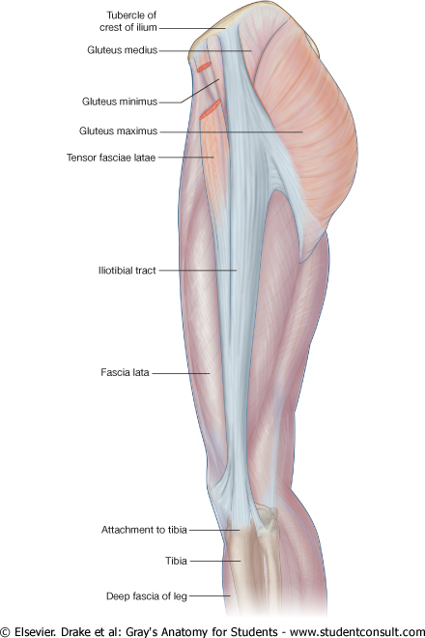
Glutei
Insertion:
Gluteus minimus: anterior surface of the greater trochanter
Gluteus medius: lateral surface of the greater trochanter
Gluteus maximus:
Main insertion: iliotibial tract
Other insertion: gluteal tuberosity of the femur.

Slide 10
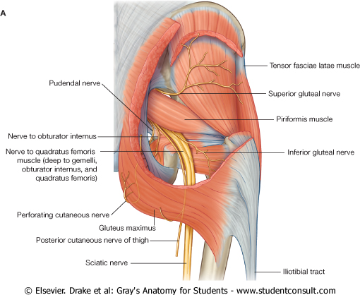
NERVE SUPPLY & ACTION
Gluteus medius & minimus:
Nerve supply:
Superior gluteal nerve.
Action:
abduction & medial rotation of hip joint.
Also they prevent tilt of the pelvis on raising the other injured limb from ground.
Gluteus maximus:
Nerve supply:
Inferior gluteal nerve.
Action:
Extension & lateral rotation of the hip joint.
Through its attachment to iliotibial tract, it stabilizes the femur on tibia during standing.

Slide 11
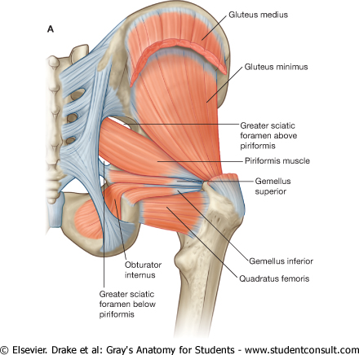
Small muscles (Lateral Rotators)
Obturator Internus:
Origin:
Inner surface of the side wall of the pelvis.
Insertion:
Into the medial surface of the greater trochanter.
Nerve supply:
Nerve to obturator internus.
Superior & Inferior Gemelli:
Origin:
Superior gemellus;
upper part of lesser sciatic notch.
Inferior gemellus:
lower part of lesser sciatic notch.
Insertion:
Upper & lower parts into tendon of obturator internus.
Nerve supply:
Superior gemellus: nerve to obturator internus
Inferior gemellus: nerve to quadratus femoris.

Slide 12
Small muscles (Lateral Rotators)
Piriformis:
Origin:
Pelvic surface of middle 3 sacral vertebrae.
Insertion:
It passes through GSF to be inserted into the upper border of the greater trochanter.
Nerve supply:
Anterior rami of S1,2
Quadratus femoris:
Origin:
Lateral border of the ischial tuberosity.
Insertion:
Quadrate tubercle & intertrochanteric crest.
Nerve supply:
Nerve to quadratus femoris.
Action: all have SIMILAR ACTION:
Lateral rotation of the hip joint.
Control movement of the hip joint.

Slide 13
NERVES
SUPERIOR GLUTEAL:
Course:
Passes through GSF, above piriformis, then between gluteus medius & minimus
Branches:
Muscular to gluteus medius, minimus & tensor fasciae lata
Articular to hip joint
INFERIOR GLUTERAL:
Course:
passes through GSF, below piriformis, then deep to gluteus maximus
Branches: muscular to gluteus maximus
NERVE TO QUADRATUS FEMORIS:
Course:
passes through GSF, below piriformis
Branches:
Muscular to quadratus femoris & inferior gemellus
Articular to hip joint

Slide 14
POSTERIOR CUTANEOUS NERVE OT THIGH :
Course:
Passes through GSF, below piriformis, then descends deep to deep fascia.
Branches:
Cutaneous branches to: gluteal region, back of scrotum (labium majus) back of thigh & upper part of back of leg.
SCIATIC :
Course:
passes through GSF, below piriformis, then superficial to: ischial spine, superior gemellus, tendon of obturator internus, inferior gemellus, quadratus femoris & adductor magnus.
Branches:
No branches in gluteal region,
Divides into tibial & common peroneal nerves, in the middle of back of thigh
NERVES

Slide 15
POSTERIOR COMPARTMENT OF THE THIGH
CONTENTS
Muscles:
Hamstring muscles:
Biceps femoris.
Semitendinosus.
Semimembranosus.
Ischial part of adductor magnus.
Blood supply:
Branches of the profunda femoris artery.
Nerve supply:
Sciatic nerve.

Slide 16
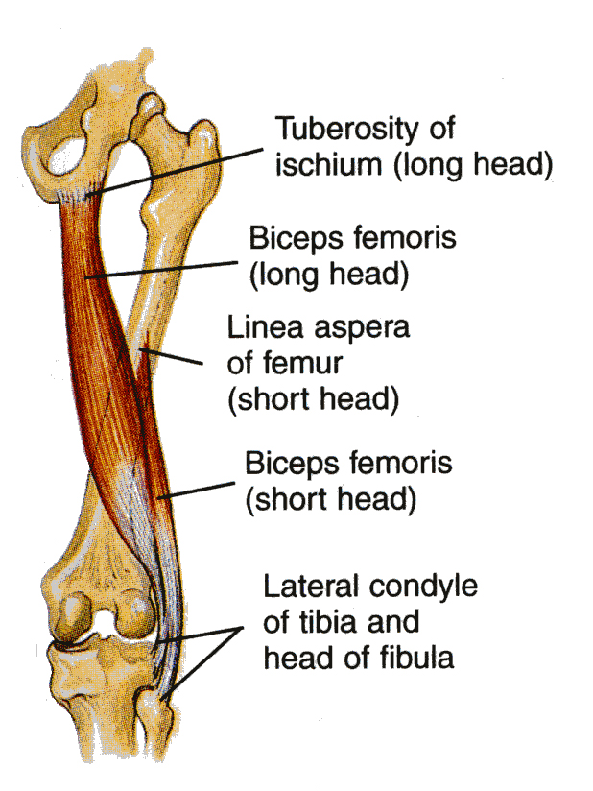
MUSCLES
Biceps Femoris
Origin:
The long head from the ischial tuberosity.
The short head from the linea aspera .
Insertion:
Into the head of the fibula.
Nerve supply:
The long head is supplied by the tibial part of the sciatic;
the short head is supplied by the common peroneal part of the sciatic.
Action :
Flexion of knee.
Lateral rotation of flexed leg.
Long head: extends hip.

Slide 17
SEMITENDINOSUS
Origin:
Ischial tuberosity.
Insertion:
Upper part of the medial surface of the shaft of the tibia (SGS)..
Nerve supply:
Tibial portion of the sciatic.
Action:
Flexes and medially rotates the leg at the knee joint;
Extends the thigh at the hip joint.

Slide 18
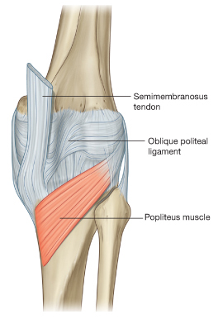
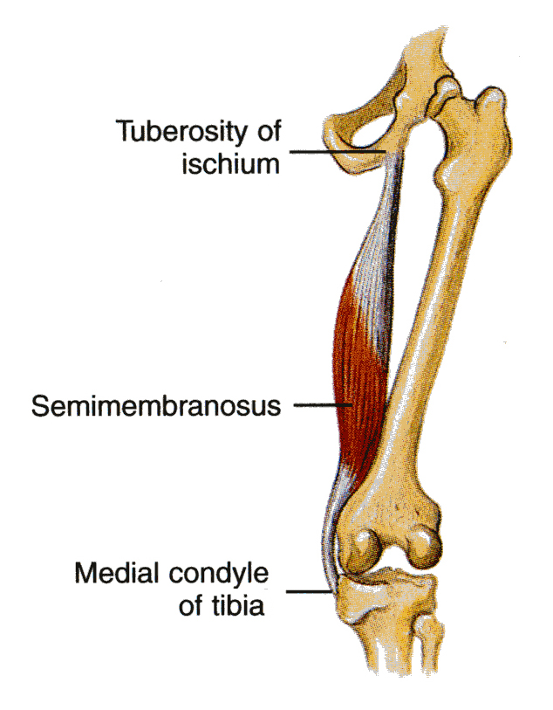
SEMIMEMBRANOSUS
Origin:
Ischial tuberosity.
Insertion:
Posterior surface of the medial condyle of the tibia.
It forms the oblique popliteal ligament, which reinforces the capsule on the back of the knee joint.
Nerve supply:
Tibial portion of the sciatic nerve.
Action:
Flexes and medially rotates the leg at the knee joint;
Extends the thigh at the hip.

Slide 19
ADDUCTOR MAGNUS (HAMSTRING PART)
Origin:
Ischial ramus and ischial tuberosity
Insertion:
Adductor tubercle of the medial condyle of the femur.
Nerve supply:
The tibial portion of the sciatic.
Action:
Extends the thigh at the hip joint.

Slide 20
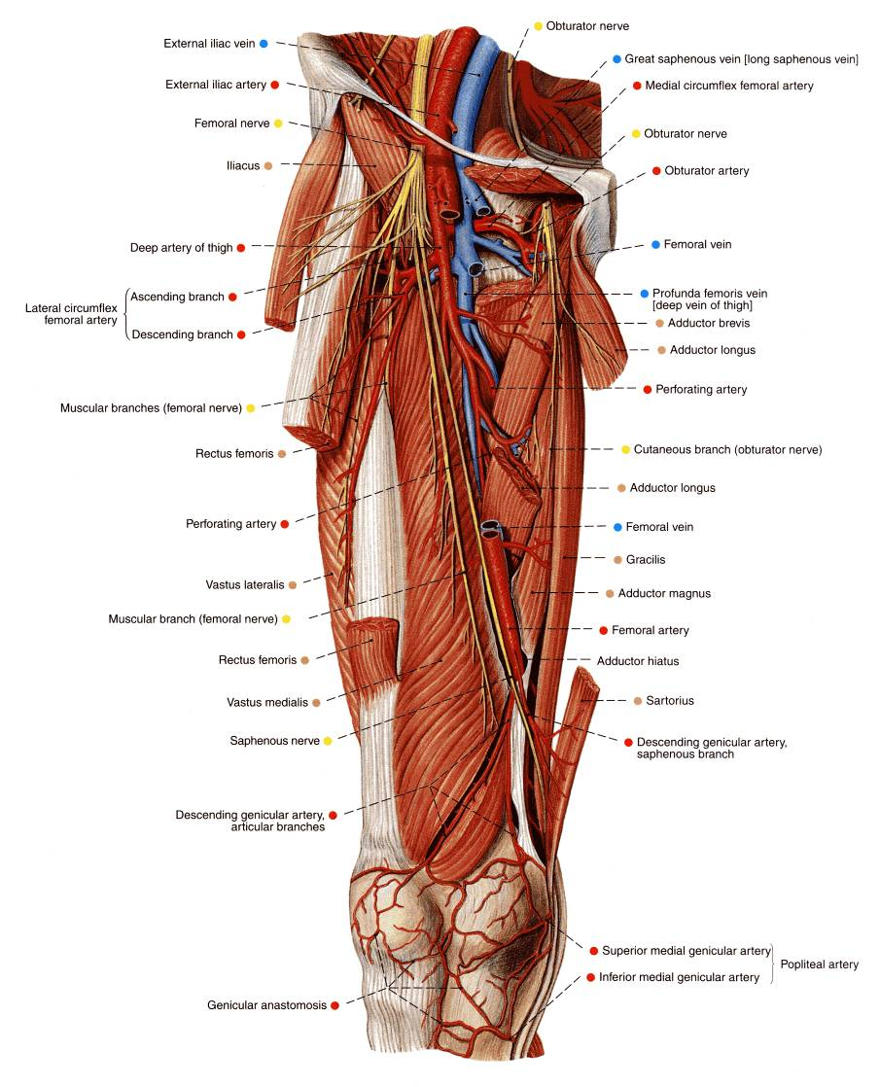
BLOOD SUPPLY
The four perforating branches of the profunda femoris artery provide a rich blood supply to this compartment.
The profunda femoris vein drains the greater part of the blood from the compartment.

Slide 21
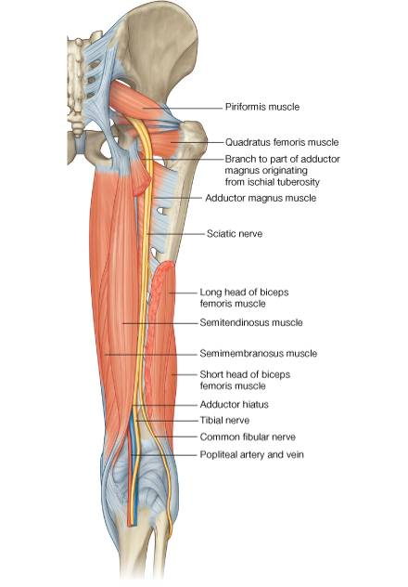
NERVE SUPPLY
Sciatic Nerve
The sciatic nerve, a branch of the sacral plexus (L4 and 5; S1, 2, and 3), leaves the gluteal region as it descends in the midline of the thigh.
It is overlapped posteriorly by the adjacent margins of the biceps femoris and semimembranosus muscles.
It lies on the posterior aspect of the adductor magnus.
In the lower third of the thigh it ends by dividing into the tibial and common peroneal nerves.

Slide 22
THANK YOU

