Slide 1
Hip, Knee & Ankle Joints
Dr. Ahmed Fathalla Ibrahim
&
Dr. Zeenat Zaidi

Slide 2
OBJECTIVES
At the end of the lecture, students should be able to:
List the type & articular surfaces of the hip, knee and ankle joints.
Describe the capsule and ligaments of the hip, knee and ankle joints.
Describe movements of hip, knee and ankle joints and list the muscles involved in these movements.
List important bursae in relation to knee joint.
Apply Hilton’s law about nerve supply of joints.

Slide 3
HIP JOINT

Slide 4
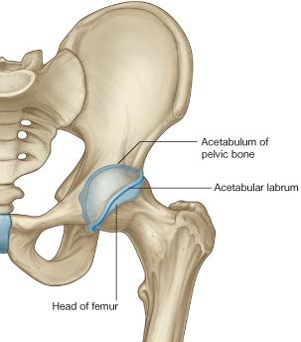
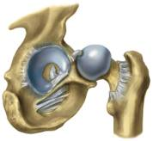
Type & Articular Surfaces
TYPE:
Synovial, ball & socket joint.
ARTICULAR SURFACES:
Acetabulum of hip (pelvic) bone
Head of femur
Acetabular labrum: c-shaped fibro-cartilaginous collar attached to margins of acetabulum, increases its depth for better retaining of head of femur.
Acetabular labrum

Slide 5
Ligaments: 3 Extracapsular
Iliofemoral ligament:
Y-shaped
Located anterior to joint
limits extension
Intertrochanteric line
Pubofemoral ligament:
Located antero-inferior to joint
limits abduction & lateral rotation
Ischiofemoral ligament:
Located posterior to joint
limits medial rotation

Slide 6
Ligaments: 2 Intracapsular
Transverse acetabular ligament: converts acetabular notch into foramen through which pass acetabular vessels
Ligament of femoral head: carries vessels to head of femur

Slide 7
Movements
Flexion: Iliopsoas (mainly), sartorius, pectineus, rectus femoris.
Extension: Hamstrings (mainly), gluteus maximus (powerful extensor).
Abduction: Gluteus medius & minimus, sartorius.
Adduction: Adductors, gracilis.
Medial rotation: Gluteus medius & minimus.
Lateral rotation: Gluteus maximus, quadratus femoris, piriformis, obturator externus & internus.

Slide 8
KNEE JOINT

Slide 9
Type & Articular Surfaces
Knee joint is formed of:
Three bones.
Three articulations.
Femoro-tibial articulation: between the 2 femoral condyles & upper surfaces of the 2 tibial condyles (Type: synovial, modified hinge).
Femoro-patellar articulation: between posterior surface of patella & patellar surface of femur (Type: synovial, plane).

Slide 10
Menisci
They are 2 C-shaped plates of fibro-cartilage attached by anterior & posterior horns, to the articular surface of tibia.
FUNCTION:
They deepen articular surfaces of tibial condyles.
They serve as cushions between tibia & femur.
The lateral meniscus is small & circular.
Its outer border is separated from lateral collateral ligament by popliteal tendon.
The medial meniscus is large & oval.
Its outer border is attached to the capsule & medial collateral ligament.
medial meniscus is less mobile & more liable to be injured.

Slide 11
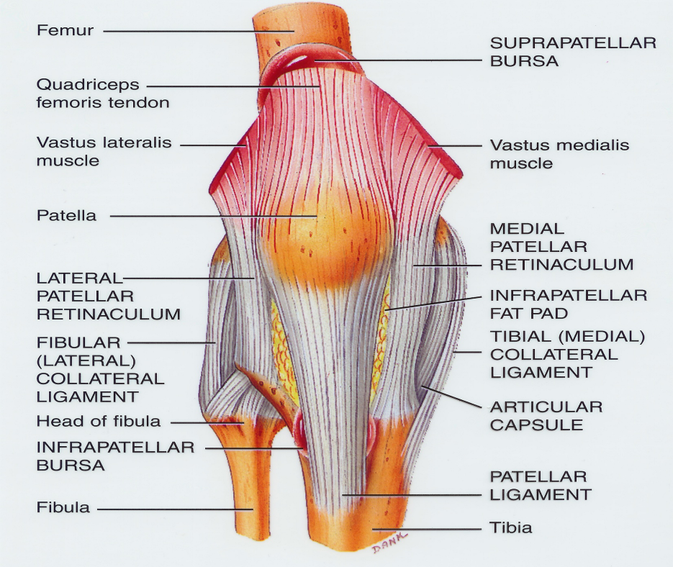
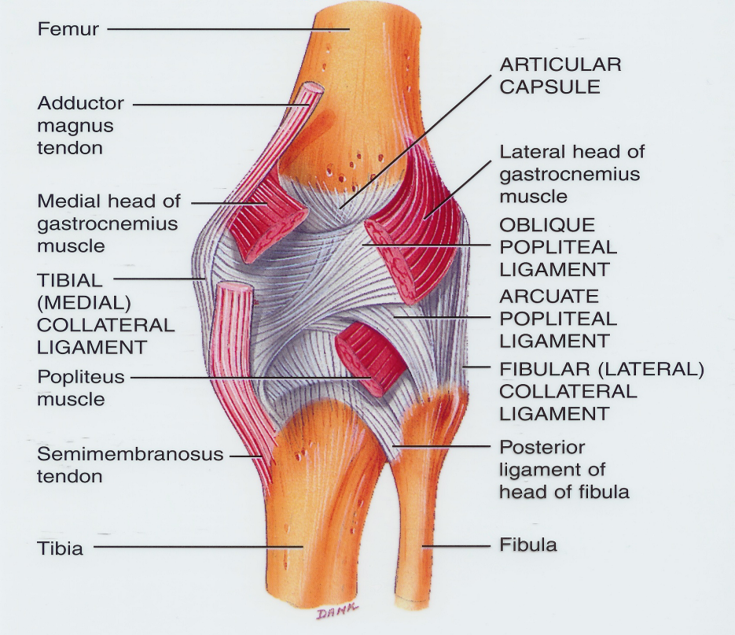
Capsule
Is deficient anteriorly & is replaced by: quadriceps femoris tendon, patella & ligamentum patellae.
Possesses 2 openings: one for popliteus tendon & one for communication with suprapatellar bursa.

Slide 12
Ligaments: 4 Extracapsular
Ligamentum patellae (patellar ligament): from patella to tibial tuberosity.
Medial (tibial) collateral ligament: from medial epicondyle of femur to upper part of medial surface of tibia (firmly attached to medial meniscus).
Lateral (fibular) collateral ligament: from lateral epicondyle of femur to head of fibula (separated from lateral meniscus by popliteus tendon).
Oblique popliteal ligament: extension of semimembranosus tendon.

Slide 13
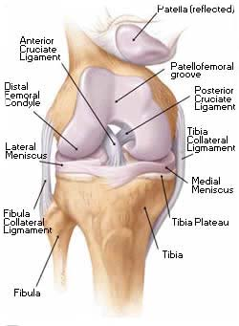
Ligaments: 2 Intracapsular
The Cruciate Ligaments:
Two in number, situated in the middle of the joint.
They are called cruciate because they cross each other
Have received the names anterior and posterior, from the position of their attachments to the tibia.
Anterior cruciate ligament:
Extends from anterior part of intercondylar area of tibia to posterior part of lateral condyle of femur.
Prevents posterior displacement of femur on tibia.
Posterior cruciate ligament:
Extends from posterior part of intercondylar area of tibia to anterior part of medial condyle of femur.
Prevents anterior displacement of femur on tibia.

Slide 14
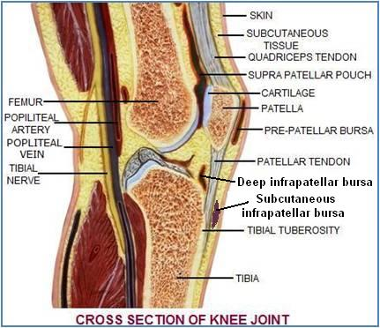
Bursae Related to Knee
Suprapatellar bursa: between femur & quadriceps tendon, communicates with synovial membrane of knee joint (Clinical importance?)
Prepatellar bursa: between patella & skin.
Deep infrapatellar bursa: between tibia & ligamentum patella.
Subcutaneous infrapatellar bursa: between tibial tuberosity & skin.
Popliteal bursa (not shown): between popliteus tendon & capsule, communicates with synovial membrane of knee joint.

Slide 15
Movements
FLEXION:
Mainly by hamstring muscles: biceps femoris , semitendinosus & semimembranosus.
Assisted by sartorius , gracilis & popliteus.
EXTENSION:
Quadriceps femoris.
ACTIVE ROTATION (PERFORMED WHEN KNEE IS FLEXED):
A) MEDIAL ROTATION:
Mainly by semitendinosus & semimembranosus.
Assisted by sartorius & gracilis.
B) LATERAL ROTATION:
Biceps femoris.

Slide 16
Movements (cont’d)
INACTIVE (DEPENDANT) ROTATION:
A) LOCKING OF KNEE:
Lateral rotation of tibia, at the end of extension
Results mainly by tension of anterior cruciate ligament.
In locked knee, all ligaments become tight.
B) UNLOCKING OF KNEE:
Medial rotation of tibia, at the beginning of flexion.
Performed by popliteus to relax ligaments & allow easy flexion.

Slide 17
X-ray Image of Knee joint
Anterior view
Lateral view

Slide 18
ANKLE JOINT

Slide 19
Skeleton of Foot

Slide 20
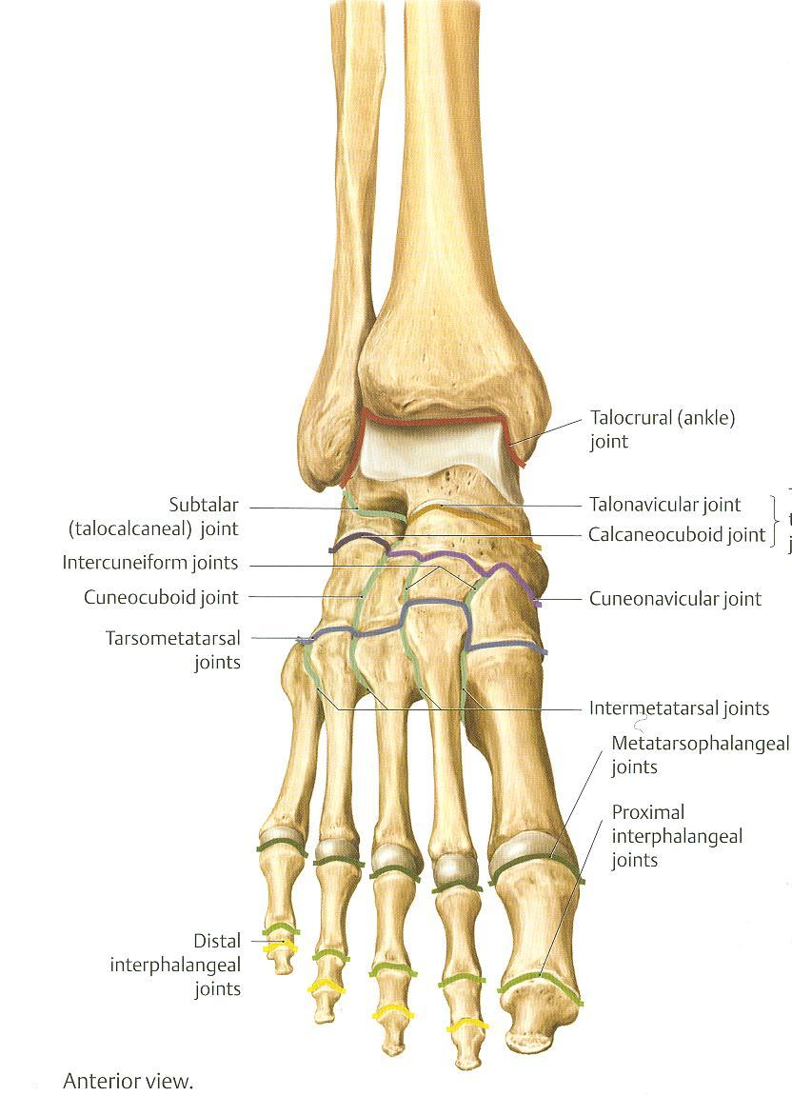
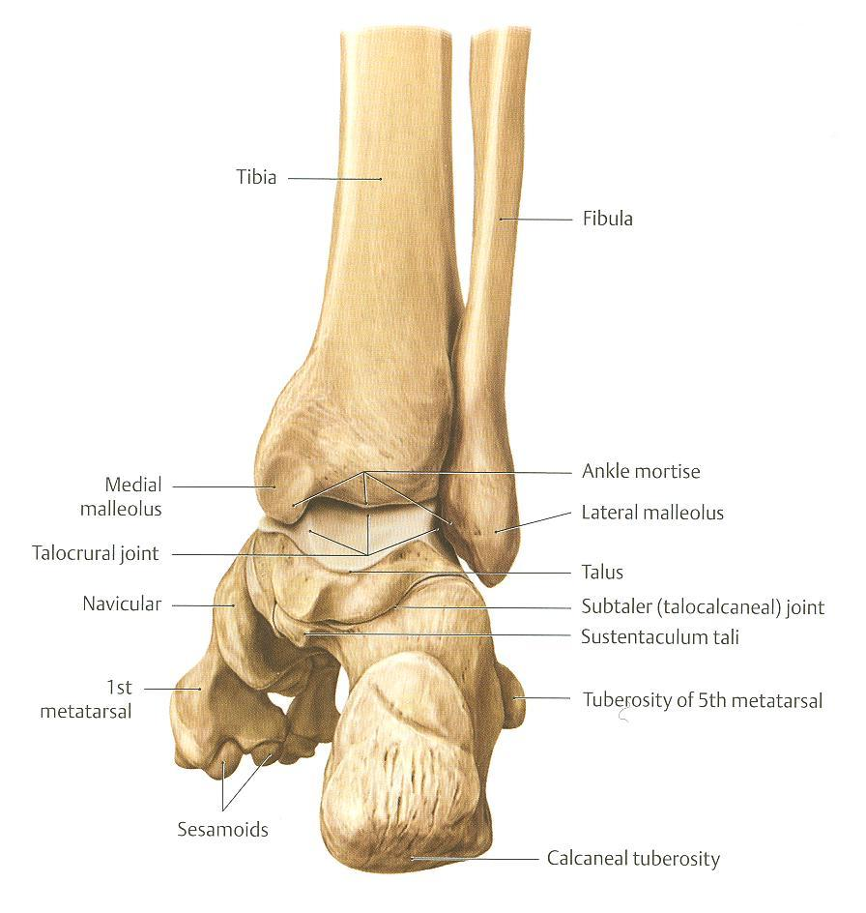
Type & Articular Surfaces
TYPE: synovial, hinge joint.
ARTICULAR SURFACES:
UPPER:
A socket formed by: Lateral malleolus. the lower end of tibia & medial malleolus.
LOWER:
Body of talus.

Slide 21
Ligaments
MEDIAL (DELTOID) LIGAMENT:
A strong triangular ligament.
Apex: attached to medial malleolus.
Base: subdivided into 4 parts:
Anterior tibiotalar part.
Tibionavicular part.
Tibiocalcaneal part.
Posterior tibiotalar part.
LATERAL LIGAMENT:
Composed of 3 separate ligaments (WHY?).
Anterior talofibular ligament.
Calcaneofibular ligament.
Posterior talofibular ligament.

Slide 22
Movements
DORSIFLEXION:
Performed by muscles of anterior compartment of leg (tibialis anterior, extensor hallucis longus, extensor digitorum longus & peroneus tertius).
PLANTERFLEXION:
Initiated by soleus.
Maintained by gastrocnemius.
Assisted by other muscles in posterior compartment of leg (tibialis posterior, flexor digitorum longus & flexor hallucis longus) + muscles of lateral compartment of leg (peroneus longus & peroneus brevis).
INVERSION & EVERSION MOVEMENTS occur on the talo-calcaneo-navicular joint (Not on ankle joint).

Slide 23
Nerve Supply
REMEMBER HILTON’S LAW:
“The joint is supplied by branches from nerves supplying muscles acting on it”.

