Slide 1
Sunday 30/1/1433 (25/12/2011)
8-9 Anatomy of shoulder
9-10 Arm & elbow
10-11 Physiology
11-12 Forearm
1-2 Hand

Slide 2
Axillary & Median Nerves
Prof. Saeed Makarem & Dr. Zeenat Zaidi

Slide 3
Objectives
At the end of the lecture, students should be able to:
Describe the origin, course, relations, branches and distribution of the axillary & median nerves
Describe the common causes and affects of injury to the axillary and median nerves

Slide 4
Brachial plexus

Slide 5
Axillary Nerve
Origin: (C 5 & 6).
Posterior cord of brachial plexus
Course:
It passes inferiorly and laterally along the posterior wall to exit the axilla
Then, it passes posteriorly around the surgical neck of the humerus.
It is accompanied by the posterior circumflex humeral artery.
Branches:
Motor to the deltoid and teres minor muscles.
Sensory: superior lateral cutaneous nerve of arm that loops around the posterior margin of the deltoid muscle to innervate skin in that region.

Slide 6
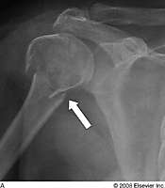
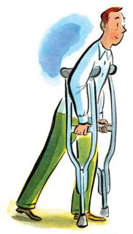
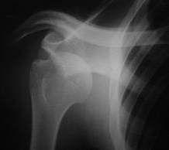
Axillary Nerve Lesion
1
The axillary nerve is usually injured due to:
Fracture of surgical neck of the humerus.
Downward dislocation of the shoulder joint
Compression. from the incorrect use of crutches.
3
2

Slide 7
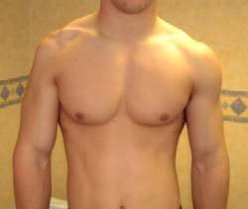
Axillary Nerve Lesion
Affects:
Motor:
Paralysis of the deltoid and teres minor muscles.
Impaired abduction of the shoulder (30-90˚).
The paralyzed deltoid wastes rapidly.
As the deltoid atrophies, the rounded contour of the shoulder is flattened compared to the uninjured side.
Sensory: Loss of sensation over the lateral side of the proximal part of the arm.

Slide 8
Median Nerve
(C5,6,7, 8, T1)
The median nerve is formed anterior to the third part of the axillary artery by the union of lateral and medial roots originating from the lateral and medial cords of the brachial plexus.

Slide 9
Median Nerve in the Arm
It enters the arm from the axilla at the inferior margin of the teres major muscle.
It passes vertically down the medial side of the arm in the anterior compartment and is related to the brachial artery throughout its course:
in proximal regions, it lies immediately lateral to the brachial artery;
in more distal regions it crosses to the medial side of the brachial artery and lies anterior to the elbow joint.
The median nerve has no major branches in the arm, but a branch to one of the muscles of the forearm, the pronator teres muscle, may originate from the nerve immediately proxim to the elbow joint.

Slide 10
Median Nerve in the Forearm
Median nerve passes into the forearm anterior to elbow joint, where branches innervate most of the muscles in the anterior compartment of the forearm (except for the flexor carpi ulnaris muscle and the medial half of the flexor digitorum profundus, which are innervated by the ulnar nerve).

Slide 11
Median Nerve in the Hand
The median nerve continues into the hand by passing deep to the flexor retinaculum.
It innervates:
Three thenar muscles associated with the thumb
Lateral 2 lumbrical muscles associated with movement of the index and middle fingers; and
Skin over the palmar surface of the lateral three and one-half digits and over the lateral side of the palm and middle of the wrist.

Slide 12
Median Nerve Lesion
Injury of median nerve at different levels cause different syndromes.
In the arm and forearm the median nerve is usually not injured by trauma because of its relatively deep position.
Median nerve can be damaged:
In the elbow region
At the wrist above the flexor retinaculum
In the carpal tunnel

Slide 13
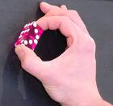
The most serious disability of median nerve injuries is the:
Loss of opposition of the thumb. The delicate pincer-like action is not possible
Loss of sensation from the thumb and lateral 2½ fingers & lateral ⅔ of the palm

Slide 14
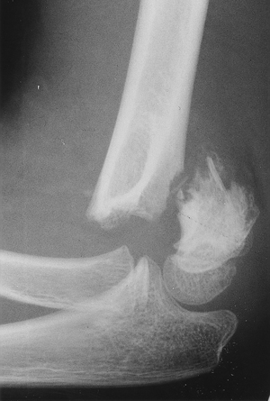
Median Nerve Lesion in the Elbow Region
Damaged in supracondylar fracture of humerus
Muscles affected are:
Pronator muscles of the forearm
All long flexors of the wrist and fingers except flexor carpi ulnaris and medial half of flexor digitorum profundus

Slide 15
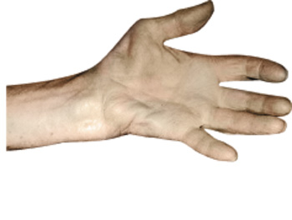
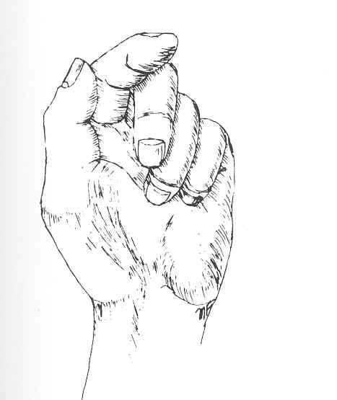
Motor Effects:
Loss of pronation. Hand is kept in supine position
Wrist shows weak flexion, and ulnar deviation
Loss of flexion on the interphalangeal joints of the index and middle fingers
Weak flexion of ring and little finger
Thumb is adducted and laterally rotated, with loss of flexion of terminal phalanx and loss of opposition
Wasting of thenar eminence
Hand looks flattened and “apelike”, and presents an inability to flex the three most radial digits when asked to make a fist.
Wasting of thenar eminence

Slide 16
Sensory Effects: Loss of sensation from:
The radial side of the palm
Palmer aspect of the lateral 3½ fingers
Distal part of the dorsal surface of the lateral 3½ fingers
Trophic Changes:
Dry and scaly skin
Easily cracking nails
Atrophy of the pulp of the fingers

Slide 17
Median Nerve Lesion at the Wrist
Often injured by penetrating wounds (stab wounds or broken glass) of the forearm.
Motor:
Thenar muscles are paralyzed and atrophy in time so that the thenar eminence becomes flattened
Opposition and abduction of thumb are lost, and thumb and lateral two fingers are arrested in adduction and hyperextension position. “Apelike hand”
Sensory & trophic changes are the same as in the elbow region injuries

Slide 18
Carpal Tunnel Syndrome
The commonest neurological problem associated with the median nerve is compression beneath the flexor retinaculum at the wrist
Motor: Weak motor function of thumb, index & middle finger
Sensory: Burning pain or ‘pins and needles’ along the distribution of median nerve to lateral 3½ fingers
No sensory changes over the palm as the palmer cutaneous branch is given before the median nerve enters the carpal tunnel

Slide 19
Summary
Median Nerve
Origin: Medial and lateral cords
Spinal segments: (C5), C6 to T1
Function:
Motor All muscles in the anterior compartment of the forearm (except flexor carpi ulnaris and medial half of flexor digitorum profundus), three thenar muscles of the thumb and two lateral lumbrical muscles
Sensory Skin over the palmar surface of the lateral three and one-half digits and over the lateral side of the palm and middle of the wrist
Axillary Nerve
Origin: Posterior cord
Spinal segments: C5, C6
Function:
Motor: Deltoid, teres minor
Sensory: Skin over upper lateral part of arm

Slide 20
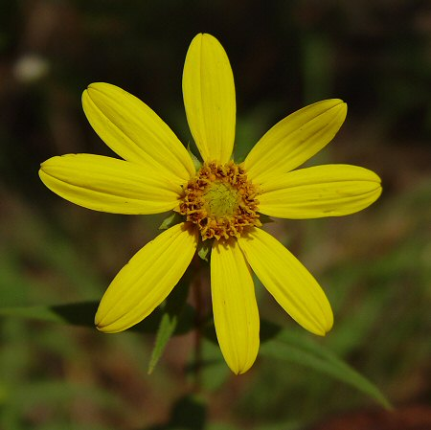
Thank U
&
Good Luck

