Slide 1
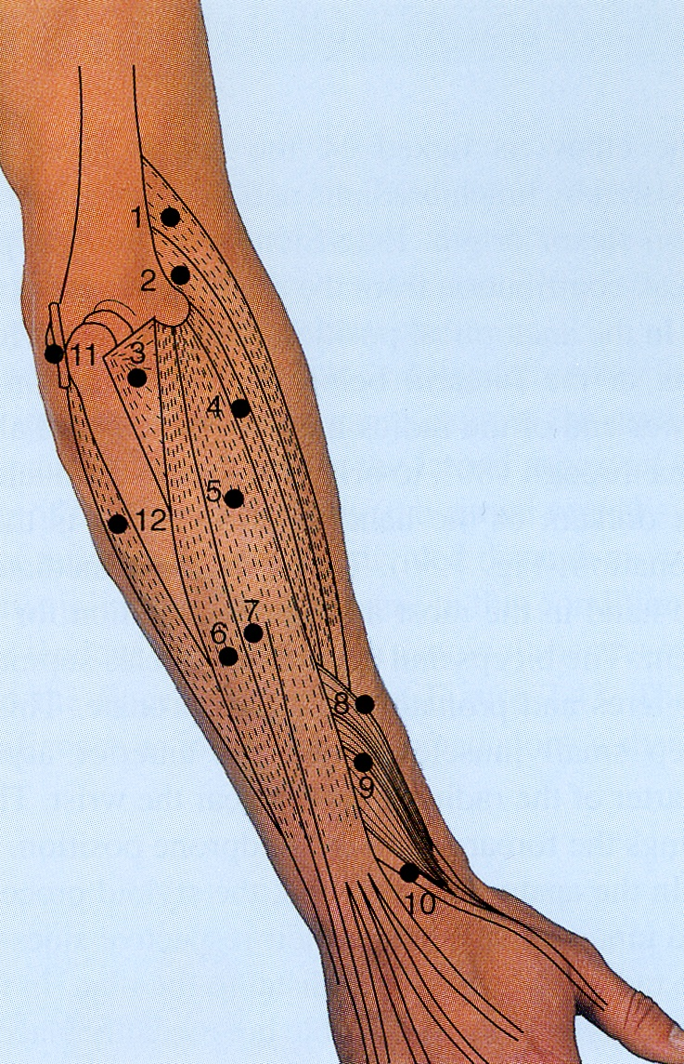
FOREARM
By :
Dr. Sanaa Al-Sharawy
Prof. Saeed Abuel Makarem

Slide 2
The forearm extends from elbow to wrist.
It posses two bones radius laterally & Ulna medially.
The two bones are connected together by the interosseous membrane.
This membrane allows movement of Pronation and Supination while the two bones are connected together.
Also it gives origin for the deep muscles.

Slide 3
The forearm is enclosed in a sheath of deep fascia, which is attached to the posterior border of the ulna .
This fascial sheath, together with the interosseous membrane & fibrous intermuscular septa, divides the forearm into several compartments, each having its own muscles, nerves, and blood supply.
Fascial Compartments of the Forearm

Slide 4
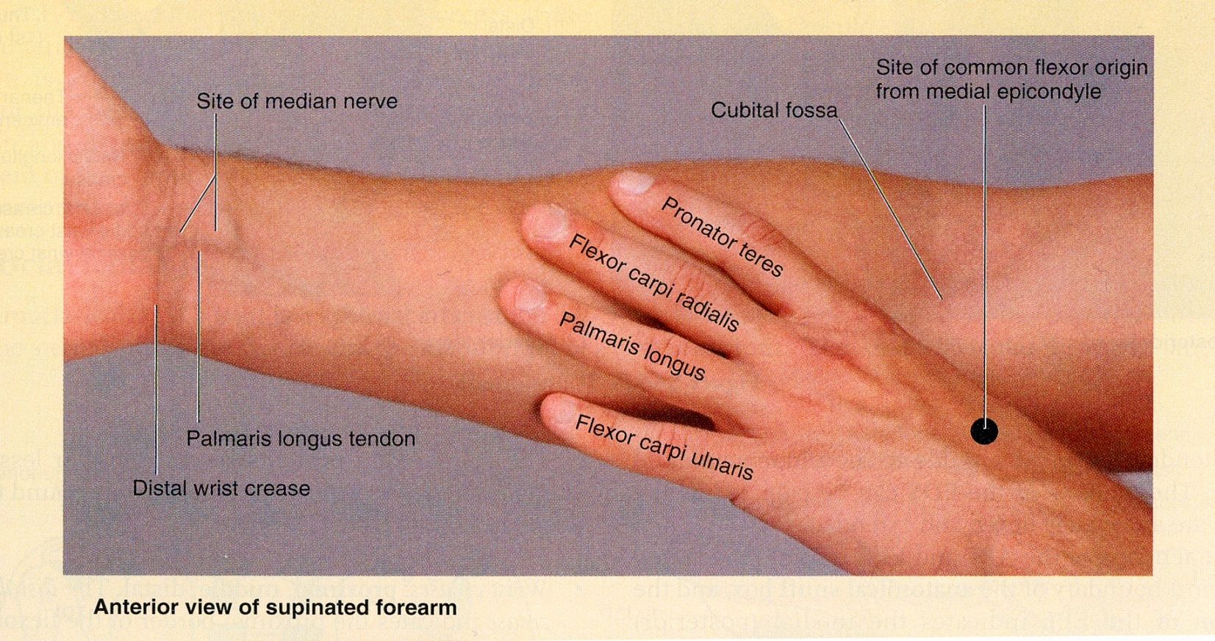
These muscles: 8
Act on the elbow & wrist joints and those of the fingers.
Form fleshy masses in the proximal part and become tendinous in the distal part of the forearm.
Arranged in three groups:
FLEXOR GROUP
I-Superficial: 4
Pronator teres
Flexor carpi radialis
Palmaris longus
Flexor carpi ulnaris
III- Deep: 3
Flexor digitorum profundus
Flexor pollicis longus
Pronator quadratus
II-Intermediate: 1
Flexor digitorum superficialis

Slide 5
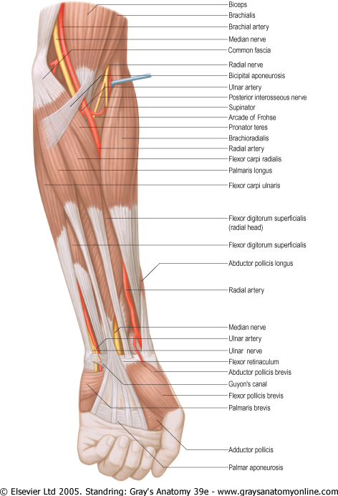
Superficial Flexors:
They arise - more or less- from the common flexor origin (front of medial epicondyle).
All are supplied by median nerve except one, flexor carpi ulnaris, FCU (ulnar).
All cross the wrist joint except one, pronator teres, (PT).

Slide 6
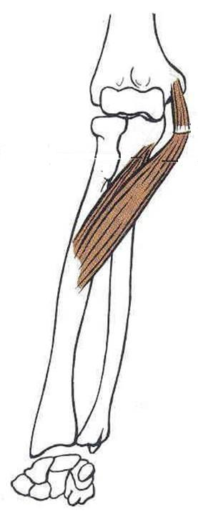
Pronator teres Insertion: middle of lat. surface of radius
Action: pronation & flexion of forearm .
Flexor Carpi Radialis
Insertion: Base of 2nd metacarpal bone
Action: Flexion & abduction of the hand
Palmaris Longus
Insertion: into the flexor retinaculum & palmar aponeurosis.
Action: Flexes hand & tightens palmer aponeurosis

Slide 7
Flexor Digitorum Superficialis
Origin:
Common flexor origin,
Coronoid process of ulna;
Anterior surface of radius
Insertion:
base of middle phalanges of medial 4 fingers.
Action:
Flexes middle and proximal phalanges of medial 4 fingers, and the hand
Flexor Carpi Ulnaris
Insertion:
Pisiform,
hook of hamate
5th metacarpal bone
Action:
Flexion and adduction of the hand.

Slide 8
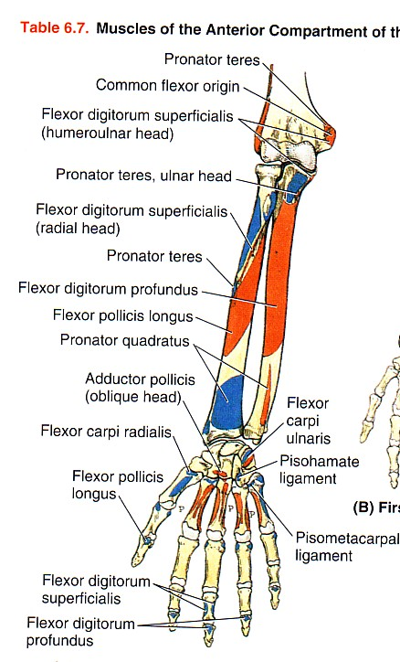
Deep Flexors
One above ulna: Flexor Digitorum profundus
One above radius: Flexor pollicis longus
One above the 2
bones:
Pronator Quadratus.

Slide 9
Flexor Digitorum Profundus
Insertion: bases of distal phalanges of medial 4 digits
Action: Flexes distal phalanges of medial 4 digits.
Flexor Pollicis Longus
Insertion: Base of distal phalanx of thumb
Action: flexes interphalangeal, metacarpophalangeal & carpometacarpal joints of thumb.
Pronator Quadratus
Insertion: distal fourth of ant. surface of radius
Action: pronates forearm (primover), helps to hold the bones together.

Slide 10
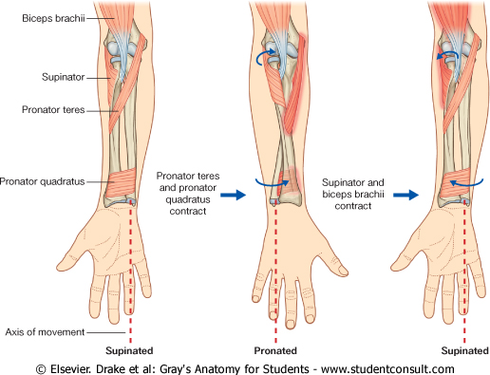
Supination
and
pronation
It occurs in the superior and inferior radioulnar joints;
Muscles produce supination
Biceps brachii.
Supinator.
Muscles produce pronation
Pronator teres.
pronator quadratus.
NB. Brachioradialis put the forearm in midprone- position.

Slide 11
Posterior compartment: 3 groups
Superficial group 5
Extensor carpi radialis brevis
Extensor digitorum
Extensor digiti minimi
Extensor carpi ulnaris
Anconeus
Common Extensor
Origin .
(front of lateral epicondyle).
Superficial
Lateral group 2
Brachioradialis
Extensor carpi radialis longus
Deep group 5 (3 to thumb+ 1 to index + supinator).
Supinator.
Abductor pollicis longus.
Extensor pollicis brevis.
Extensor pollicis longus.
Extensor indices.

Slide 12
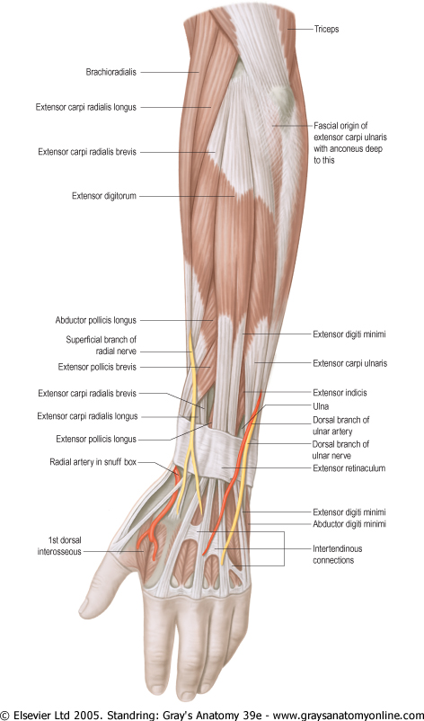
Posterior compartment:
I- Superficial group:
7 muscles ( from lateral to medial) :
Brachioradialis, (BR).
Extensor carpi radialis longus, (ECRL).
Extensor carpi radialis brevis, (ECRB).
Extensor digitorum, (ED).
Extensor digiti minimi, (EDM).
Extensor carpi ulnaris, (ECU).
Anconeus. (An).

Slide 13
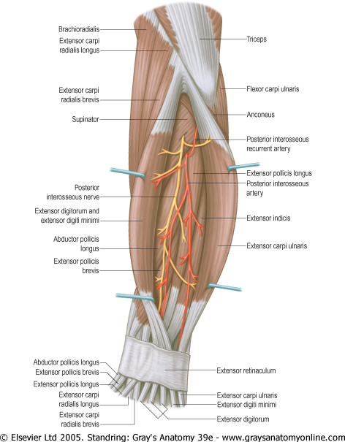
Superficial extensors
All arises from the common extensor origin, (front of lateral epicondyle) of the humerus, EXCEPT, 2 (BR & ECRL).
All cross the wrist EXCEPT, one, brachioradialis.
All supplied by deep branch of radial nerve, EXCEPT ABE
A, anconeus
B, Brachioradialis
E, Extensor carpi radialis longus
These 3 muscles are supplied by the radial nerve itself

Slide 14
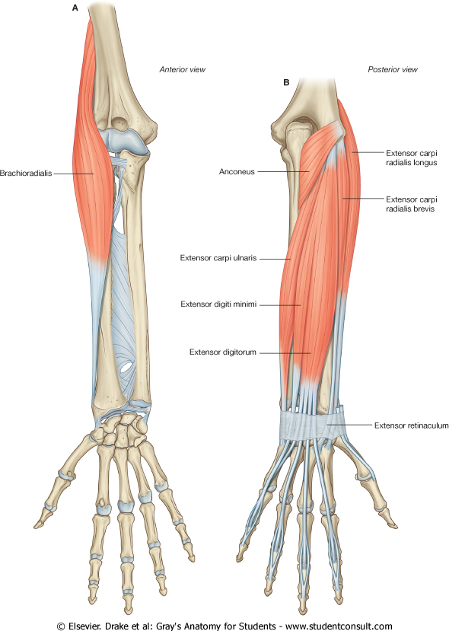
Brachioradialis
Origin:
Lateral supracondylar ridge of humerus
Insertion:
Base of styloid process of radius
Action:
Flexes forearm; (elbow).
Rotates forearm to the midprone position
Extensor Carpi radialis longus
Origin:
Lateral supracondylar ridge of humerus
Insertion:
Posterior surface of base of 2nd metacarpal bone
Action:
Extends and abducts hand at wrist joint

Slide 15
INSERTION
Extensor carpi radialis brevis: base of 3rd metacarpal bone.
Extensor digitorum:
Extensor expansion of the medial 4 fingers.
Extensor digiti minimi:
Extensor expansion of the little finger.
Extensor carpi ulnaris:
Base of the 5th metacarpal bone.

Slide 16
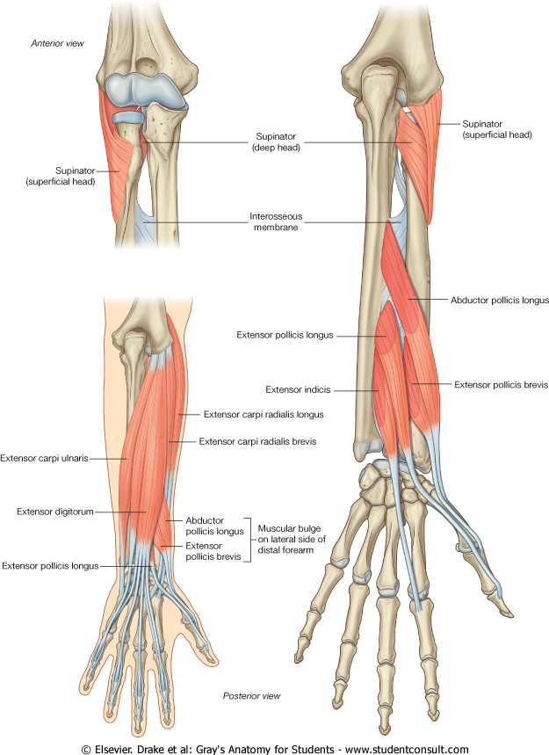
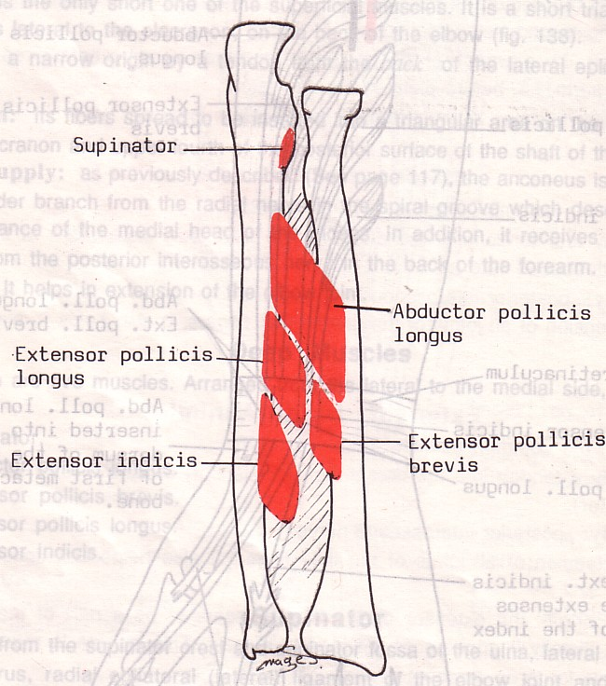
II- Deep group:
5 muscles
1- Abductor pollicis longus, (APL).
2- Extensor pollicis brevis, (EPB).
3- Extensor pollicis longus, (EPL).
4- Extensor indicis (EI).
5- Supinator.
All back muscles of forearm are supplied by posterior interosseous nerve except , ABE by Radial nerve.

Slide 17
Dorsal Extensor Expansion
It is formed on the dorsum of medial 4 fingers by : the union of the tendons of : Extensor digitorum, Extensor digiti minimi, Extensor indicis, palmar and dorsal interossei and lumbricals muscles.
All these tendons unite to form one tendon which divides into 3 slips, a median one attached to middle phalanges and 2 lateral attached to the terminal phalanges.

Slide 18
THANK YOU

