Slide 1
Vascular Anatomy of the upper limb
Dr. Zeenat Zaidi
Dr. Essam Eldin Salama

Slide 2
Objectives
At the end of the lecture, the students should be able to :
Identify the origin of the vascular supply for the upper limb.
Describe the main arteries and their branches of the arm, forearm & hand.
Describe the vascular arches for the hand.
Describe the superficial and deep veins of the upper limb

Slide 3
Arteries Of The Upper Limb
Right subclavian
artery
Left subclavian
artery
Axillary artery
Brachial artery
Ulnar
artery
Radial artery
Palmar arches

Slide 4
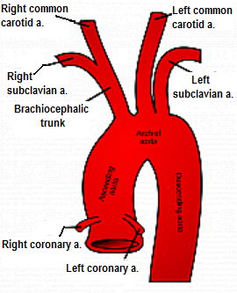
The Subclavian Artery
The right artery originates from the brachiocephalic artery.
The left artery originates from the arch of the aorta
*
*
Cotinues as Axillary artery at the lateral border of the 1st rib

Slide 5
The Axillary Artery
Begins at the lateral border of the 1st rib as continuation of the subclavian artery.
Continues as brachial artery at lower border of teres major muscle.
Is closely related to the cords of brachial plexus and their branches
Is enclosed within the a fascial sheath, the axillary sheath
Is crossed anteriorly by the pectoralis minor muscle, and is divided into three parts; 1st, 2nd & 3rd
Subclavian artery
Pec. minor
Brachial artery
Axillary artery

Slide 6
The 1st part of the axillary artery
Extends from the lateral border of 1st rib to upper border of the pectoralis minor muscle.
Related:
Anterioly: to the pectoralis major muscle
Laterally: to the cords of the brachial plexus.
Branches: ONE branch Highest thoracic artery
1st rib
1st part
2nd part
*
Highest thoracic artery a.
3rd part
Pec. minor
Teres major

Slide 7
The 2nd part of the axillary artery
lies behind the pectoralis minor muscle.
It is related medially, laterally, and posteriorly, to the corresponding cord of the brachial plexus
Branches: TWO branches
Thoracoacromial a.
Lateral thoracic a.
1st rib
1st part
2nd part
*
3rd part
Thoraco-acromial a.
Pec. minor
*
Lateral Thoracic a.
Teres major
The cords of the brachial plexus are named lateral, medial & posterior according to their relation to the 2nd part of axillary artery

Slide 8
The 3rd part of the axillary artery
Extends from the lower border of pectoralis minor muscle to the lower border teres major muscle.
Related medially, laterally, and posterioly, to the branches of the cords of the brachial plexus
Gives THREE Branches:
Subscapular,
Anterior circumflex humeral
Posterior circumflex humeral.
1st rib
1st part
2nd part
3rd part
*
Pec. minor
*
*
Teres major
Subscapular a.
Anterior & posterior circumflex humeral aa.

Slide 9
The Brachial Artery
Axillary artery
Is the continuation of the axillary artery, at the lower border of teres major muscle.
Provides main arterial supply for the arm.
Terminates opposite neck of radius by dividing into radial & ulnar arteries.
Brachial artery
Radial artery
Ulnar artery

Slide 10
Brachial Artery: Relations
Anteriorly: crossed from above downward by medial cutanous nerve of the forearm, median nerve, and bicipital aponeurosis.
Posterioly: triceps, coraco-brachialis and brachialis.
Medially: basilic vien, ulnar and mdian nerves.
Laterally: coracbrachialis and biceps muscles.
coracobrachialis
biceps
brachialis
Ulnar n.
Median n.

Slide 11
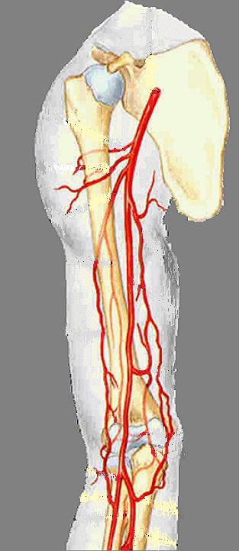
Brachial Artery: Branches
Muscular.
Nutrient to humerus.
Profunda brachii
Superior ulnar collateral.
Inferior ulnar collateral.

Slide 12
The Ulnar Artery
The larger of the two terminal branches of the brachial artery
Begins in the cubital fossa at the level of neck of radius.
Descends through the anterior compartment of the forearm.
Enters the palm, in front of the flexor retinaculum, with the ulnar nerve.
Ends by forming the superficial palmer arch, with the superficial palmer branch of radial artery.
Brachial artery
Ulnar artery
Radial artery
*
Superficial palmar arch

Slide 13
Ulnar Artery: Branches
Muscular .
Recurrent branch for anastomosis around the elbow joint.
Common interosseous artery, which gives anterior and posterior interosseous arteries.
Branch to anastomose around the wrist joint.

Slide 14
The Radial Artery
The smaller of the two terminal branches of the brachial artery
Begins in the cubital fossa at the level of neck of radius.
Descends downward and laterally.
Leaves the forearm by winding around the lateral aspect of the wrist to reach the dorsum of the hand
Radial artery

Slide 15
Radial Artery: Branches
Muscular
Recurrent branch for anastomosis around the elbow joint.
Superficial palmar branch, joins the ulnar artery to form the superficial palmar arch.

Slide 16
Arteries of the Palm
Ulnar artery:
Enters the hand:
anterior to the flexor retinaculum,
on the lateral side of the ulnar nerve and pisiform bone.
Gives a deep branch.
Continue as the superficial palmar arch.
Ulnar artery
FR
Superficial palmar arch

Slide 17
Arteries of the Palm
Radial artery;
Leaves dorsum of the hand by turning forward between the proximal ends of the 1st and 2nd metacarpal bones and two heads of the 1st dorsal inerossous muscle.
On entering the palm it continues as deep palmar arch.
It gives; arteria radialis indecis and arteria princeps policis.
Radial artery
1st dorsal interosseous muscle

Slide 18
The Superficial Palmar Arch
Radialis indices a.
Is the direct continuation of the ulnar artery, as it curves laterally behind the palmar aponeurosis.
Is completed by branch from the radial artery.
Lies approximately at the level of the distal border of the extended thumb
Gives: digital arteries from its convexity to supply the fingers.
Princeps pollicis a.
Digital arteries
Ulnar a.
Radial a.

Slide 19
Is a continuation of the radial artery as it curves medially beneath long flexor tendons , in front of the metacarpal bones and interosseous muscles.
Is completed on the medial side by deep branch of ulnar artery.
Lies at a level of the proximal border of extended thumb.
It sends branches:
superiorly to share in anastomosis around the wrist joint &
inferiorly to join branches of the superficial palmar arch.
The Deep Palmar Arch
Ulnar a.
Radial a.

Slide 20
The superficial palmar arch is more distal than the deep palmar arch.

Slide 21
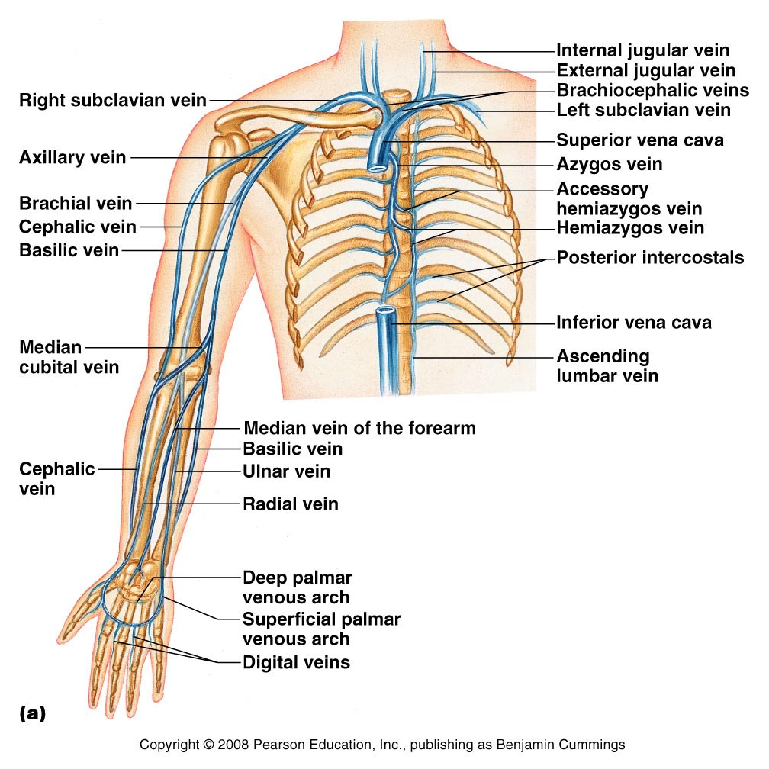
Veins of the Upper Limb
The veins of the upper limb are divided into two sets: Superficial and Deep
The two sets anastomose frequently with each other.
The superficial veins are placed immediately beneath the skin, in the superficial fascia.
The deep veins accompany the arteries, and constitute the venæ comitantes of those vessels

Slide 22
Superficial Veins of the Upper Limb
Dorsal Venous Arch (network)
The dorsal digital veins drain into dorsal metacarpal veins, which unite to form a dorsal venous arch or network.
Dorsal venous network lies on the dorsum of the hand, in the subcutanous tissue, proximal to the metacarpophalangeal joints
Drains into the cephalic vein laterally, and basilic vein medially

Slide 23
Cephalic Vein
Basilic Vein
Arises from the lateral end of the dorsal venous arch of hand
Ascends on radial side of the forearm to the elbow and continues up the arm in the deltopectoral groove
Pierces clavipectoral fascia to drain into the axillary vein.
Arises from the medial side of the dorsal venous arch of hand
Ascends on the ulnar side of forearm to the elbow , in the middle of the arm, it pierces the deep fascia and joins the brachial vein or axillary vein
Median Cubital Vein
Links cephalic vein and basilic vein in the cubital fossa.
Is a frequent site for venipuncture

Slide 24
Deep Veins of the Upper Limb
Accompany the arteries of the same region and bear similar names.
Venae commitantes: They are generally arranged in pairs, and are situated one on either side of the corresponding artery, and connected at intervals by short transverse branches.
The superficial and deep palmar arterial arches are each accompanied by a pair of venæ comitantes which constitute the superficial and deep palmar venous arches, and receive the veins corresponding to the branches of the arterial arches
The deep veins of the forearm are the venæ comitantes of the radial and ulnar veins
The brachial veins are placed one on either side of the brachial artery

Slide 25
The axillary vein:
Begins at the lower border of the Teres major, as the continuation of the basilic vein
Ends at the outer border of the first rib as the subclavian vein
Receives the brachial veins and, close to its termination, the cephalic vein
The subclavian vein:
Is the continuation of the axillary vein
Extends from the outer border of the first rib to the sternal end of the clavicle, where it unites with the internal jugular to form the brachiocephalic (innominate) vein

Slide 26
Thank you

