Slide 1
BONES OF THE UPPER LIMB
Dr. Khaleel Alyahya
Assistant Professor
College of Medicine
King Saud University
Dr. Jameela Al-Medany
Associate Professor
College of Medicine
King Saud University

Slide 2
OBJECTIVES
At the end of the lecture, students should:
List the different bones of the Upper Limb.
List the characteristic features of each bone.
Differentiate between bones of right and left sides.
List the articulations between the different bones.

Slide 3
Bones of Upper Limb
It consists of the following:
Pectoral Girdle
Arm
Forearm
Hand

Slide 4
Pectoral Girdle
It composed of Two bones:
Clavicle
Scapula
It is very light and it allows the upper limb to have exceptionally free movement.

Slide 5
Clavicle
It is a long bone lying horizontally across the root of the neck
It is subcutaneous throughout its length.
Functions:
Holds the arm away from the trunk.
Transmits forces from the upper limb to the axial skeleton.
Provides attachment for muscles.
If the clavicle is broken, the whole shoulder region caves in medially.

Slide 6
Clavicle
Its medial 2/3 is convex forward
Its lateral 1/3 is concave forward
Its medial (sternal) end is rounded.
Its lateral (acromial) end is flattened.
It has two surfaces:
Superior
Inferior
The Inferior surface shows:
Conoid tubercle & Trapezoid line.

Slide 7
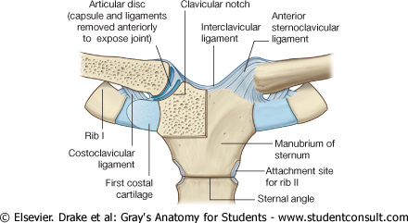
Articulations
Medially, sternoclavicular joint
with the Manubrium
Laterally, Acromioclavicular joint
with the Acromial end of the scapula
Inferiorly, costoclavicular Joint
with the 1st rib

Slide 8
Scapula
It is a triangular flat bone.
Extends between the 2nd _ 7th ribs.
It has:
Two surfaces: Anterior & Posterior.
Three Borders: superior, medial (vertebral) & lateral (axillary).
Three Processes: Spine, Coracoid & Acromion.
Three Angles: superior, lateral (forms the Glenoid cavity) & inferior.
Suprascapular notch: medial to coracoid process.
It is a nerve passageway.

Slide 9
Fossae of Scapula
It has Three Fossae:
Two on the posterior surface:
Supraspinous Fossa
above the spine.
Infraspinous Fossa
below the spine.
One on the Anterior surface:
Subscapular Fossa.

Slide 10
Arm (Humerus)
It is formed by a single bone.
It is a typical long bone.
It has:
Upper End:
Head: Smooth& forms 1/3 of a sphere.
Anatomical neck: Immediately below the head.
Greater & Lesser tubercles: separated by Intertubercular Groove.
Surgical Neck: between the upper end and the shaft.
surgical

Slide 11
Arm (Humerus)
Shaft:
Anterior & Posterior surfaces.
Deltoid tuberosity:
A rough elevation halfway down the lateral aspect.
Spiral (Radial) groove:
Runs obliquely down the posterior aspect of the shaft.
It lodges the important radial nerve & vessels.
surgical

Slide 12
Arm (Humerus)
Distal End:
Medial : Trochlea.
Lateral: Capitulum.
Above the trochlea (on the anterior surface): Coronoid fossa.
Above the trochlea (on the posterior surface): Olecranon fossa.
Above capitulum :
Radial fossa.
Epicondyles: medial & lateral.
surgical

Slide 13
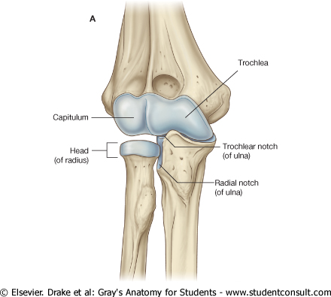
Articulations
Head of the humerus with the glenoid cavity of the scapula form the Shoulder joint.
Lower end (Trochlea & Capitulum) with the upper ends of the radius & ulna form the Elbow joint.

Slide 14
Forearm
Formed of two bones:
The Radius is the lateral bone.
The Ulna is the medial bone.

Slide 15
Radius
Proximal (Upper)) end:
Head: small & circular& Its upper surface is concave.
Neck
Radial (Biciptal) Tuberosity
Shaft:
Wider below than above
Three surfaces: Anterior, Lateral & Posterior
Sharp medial interosseous border.
Pronator tubercle: halfway down the lateral side.
Distal (Lower) end:
Styloid process: laterally.
Ulnar notch: medially.
Dorsal tubercle: posteriorly.

Slide 16
Ulna
Proximal (Upper)) end:
Posterior: Olecranon process
Forms the prominence of the elbow.
Anterior: Coronoid process.
Both they are separated by the Trochlear notch
Lateral : Radial notch
Shaft:
Three surfaces (Anterior, Medial & Posterior).
Sharp lateral interosseous border.
Distal (Lower) end:
Small rounded head
Medial : Styloid process
Lateral : Radial notch

Slide 17
Articulations of Radius & Ulna
Distal end of Humerus with the proximal ends of Radius & Ulna Elbow joint
Proximal Radioulnar joint
Distal Radioulnar joint
The two bones are connected by the flexible interosseous membrane
Proximal
Radioulnar joint.

Slide 18
Hands
The skeleton of the hand consists of the:
Carpals for the carpus (wrist)
Metacarpals for the palm
Phalanges for the fingers

Slide 19
Carpal Bones
Eight carpal bones arranged in two irregular rows, each of four.
They present Concavity on their Anterior surface.
Proximal row (from lateral to medial):
Scaphoid
Lunate
Triquetrum
Pisiform
Distal row (from lateral to medial):
Trapezium
Trapezoid
Capitate
Hamate

Slide 20
Metacarpals& Phalanges Bones
Metacarpals:
Five bones, each has a Base, Shaft, and a Head.
They are numbered 1-5 from the thumb.
The 1st metacarpal is the shortest and most mobile.
When the fist is clenched, the heads of the metacarpals become obvious (knuckles)
Phalanges :
Each hand contains 14 phalanges.
Three in each finger (proximal, middle & distal) except in the thumb which has only two (proximal &distal).

Slide 21
Articulations
Bases of the Metacarpal bones articulate with the distal row of the carpal bones
Carpometacarpal joints
Heads (knuckles) articulate with the Proximal Phalanges
Metacarpophalangeal joints
The phalanges articulate with each other
Interphalangeal joints
Distal end of Radius with the Proximal Raw of Carpal bones
Wrist joint

Slide 22
QUEST!ON?

