Slide 1
DEVELOPMENT OF SKELETAL & MUSCULAR SYSTEM
Dr. Ahmed Fathalla Ibrahim
Associate Professor of Anatomy
College of Medicine
King Saud University
E-mail: ahmedfathala@hotmail.com
Dr. Zeenat Zaidi
Associate Professor of Anatomy
College of Medicine
King Saud University

Slide 2
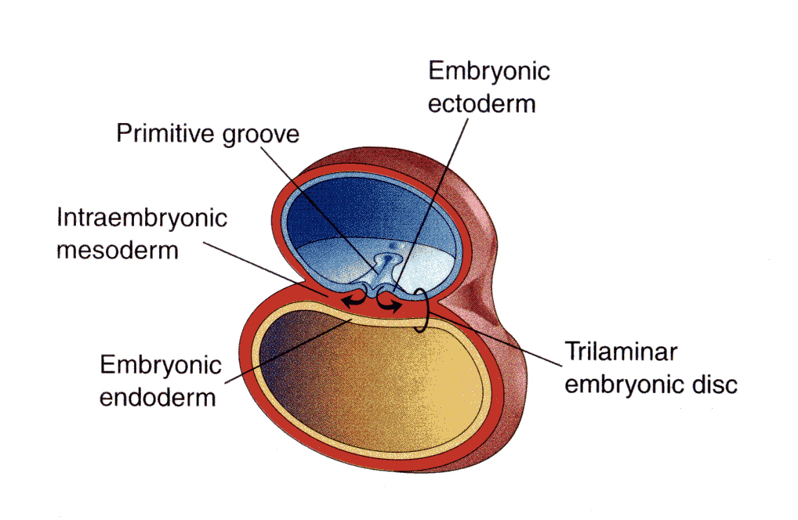
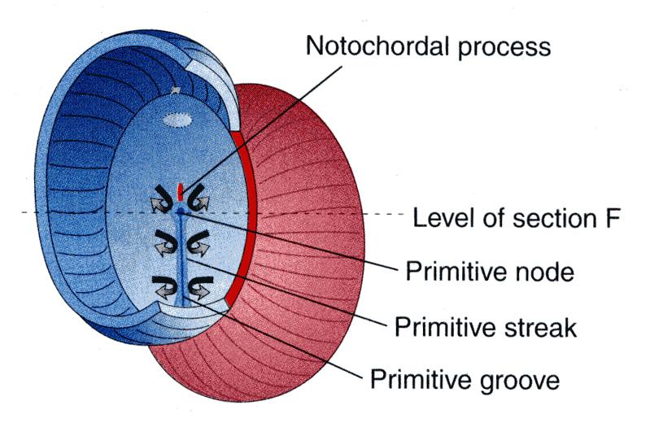
Embryo
Amniotic
cavity
Embryo
Yolk sac

Slide 3
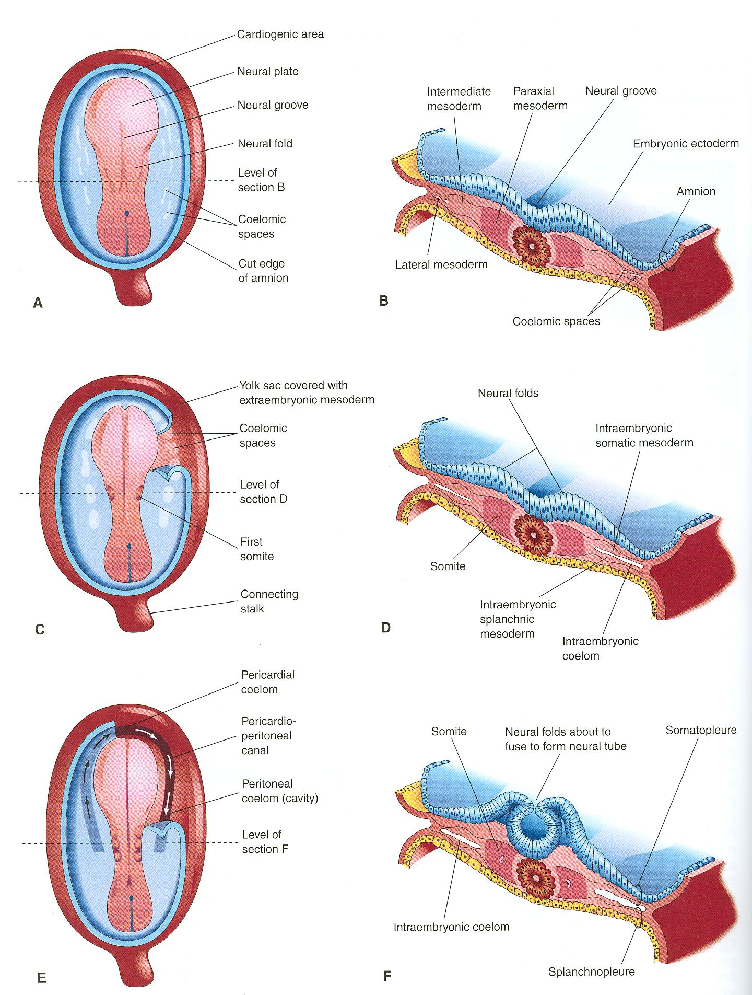
Notochord:
stimulates neural tube
formation
Somatic mesoderm
Splanchnic mesoderm

Slide 4
INTRAEMBRYONIC MESODERM
Proliferates between Ectoderm & Endoderm EXCEPT in the central axis of embryo where NOTOCHORD is found.
Differentiates into 3 parts:
Paraxial mesoderm: on each side of notochord.
Intermediate mesoderm
Lateral mesoderm
Paraxial mesoderm divides into units (somites).
Lateral mesoderm divides by intraembryonic coelom into:
Somatic mesoderm (between ectoderm & coelom).
Splanchnic mesoderm (between endoderm & coelom).

Slide 5
SOMITE
SOMITE
Notochord
Neural tube
Epaxial division:
Muscles of back
(Extensors of VC)
Sclerotome
Sclerotome
Epaxial division:
Muscles of back
(Extensors of VC)
Vertebral column
Ribs & sternum
Myotome
Myotome
Hypaxial division:
Muscles of body wall
Myoblasts migrate
into limb:
Limb muscles
Myoblasts migrate
into limb:
Limb muscles

Slide 6
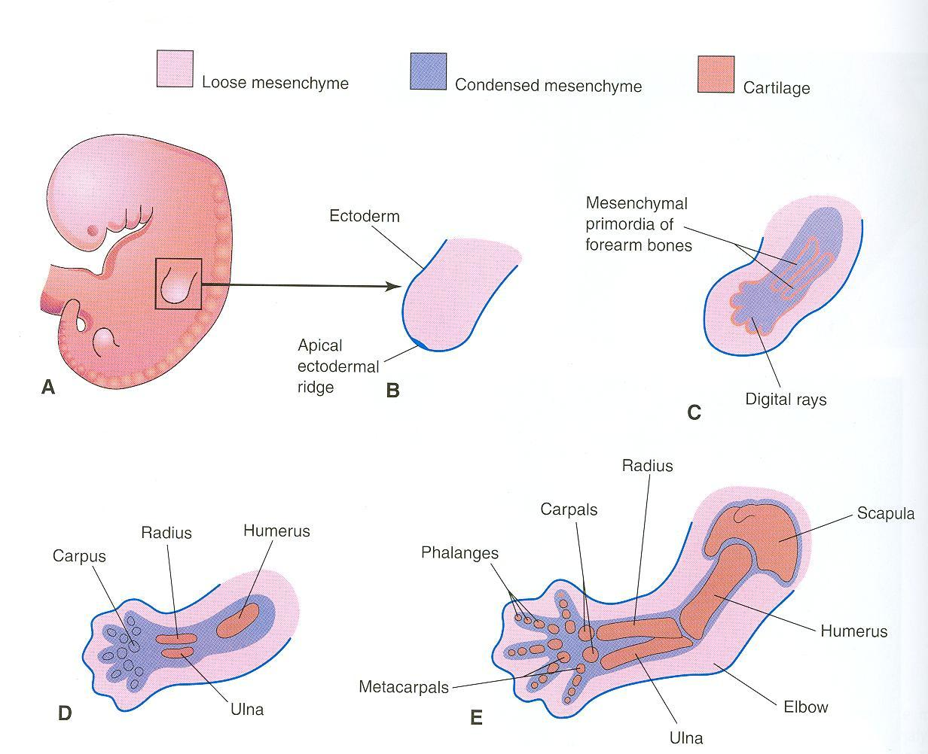
Mesenchyme from lateral mesoderm
Induces growth of mesenchyme & its transformation into cartilage
Cartilage ossifies by:
Endochondral ossification
Myoblasts migrate from myotomes to form:
Muscles of limbs

Slide 7
OSSIFICATION OF LONG BONES
Appearance of
primary ossific
centers: ossification
of diaphysis
Appearance of
secondary ossific
centers: ossification
of epiphysis
Ossification of
epiphseal plate:
Complete union of
epiphysis & diaphysis
Bone in
cartilaginous state
Epiphysis
Epiphyseal
plate of
cartilage
Growth of
bone stops
Diaphysis
Diaphysis
Epiphysis
BIRTH
PUBERTY
Bone increases in length by
proliferation of epiphyseal plate
Bone age is a good index of general maturation. Bone age is determined by:
Appearance of ossific centers in diaphysis & epiphysis (specific for each bone & sex)
Disappearance of epiphyseal plate (specific for each bone & sex)

Slide 8
DEVELOPMENT OF CRANIUM (SKULL)
The skull develops from mesoderm around the developing brain.
The skull consists of:
Neurocranium: protective case for brain
Viscerocranium: skeleton of face
Bones of skull ossify either by:
*Endochondral ossification or
*Intramembranous ossification

Slide 9
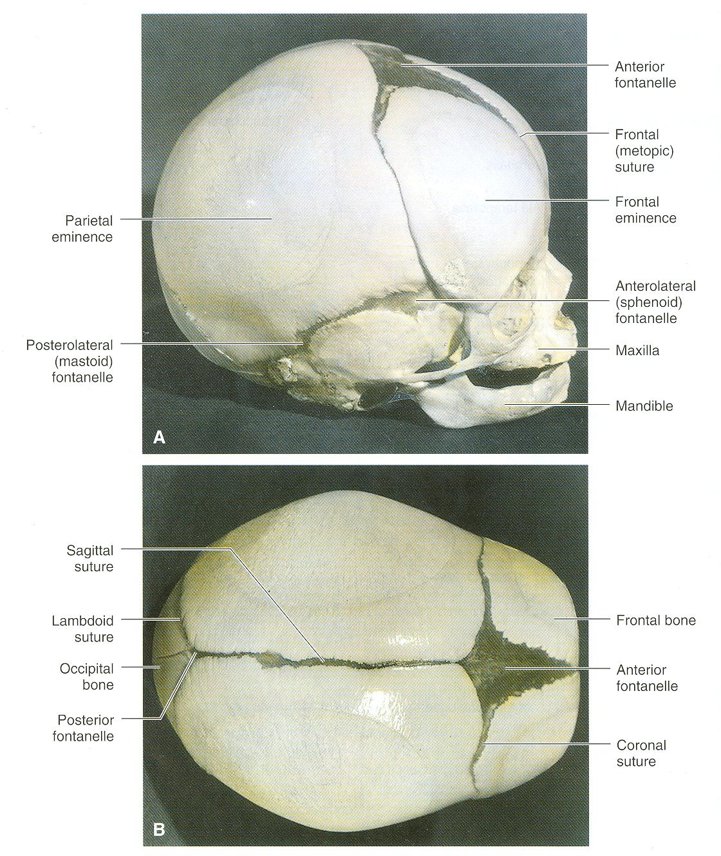
Bones of skull that ossify by
intramembranous ossification:
F = Frontal
P = Parietal
Z = Zygomatic
ST = Squamous temporal
Mand = Mandible
Max = Maxilla
F
P
F
ST
Z
Max
Mand
P
F
F
P

Slide 10
SUMMARY OF DEVELOPMENT OF BONE
All bones develop from MESODERM.
AXIAL SKELETON:
*Vertebrae, ribs & sternum: from sclerotomes of somites (paraxial mesoderm)
*Skull: from mesoderm surrounding the brain
APPENDICULAR SKELETON: from somatic part of lateral mesoderm
All bones ossify by endochondral ossification EXCEPT:
Some bones of skull
Clavicle

Slide 11
JOINTS
They develop from mesoderm between bones:
In fibrous joints: mesoderm differentiates into dense fibrous connective tissue.
In cartilaginous joints: mesoderm differentiates into cartilage.
In synovial joints: a synovial cavity is formed inside mesoderm; mesoderm differentiates into synovial membrane, capsule & ligaments.

Slide 12
SUMMARY OF DEVELOPMENT OF MUSCLES
All muscles develop from MESODERM EXCEPT:
Muscles of iris (eyeball)
Myoepithelial cells of ECTODERM mammary & sweat glands
All skeletal muscles develop from myotomes of paraxial mesoderm EXCEPT: some head & neck muscles from mesoderm of pharyngeal arches

Slide 13
SUMMARY OF DEVELOPMENT OF MUSCLES
Cardiac & smooth muscles develop from lateral mesoderm:
Cardiac muscles from: splanchnic part of lateral mesoderm
Smooth muscles:
*In the wall of viscera from: splanchnic part of lateral mesoderm
* In the wall of blood & lymphatic vessels from: somatic part of lateral mesoderm

Slide 14
QUESTION 1
Which one of the following group of muscles are derivatives from epaxial division of myotomes?
Muscles of back
Muscles of limbs
Muscles of viscera
Cardiac muscles

Slide 15
QUESTION 2
Which one of the following bones ossifies by intramembranous ossification?
Vertebra
Humerus
Ribs
Mandible

Slide 16
THANK YOU

