Slide 1
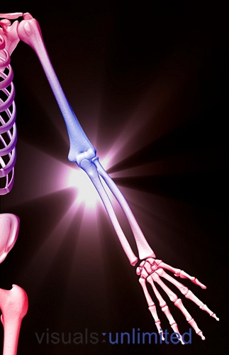
ARM, CUBITAL FOSSA
& ELBOW JOINT
Khaleel Alyahya, PhD, MEd Zeenat Zaidi, MD, PhD

Slide 2
OBJECTIVES
At the end of the lecture, students should:
Describe the attachments, actions and innervations of:
Biceps brachii
Coracobrachialis
Brachialis
Triceps brachii
Demonstrate the following features of the elbow joint:
Articulating bones
Capsule
Lateral & medial collateral ligaments
Synovial membrane
Demonstrate the movements; flexion and extension of the elbow.
List the main muscles producing the above movements.
Define the boundaries of the cubital fossa and enumerate its contents.

Slide 3
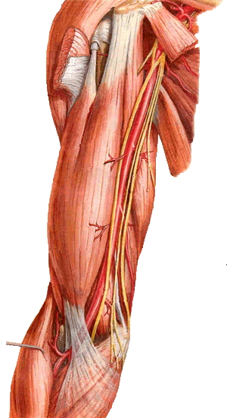
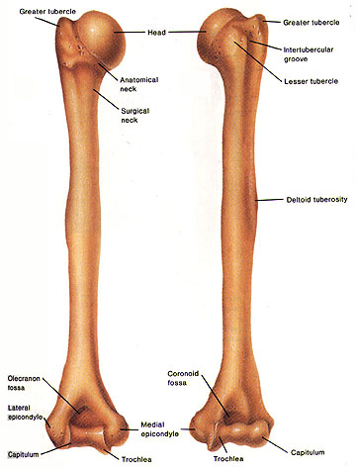
The ARM
Shoulder
A R M
Posterior
view
Anterior
view
Elbow
Arm
Humerus

Slide 4
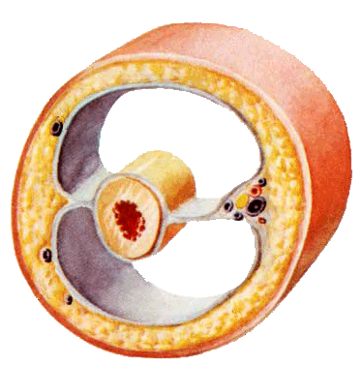
The ARM
The lateral and medial intermuscular septa divide the distal part of the arm into two compartments:
Anterior
Posterior
Lateral intermuscular septum
Medial intermuscular septum
Neurovascular bundle
skin
Fascia
Humerus

Slide 5
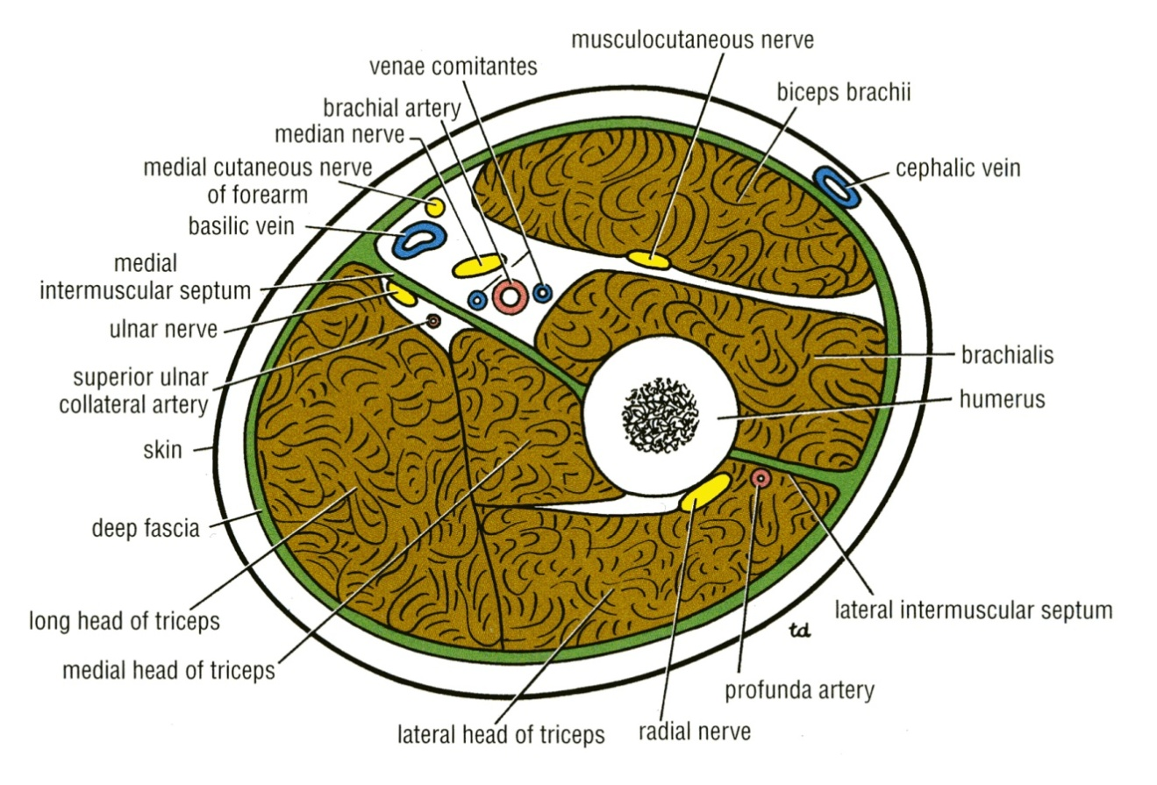
Anterior Fascial Compartment Contents
Muscles: Biceps brachii, Coracobrachialis &Brachialis.
Blood Vessels: Brachial artery & Basilic vein.
Nerves : Musculocutaneous, Median, Radial & Ulnar.

Slide 6
Muscles of the Anterior Compartment
Coracobrachialis
Biceps brachii
Brachialis

Slide 7
Biceps Brachii
Coracoid Process
Origin: Two heads:
Long Head from supraglenoid tubercle of scapula (intracapsular)
Short Head from the tip of coracoid process of scapula
The two heads join in the middle of the arm

Slide 8
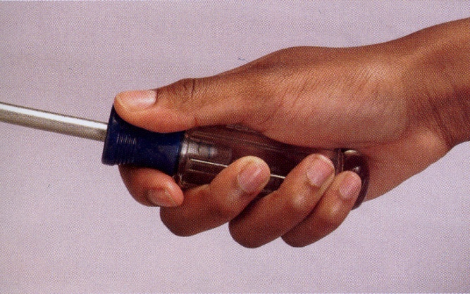
Biceps Brachii
Biceps brachii
Insertion:
in the posterior part of the radial tuberosity.
into the deep fascia of the medial aspect of the forearm through bicipital aponeurosis.
Nerve supply:
Musculocutaneous
Action:
Strong supinator of the forearm
used in screwing.
Powerful flexor of elbow
Weak flexor of shoulder
Tendon inserted to radial tuberosity
Bicipital
aponeurosis

Slide 9
Coracobrachialis
Origin:
Tip of the coracoid process
Insertion:
Middle of the medial side of the shaft of the humerus
Nerve supply:
Musculocutaneous
Action:
Flexor & a weak adductor of the arm

Slide 10
Brachialis
Origin:
Front of the lower half of humerus
Insertion:
Anterior surface of coronoid process of ulna
Nerve supply:
Musculocutaneous & Radial
Action:
Strong flexor of the forearm

Slide 11
Posterior Fascial Compartment Contents
Muscles: Triceps
Vessels: Profunda brachii & Ulnar collateral arteries
Nerves: Radial & Ulnar

Slide 12
Muscles of the Posterior Compartment
Triceps brachii

Slide 13
Triceps
Origin: Three heads:
Long Head from infrglenoid tubercle of the scapula
Lateral Head from the upper half of the posterior surface of the shaft of humerus above the spiral groove
Medial Head from the lower half of the posterior surface of the shaft of humerus below the spiral groove

Slide 14
Triceps
Insertion:
Common tendon inserted into the upper surface of the olecranon process of ulna
Nerve supply:
Radial nerve
Action:
Strong extensor of the elbow joint

Slide 15
Cubital Fossa
The cubital fossa is a triangular depression that lies in front of the elbow

Slide 16
Boundaries of Cubital Fossa
Base:
Line drawn through the two epicondyles of humerus
Laterally:
Brachioradialis
Medially:
Pronator teres
Roof:
Skin, superficial & deep fascia and bicipital aponeurosis
Floor:
Brachialis medially and supinator laterally.
Brachioradialis
Pronator teres

Slide 17
Content of Cubital Fossa
(From medial to lateral side)
3. Biceps brachii tendon
1. Median nerve
4. Deep branch of radial nerve
2. Brachial artery
divides into radial & ulnar arteries.
Ulnar artery
Radial artery

Slide 18
ELBOW Joint
Uniaxial, Synovial Hinge joint
Articulation
Trochlea and capitulum of the humerus above
Trochlear notch of ulna and the head of radius below

Slide 19
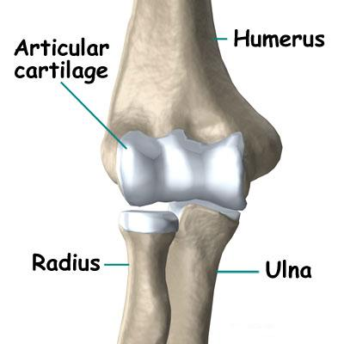
ELBOW Joint
The articular surfaces are covered with articular (hyaline) cartilage.
Capitulum
Trochlea

Slide 20
Capsule
Anteriorly: attached
Above
To the humerus along the upper margins of the coronoid and radial fossa and to the front of the medial and lateral epicondyles.
Below
To the margin of the coronoid process of the ulna and to the anular ligament, which surrounds the head of the radius.

Slide 21
Capsule
Posteriorly: attached
Above
To the margins of the olecranon fossa of the humerus.
Below
To the upper margin and sides of the olecranon process of the ulna and to the anular ligament.

Slide 22
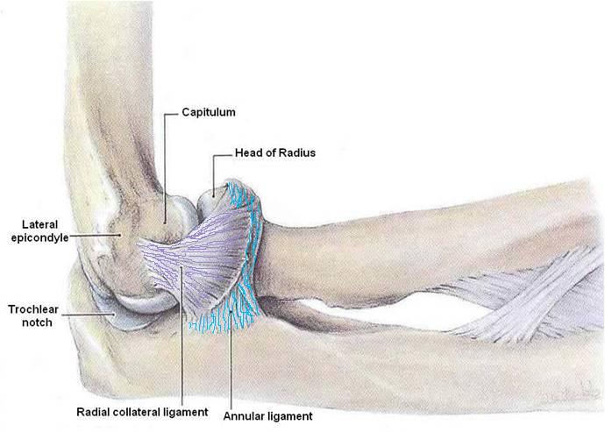
Ligaments
Lateral (radial collateral) ligament
Triangular in shape:
Apex
Attached to the lateral epicondyle of humerus
Base
Attached to the upper margin of annular ligament.

Slide 23
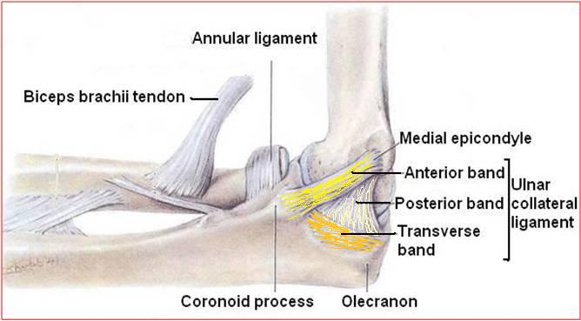
Ligaments
Medial (ulnar collateral) ligament
Anterior strong cord-like band:
Between medial epicondyle and the coronoid process of ulna
Posterior weaker fan-like band:
Between medial epicondyle and the olecranon process of ulna
Transverse band:
Passes between the anterior and posterior bands

Slide 24
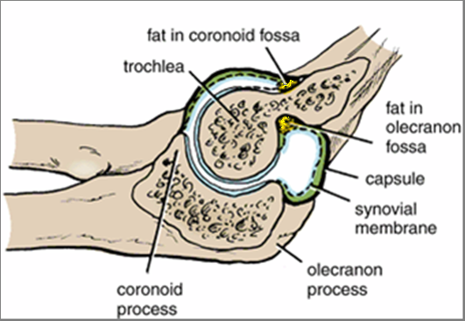
Synovial Membrane
This lines the capsule and covers fatty pads in the floors of the coronoid, radial, and olecranon fossa.
Is continuous below with synovial membrane of the superior radioulnar joint

Slide 25
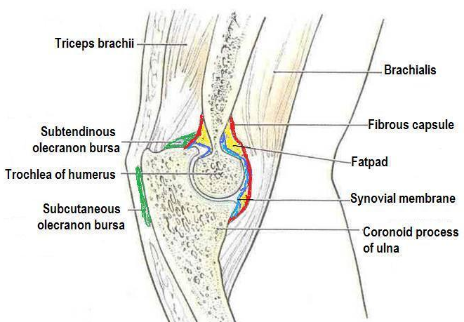
Relations
Anterior:
Brachialis, tendon of biceps, median nerve, brachial artery
Posterior:
Triceps muscle, small bursa intervening
Lateral:
Common extensor tendon & the supinator
Medial:
Ulnar nerve
Considered the largest unprotected nerve in the human body by muscle or bone,
Bursae around the elbow joint:
Subcutaneous olecranon bursa
Subtendinous olecranon bursa

Slide 26
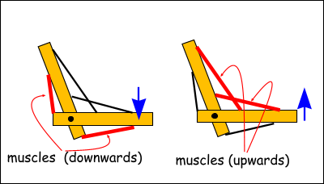
Movements
Flexion
Is limited by the anterior surfaces of the forearm and arm coming into contact.
Extension
Is limited by the tension of the anterior ligament and the brachialis muscle.
The joint is supplied by branches from the:
Median
Ulnar
Musculocutaneous
Radial nerves

Slide 27
Carrying Angle
Angle
Between the long axis of the extended forearm and the long axis of the arm
Opens
Laterally
About
170 degrees in male and 167 degrees in females
Disappears
When the elbow joint is flexed
Permits
The forearms to clear the hips in swinging movements during walking, and is important when carrying objects
165⁰-170⁰

Slide 28
Articulations
The elbow joint is stable because of the:
Wrench-shaped articular surface of the olecranon and the pulley-shaped trochlea of the humerus
Strong medial and lateral ligaments.
Elbow dislocations are common & most are posterior.
Posterior dislocation usually follows falling on the outstretched hand.
Posterior dislocations of the joint are common in children because the parts of the bones that stabilize the joint are incompletely developed.

Slide 29
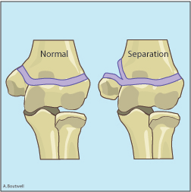
ELBOW Joint
Avulsion of the epiphysis of the medial epicondyle is also common in childhood because then the medial ligament is much stronger than the bond of union between the epiphysis and the diaphysis.

Slide 30
QUEST!ONS?

