Slide 1
Popliteal fossa Posterior compartment of leg & Sole of foot
Dr. Vohra

Slide 2
Objectives
At the end of this lecture the students should be able
to know:
The location, boundaries & contents of the popliteal fossa
The contents of posterior fascial compartment
The structures hold by retinacula of the ankle
Layers forming in the sole of foot & bone those form the arches of the foot

Slide 3
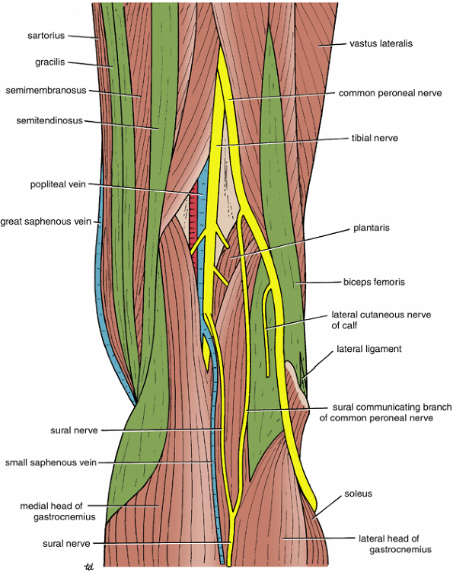
Popliteal Fossa
Is a diamond-shaped intermuscular space at the back of knee
Boundaries
Laterally: above: biceps femoris.
Below: lateral head of gastrocnemius & plantaris
Medially: above: semimembranosus & semitendinosus
Below: medial head of gastrocnemius
Roof: Skin, superficial fascia and deep fascia of the thigh
Floor: popliteal surface of femur, posterior ligament of knee joint and popliteus muscle

Slide 4
Popliteal Fossa
Contents:
1. Popliteal vessels
2. Small saphenous vein
3. Common peroneal nerve
4. Tibial nerve
5. Posterior cut. nerve of thigh
6. Connective tissue & popliteal lymph nodes

Slide 5
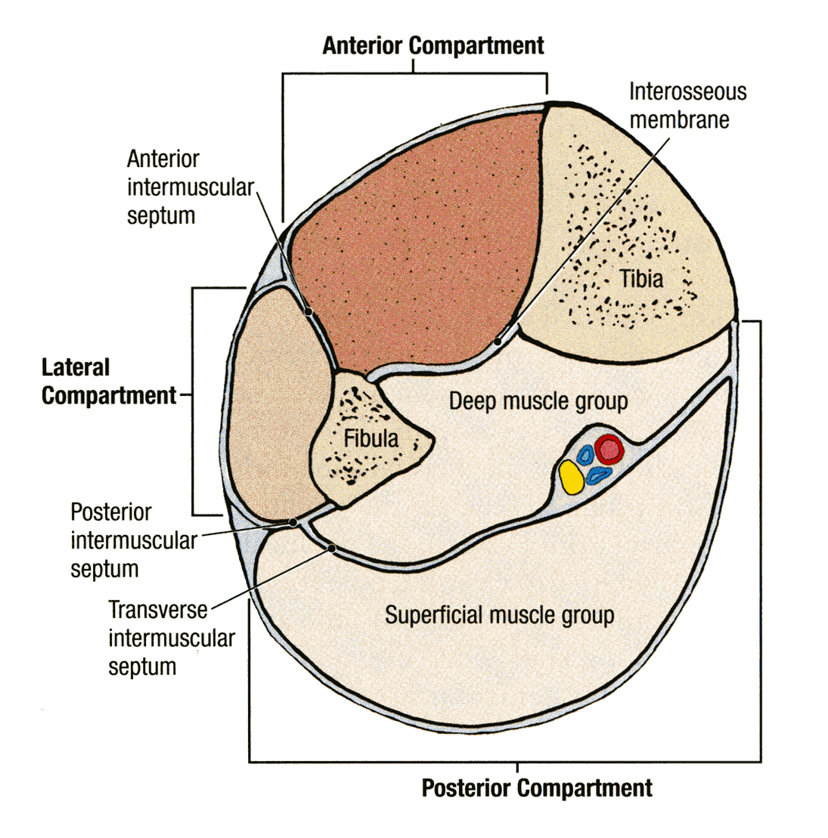
CONTENTS OF THE POSTERIOR FASCIAL COMPARTMENT OF THE LEG
The transverse intermuscular septum of the leg is a septum divides the muscles of the posterior compartment into superficial and deep groups.
Contents:
Superficial group of muscles
Deep group of muscles
Posterior tibial artery
Tibial nerve

Slide 6
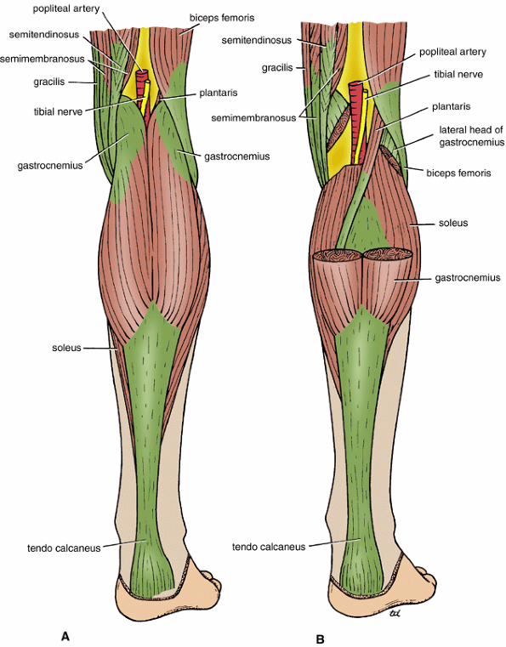
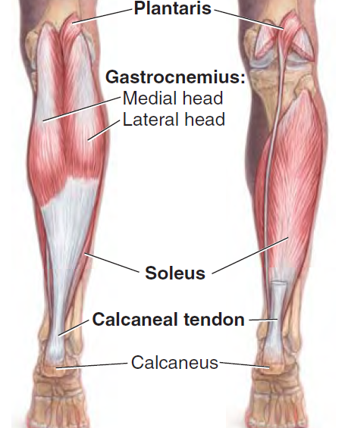
SUPERFICIAL GROUP
Plantaris 2. Gastrocnemius 3. Soleus

Slide 7
SUPERFICIAL GROUP
Muscle | Origin | Insertion | Nerve | Action
Gastrocnemius | Lateral head from lateral condyle of femur & medial head from above medial condyle | Posterior surface of calcaneum via tendo calcaneus | Tibial | Plantar flexes foot at ankle joint; flexes knee joint
Plantaris | Lateral supracondylar ridge of femur | Posterior surface of calcaneum | Tibial | Plantar flexes foot at ankle joint; flexes knee joint
Soleus | Shafts of tibia and fibula | Posterior surface of calcaneum via tendo calcaneus | Tibial | Together with gastrocnemius and plantaris is powerful plantar flexor of ankle joint; provides main propulsive force in walking and running

Slide 8
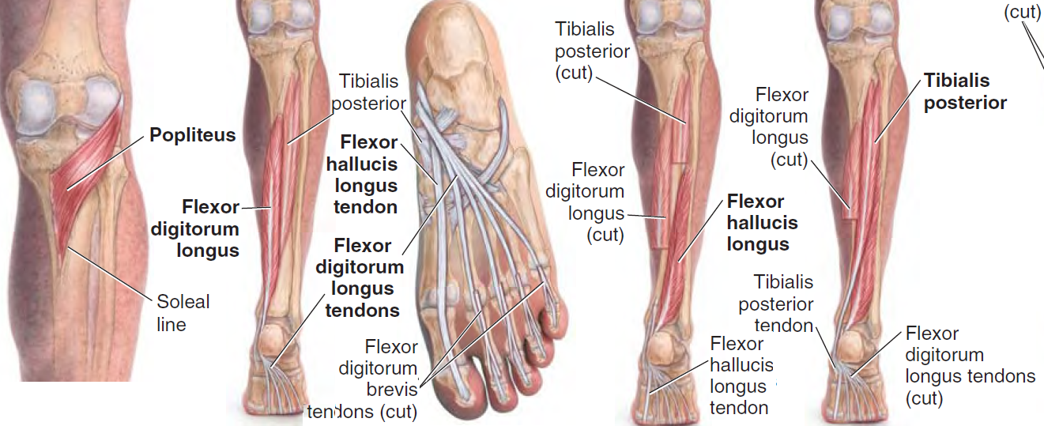
DEEP GROUP
Popliteus 2. Flexor digitorum longus 3. Flexor hallucis longus
4. Tibialis posterior

Slide 9
DEEP GROUP
Popliteus | Lateral surface of lateral condyle of femur | Post surface of shaft of tibia above soleal line | Tibial | Flexes leg at knee joint; unlocks knee joint by lateral rotation of femur on tibia
Flexor digitorum longus | Posterior surface of shaft of tibia | Bases of distal phalanges of lateral four toes | Tibial | Flexes distal phalanges of lateral four toes; plantar flexes foot at ankle joint; supports medial and lateral longitudinal arches
Flexor hallucis longus | Posterior surface of shaft of fibula | Base of distal phalanx of big toe | Tibial | Flexes distal phalanx of big toe; plantar flexes foot at ankle joint; supports medial longitudinal arch
Tibialis posterior | Posterior surface of shafts of tibia and fibula and interosseous membrane | Tuberosity of navicular bone and other neighboring bones | Tibial | Plantar flexes foot at ankle joint; inverts foot at subtalar and transverse tarsal joints; supports medial longitudinal arch

Slide 10
POSTERIOR TIBIAL ARTERY
The posterior tibial artery is one of the terminal branches of the popliteal artery

Slide 11
TIBIAL NERVE
The tibial nerve is the larger terminal branch of the sciatic nerve in the lower third of the back of the thigh

Slide 12
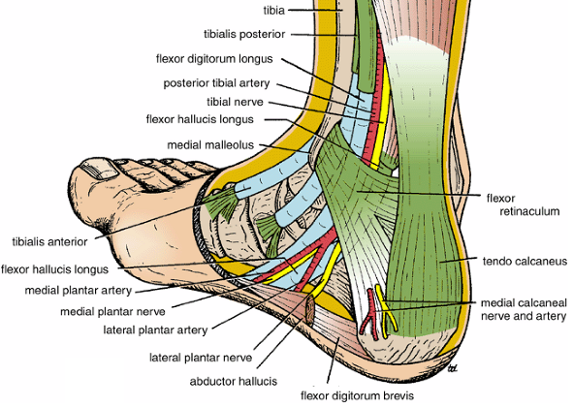
Flexor Retinaculum
Extends from back of
medial malleolus to
medial side of
calcaneum

Slide 13
Structures passing posterior to medial malleolus, deep to flexor retinaculum
Medial to lateral
Tibialis posterior tendon
Flexor digitorum longus tendon
Posterior tibial artery with venae comitantes
Tibial nerve
Flexor hallucis longus tendon
All the tendons are surrounded
by a synovial sheath

Slide 14
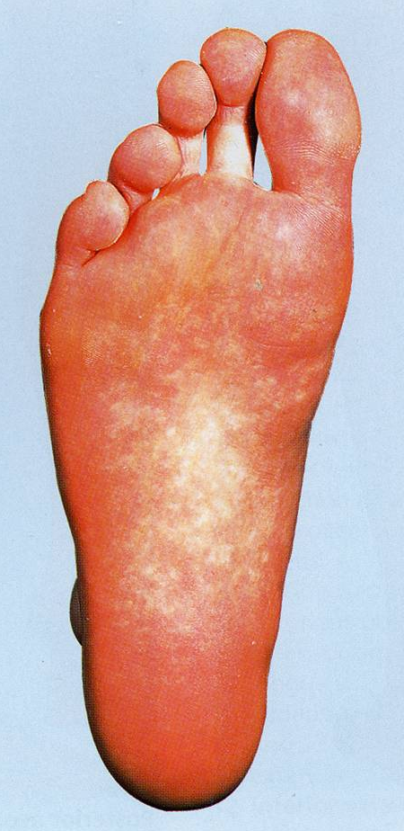
SOLE OF THE FOOT
The skin of the sole of the foot is thick and hairless
The skin of the sole shows a few flexure creases at the sites of skin movement
Sweat glands are present in large numbers

Slide 15
DEEP FASCIA
The plantar aponeurosis is a triangular thickening of the deep fascia that protects the underlying nerves, blood vessels, and muscles.
Its apex is attached to the medial and lateral tubercles of the calcaneum.
The base of the aponeurosis divides into five slips that pass into the toes.

Slide 16
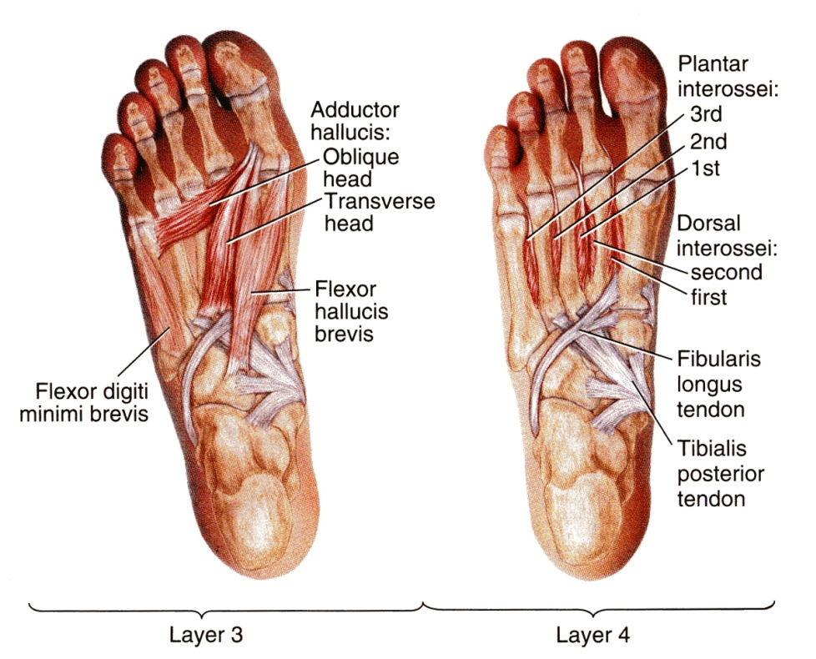
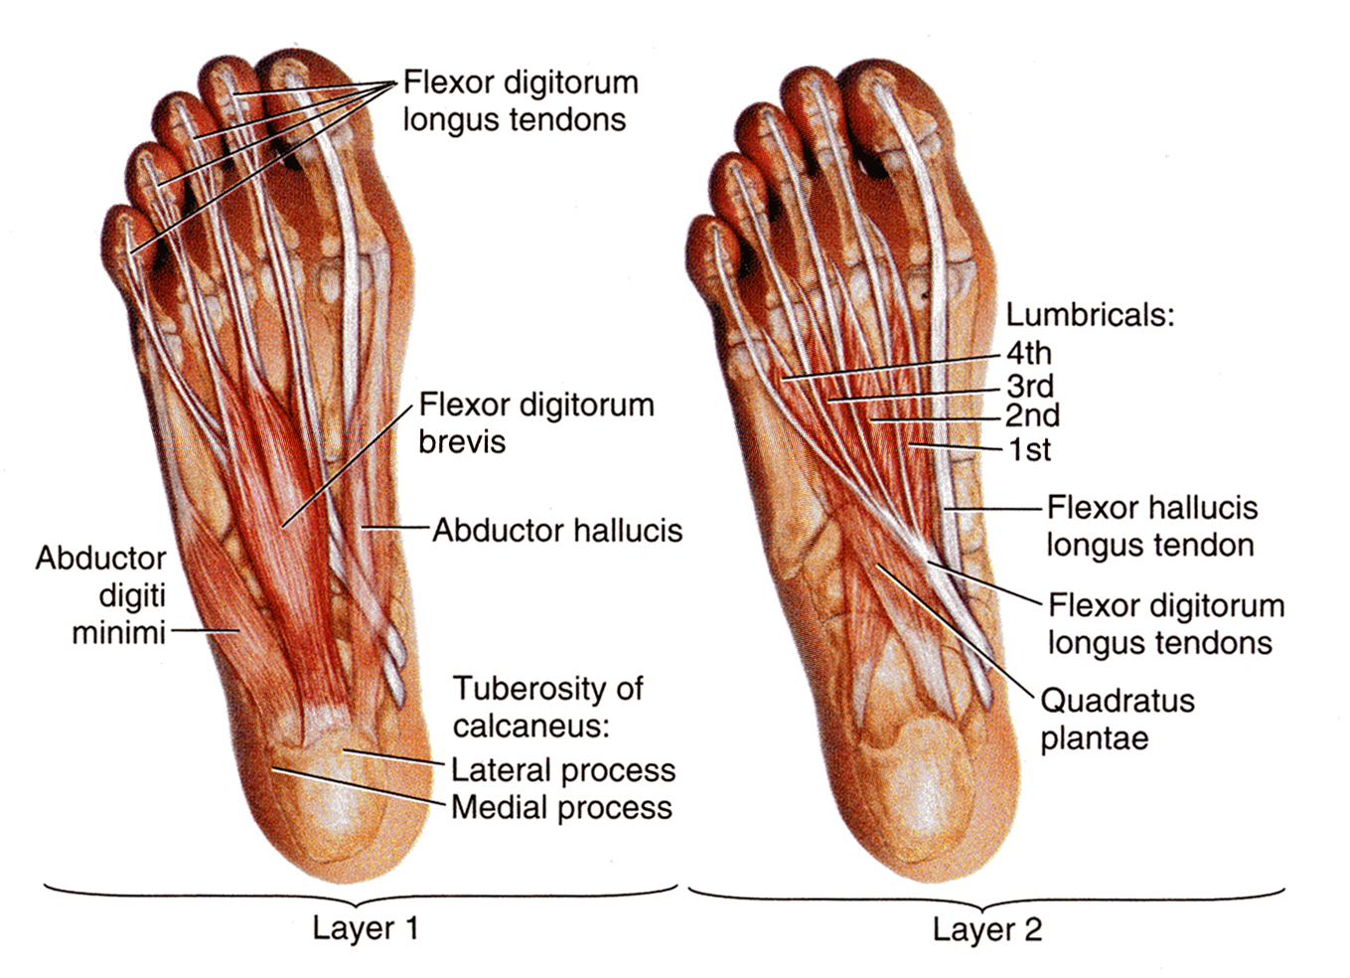
MUSCLES OF THE SOLE OF THE FOOT
The muscles of the sole are conveniently described in four layers from superficial to deep.

Slide 17
First Layer
Abductor hallucis,
Flexor digitorum brevis,
Abductor digiti minimi

Slide 18
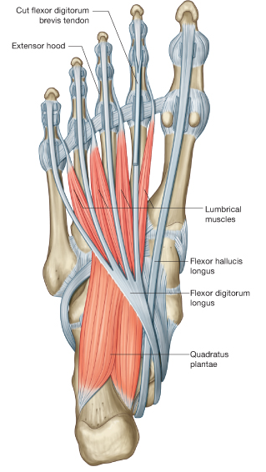
Second Layer
Quadratus plantae,
Lumbricals,
Flexor digitorum longus tendon,
Flexor hallucis longus tendon

Slide 19
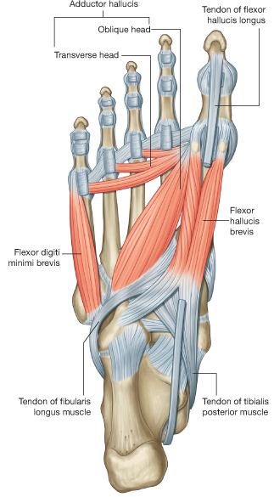
Third Layer
Flexor hallucis brevis
Adductor hallucis
Flexor digiti minimi brevis

Slide 20
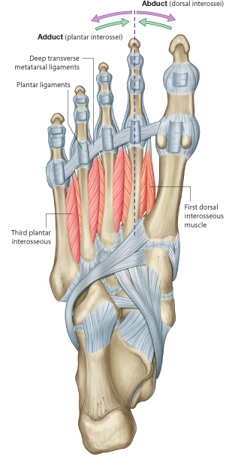
Fourth Layer
Interossei,
Peroneus longus tendon,
Tibialis posterior tendon

Slide 21
Unlike the small muscles of the hand, the sole muscles have few delicate functions and are chiefly concerned with supporting the arches of the foot.
Although their names would suggest control of individual toes, this function is rarely used in most people

Slide 22
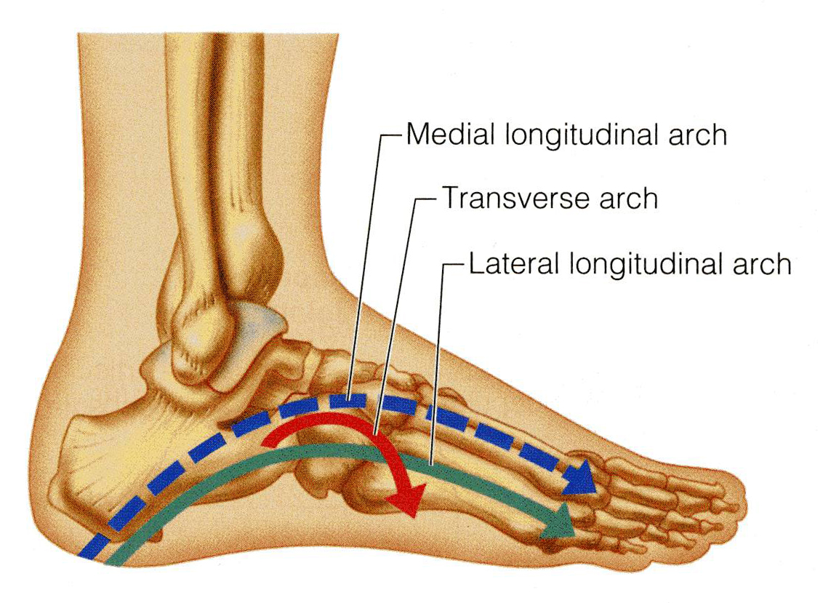
Arches of Foot
Medial longitudinal arch
Is formed of calcaneum, talus, navicular, 3 cuneiform bones, and first medial 3 metatarsal bones.
Lateral longitudinal arch
Is formed of calcaneum, cuboid & lateral 4th & 5th metatarsal bones
Transverse arch
Lies at the level of tarso-metatarsal joints, formed of bases of metatarsal bones, cuboid & 3 cuneiform bones.

Slide 23
Function of Arches of the Foot
Weight bearing
Support walking & running
Provide potential space neurovascular bundle of the sole
Act as shock absorber
In young child the foot appears to be flat because of presence of a large amount of subcutaneous fat on the sole of foot

Slide 24
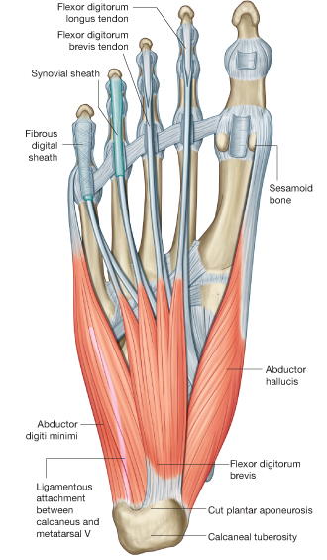
Fibrous Flexor Sheaths
The inferior surface of each toe, from the head of the metatarsal bone to the base of the distal phalanx, is provided with a strong fibrous sheath, which is attached to the sides of the phalanges.
The fibrous sheath, together with the inferior surfaces of the phalanges and the interphalangeal joints, forms a blind tunnel in which lie the flexor tendons of the toe

Slide 25
Synovial Flexor Sheaths
The tendons of the flexor hallucis longus and the flexor digitorum longus are surrounded by synovial sheaths

Slide 26
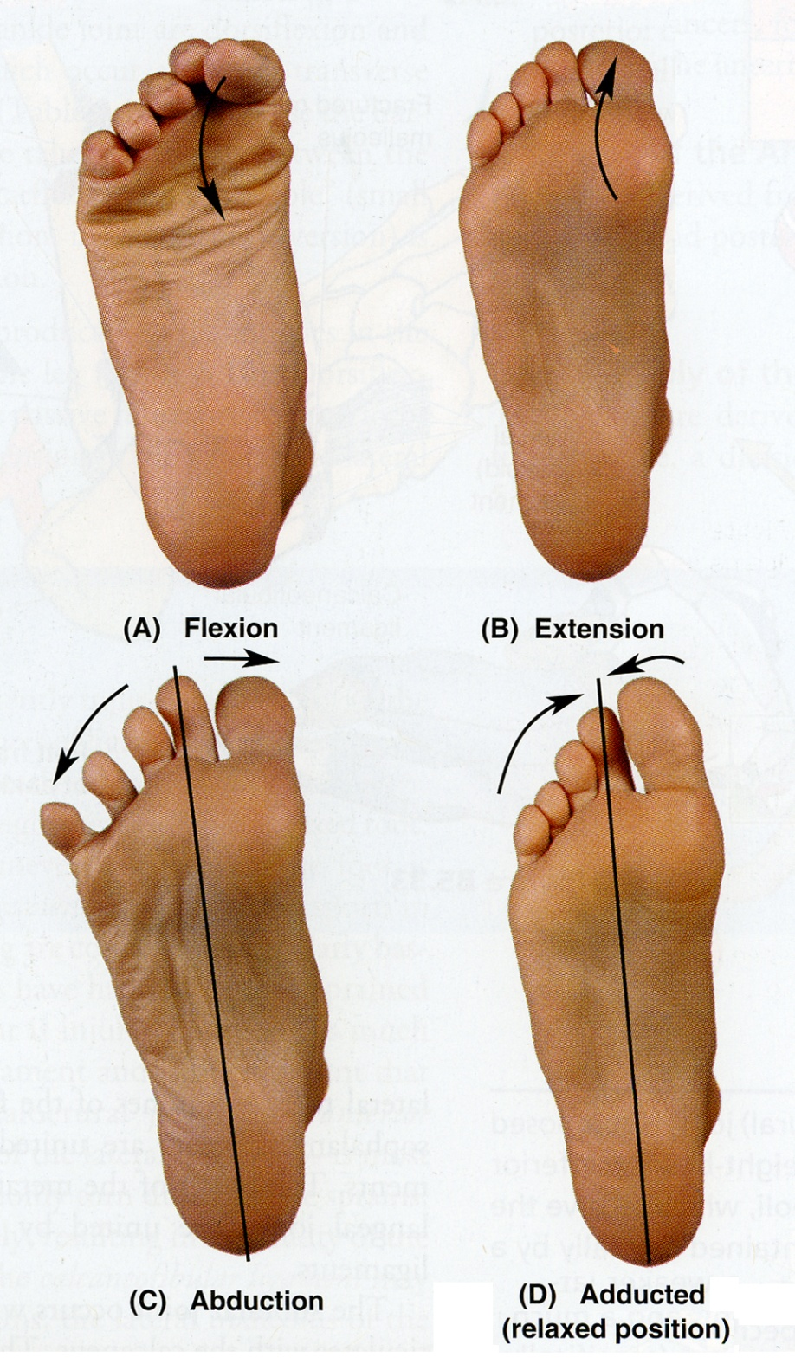
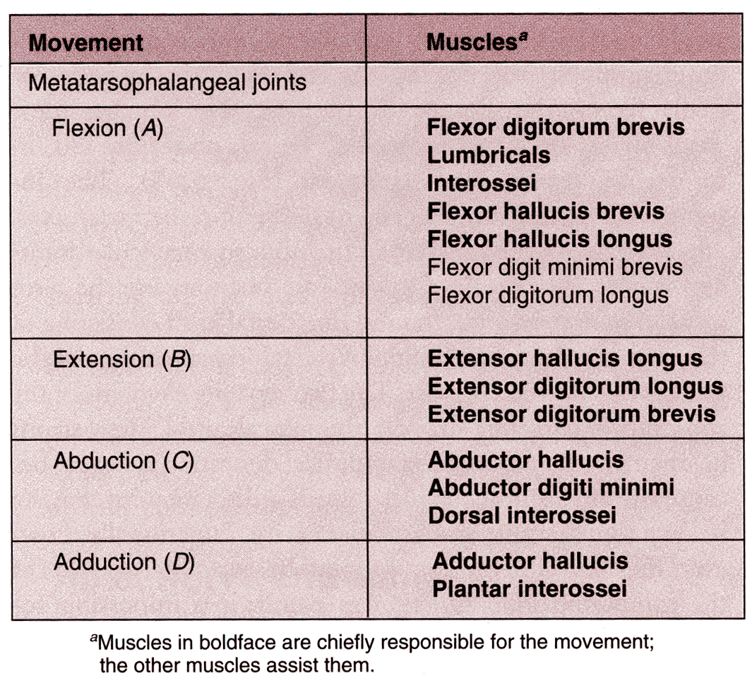

Slide 27
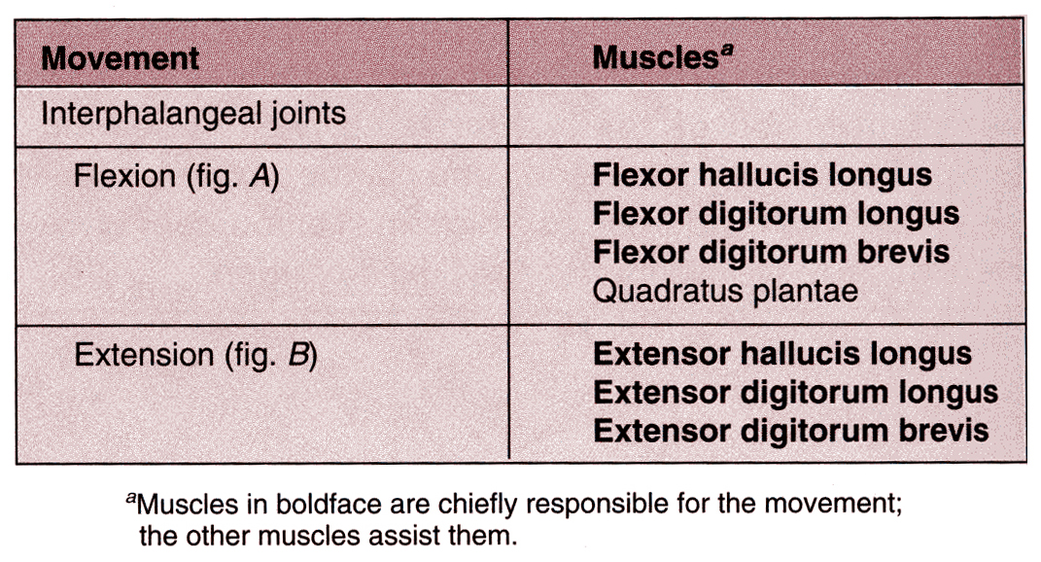

Slide 28
THE END

