Slide 1
Radiology of the back
Radiology department

Slide 2
X-ray

Slide 3
1
4
2
5
6
3

Slide 7
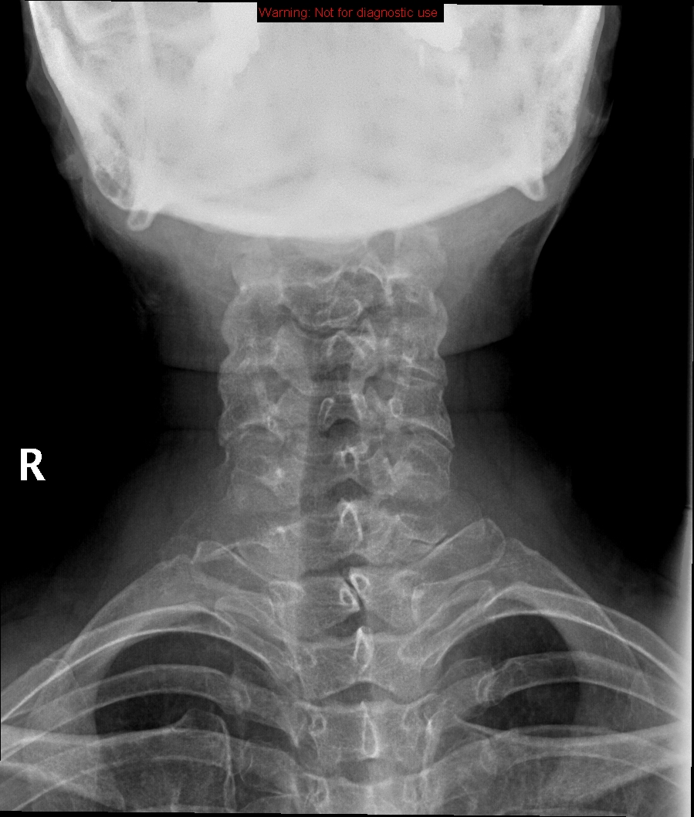
1
2
3
4

Slide 8
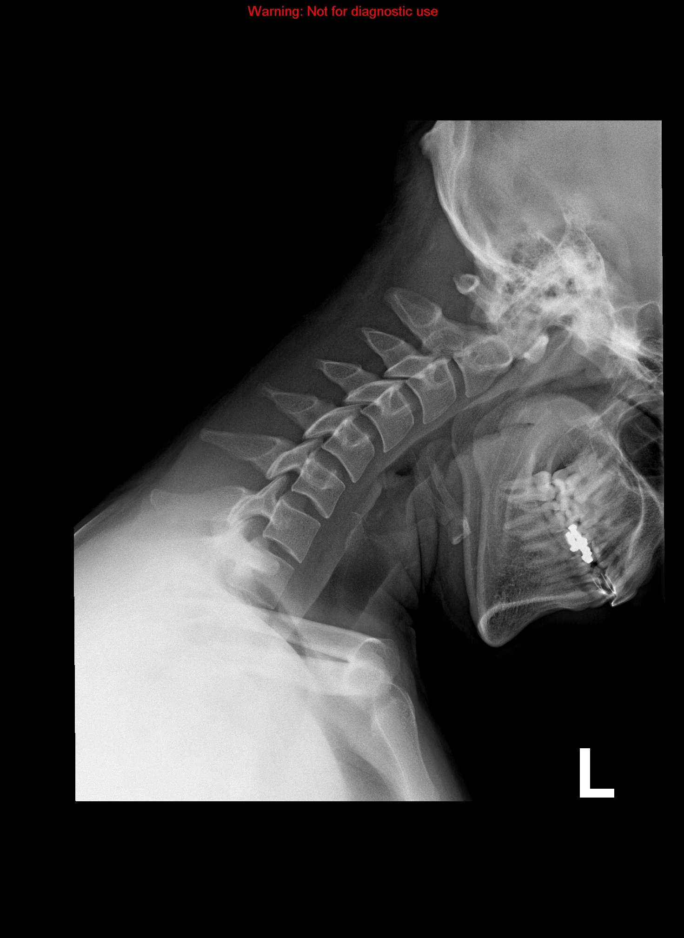

Slide 9
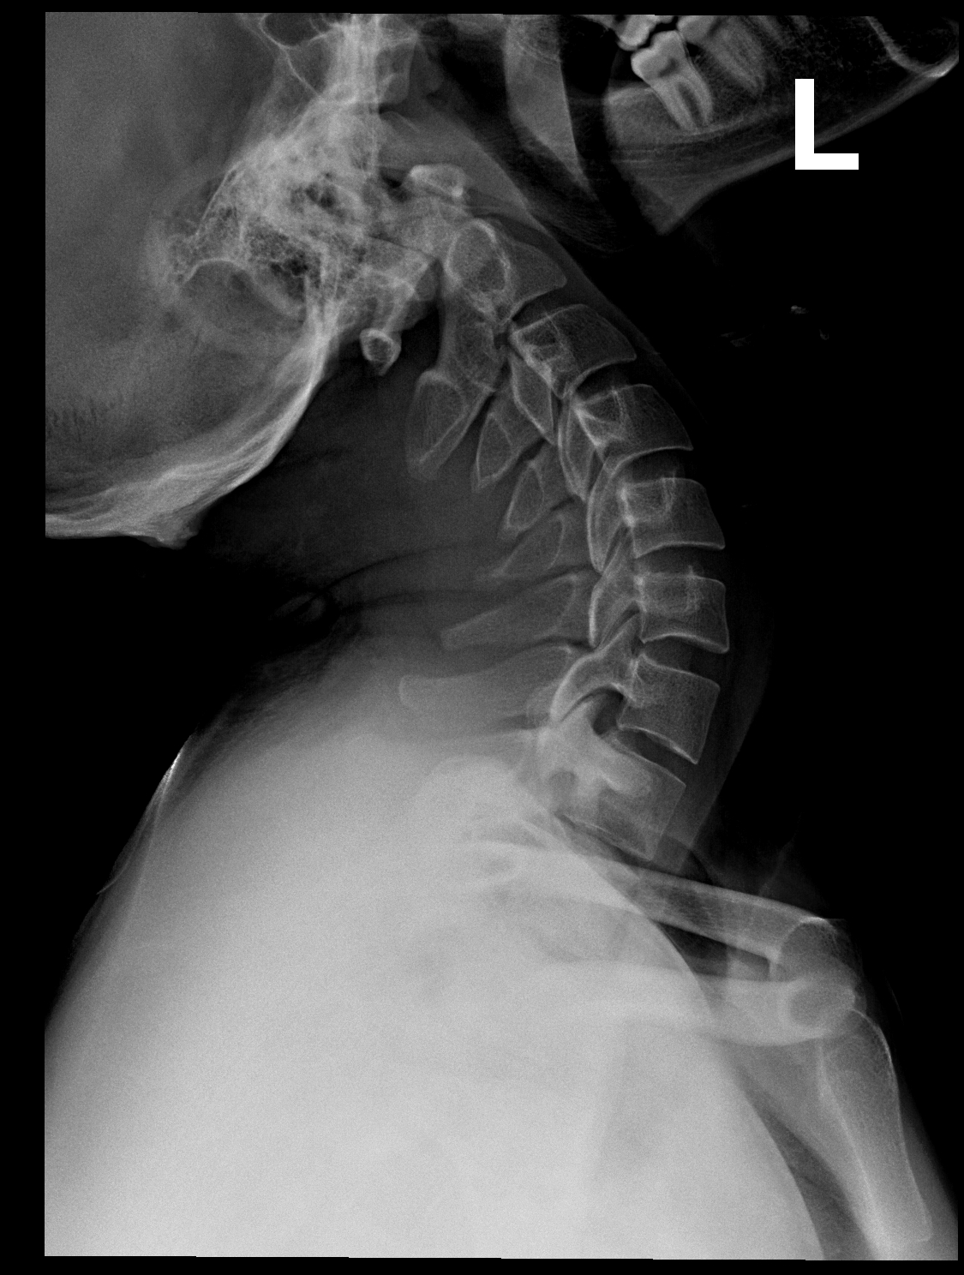

Slide 11
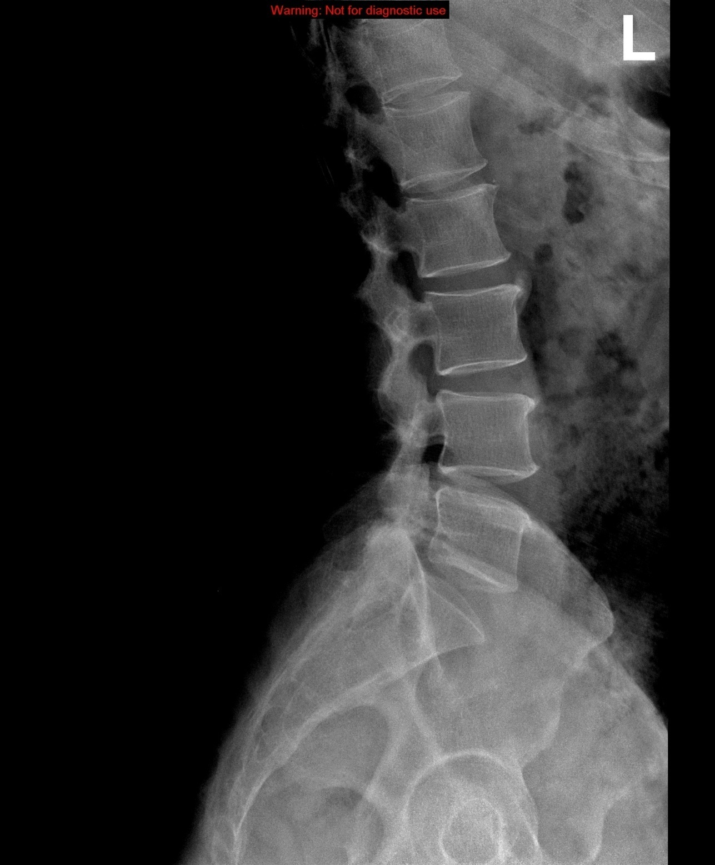
3
1
2

Slide 12
T12
L1
L2
L3
L4
L5
S

Slide 13
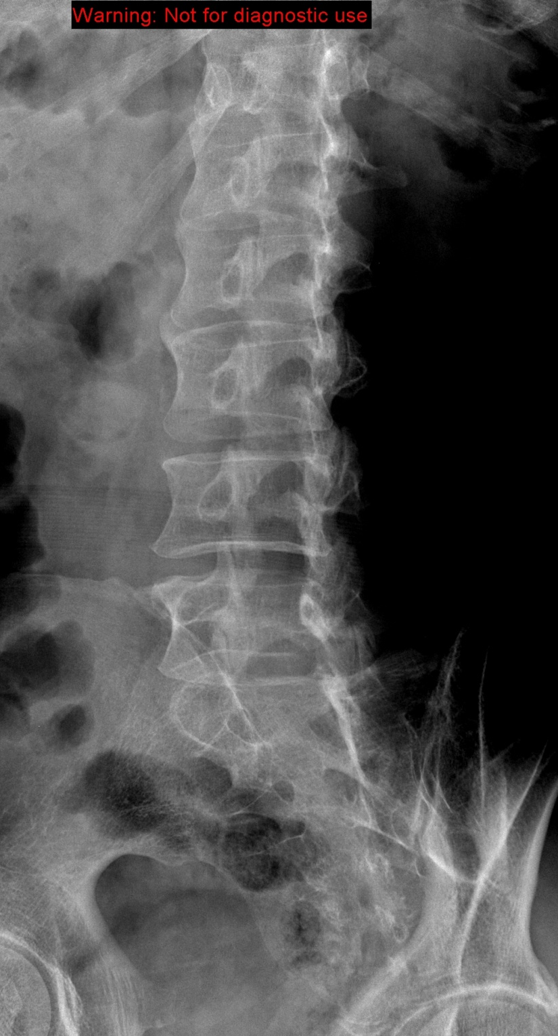

Slide 14
CT

Slide 15
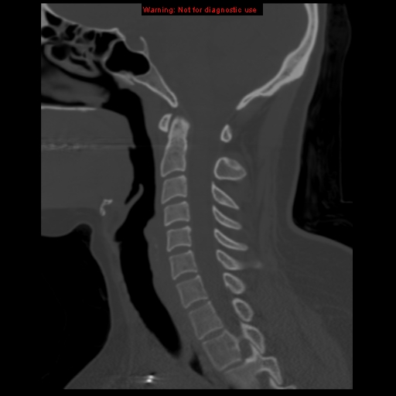
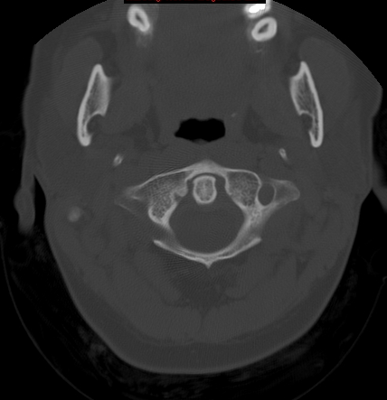
4
1
5
2
3
6

Slide 16
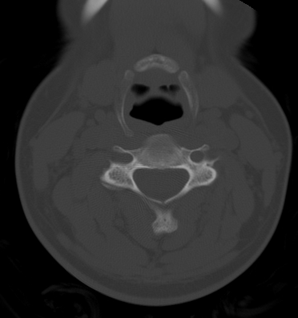
1
4
5
2
3
6

Slide 17
4
1
5
2
6
3
7

Slide 18
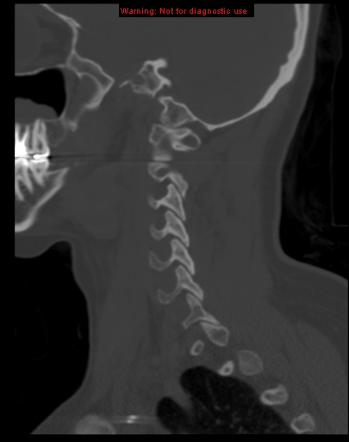
1
2
3

Slide 19
5
1
6
2
7
3
8
4

Slide 20
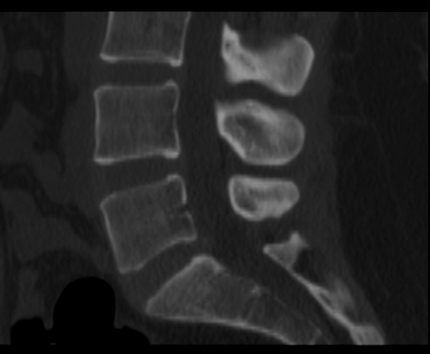
3
1
2
4

Slide 21
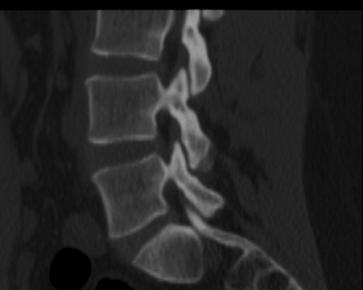
1
2
3
4

Slide 22
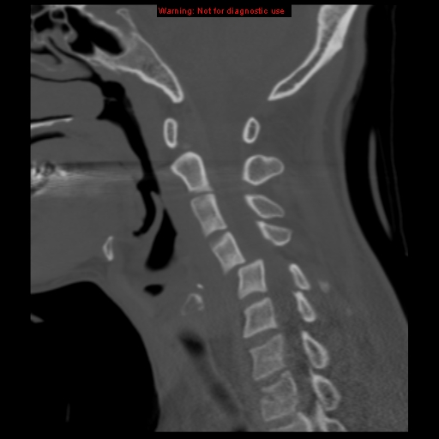
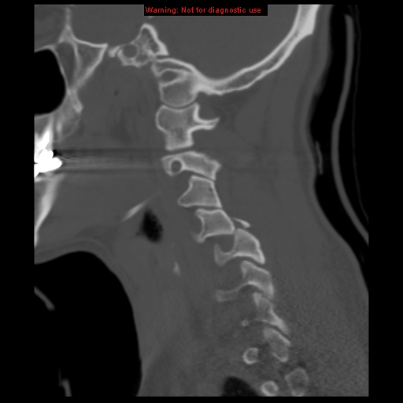

Slide 23
MRI

Slide 24
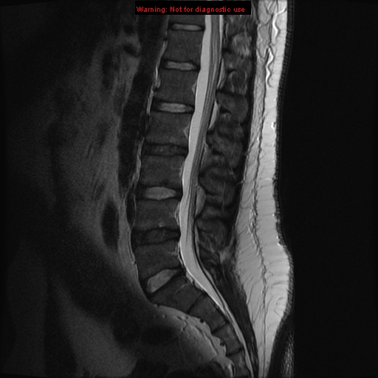
1
4
2
3
5
6
7

Slide 25
T12
L1
L2
L3
L4
L5
S1

Slide 26
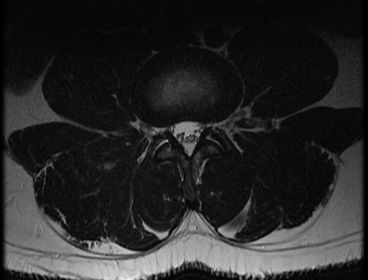
6
5
4
7
1
8
2
9
3

Slide 27
