Slide 1
بسم الله الرحمن الرحيم

Slide 2
Creatine Metabolism
Dr. Sumbul Fatma
Department of Pathology

Slide 3
Objectives
To study the importance of creatine in muscle as a storage form of energy
To understand the biosynthesis of creatine
To study the process of creatine degradation and formation of creatinine as an end product
To understand the clinical importance of creatinine as a sensitive indicator of kidney function
To study different types of creatine kinase (CK) and their clinical importance

Slide 4
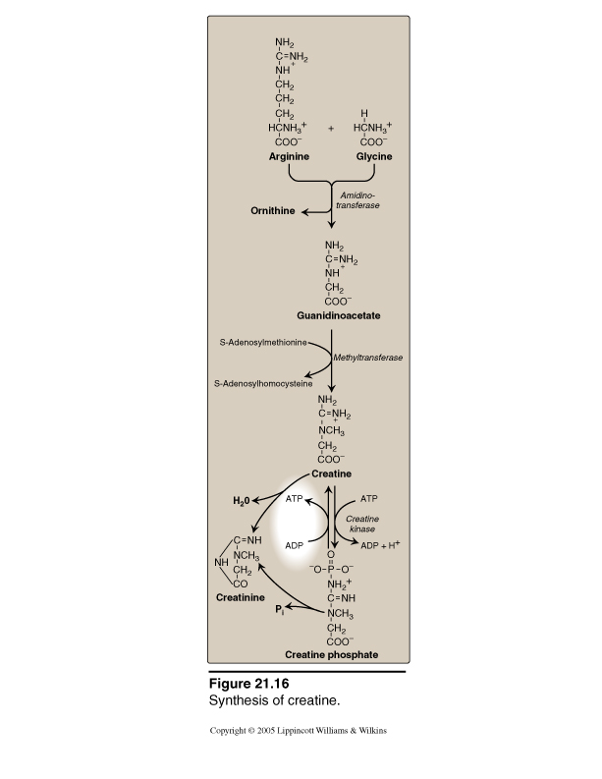
Creatine Metabolism
End product
Energy Source

Slide 5
Creatine Biosynthesis
Three amino acids are required:
Glycine
Arginine
Methionine (as S-adenosylmethionine)
Site of biosynthesis:
Step 1: Kidneys
Step 2: Liver

Slide 6
Creatine Biosynthesis
Arginine + Glycine
Kidneys
Amidino-transferase
Ornithine
Guanidinoacetate
SAM
Liver
Methyltransferase
SAH
Creatine

Slide 7
Distribution of body creatine
From liver, transported to other tissues
98% are present in skeletal and heart muscles
In Muscle, gets converted to the high energy source creatine phosphate (phosphocreatine)
Creatine
ATP
ATP
Creatine Kinase
ADP
ADP + H+
Creatine phosphate

Slide 8
Creatine Phosphate
Is a high-energy phosphate compound
Acts as a storage form of energy in the muscle
Provides a small but, ready source of energy during first few minutes of intense muscular contraction
The amount of creatine phosphate in the body is proportional to the muscle mass

Slide 9
Creatine Degradation
Creatine and creatine phosphate spontaneously form creatinine as an end product
Creatinine is excreted in the urine
Serum creatinine is a sensitive indicator of kidney disease (Kidney function test)
Serum creatinine increases with the impairment of kidney function

Slide 10
Creatine Degradation
Creatine
H₂O
ATP
ATP
Creatinine
Creatine Kinase
ADP
ADP + H+
Pi
Plasma
Creatine phosphate
Glomerular filtration
Urine

Slide 11
Urinary Creatinine
A typical male excretes about 15mmol of creatinine per day
A decrease in muscle mass due to muscular dystrophy or paralysis leads to decreased level of creatinine in urine
The amount of creatinine in urine is used as an indicator for the proper collection of 24 hours urine sample

Slide 12
Creatine Kinase (CK)
CK is responsible for the generation of energy in contractile muscular tissues
CK levels are changed in disorders of cardiac and skeletal muscle
Creatine
ATP
ATP
Creatine Kinase
ADP
ADP + H+
Creatine phosphate

Slide 13
Creatine Kinase (CK)
CK is required for conversion of creatine into creatine phosphate
CK has 3 isoenzymes:
CK-MM mainly in skeletal muscle
CK-MB mainly in heart muscle
CK-BB mainly in brain
3. Serum total CK is increased in:
Crush injuries (Damage of skeletal muscles)
Myocardial infarction (Damage of heart muscle)

Slide 14
Creatine Metabolism
End product
Energy Source

Slide 15
References
Lippincott, page 287-288
Bishop 6th edition, page 223-227

Slide 16
Creatinine in urine and plasma
Normal serum creatinine level is 0.7 to 1.4 mg/dl and serum creatine level is 0.2 to 0.4mg/dl
The amount of creatinine excreted is proportional to the total creatine phosphate content of the body
therefore can be used to estimate muscle mass
Serum creatinine is a sensitive indicator of kidney disease (Kidney function test)
Because normally creatinine is rapidly removed from the blood and excreted
The amount of creatinine in urine is used as an indicator for the proper collection of 24 hours urine sample (normal urinary output is 15-25 mg/kg/d)

