Slide 1
DEVELOPMENT OF SKELETAL & MUSCULAR SYSTEM
Dr. Ahmed Fathalla Ibrahim
Associate Professor of Anatomy
College of Medicine
King Saud University
E-mail: ahmedfathala@hotmail.com
Dr. Zeenat Zaidi
Associate Professor of Anatomy
College of Medicine
King Saud University
zeenatzaidi@hotmail.com

Slide 2
OBJECTIVES
At the end of the lecture, the student should be able to describe the:
Division of the intraembryonic mesoderm.
Formation and division of somite.
Derivatives of somite (sclerotome & myotome).
Formation of somatic and splanchnic layers of lateral plate mesoderm and their derivatives.
Difference between the intramembranous and intracartilaginous ossification and name the bones developed by these processes.
The origin of skeletal, cardiac and smooth muscles in the body.

Slide 3
Intraembryonic Mesoderm
Develops between Ectoderm & Endoderm EXCEPT in the central axis of embryo where NOTOCHORD is found.
Differentiates into 3 parts:
Paraxial mesoderm: on each side of notochord.
Intermediate mesoderm
Lateral mesoderm
Notochord:
stimulates neural tube
formation
3
2
1

Slide 4
Paraxial mesoderm divides into units (somites).
Lateral mesoderm divides by intraembryonic coelom into:
Somatic mesoderm (between ectoderm & coelom).
Splanchnic mesoderm (between endoderm & coelom).
Somatic mesoderm
Intraembryonic celome
Splanchnic mesoderm

Slide 5
A small cavity, the myocele appears in each somite but soon disappears
Each somite divides into ventromedial part called sclerotome and dorsolateral part the dermomyotome
Sclerotome: Bones of the axial skeleton (cranium, vertebral column, ribs and sternum)
Myotome: Associated muscles of the back &
Dermatome: The adjacent dermis of the skin

Slide 6
Development of the Bones
Based on the mode of development, there are two types of bones in the body:
Cartilage bones, that develop via intracartilagenous (endochondral ossification). A cartilage model first forms and is eventually replaced with bone e.g. formation of the bones of the axial & appendicular skeletons and the cranial base.
Membrane bones, that develop via intramembranous ossification. Bone forms directly from mesenchymal cells without the prior formation of cartilage e.g. majority of bones of the face and skull

Slide 7
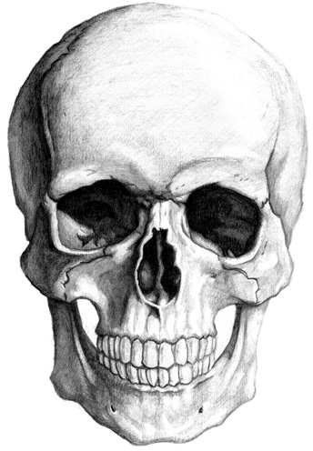
Development of Cranium (Skull)
The skull bones develops from mesoderm around the developing brain.
The skull consists of:
Neurocranium: protective case for brain
Viscerocranium: skeleton of face
Bones of skull ossify either by:
Intracartilagenous (Endochondral) ossification, or
Intramembranous ossification

Slide 8
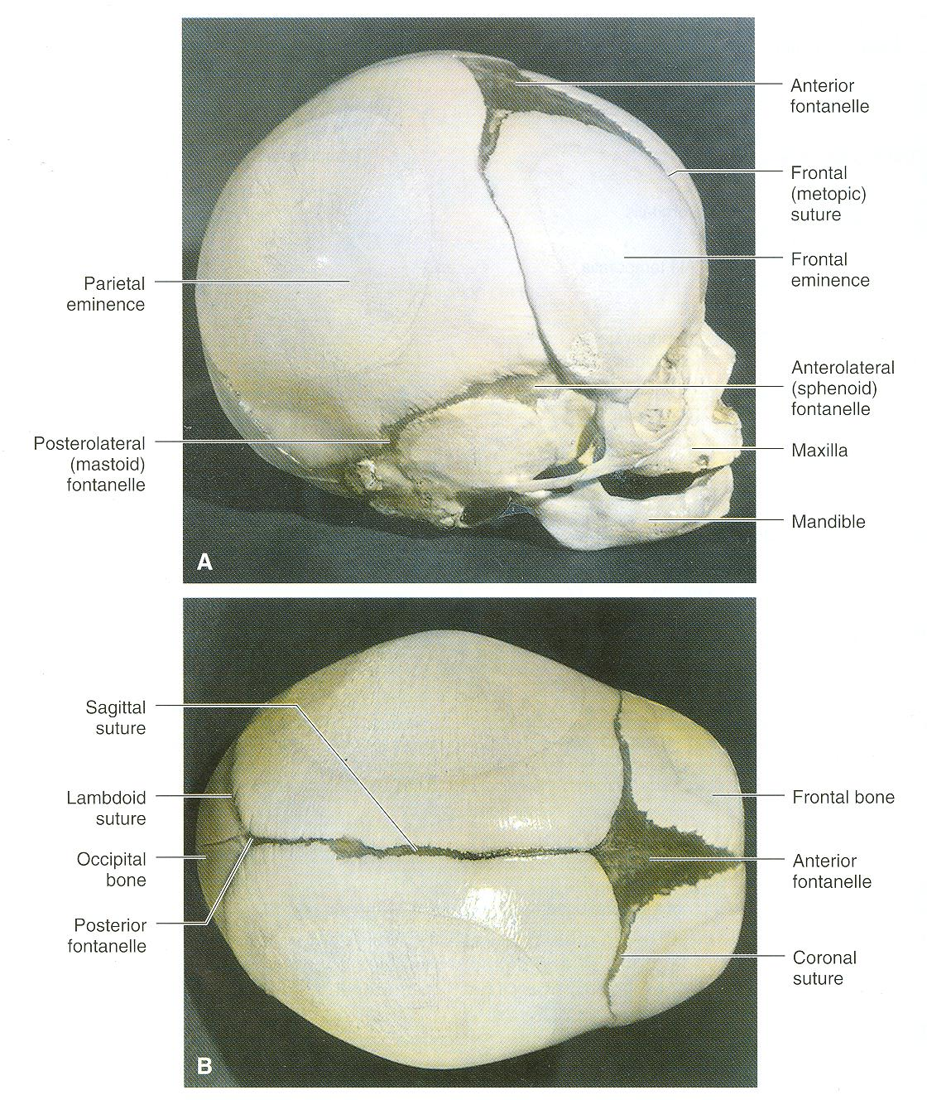
Bones of skull that ossify by
intramembranous ossification:
Frontal
Parietal
Zygomatic
Squamous temporal
Maxilla
Mandible
2
1
3
5
4
6
Base of skull develops by
intracartilagenous ossification
2
1

Slide 9
Mesenchyme from lateral mesoderm
Induces growth of mesenchyme & its transformation into cartilage
Cartilage ossifies by:
Endochondral ossification
Myoblasts migrate from myotomes to form:
Muscles of limbs

Slide 10
Ossification of Long Bones
Appearance of
primary ossification
centers: ossification
of diaphysis
Appearance of
secondary ossification
centers: ossification
of epiphysis
Ossification of
epiphseal plate:
Complete union of
epiphysis & diaphysis
Bone in
cartilaginous state
Epiphysis
Epiphyseal
plate of
cartilage
Growth of
bone stops
Diaphysis
Diaphysis
Epiphysis
BIRTH
PUBERTY
Bone increases in length by
proliferation of epiphyseal plate
Bone age is a good index of general maturation. Bone age is determined by:
Appearance of ossification centers in diaphysis & epiphysis (specific for each bone & sex)
Disappearance of epiphyseal plate (specific for each bone & sex)

Slide 11
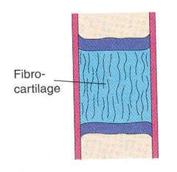
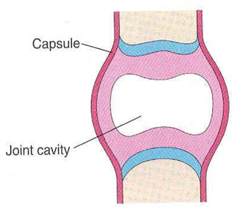
Development of Joints
They develop from mesoderm lying between bones:
In fibrous joints: mesoderm differentiates into dense fibrous connective tissue.
In cartilaginous joints: mesoderm differentiates into cartilage.
In synovial joints: a synovial cavity is formed inside mesoderm; mesoderm differentiates into synovial membrane, capsule & ligaments.

Slide 12
Summary of Development of Bone
All bones develop from MESODERM.
AXIAL SKELETON:
*Vertebrae, ribs & sternum: from sclerotomes of somites (paraxial mesoderm)
*Skull: from mesoderm surrounding the brain
APPENDICULAR SKELETON: from somatic part of lateral mesoderm
All bones ossify by endochondral ossification EXCEPT:
Some bones of skull
Clavicle

Slide 13
12 weeks embryo

Slide 14
DEVELOPMENT OF MUSCLES
All muscles develop from MESODERM EXCEPT muscles of iris (eyeball) and myoepithelial cells of mammary & sweat glands which develop from ECTODERM
Cardiac muscles develop from: splanchnic part of lateral mesoderm
Smooth muscles:
In the wall of viscera from: splanchnic part of lateral mesoderm
In the wall of blood & lymphatic vessels from: somatic part of lateral mesoderm
All skeletal muscles develop from myotomes of paraxial mesoderm EXCEPT some head & neck muscles which develop from mesoderm of pharyngeal arches

Slide 15
Myotome
Each myotome divides into:
Dorsal Epaxial division
Ventral Hypaxial division
The Epaxial division gives rise to the muscles of the back (extensor muscles of the vertebral column)
Ventral Hypaxial division gives rise to the muscles of the ventral body wall
Myoblasts migrate
into limb and give
Limb muscles

Slide 16
QUESTION 1
Which one of the following group of muscles are derivatives from epaxial division of myotomes?
Muscles of back
Muscles of limbs
Muscles of viscera
Cardiac muscles

Slide 17
QUESTION 2
Which one of the following bones ossifies by intramembranous ossification?
Vertebra
Humerus
Ribs
Mandible

Slide 18
QUESTION 3
Regarding the ossification of long bones, which one of the following statement is correct?
Primary ossification centre appears after birth.
Secondary ossification centre leads into ossification of diaphysis.
Long bones ossify by intramembranous ossification.
When epiphysis unites with diaphysis, growth of bone stops.

Slide 19
thank u & good luck

