Slide 1
MUSCULAR TISSUE
Objectives:
By the end of this lecture you should be able to:
Identify and describe the histological structure of the three types of muscle cells and list the differences between them.

Slide 2
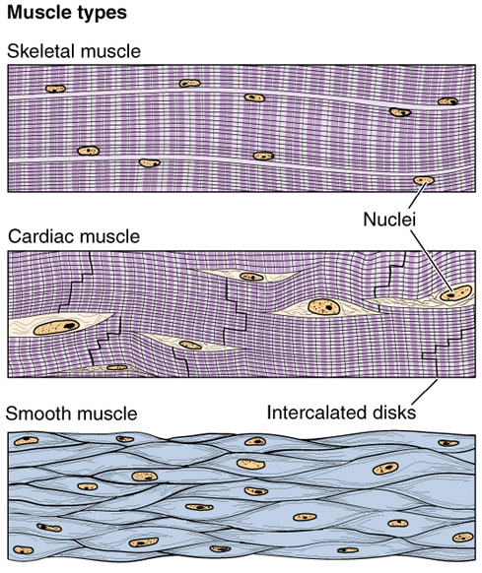
MUSCULAR TISSUE
Made of elongated muscle cells (fibers).
3 types of muscles (muscle fibers):
1- Skeletal: striated, voluntary.
2- Cardiac: striated, involuntary.
3- Smooth: non-striated, involuntary.

Slide 3
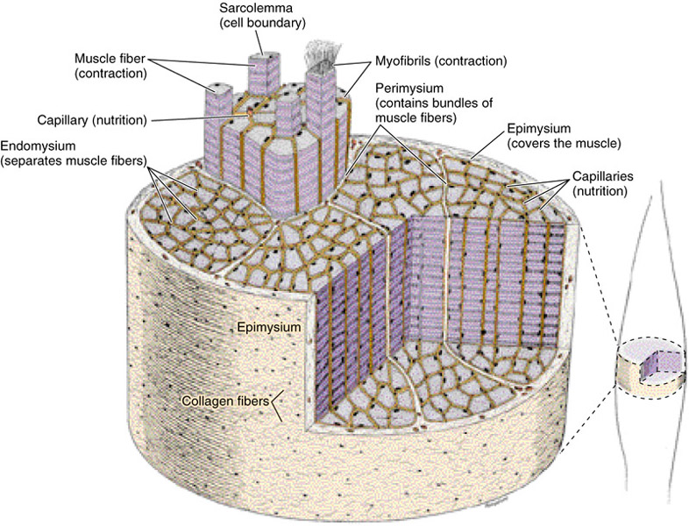
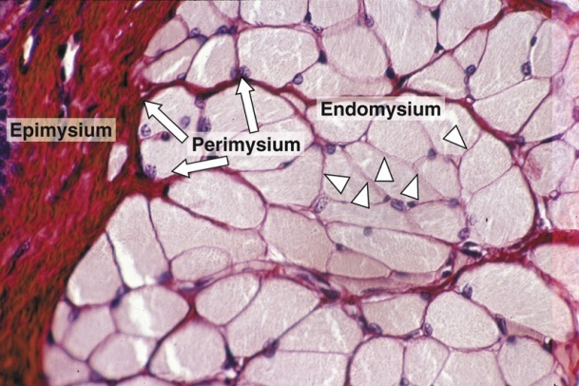
SKELETAL MUSCLE
The whole muscle is covered by a C.T. covering, the epimysium.
Consists of parallel skeletal muscle fibers, arranged in bundles, separated by C.T. septa, the perimysium.
The individual fibers are separated by C.T., endomysium,

Slide 4
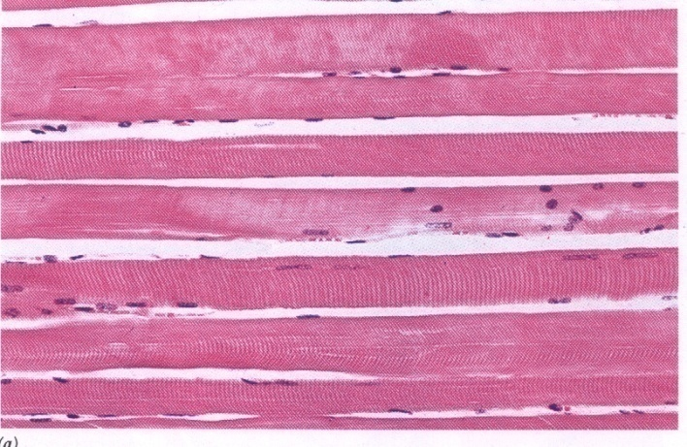
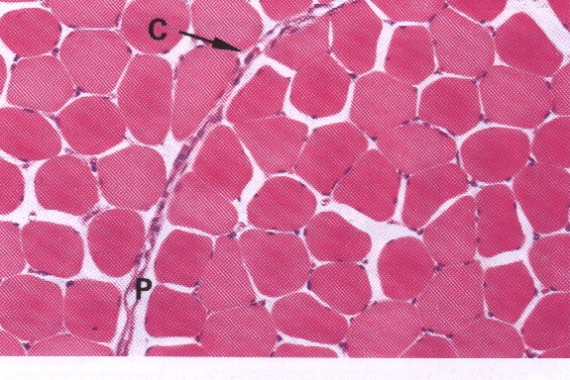
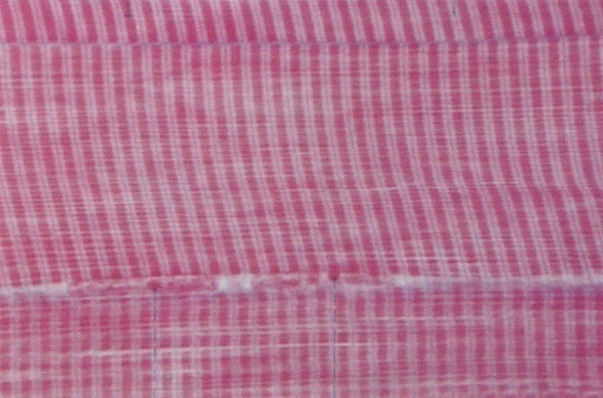
Skeletal Muscle Fibers
L.M. Picture:
Cylindrical in shape.
Non-branched.
Covered by a clear cell membrane, the sarcolemma.
Multinucleated: nuclei are multiple and are peripherally located (close to the sarcolemma).
Cytoplasm (sarcoplasm) is acidophilic and shows clear transverse striations.

Slide 5
Thank you

Slide 6
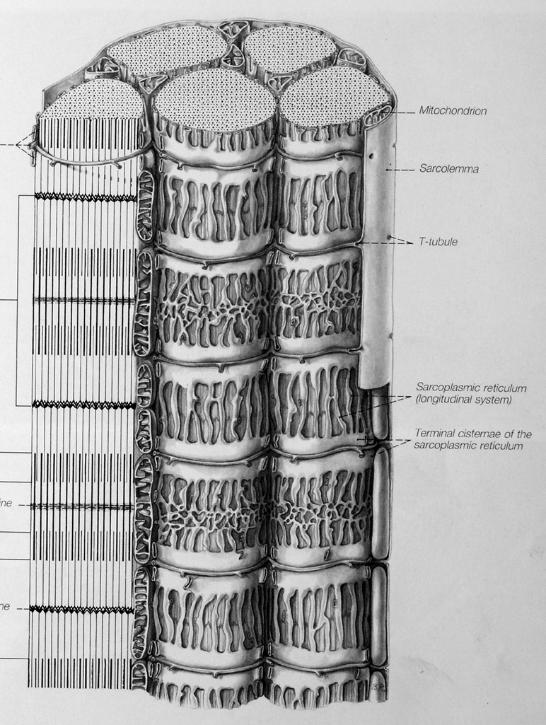
Skeletal Muscle Fibers
E.M. Picture:
Sarcoplasm contains:
Parallel myofibrils.
Numerous mitochondria, arranged in rows between the myofibrils.
Well developed smooth endoplasmic reticulum (sarcoplasmic reticulum).
Myoglobin pigment.
Glycogen.

Slide 7
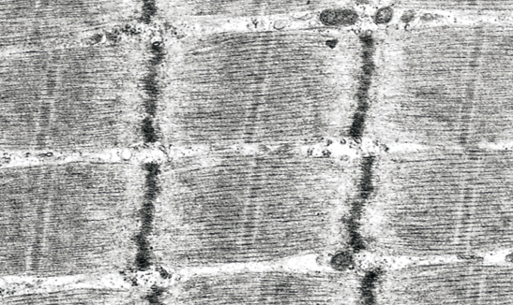
Skeletal Muscle Fibers
E.M. Picture of Myofibrils:
Contractile threads (organelles), arranged longitudinally in the sarcoplasm.
Each myofibril shows alternating dark (A) and light bands (I).
The A band shows a pale area in the middle (H band) which is divided by a dark line (M line).
The (I) band shows a dark line in the middle (Z line).

Slide 8
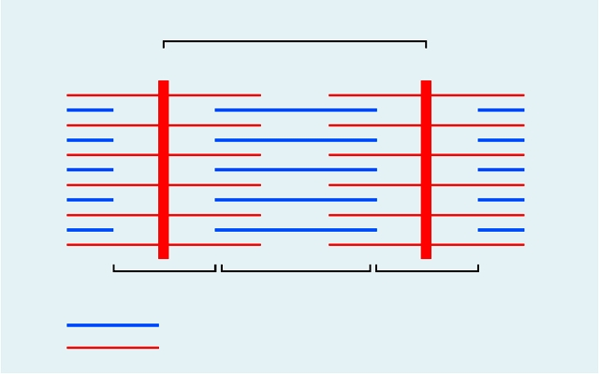
Skeletal Muscle Fibers
E.M. Picture of Myofibrils:
The sarcomere is the distance between 2 successive Z lines.
The myofibrils are formed of myofilaments (thick myosin and thin actin).
The (A) band is formed of myosin myofilaments mainly and the terminal ends of actin myofilaments.
The (I) band is formed of actin myofilaments.
Sarcomere
Z
Z
I
A
I
A
A
A
A
A
Myosin
Actin
Notes:
The (A) band is dark because it contains both myosin and actin. The (I) band and the (H) zone are light because they have only one type of myofilaments (actin in I and myosin in H).

Slide 9
Skeletal Muscle Fibers
The TRIAD tubular system:
The sarcolemma sends transverse invaginations into the sarcoplasm, the T-tubules. They form collars around the myofibrils at the level of the A - I junctions.
The SR forms transverse wider cisternae (terminal cisternae) on either side of the T-tubule.
The 2 terminal cisternae of the SR and the T-tubule in-between them form the triad tubular system, which plays an important role during muscle contraction.

Slide 10
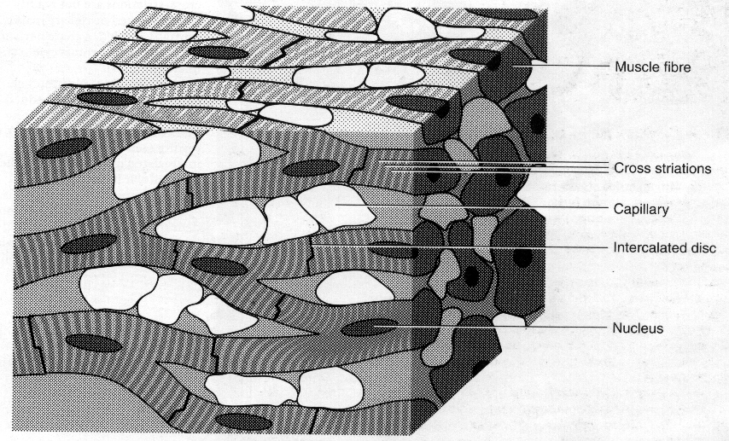
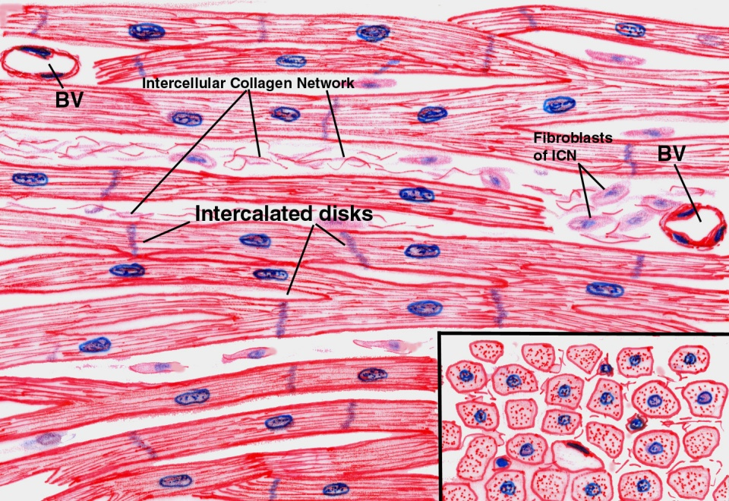
CARDIAC MUSCLE
Found in the myocardium.
Striated and involuntary.
L.M. Picture of Cardiac Muscle Fibers:
Cylindrical in shape.
Intermediate in diameter between skeletal and smooth muscle fibers.
Branch and anastomose.
Covered by a thin sarcolemma.
Mononucleated. Nuclei are oval and central.
Sarcoplasm shows non-clear striations (fewer myofibrils).
Divided into short segments (cells) by the intercalated discs.

Slide 11
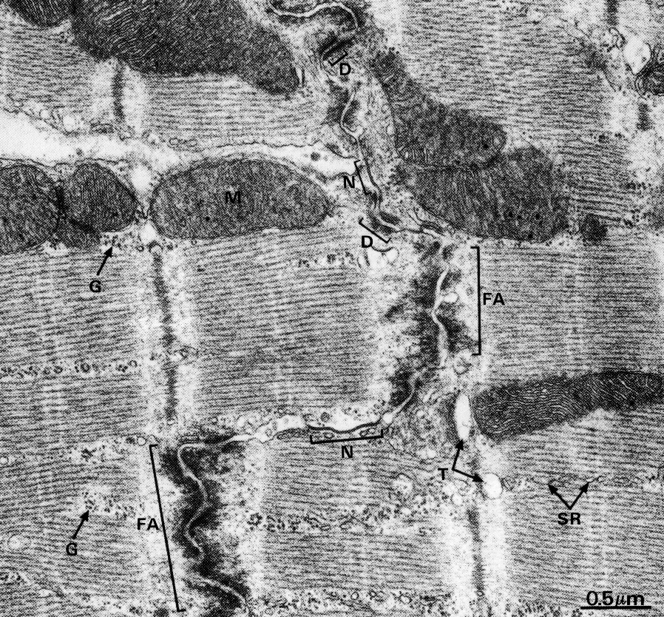
Cardiac Muscle Fibers
E.M. Picture:
Few myofibrils.
Numerous mitochondria.
Less abundant SR.
T-tubules come in contact with only one cisterna of SR forming “Diads” (not triads).
Glycogen & myoglobin.
Intercalated discs: are formed of the two cell membranes of 2 successive cardiac muscle cells, connected together by junctional complexes (desmosomes and gap junctions).
Notes:
Gap junctions allow communication and passage of impulses between cardiac muscle cells.

Slide 12
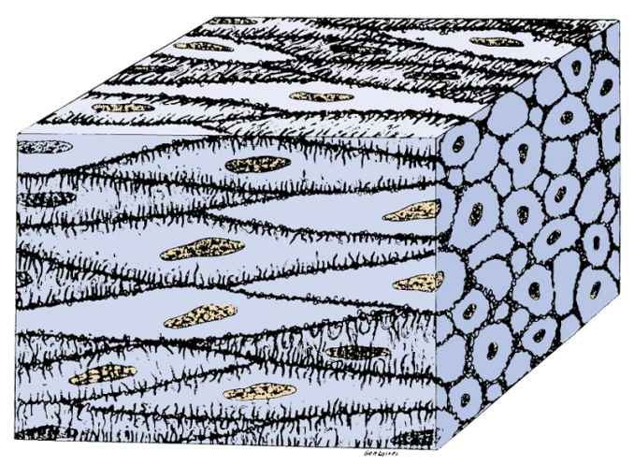
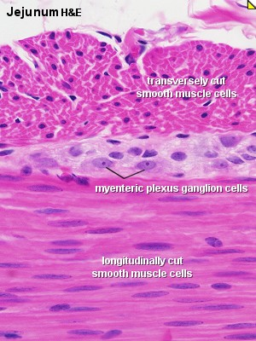
SMOOTH MUSCLE
Present in walls of blood vessels and viscera (digestive, urinary, genital .... etc).
Non-striated and involuntary.
L.M. Picture of Smooth Muscle Fibers:
Fusiform in shape (spindle-shaped).
Small diameter.
Non-branched.
Thin sarcolemma.
Mononucleated. Nuclei are oval & central in position.
Sarcoplasm is non-striated.

Slide 13
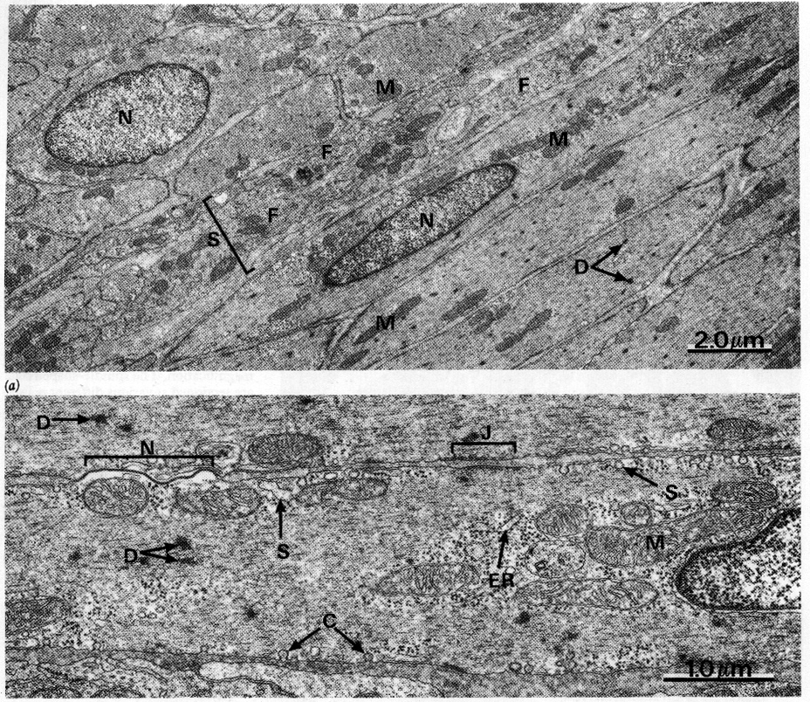
Smooth Muscle Fibers
E.M. Picture:
Sarcoplasm contains mitochondria and sarcoplasmic reticulum.
Myosin & actin filaments are irregularly arranged (that’s why no striations could be observed).
Cells are connected together by gap junctions for cell communication.

Slide 14
REGENERATION OF MUSCLE
(1) Skeletal muscle cells:
- Can not divide.
- Limited regeneration by satellite cells
(stem cells on the muscle cell’s surface).
(2) Cardiac muscle cells:
- No regenerative capacity.
(3) Smooth muscle cells:
- Can divide.
- Regenerate from pericytes.
→ active regenerative response.

Slide 15
Comparison between different types of muscle fibers
SKELETAL
CARDIAC
SMOOTH
Site
Muscle attached to skeleton
Myocardium of the heart
Viscera, e.g. stomach
Shape
Cylindrical
Cylindrical
Fusiform
Diameter
Largest
Medium-sized
Smallest
Branching
Non-branched
Branched
Non-branched
Striations
Clear
Not clear
Absent
Intercalated discs
Absent
Present
Absent
Nuclei
Numerous and peripheral
One central nucleus
One central nucleus
Action
Voluntary
Involuntary
Involuntary
Regeneration
Limited
No
Yes

Slide 16
Clinical Application
Cardiac hypertrophy:
During cardiac hypertrophy the number of cardiac muscle cells is not increased; instead, they become longer and larger in diameter.

Slide 17
Clinical Application
Cardiac damage:
Damage to cardiac muscle does not result in regeneration of muscle tissue; instead, the dead cardiac muscle cells are replaced by fibrous connective tissue.

Slide 18
Clinical Application
Myasthenia gravis:
It is an autoimmune disease in which autoantibodies attach to acetylcholine receptors, blocking their availability to acetylchoine.
Skeletal muscles including diaphragm weaken gradually.

