Slide 1
Hyaline cartilage

Slide 2
Hyaline cartilage

Slide 3
Elastic cartilage

Slide 4
Elastic cartilage

Slide 5
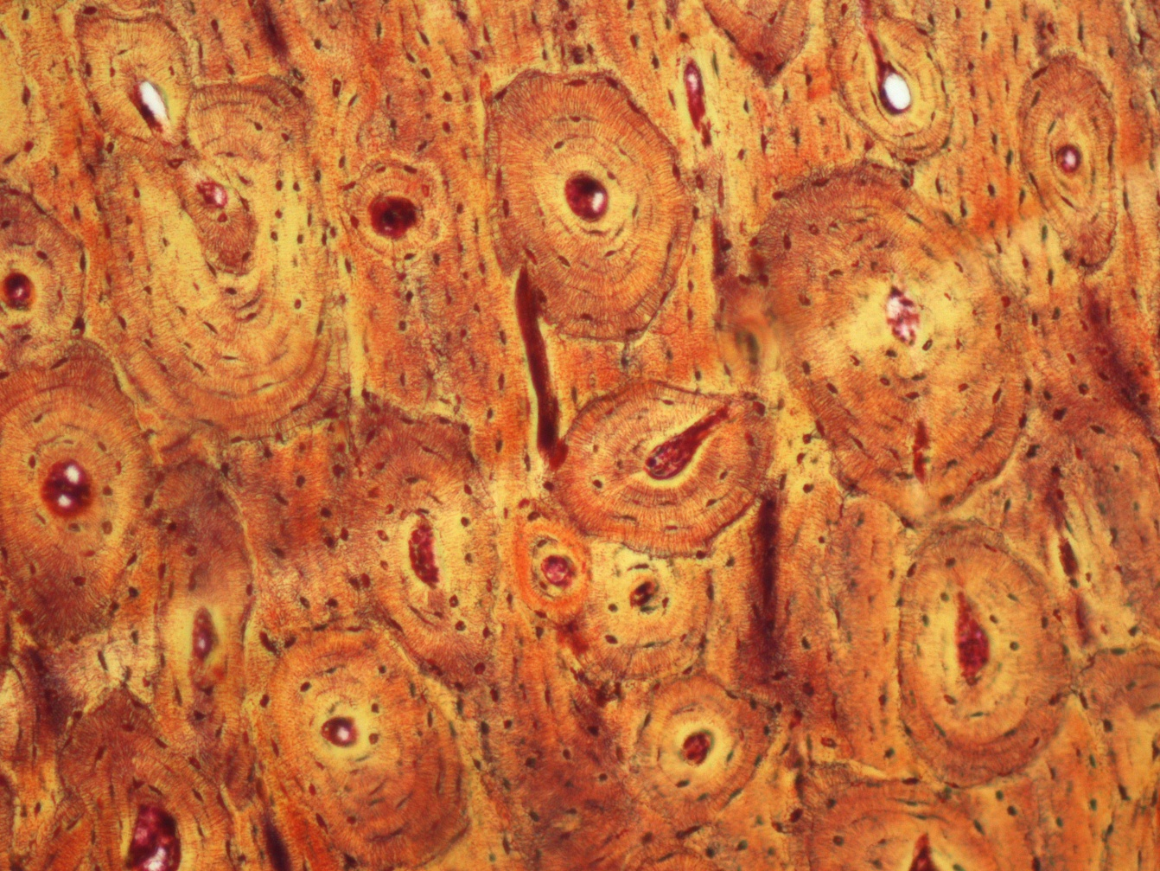
Compact bone-T.S.

Slide 6
Compact bone-T.S.

Slide 7
Cancellus or spongy bone

Slide 8
Cancellus or spongy bone

Slide 9
Skeletal muscle

Slide 10
Skeletal muscle

Slide 11
Skeletal muscle

Slide 12
Skeletal muscle

Slide 13
Cardiac muscle

Slide 14
Cardiac muscle

Slide 15
Smooth muscle

Slide 16
Smooth muscle

Slide 17
Thank you

