Slide 1
Mechanisms of Autoimmunity
Immunology Unit
Department of Pathology
College of Medicine

Slide 2
Objectives
Autoimmunity results from activation of immune response against self antigens.
To learn how immunological tolerance (central and peripheral) is induced against self antigens for maintaining normal health.
To gain understanding of various factors contributing to the breakdown of immunological tolerance and development of autoimmunity.
Gender predilection in autoimmunity is a well known phenomenon and is briefly described.

Slide 3
Autoimmunity
A condition that occurs when the immune system mistakenly attacks and destroys healthy body tissue

Slide 4
Autoimmunity
Immune system has evolved to discriminate between
Self and Non-self
Mediated by auto-reactive T cells and auto-reactive B cells (auto-antibodies)
Tolerance to self is acquired by:
Deletion (clonal deletion)
OR
B) Functional inactivation (clonal anergy)
of developing lymphocytes that possess antigenic receptors with high affinity for self-antigens.

Slide 5
Self-Tolerance
Central Tolerance
(Thymus & Bone marrow)
Peripheral tolerance
(Peripheral tissues)

Slide 6
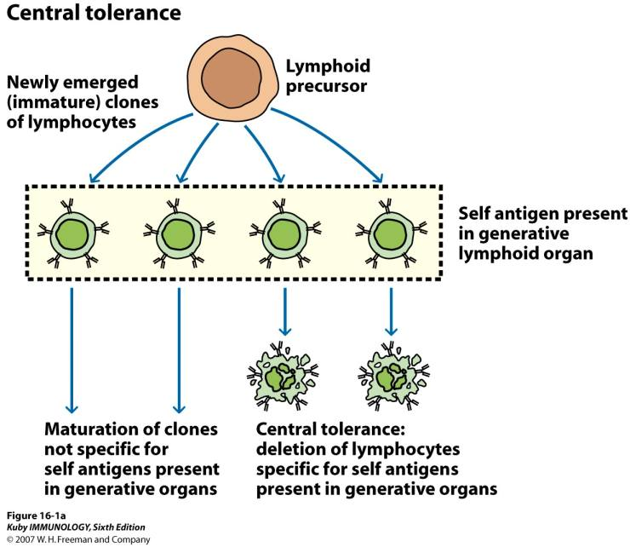

Slide 7
Educated T-cell
Autoreactive cell
Central Tolerance

Slide 8
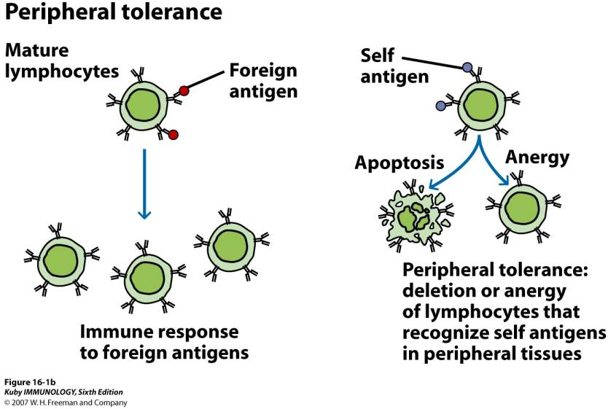

Slide 9
Peripheral Tolerance of T Lymphocytes

Slide 10
Autoreactive
T-cells
Normal tissue
Self Ag
blood barrier

Slide 11
Failure of Immune Tolerance
(Development of Autoimmunity)

Slide 12
Induction of Autoimmunity “Proposed Mechanisms!”
Sequestered antigens
Molecular mimicry
Inappropriate class II MHC expression on none-antigen presenting cells
Polyclonal B cell activation

Slide 13
1. Sequestered antigens
Some self-antigens are sequestered (hidden) in specialized tissues.
These are not seen by the developing immune system – will not induce self-tolerance.
Exposure of T cells to these normally sequestered/tissue-specific self-antigens in the periphery results in their activation.

Slide 14
Examples of Sequestered Antigens
Myelin basic protein (MBP), associated with MS
Sperm-associated antigens in some individuals following vasectomy
Lens and corneal proteins of the eye following infection or trauma
Heart muscle antigens following myocardial infarction

Slide 15
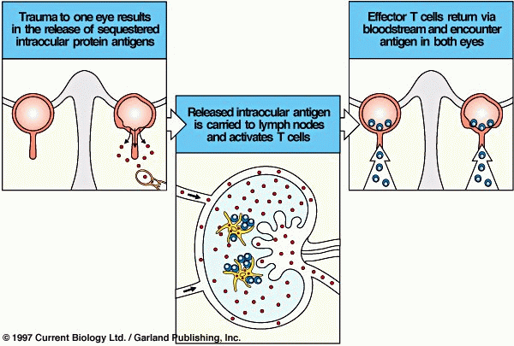

Slide 16
2. Molecular Mimicry (Cross-reacting Antigens)
Viruses and bacteria possess antigenic determinants that are very similar, or even identical, to normal host cell components.
This phenomenon, known as molecular mimicry, occurs in a wide variety of organisms.
Molecular mimicry may be the initiating step in a variety of autoimmune diseases.

Slide 17
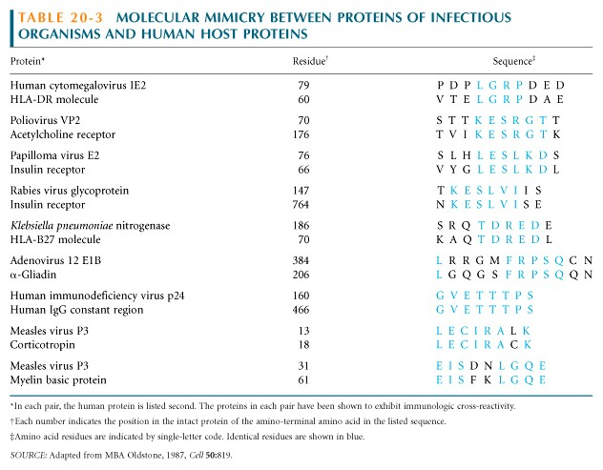
Examples of Molecular Mimicry

Slide 18
3. Inappropriate Expression of Class II MHC Molecules
Class II MHC ordinarily expressed on antigen presenting cells, such as macrophages, dendritic cells and B cells.
Abnormal expression of MHC determinants allows the recognition of these auto-antigens by self-reactive T cells.

Slide 19
Inappropriate Expression of Class II MHC Molecules
This may occur due to the local production of IFN-γ, which is known to increase class II MHC expression on a variety of cells.
The inducer of IFN-γ under these circumstances could be a viral infection.

Slide 20
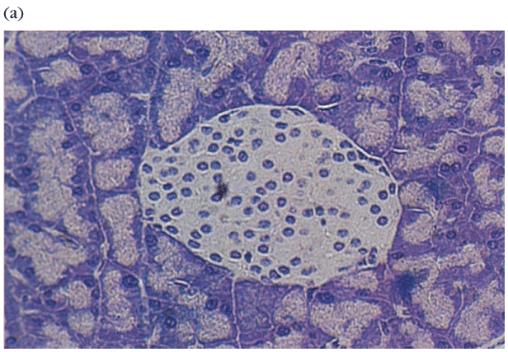
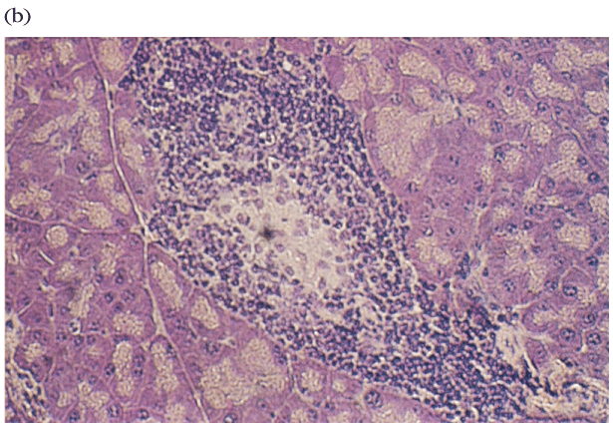
Type I Diabetes: Pancreatic β cells express abnormally high levels of MHC I and MHC II (?)
Normal Pancreas Pancreas with Insulitis

Slide 21
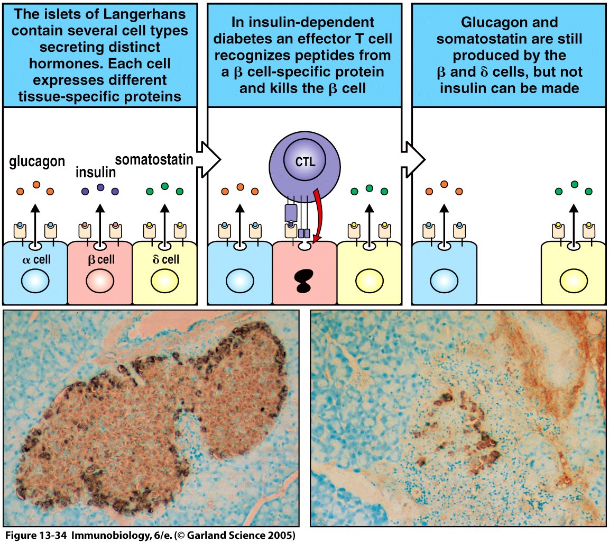

Slide 22
4. Polyclonal B Cell Activation
Viruses and bacteria can induce nonspecific polyclonal B cell activation, including:
- Certain gram negative bacteria
- Herpes simplex virus.
- Cytomegalovirus
- Epstein Barr Virus
- Human immunodeficiency virus (HIV)

Slide 23
These viruses induce the proliferation of numerous clones of B cells to secrete IgM in the absence of a requirement for CD4 T cell help.
Polyclonal activation leads to the activation of self-reactive B cells and autoantibody production.
Patients with infectious mononucleosis (caused by EBV) and AIDS (HIV) have a variety of auto-antibodies.

Slide 24
Hormonal Factors
About 90% of autoimmune diseases occur in women – cause not known
In animal models estrogen can induce B cells to enhance formation of anti-DNA antibodies
SLE either appears or exacerbates during pregnancy

Slide 25
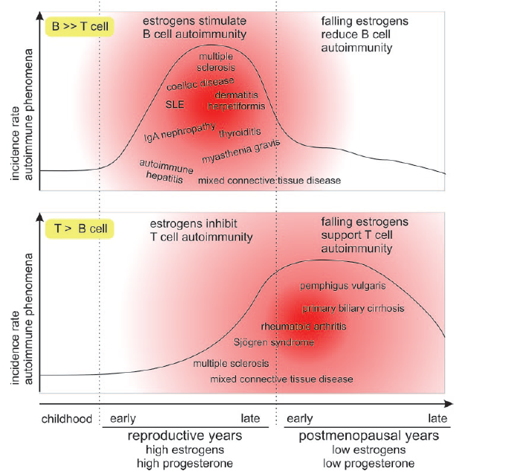

Slide 26
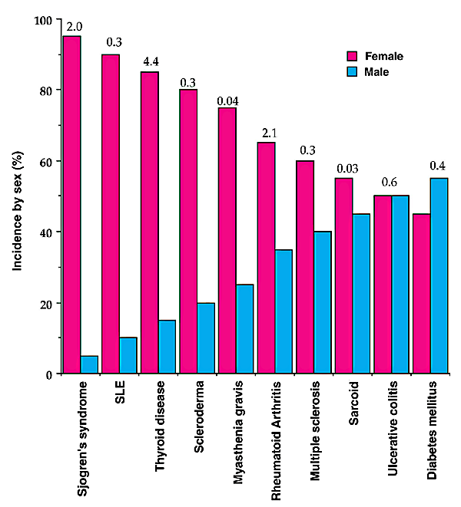
Nature Immunology 2, 777 - 780 (2001)

Slide 27
Drug Induced Lupus Erythematosus
Lupus erythematosus like syndrome develops inpatients receiving a variety of drugs such as
Hydralazine (used for hypertension),
Procainamide,
Isoniazid
Penicillin
Many are associated with the development of anti-nuclear antibodies (ANAs)
Renal and CNS involvement is uncommon
Anti-histone antibodies are frequently present

Slide 28
Take home message
Normal healthy state is maintained by immunological tolerance against self antigens at central and peripheral levels
Autoimmune diseases result from the breakdown of immunological tolerance to self antigens
Certain autoimmune diseases exhibit strong association with female gender

Slide 29
Thank you

