Slide 1
Autoimmune Diseases
Immunology Unit
Department of Pathology
College of Medicine

Slide 2
Objectives
To know that the inflammatory processes in auto immune diseases are mediated by hypersensitivity reactions (type II, III and IV)
To know that autoimmune diseases can be either organ specific or may be generalized involving many organs or tissues
To understand that the manifestations of autoimmune diseases depend upon the organ and the degree of damage inflicted on the target tissues

Slide 3
Disease processes and tissue damage are due to Type II Type III and Type IV hypersensitivity reactions

Slide 4
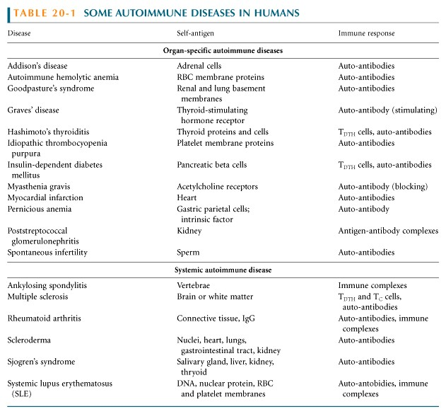

Slide 5
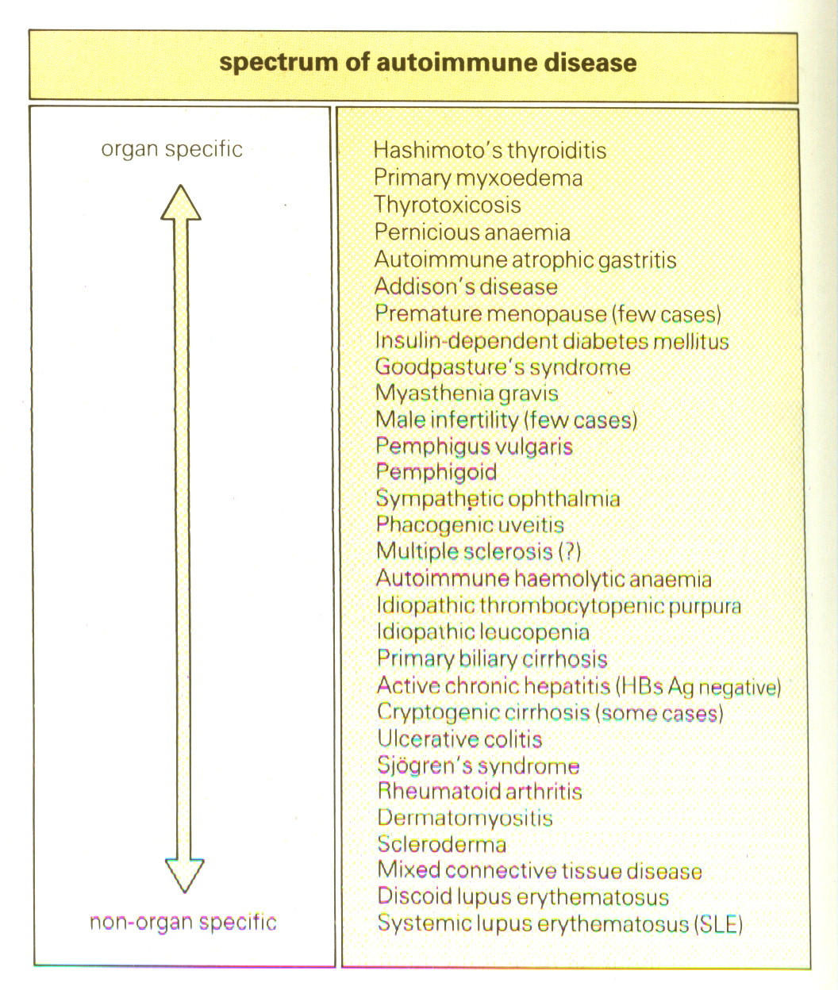

Slide 6
Examples of Autoimmune Diseases Affecting Different Systems:
Nervous System:
Gastrointestinal System:
Multiple sclerosis
Crohn's Disease
Myasthenia gravis
Ulcerative colitis
Autoimmune neuropathies such as:
Primary biliary cirrhosis
- Guillain-Barré Syndrome (GBS)
Autoimmune hepatitis
Autoimmune uveitis
Endocrine Glands:
Blood:
Type 1 or immune-mediated diabetes mellitus
Autoimmune hemolytic anemia
Grave's Disease
Pernicious anemia
Hashimoto's thyroiditis
Autoimmune thrombocytopenia
Autoimmune oophoritis and orchitis
Blood Vessels:
Autoimmune disease of the adrenal gland
Multiple Organs, Musculoskeletal System
Temporal arteritis
Anti-phospholipid syndrome
Rheumatoid arthritis
Vasculitides such as
Systemic lupus erythematosus
Wegener's granulomatosis
Scleroderma
Behcet's disease
Polymyositis, dermatomyositis
Skin:
Ankylosing spondylitis
Psoriasis
Sjogren's syndrome
Dermatitis herpetiformis
Pemphigus vulgaris
Vitiligo

Slide 7
Organ Specific
Autoimmune Diseases
Mediated by stimulating or blocking
auto-antibodies
Graves’ disease (Stimulating antibodies)
Myasthenia gravis (Blocking Antibodies)

Slide 8
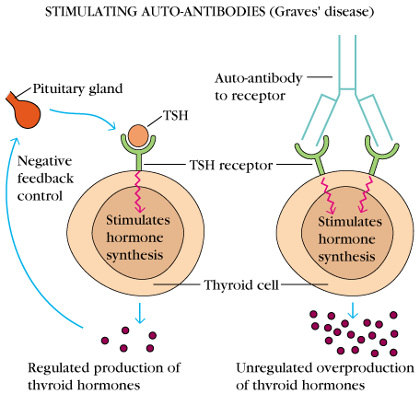
1. Graves’ Disease (Thyrotoxicosis)
Production of thyroid hormones is regulated by thyroid-stimulating hormones (TSH)
The binding of TSH to a receptor on thyroid cells stimulates the synthesis of two thyroid hormones: thyroxine and triiodothyronine

Slide 9
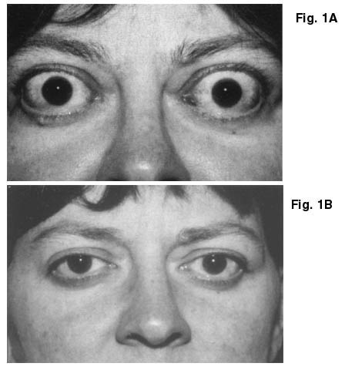
A person with Graves’ Disease makes auto-antibodies to the receptor for TSH.
Binding of these auto-antibodies to the receptor mimics the normal action of TSH leading to over-stimulation of the thyroid gland

Slide 10
2. Myasthenia Gravis
Clinically characterised by weakness and fatigability on sustained effort
Antibodies directed against acetylcholine receptor (AChR)
IgG Ab interact with the postsynaptic AChR at the nicotinic neuromuscular junction (NMJ).
There is reduction in the number of functional AChR receptors by increasing complement mediated degradation of receptors

Slide 11
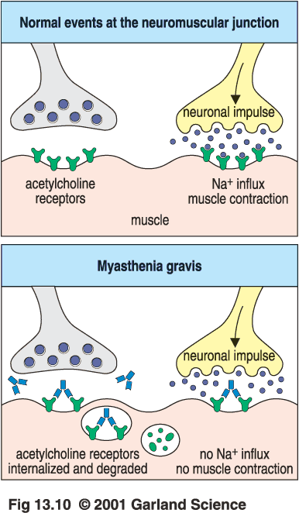
Myasthenia gravis
Motor end-plates of muscles
Notes:
Treated by antithyroid, radioactive iodine or surgery

Slide 12
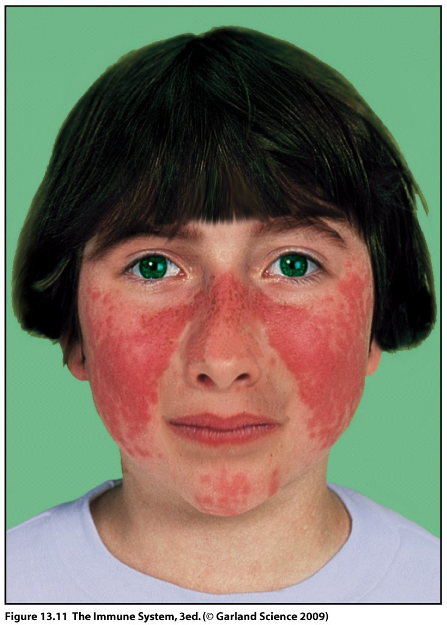
Systemic Autoimmune Immune diseases
Systemic lupus erythematosis (SLE)
Systemic lupus erythematosis is the most common autoimmune disorder
The characteristic “butterfly rash” is made worse by exposure to sunlight
Lupus is a potentially fatal autoimmune disease

Slide 13
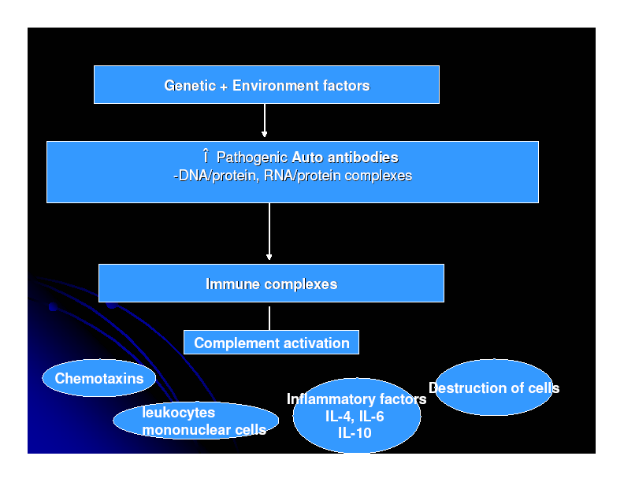

Slide 14
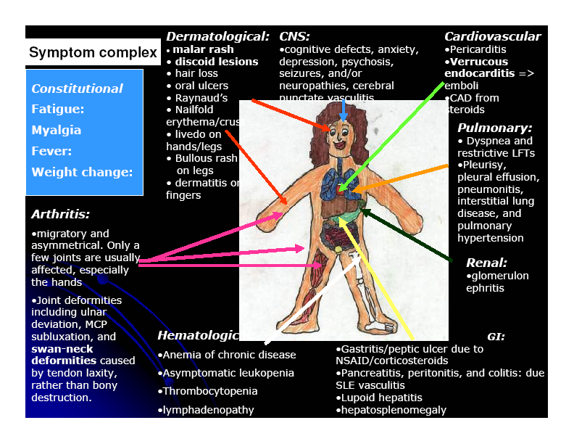

Slide 15
Auto antibodies
The anti-nuclear antibody (ANA) test is the best screening test for SLE and is determined by immunofluorescence or ELISA tests
The ANA is positive in significant titer (usually 1:160 or higher) in virtually all patients with SLE

Slide 17
Other investigations
Anti-double-stranded DNA titers
Complement Levels (CH50, C3, C4)
ESR
CRP
Complement Split products
Decreased complement C1q

Slide 18
Treatment
NSAIDs
(Non-steroidal anti-inflammatory drugs)
Antimalarials (Hydroxychloroquine)
Immunosuppressive agents

Slide 19
2. Rheumatoid Arthritis
Rheumatoid arthritis is an autoimmune disease in which the normal immune response is directed against an individual's own tissue, including the :
Joints
Tendons
Bones
Resulting in inflammation and destruction of these tissues

Slide 20
Rheumatoid Arthritis (Contd.)
The cause of rheumatoid arthritis is not known
Investigating possibilities of a foreign antigen, such as a virus
Both prevalence and incidence are 2-3 times greater in women than in men

Slide 21
Pathogenesis
(Type III hypersensitivity reaction)
In rheumatoid arthritis, many individuals produce a group of auto-antibodies known as rheumatoid factor
These antibodies react with determinants in the F_{C} region of IgG

Slide 22
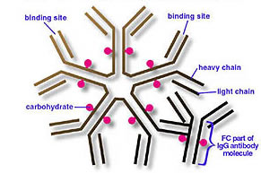
Rheumatoid Factor
The classic
rheumatoid factor is an
IgM antibody
with this kind
of reactivity.

Slide 23
Pathogenesis
(Type III hypersensitivity reaction)
Such auto-antibodies bind to normal circulating IgG, forming IgM-IgG complexes which may be deposited in joints.
This leads to activation of synovial macrophages
The macrophages engulf the immune complexes and then release TNF and other pro-inflammatory cytokines e.g., IL-1

Slide 24
Pathogenesis
(Type III hypersensitivity reaction)
TNF induces the secretion of metalloproteinases; which are known to cause joint destruction
T cell activation due to unknown antigens also contributes to the inflammation in RA

Slide 25
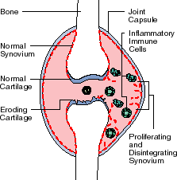
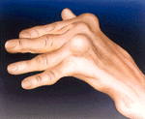
Rheumatoid Arthritis
Rheumatoid arthritis (RA) affects peripheral joints and may cause destruction of both cartilage and bone.

Slide 26
Treatment and Prognosis
Medications
NSAIDS (Non-steroidal anti-inflammatory drugs)
Disease-modifying drugs (eg, gold, hydroxychloroquine, sulfasalazine, penicillamine)
Immunosuppressive therapy:
Corticosteroids
Methotrexate
Surgery
Physical therapy

Slide 27
Take home message
The spectrum of autoimmune disorders is wide ranging from single organ involvement to a systemic disease
The disease process is usually prolonged and is generally associated with significant morbidity and mortality
The mainstay of the treatment is to maintain immunosuppression

Slide 28
Thank you

