Slide 1
Lecture Title:
Fungal Infections of the skin
Superficial and cutaneous infections
( Microbiology)
Lecturer name:
Dr. Ahmed M. Albarrag
Lecture Date: Dec-2011

Slide 2
Skin fungal infections
Clinical Skin fungal infections are generally divided into :
Superficial, including tinea versicolor, tinea nigra and piedra
Cutaneous, including Dermatophytosis, Candidiasis of skin ,mucosa, and nails and others
Subcutaneous, including mycetoma, sporotrichosis, chromoblastomycosis; and others

Slide 3
Superficial Mycoses
Defined as infections in which a fungal pathogen is restricted to the stratum corneum, with little or no tissue reaction.
These affect the uppermost dead layers of skin or hair shaft.
They are painless and usually do not provoke the immune system
They include:
1- Tinea versicolor
2- Tinea nigra
3- Piedra

Slide 4
Superficial Mycoses
Tinea Versicolor
Tinea versicolor is a long-term (chronic) fungal infection of the skin
Patches of brown or discolored skin with sharp borders and fine scales. The patches are often dark reddish-tan in color
The most common sites:
The back, underarms, upper arms, chest, and neck.
Affected areas do not darken in the sun
there may be hypopigmentation or hyperpigmentation of skin.
Usually asymptomatic
Etiology:
Malassezia furfur
It is a Yeast, Lipophilic
Normal flora of skin

Slide 5
Tinea Versicolor
Diagnosis:
Skin scraping
Potassium hydroxide (KOH)
Positive for short hyphae and spores (Spaghetti and meatballs)
Culture:
Malassezia furfur
It is a Yeast, Lipophilic
To grow, oil should be added to
the media

Slide 6
Superficial Mycoses
Tinea nigra
Painless macules or patches with brown or black color
Usually located on palm of hand or sole of foot.
Acquired by Piercing of skin with plant material in Agricultural soil.
Etiology:
Exophiala werneckii
Dematiaceous filamentous fungus
Laboratory Diagnosis:
Skin scrapings: In 10% or 20% KOH will show brown septate hyphae
Culture on SDA & Mycobiotic: growth of dematiaceous fungus.
Identify my microscopic appearance of conidia

Slide 7
Superficial Mycoses
Piedra
Asymptomatic infection of the hair shaft, Nodules on hair shaft
On scalp hair / mustache, beard
Black piedra
Dark pigmented nodules. Hard and firmly attached to hair shaft,
Eiology : Piedraia hortae
White piedra
Lightly pigmented, white to brown nodules, Soft, loosely attached
Etiology:Trichosporon beigelii yeast
Pseudohyphae, arthrospores
Lab Diagnosis:
Hair with nodule
Direct microscopy: 10% -20% KOH
Culture : on Mycobiotic & SDA

Slide 8
Treatment of Superficial infections
2% salicylic acid, 3% sulfur ointments, whitfield’s ointment Ketoconazole
Piedra: Cutting or shaving the hair
Or apply 2% salicylic acid
Or 3% sulfur ointment.
Nizoral shampoo (contains Ketoconazole)
Antifungal agents
Topical
Systemic

Slide 9
Dermatophytoses
Fungal infections of the Keratinized tissues of the body
Scalp, glabrous skin, and nails caused by a closely related group of fungi known as dermatophytes . They are primary pathogens
Contagious
transmitted through infected scales hyphae or arthroconidia on the skin.
direct contact between infected humans or animals (goats, sheep, camel, cows, horses
Transfer form on area to the body to another, Familial cross infection occurs
Tinea or Ringworm
T.capitis scalp
T.corporis : glabrous skin
T.pedis foot (Athlete’s foot)
T.cruris: groin
T. unguium nail
T.barbae beard
T.manuum hand

Slide 10
Etiology Dermatophytes
A group of related fungi called dermatophytes (filamentous fungi)
Primary pathogens
Microsporum - infections on skin and hair
Epidermophyton - infections on skin and nails
Trichophyton - infections on skin, hair, and nails.
Geophilic species - keratin-utilizing soil saprophytes (e.g., M. gypseum, T. ajelloi).
Zoophilic species - keratin-utilizing on hosts - living animals (e.g., M. canis, T. verrucosum).
Anthropophilic species - keratin-utilizing on hosts - humans (e.g., M. audounii, T. tonsurans)

Slide 11
Microsporum canis

Slide 12
Epidermophyton floccosum

Slide 13
Trichophyton mentagrophytes

Slide 14
Tinea Capitis
Presentations of Tinea Capitis
Non-inflammatory
Pustular
Inflammatory
Kerion
Favus (=t.favosa) with scutulum (yellow crusts)
Using the Wood’s lamp on infected hair
fluoresce especially microsporum spp. lesions.

Slide 15
Tinea Capitis Diagnosis
History
Contact with infected person, pets,
duration
Clinical presentation
Broken hairs, black dots, localized, inflammatory, etc.
Woods Lamp
Blue green.
Hair Shaft Exam
10-20% KOH, Endo/Exothrix
Culture

Slide 16
Other Identification Tests:
Endothrix & Ectothrix hair infection
Hair perforation test
Urease test
Pigment production
Nutrient requirement such as – Trichophyton series Agar 1-7

Slide 17
Tinea Capitis Treatment
Must treat hair follicle
Topical , but might be not effective
Systemic agents
Griseofulvin for children – liquid with good taste.
Terbinafine.
Treat until no visual evidence, culture (-)… plus 2 weeks
Average of 6-12 weeks of treatment.
Examine / treat family in recurrent cases.

Slide 18
General Morphology Onychomycosis
General Appearance:
Typically begins at distal nail corner
Thickening and opacification of the nail plate
Nail bed hyperkeratosis
Onycholysis
Discoloration: white, yellow, brown

Slide 19
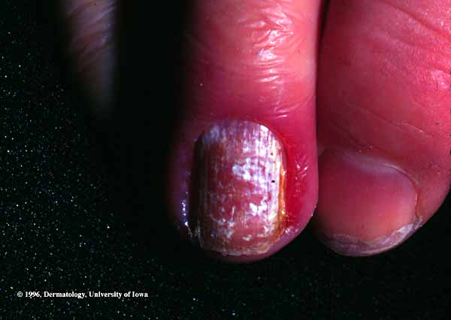
Candidaisis of nail
Paronychia

Slide 20
Diagnostic Tests
KOH Preparations
Skin
Nails
Thin clipping, shaving or scraping
Let dissolve in KOH for 6-24 hours.
Can be difficult to visualize.
Culture often required.
Hair
Apply KOH
Look for fungal elements

Slide 21
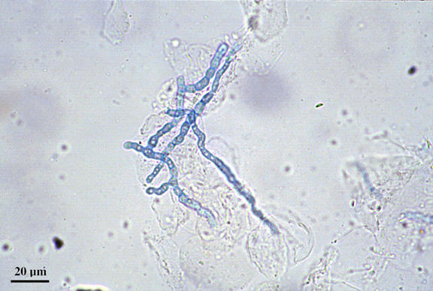
Diagnostic Tests
KOH Preparations
Skin
Two slides or slide and #15 blade.
Scrape border of lesion.
Apply 1-2 drops of KOH and heat gently
Examine at 10x and 40x
Focus back and forth through depth of field.
Look for hyphae
Clear, Green
Cross cell interfaces
Branch, constant diameter.
Chlorazol black, Parkers ink can help.
Notes:
Spaghetti meatball appearance is classical for yeast
The most common pathogen for tinea capitus used to be microsporoum. It is now T. Tonsauran thus render wood’s light useless

Slide 22
Ectothrix and Endothrix

Slide 23
Diagnostic Tests
Fungal Cultures
Sabouraud dextrose Agar (SDA)
DTM (Dermatophyte Test Medium)
Yellow to red is (+).

Slide 24
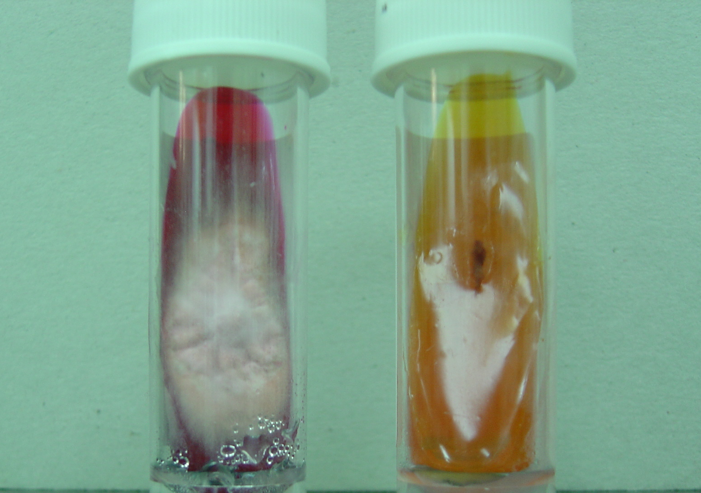
Diagnostic Test: Fungal Culture DTM
A special medium for the identification of dematophytes
It has pH 5.6, Antibacterial, Antifungal, and Phenol red (Amphoteric dye)
Not recommended for use in clinics.
Positive Negative
Growth and change
in color to red

Slide 25
Other Identification Tests:
Endothrix & Ectothrix hair infection
Hair perforation test
Urease test
Pigment production in PDA & CMA media
Nutrient requirement such as – Trichophyton series Agar 1-7

Slide 26
Dermatophytoses
Treatment:
Topical or systemic
Griseofulvin
Terbinafine (Lamisil)
Azoles
Miconazole (Daktrin), Clotrimazole (Canesten), Econazole
Systemic Itraconazole - others

Slide 27
Dermatomycoses
Other non-dermatophyte skin infections
Skin and Onychomycosis
These are caused by other fungi including:
Candid albicans,
Aspergillus,
Scytalidium,
Scopulariopsis,
Fusarium,
Acremonium,
and others

Slide 28
Candidiasis
Candida albicans
Normal Flora
Occurs in moist areas especially where skin touches.
Presentation: primary lesion is a red pustule.
Common types of candidal infection of skin and mucosal membranes include
intertrigo,
diaper dermatitis,
erosio interdigitalis blastomycetica,
Candidal Paronychia
Oral thrush
Vaginal candidiasis
perianal dermatitis,
candidal balanitis

Slide 29
Treatment of Candidiasis of skin
Keep dry
Topical – azoles.
Occasionally co-administration of topical steroid may be helpful.
Treat co-existent bacterial infection if present.

Slide 30
For images of superficial and cutaneous fungal infections you can visit the following web site
http://www.dermatlas.com/

Slide 31
Thank You ☺
( Microbiology)
Dr. Ahmed M. Albarrag
Dec-2011

