Slide 1
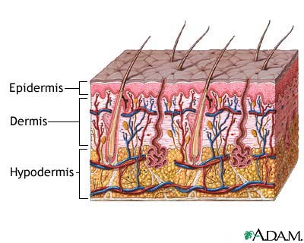
Skin and Soft-Tissue Infections
IMPETIGO, ABSCESSES, CELLULITIS, AND ERYSIPELA

Slide 2
Introduction
Common
Can be mild to moderate or sever muscle or bone and lungs or heart valves .
Staphylococcus aureus is the almost cause
Emerging antibiotic resistance among
Staphylococcus aureus (methicillin resistance)
Streptococcus pyogenes (erythromycin resistance)

Slide 3
key to developing an adequate differential diagnosis requires
History
patient’s immune status, the geographical locale, travel history, recent trauma or surgery, previous antimicrobial therapy, lifestyle,and animal exposure or bites
Physical examination
severity of infection
biopsy or aspiration
radiographic procedures
Level of infection and the presence of gas or abscess.
Surgical exploration or debridement
Diagnostic and therapeutic

Slide 4
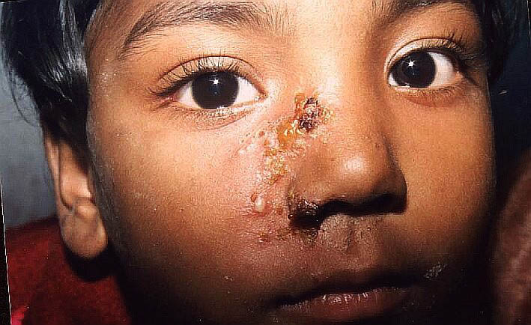
IMPETIGO-( Pyoderma)
A common skin infection
Nearly always caused by β-hemolytic streptococci and/or S.aureus.
Consists of discrete purulent lesions
Bullous (S. aureus ) or nonbullous
Children 2–5 Yr in tropical or subtropical regions
Exposed areas of the body( face and extremities)
Skin colonization- Inoculation by abrasions, minor trauma, or insect bites
Systemic symptoms are usually absent.
poststreptococcal glomerulonephritis.
(anti–DNAse B)
Cloxacillin , Cefazolin or erythromycin
Mupirocin

Slide 5
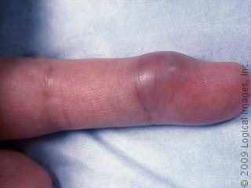
ABSCESSES, CELLULITIS, AND ERYSIPELA
Cutaneous abscesses.
Collections of pus within the dermis and deeper skin tissues.
Painful, tender, and fluctuant
Typically polymicrobial,, S. aureus alone in ∼ 25 %
Do Gram stain,culture, and systemic antibiotics
Multiple lesions, cutaneous gangrene, severely impaired host defenses, extensive surrounding cellulitis or
high fever.
Incision and evacuation of the pus

Slide 6
Furuncles and carbuncles.
Furuncles (or “boils”) are infections of the hair follicle, usually caused by S. aureus, in which suppuration extends through the dermis into the subcutaneous tissue
Carbuncle- extension to involve several adjacent follicles with coalescent inflammatory mass - back of the neck especially in diabetics
Larger furuncles and all carbuncles require incision and drainage.
Systemic antibiotics are usually unnecessary

Slide 7
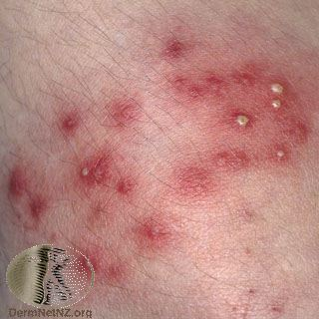
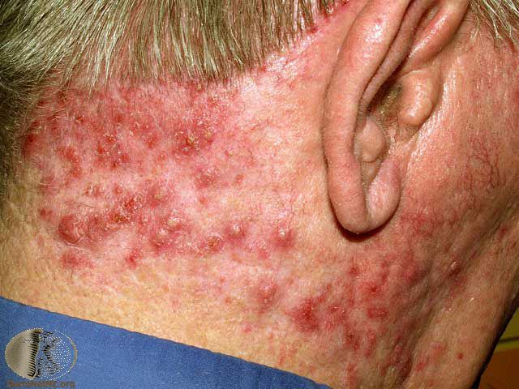
Outbreaks of furunculosis caused by MSSA, and MRSA,
Families-prisons-sports teams
Inadequate personal hygiene
Repeated attacks of furunculosis
Presence of S. aureus in the anterior nare- 20-40%
Mupirocin ointment- eradicate staphylococcal carriage nasal colonization

Slide 8
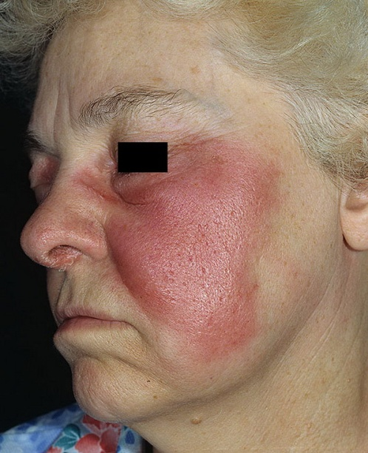
Cellulitis and erysipelas.
Diffuse spreading skin infections, excluding infections associated with underlying suppurative foci
Most of the infections arise from streptococci, often group A, but also from other groups, such as B, C, or G.
Erysipelas
Afects the upper dermis (raised-clear line of demarcation)
Red, tender, painful plaque
Infants, young children-
b-hemolytic streptococci ( group A or S. pyogenes.)
Penicillin-IV or oral.

Slide 9
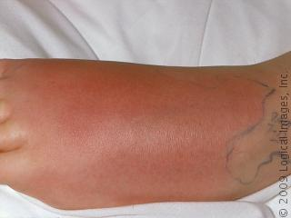
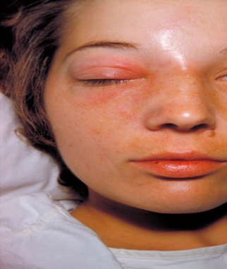
Cellulitis
Acute spreading infection involves the deeper dermis and subcutaneous tissues.
β-hemolytic streptococci, Group A streptococci, and group B streptococci-diabetics
S. aureus : commonly causes cellulitis- penetrating trauma.
Haemophilus influenzae periorbital cellulitis in children
Risk factors ; Obesity, venous insufficiency, lymphatic obstruction (operations), preexisting skin infections- ulceration, or eczema,
CA-MRSA
Carry Panton-Valentine leukocidin gene
More sensitive to antibiotics
Can lead to sever skin and soft tissue infection or septic shock

Slide 10
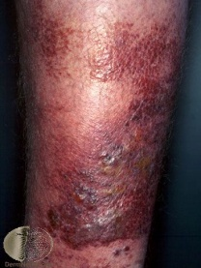
Diagnosis and Treatment
Clinical diagnosis S&S
High WBCs,blood culture rarely needed
Aspiration and biopsy might be needed in diabetes mellitus, malignancy, animal bites, neutropenia (Pseudomonas aeruginosa ),immunodeficiency, obesity and renal failure
Observe for progression to sever infection(increased in size with systemic manifestation ie . fever, leukocytosis)
Treatment: cover streptococcus and staphylococcus
Penicillin,cloxacillin,cefazolin(cephalexin),clindamycin
Vancomycin or linazolid in case of MRSA
Clindamycin, TMP-SMZ for CaMRSA

Slide 11
Necrotizing fasciitis
flesh-eating disease

Slide 12
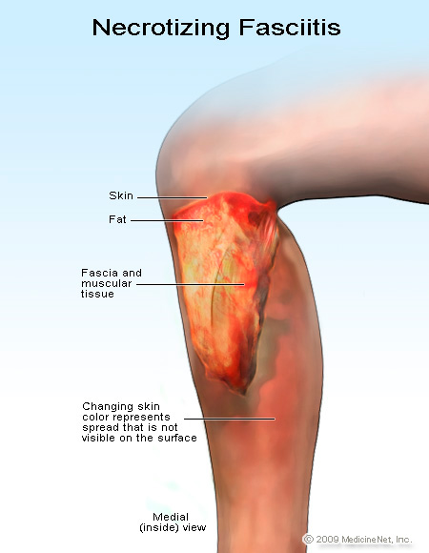
Introduction
It is a rare deep skin and subcutaneous tissues infection
It can be monomicrobial or polymicrobial infection
Most common in the arms, legs, and abdominal wall and is fatal in 30%-40% of cases.
Fournier's gangrene (testicular), Necrotizing cellulitis
Group A streptococcus (Streptococcus pyogenes)
Staphylococcus aureus or CA-MRSA
Clostridium perfringens (gas in tissues)
Bacteroides fragilis
Vibrio vulnificus (liver function)
Gram-negative bacteria (synergy).
E. coli, Klebsiella, Pseudomonas
Fungi

Slide 13
Risk factors
Immune-suppression
Chronic diseases: ( diabetes, liver and kidney diseases, malignancy
Trauma:(laceration, cut, abrasion, contusion, burn, bite, subcutaneous injection, operative incision)
Recent viral infection rash (chickenpox)
Steroids
Alcoholism
Malnutrition
Idiopathic

Slide 14
Pathophysiology
destruction of skin and muscle by releasing toxins
Streptococcal pyogenic exotoxins
Superantigen
Non-specific activation of T-cells
Overproduction of cytokines
Severe systemic illness (Toxic shock syndrome)

Slide 15
Signs and symptoms
Rapid progression of sever pain with fever , chills (typical)
Swelling , redness, hotness, blister gas formation, gangrene and necrosis
Blisters with subsequent necrosis , necrotic eschars
Diarrhea and vomiting (very ill)
Shock organ failure
Mortality as high as 73 % if untreated

Slide 16
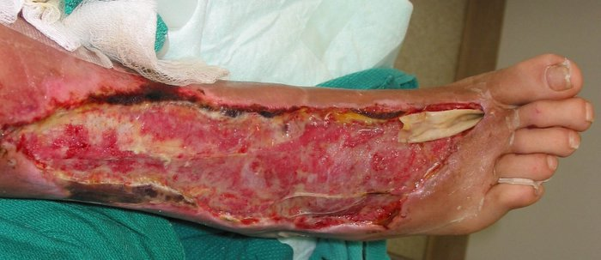
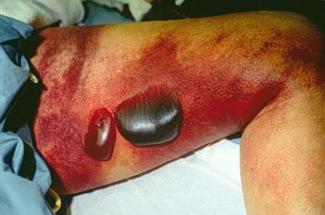
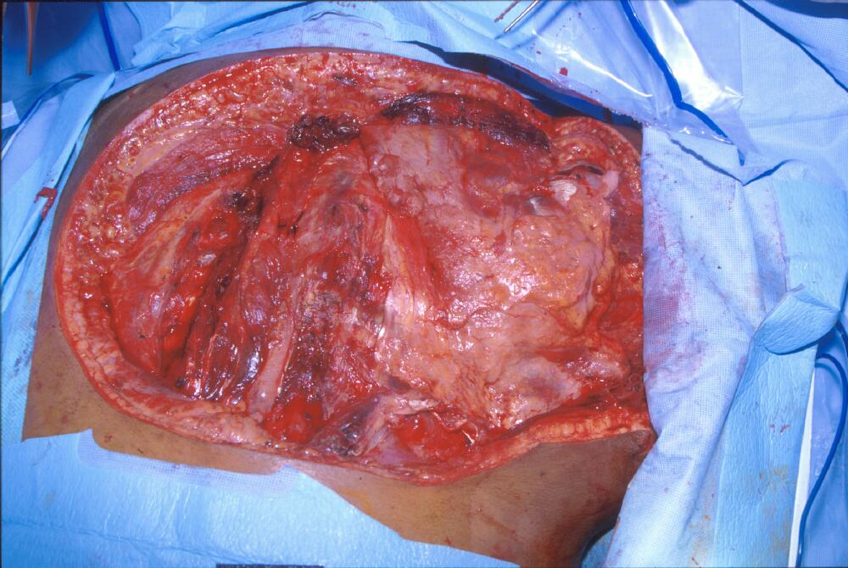
Notes:
Necrotizing fasciitis and clostridial myonecrosis due to infection with Clostridium septicum. The patient required multiple extensive debridements down to bone (see image), but did not survive the severe infection with severe septic shock. Blood and wound cultures were positive for the organism. At autopsy, an occult colonic malignancy was also noted--presumably the source for her infection.

Slide 17
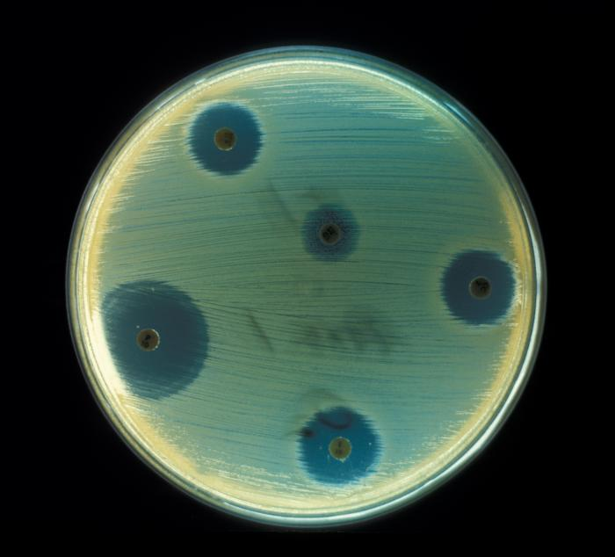
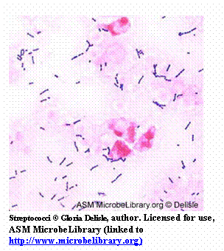
Diagnosis
A delay in diagnosis is associated with a grave prognosis and increased mortality
Clinical-high index of suspicion
Blood tests
CBC-WBC , differential , ESR
BUN (blood urea nitrogen)
Surgery debridement- amputation
Radiographic studies
X-rays : subcutaneous gases
Doppler CT or MRI
Microbiology
Culture &Gram's stain
( blood, tissue, pus aspirate)
Susceptibility tests

Slide 18
Treatment
If clinically suspected patient needs to be hospitalized OR require admission to ICU
Start intravenous antibiotics immediately
Antibiotic selection based on bacteria suspected
broad spectrum antibiotic combinations against
methicillin-resistant Staphylococcus aureus (MRSA)
anaerobic bacteria
Gram-negative and gram-positive bacilli
Surgeon consultation
Extensive Debridement of necrotic tissue and collection of tissue samples
Can reduce morbidity and mortality

Slide 19
Treatment
Antibiotics combinations
Penicillin-clindamycin-gentamicin
Ampicillin/sulbactam
Cefazolin plus metronidazol
Piperacillin/tazobactam
Clostridium perfringens - penicillin G
Hyperbaric oxygen therapy (HBO) treatment

Slide 20
TAKE HOME POINTS
Most commonly caused by Staphylococcus aureus and Streptococcus pyogenes
Risk factors for developing SSTIs include breakdown of the epidermis, surgical procedures ,crowding, comorbidities, venous stasis, lymphedema
Most of the infection are mild and can be managed on an outpatient basis
In case

Slide 21
TAKE HOME POINTS
• Most SSTIs can be managed on an outpatient basis, although patients with evidence of rapidly progressive infection, high fevers, or other signs of systemic inflammatory response should be monitored in the hospital setting.
• Superficial SSTIs typically do not require systemic antibiotic treatment and can be managed with topical antibiotic agents, heat packs, or incision and drainage.
• Systemic antibiotic agents that provide coverage for both Staphylococcus aureus and Streptococcus pyogenes are most commonly used as empiric therapy for both uncomplicated and complicated deeper infections.

