Slide 1
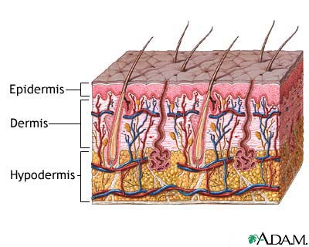
Skin and Soft-Tissue Infections
IMPETIGO, ABSCESSES, CELLULITIS, AND ERYSIPELA

Slide 2
TAKE HOME POINTS
Staphylococcus aureus and Streptococcus pyogenes are the most commonly identified causes of skin and soft tissue infections (SSTIs).
Many SSTIs are caused by methicillin-resistant
Staphylococcus aureus (CA)-MRSA
Risk factors for developing SSTIs include
Breakdown of the epidermis (eg, ulceration trauma) poor personal hygiene, eczema
crowding, comorbidities,
close contact with a person with an SSTI
venous stasis, lymphedema
surgical procedures.

Slide 3
TAKE HOME POINTS
• Most SSTIs can be managed on an outpatient basis,
although patients with evidence of rapidly progressive
infection, high fevers, or other signs of systemic
inflammatory response should be monitored in the
hospital setting.
• Superficial SSTIs typically do not require systemic
antibiotic treatment and can be managed with
topical antibiotic agents, heat packs, or incision
and drainage.
• Systemic antibiotic agents that provide coverage for
both Staphylococcus aureus and Streptococcus pyogenes
are most commonly used as empiric therapy for
both uncomplicated and complicated deeper infections.

Slide 4
Introduction
Soft-tissue infections are common, generally of mild to modest severity.
Staphylococcus aureus is the almost-universal cause of furuncles, carbuncles, and skin abscesses,worldwide is the most commonly identified agent responsible for skin and soft tissue infections
easily treated with a variety of agents.
may progress to severe infections involving muscle or bone and may disseminate to the lungs or heart valves (endocarditis).
Clinical assessment of the severity of infection is crucial
diverse etiologies depending on the epidemiological setting
Emerging antibiotic resistance among
Staphylococcus aureus (methicillin resistance)
Streptococcus pyogenes (erythromycin resistance)

Slide 5
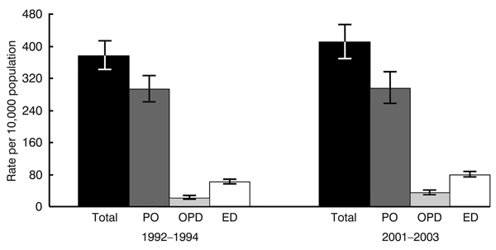
Staphylococcus aureus

Slide 6
key to developing an adequate differential diagnosis requires
History
patient’s immune status, the geographical locale, travel history, recent trauma or surgery, previous antimicrobial therapy, lifestyle,and animal exposure or bites
Physical examination
severity of infection
biopsy or aspiration
radiographic procedures
Level of infection and the presence of gas or abscess.
Surgical exploration or debridement
Diagnostic and therapeutic

Slide 7
Clinical forms
IMPETIGO-( Pyoderma)
A common skin infection consists of discrete purulent lesions that are nearly always caused by β-hemolytic streptococci and/or S.aureus.
children in tropical or subtropical regions 2–5 Yr
Skin colonization- Inoculation by abrasions, minor trauma, or insect bites
usually occurs on exposed areas of the body( face and extremities)
Bullous (S. aureus ) or nonbullous
systemic symptoms are usually absent.
poststreptococcal glomerulonephritis. (anti–DNAse B)

Slide 8
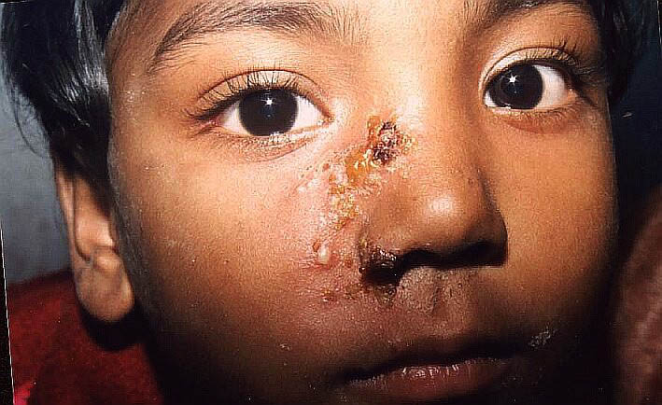
IMPETIGO
( Pyoderma)

Slide 9
Therapy
Because S. aureus currently accounts for most cases of bullous impetigo and substantial portion of nonbullous infections
Penicillinase resistant penicillins or first- generation cephalosporins
Erythromycin
erythromycin-resistant S. aureus, S. pyogenes,
Topical therapy with mupirocin
(MRSA)

Slide 10
ABSCESSES, CELLULITIS, AND ERYSIPELA
Cutaneous abscesses.
Cutaneous abscesses are collections of pus within the dermis and deeper skin tissues.
usually painful, tender, and fluctuant
typically polymicrobial,
S. aureus alone in ∼ 25 %
Incision and evacuation of the pus
Gram stain,culture, and systemic antibiotics are rarely necessary
multiple lesions,
cutaneous gangrene, severely impaired host defenses,
extensive surrounding cellulitis,
high fever.

Slide 11
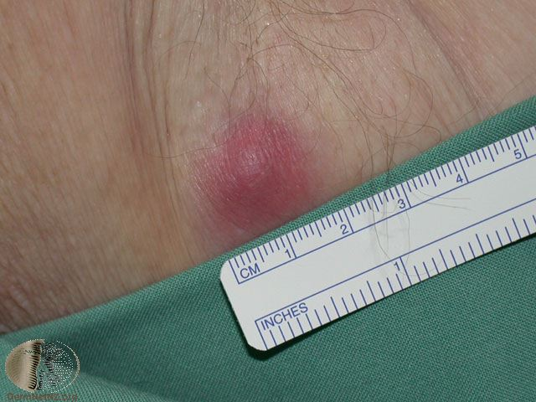

Slide 12
abscesses.

Slide 13
Furuncles and carbuncles.
Furuncles (or “boils”) are infections of the hair follicle, usually caused by S. aureus, in which suppuration extends through the dermis into the subcutaneous tissue
can occur anywhere on hairy skin
carbuncle- extension to involve several adjacent follicles with coalescent inflammatory mass - back of the neck especially in diabetics
Larger furuncles and all carbuncles require incision and drainage.
Systemic antibiotics are usually unnecessary
Outbreaks of furunculosis caused by MSSA, and MRSA,
Families-prisons-sports teams
close personal contact
Inadequate personal hygiene
repeated attacks of furunculosis
presence of S. aureus in the anterior nare- 20-40%
mupirocin ointment- eradicate staphylococcal carriage nasal colonization

Slide 14
furunculosis

Slide 15
Cellulitis and erysipelas.
Diffuse spreading skin infections, excluding infections associated with underlying suppurative foci, such as cutaneous abscesses, necrotizing fasciitis, septic arthritis, and osteomyelitis
most of the infections arise from streptococci, often group A, but also from other groups, such as B, C, or G.
erysipelas
affects the upper dermis (raised-clear line of demarcation)
red, tender, painful plaque
infants, young children-
b-hemolytic streptococci ( group A or S. pyogenes.)
Penicillin-IV or oral.

Slide 16
Cellulitis
acute spreading infection involves the deeper dermis and subcutaneous tissues.
β-hemolytic streptococci,
Group A streptococci
Group B streptococci-diabetics
S. aureus : common ly causes cellulitis- penetrating trauma.
S. aureus associated with furuncles, carbuncles, or abscesses
Periorbital cellulitis due to Haemophilus influenzae can occur in children
organisms enter through breaches in the skin
Obesity, venous insufficiency, ymphatic obstruction (operations)
preexisting skin infections- impetigo or ecthyma, ulceration
Eczema,

Slide 17
Diagnosis
Signs and symptoms: fever, chills, redness, swelling
Labs: routine labs- CBC ( leukocytosis , ESR )
Blood culture results are positive in 5% of cases
very low yield
aspiration of skin is not helpful in 75%–80%
Needle aspirations and skin biopsies are unnecessary in typical cases, which should respond to antibiotic therapy
These procedures may be more rewarding for patients with
diabetes mellitus, malignancy
animal bites, neutropenia (Pseudomonas aeruginosa )
immunodeficiency.
Obesity ,Renal Failure

Slide 18
Clinical presentations
Rapidly spreading areas of edema, redness, and heat
Systemic manifestations are common- fever, chills ,tachycardia, confusion, hypotension, and leukocytosis,
If Petechiae and ecchymoses, with systemic toxicity-necrotizing fasciitis should be considered.
the breaks in the skin are small and clinically inapparent.
lower legs. Arms, face.

Slide 19
Cellulitis

Slide 20
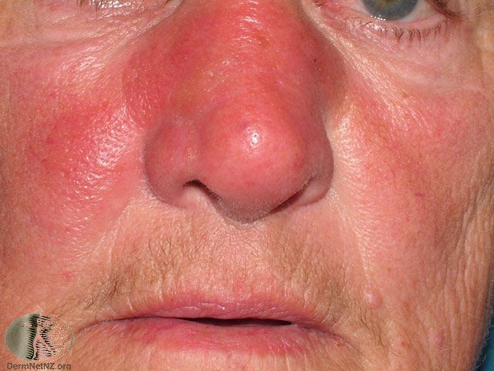
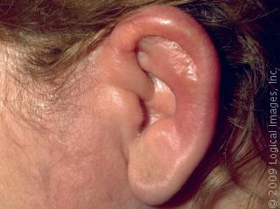
Cellulitis

Slide 21
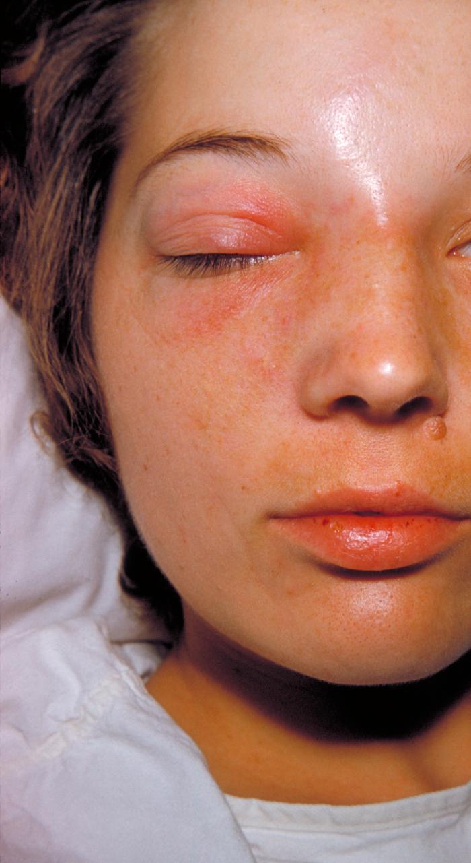
Orbital cellulitis

Slide 22
Treatment
Antibiotic is directed against streptococci and staphylococci.
MSSA SSTI
oral medications
Penicillinase-resistant penicillin-,dicloxacillin,
Cephalexin
Clindamycin - excellent antistaphylococcal activity
Erythromycin
parenteral therapy, severely ill patients
Nafcillin
Cefazolin
clindamycin or vancomycin
MRSA SSTI
Vancomycin,
Clindamycin, TMP-SMZ
Linezolid

Slide 23
Soft-tissue infections and the evaluation of MRSA infection
An emerging problem is the increasing prevalence of skin and soft-tissue infections caused by community-acquired MRSA-causing community-onset disease
Community strains (CA-MRSA)cause infections in
patients lacking risk factors, such as hospital admission or residence in a long-term care facility
Outbreaks
often susceptible to non–b-lactam antibiotics, including
doxycycline,
Clindamycin- potential for emergence of resistance
trimethoprim-sulfamethoxazole (TMP-SMZ)
fluoroquinolones, or rifampin
Vancomycin- severe infections
genes for Panton-Valentine leukocidin

Slide 24
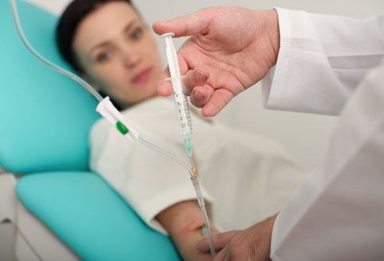
Treatment
Patients who present to the hospital with severe infection or whose infection is progressing despite empirical antibiotic therapy should be treated more aggressively, and the treatment strategy should be based upon results of
Gram stain,
culture, and drug susceptibility analysis.
Consider CA-MRSA in empiric treatment
Lack of clinical response
necrotizing fasciitis or myonecrosis.
toxic shock syndrome

Slide 25
Necrotizing fasciitis
flesh-eating disease

Slide 26
Introduction
is a rare infection of the deeper layers of skin and subcutaneous tissues easily spreading across the fascial plane within the subcutaneous tissue.
polymicrobial infection
monomicrobial infection
Fournier's (testicular) gangrene and necrotizing cellulitis
many cases have been caused by group A β-hemolytic streptococci
most common in the arms, legs, and abdominal wall and is fatal in 30%-40% of cases.

Slide 27
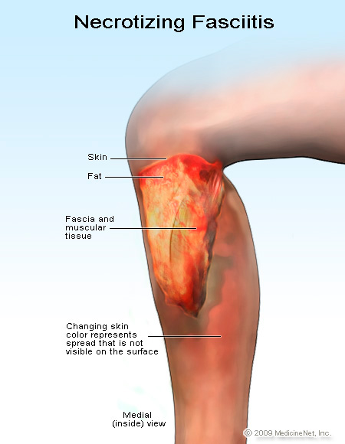

Slide 28
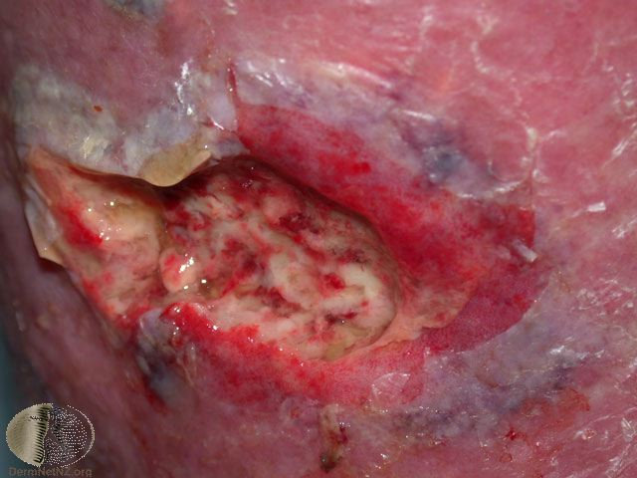

Slide 29
Etiology
Group A streptococcus (Streptococcus pyogenes)
Staphylococcus aureus
Community-acquired methicillin-resistant Staphylococcus aureus (CA-MRSA)
Vibrio vulnificus (liver function)
Clostridium perfringens (gas in tissues)
Bacteroides fragilis
Gram-negative bacteria (synergy).
E. coli, Klebsiella, Pseudomonas
Aerobic organisms ( oxygen) anaerobic organisms
Fungi

Slide 30
Risk factors
Immune-suppression
Chronic diseases:
Diabetes
liver
Kidney
Malignancy
Trauma:
laceration, cut, abrasion, contusion, burn, bite
subcutaneous injection, operative incision
Recent viral infection rash (chickenpox)
Steroids
Alcoholism
Malnutrition
Idiopathic

Slide 31
Signs and symptoms
local, at a site of trauma
severe ( surgery)
Minor (puncture wounds , insect bites, cuts, abrasions)
intense pain in excess to external appearance of the skin
Rapid progression (within hours)+ severe pain
Fever , chills (typical)
Swelling , redness, hotness, gas formation
Change in skin color or gangrene
Diarrhea and vomiting (very ill)
In the early stages, signs of inflammation may not be apparent
Blisters with subsequent necrosis , necrotic eschars
Shock organ failure
Mortality as high as 73 % if untreated

Slide 32
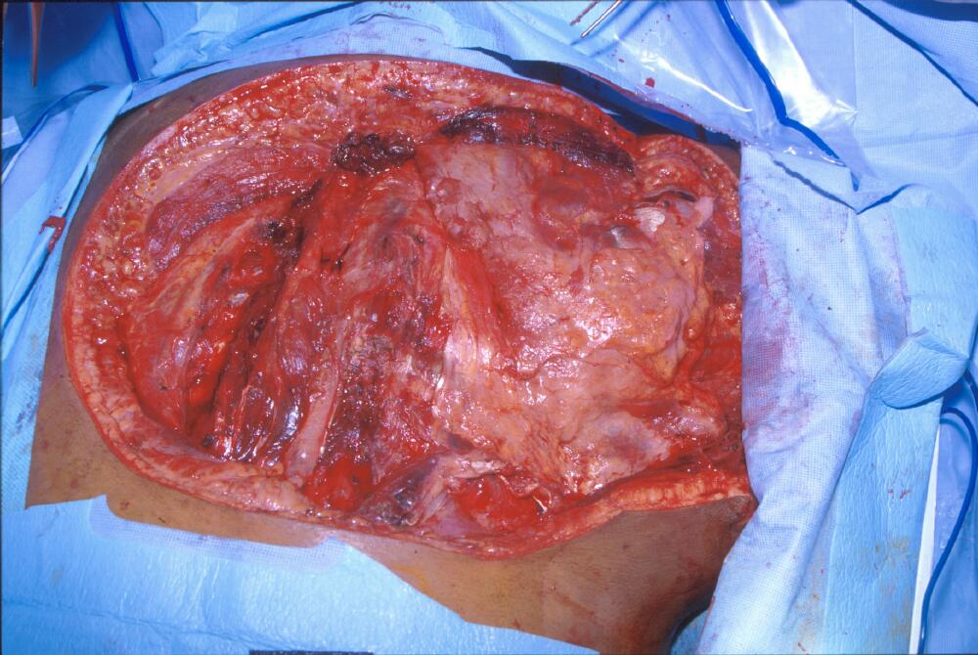
Case history
Necrotizing fasciitis and clostridial myonecrosis due to infection with Clostridium septicum. The patient required multiple extensive debridements down to bone (see image), but did not survive the severe infection with severe septic shock. Blood and wound cultures were positive for the organism. At autopsy, an occult colonic malignancy was also noted--presumably the source for her infection.

Slide 33
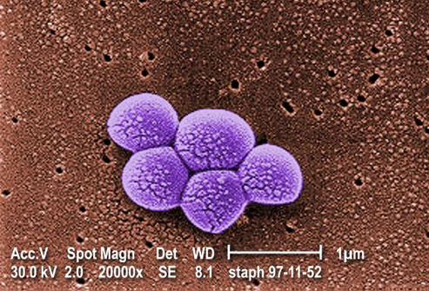
CA-MRSA
Clinical Findings in a Patient with Community-Acquired MRSA Infection.

Slide 34
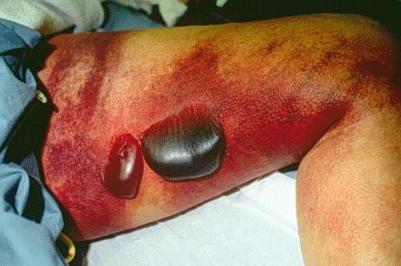

Slide 35
Pathophysiology
destruction of skin and muscle by releasing toxins
Streptococcal pyogenic exotoxins
Superantigen
non-specific activation of T-cells
overproduction of cytokines
severe systemic illness (Toxic shock syndrome)

Slide 36
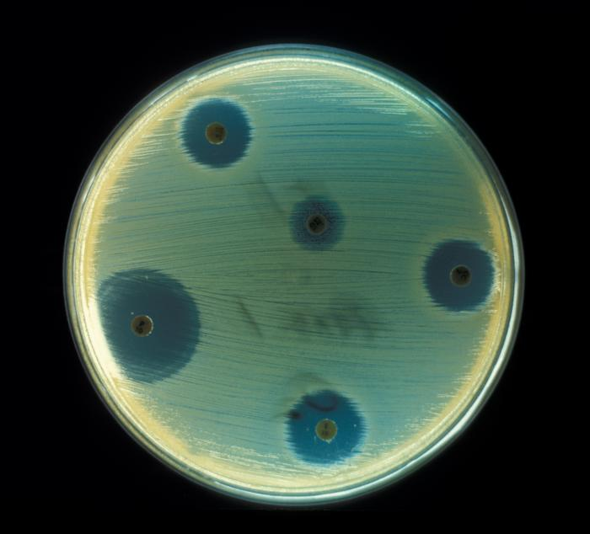
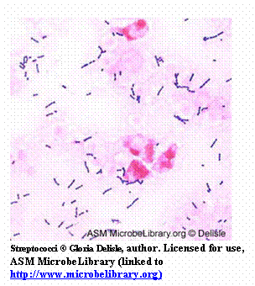
Diagnosis
A delay in diagnosis is associated with a grave prognosis and increased mortality
Clinical-high index of suspicion
Blood tests
CBC-WBC , differential , ESR
BUN (blood urea nitrogen)
Surgery debridement- amputation
Radiographic studies
X-rays : subcutaneous gases
Doppler CT or MRI
Microbiology
Culture &Gram's stain
( blood, tissue, pus aspirate)
Susceptibility tests

Slide 37
Treatment
If clinically suspected patient needs to be hospitalized OR require admission to ICU
Start intravenous antibiotics immediately
Antibiotic selection based on bacteria suspected
broad spectrum antibiotic combinations against
methicillin-resistant Staphylococcus aureus (MRSA)
anaerobic bacteria
Gram-negative and gram-positive bacilli
Surgeon consultation
Extensive Debridement of necrotic tissue and collection of tissue samples
Can reduce morbidity and mortality

Slide 38
Treatment
Antibiotics combinations
Penicillin-clindamycin-gentamicin
Ampicillin/sulbactam
Nafcillin or cefazolin plus metronidazol
Piperacillin/tazobactam
Clostridium perfringens - penicillin G
Hyperbaric oxygen therapy (HBO) treatment

