Slide 1
MUSCULOSKELETAL BLOCK Pathology Lecture 1: Fracture and bone healing
Dr. Maha Arafah
Dr. Abdulmalik Alsheikh, MD, FRCPC
Dec 11, 2011

Slide 2
MUSCULOSKELETAL BLOCK Pathology: 5 lectures
Fracture and bone healing
Congenital and developmental bone diseases
Introduction to myopathies and muscular dystrophy
Non-infectious arthritis
Osteomyelitis and septic arthritis

Slide 3
Healing of bone fractures
At the end of this lecture you should :
Know the different types of fractures
Be aware of the mechanism and stages of fracture healing process
Know the factors affecting healing process and the possible complications of healing process
Appreciate the importance of road traffic accidents as a major cause of disability in Saudi Arabia

Slide 4
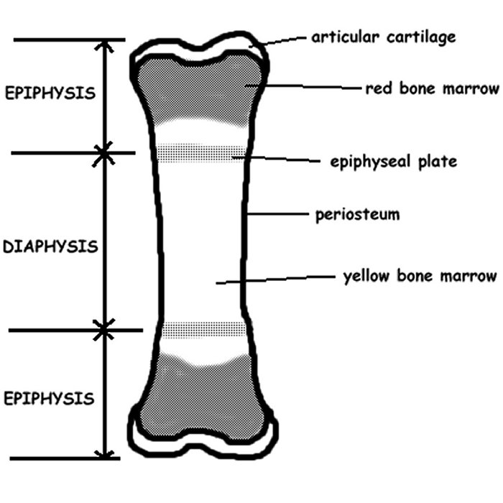
Normal anatomy
Parts of a long bones:
epiphysis (ends of bone, partially covered by articular cartilage)
physis (growth plate)
metaphysis (junction of diaphysis and epiphysis, most common site of primary bone tumors)
diaphysis (shaft)

Slide 5
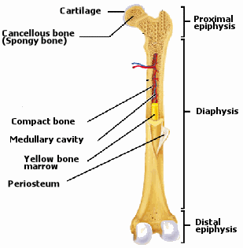
Normal anatomy
Cross section:
Periosteum
cortex (composed of cortical bone or compact bone)
medullary space (composed of cancellous or spongy bone)

Slide 7
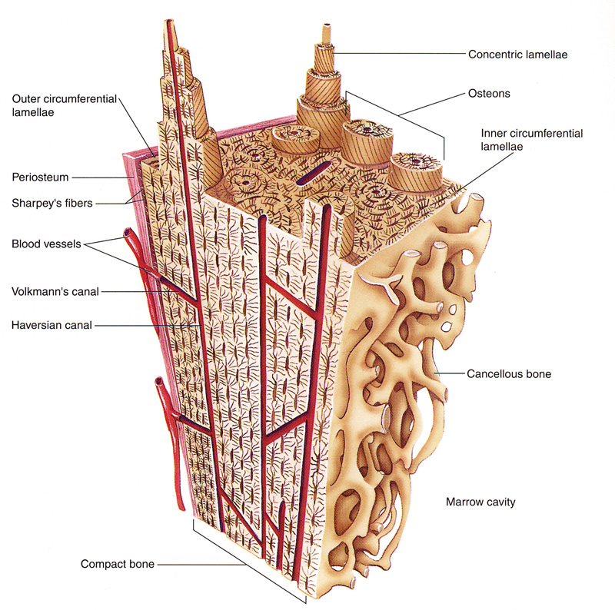
Normal histology
Bone: mineralized osteoid; either lamellar bone or woven bone.
Lamellar bone:
layered bone with concentric parallel lamellae
gradually replaces woven bone
normal type of bone found in adult skeleton
stronger than woven bone

Slide 8
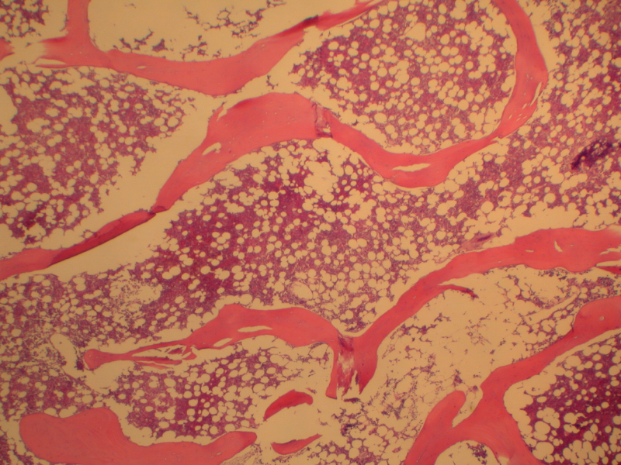

Slide 9
Osteoblasts: arise from marrow mesenchymal cells; when active, are plump and present on bone surface; eventually are encased within the collagen they produce.
Osteoclasts: large multinucleated cells found attached to the bone surface at sites of active bone resorption.

Slide 10
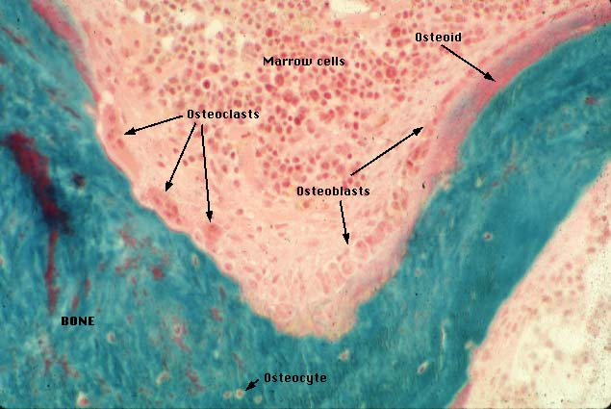

Slide 11
Fracture:- Break in the continuity of bone

Slide 12
Defintions.
Complete
Incomplete

Slide 13
Defintions.
Closed fracture (simple).
Open fracture (compound).
Complicated fracture.

Slide 14
Defintions.
Closed Fracture (simple ):-
Does NOT communicate with external environment

Slide 15
Defintions.
Open Fracture (compound ):-
Communicate with external environment
Infection !!

Slide 16
Defintions.
Complicated Fracture:-
Associated with damage to nerves, vessels or internal organs

Slide 17
Defintions.
Fracture Dislocation:-
Always X-Ray Joint
Above and Below

Slide 18
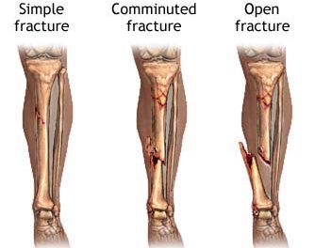
Classification of fractures
Complete or incomplete
Closed or compound
Comminuted
Displaced

Slide 19
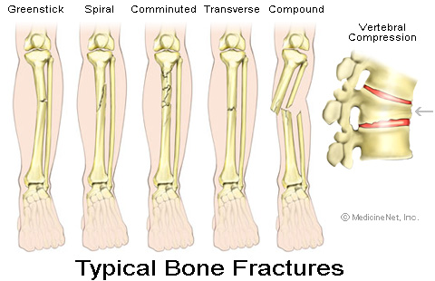

Slide 20
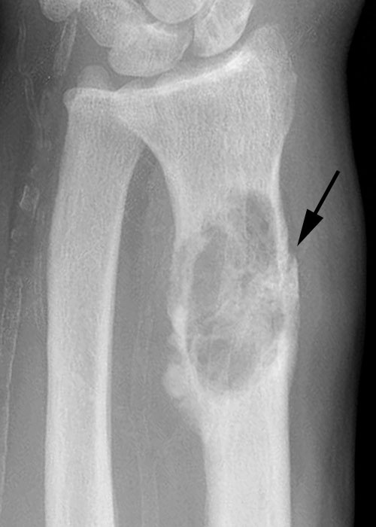
Causes of fractures
Traumatic fracture: Sever trauma
Pathological fracture:
Fracture occur with minimal trauma
the underlying bone is abnormal e.g.
Osteoporosis
Osteomalacia
Paget's disease of bone
Primary or metastatic tumor.
Stress fracture

Slide 21
Stress fracture
A stress fracture is generally an overuse injury. It occurs when muscles become fatigued or overloaded and can not absorb the stress and shock and repeated impact. Fatigued muscles transfer that stress to the nearby bone and the result is a small crack or fracture, in the bone.

Slide 22
Healing of fractures
1. Reactive Phase
i Fracture and inflammatory phase
ii. Granulation tissue formation
2. Reparative Phase
iii. Callus formation
iv. Lamellar bone deposition
3. Remodeling Phase
v. Remodeling to original bone contour

Slide 23
Excellent Reduction with Well Molded Cast

Slide 25
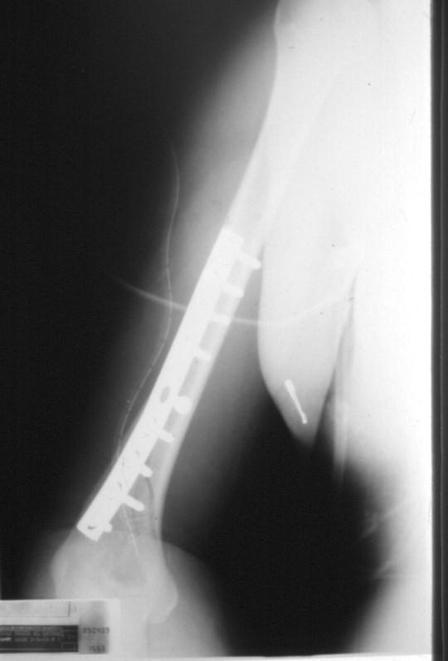

Slide 26
How does a fracture heal? Stage 1: Inflammation Bleeding from the fractured bone and surrounding tissue causes the fractured area to swell. This stage begins the day you fracture the bone and lasts about 2 to 3 weeks.

Slide 28
Reparative Phase
Soft callus Between 2 and 3 weeks after the injury, the pain and swelling will decrease. At this point, the site of the fracture stiffens and new bone begins to form. The new bone cannot be seen on x-rays. This stage usually lasts until 4 to 8 weeks after the injury.
Hard callus Between 4 and 8 weeks, the new bone begins to bridge the fracture. This bony bridge can be seen on X-rays. By 8 to 12 weeks after the injury, new bone has filled the fracture.

Slide 30
Bone remodeling Beginning about 8 to 1 2 weeks after the injury, the fracture site remodels itself, correcting any deformities that may remain as a result of the injury. This final stage of fracture healing can last up to several years.
The rate of healing and the ability to remodel a fractured bone vary tremendously for each person and depend on your age, your health, the kind of fracture, and the bone involved. For example, children are able to heal and remodel their fractures much faster than adults.

Slide 33
Fracture Healed

Slide 34
Time Factor- Perkin’s formula
 | Union | Consolidation
Upper limb | Spiral 3 Transverse 6 | 6 weeks 12 =
Lower Limb | Spiral 6 Transverse 12 | 12 = 24 =
Children Half this time is needed

Slide 35
Healing of fractures
Factors disrupting healing process:
Displaced and comminuted fractures
Infection
Vascular insufficiency
Inadequate minerals and vitamins
Inadequate immobilization

Slide 36
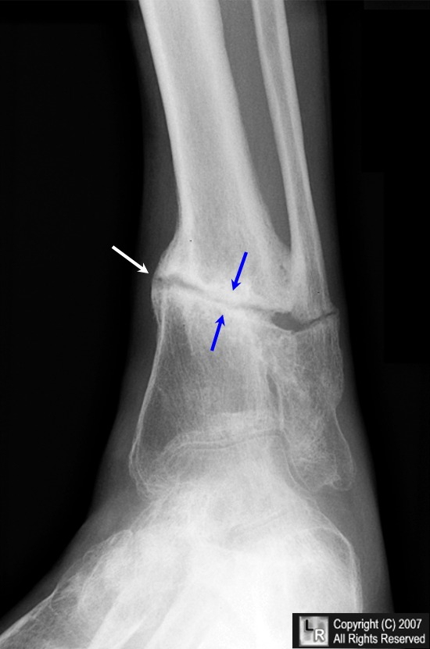
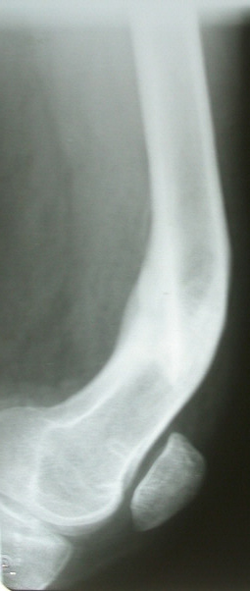
COMPLICATIONS
Delayed union: A fracture that takes longer to heal than expected is a delayed union.
Nonunion: A fracture that fails to heal in a reasonable amount of time is called a nonunion (pseudarthrosis)

Slide 37
COMPLICATIONS
Delayed Union &
Non Union Causes:-
General:-
Nutrition
Bone Disease
Old Age

Slide 38
COMPLICATIONS
Malunion:-
Malunion: A fracture that does not heal in a normal alignment is called a malunion
1- Primary Neglected #
2- After Reduction! Watch
X-Ray After 10 Days

Slide 39
COMPLICATIONS
Compartment syndrome:
Severe swelling after a fracture can put so much pressure on the blood vessels that not enough blood can get to the muscles around the fracture.
The decreased blood supply can cause the muscles around the fracture to die, which can lead to long-term disability.
Compartment syndrome usually occurs only after a severe injury.

Slide 40
COMPLICATIONS
Neurovascular injury
Infection: Open fractures can become infected
Post-traumatic arthritis: Fractures that extend into the joints (intra-articular fractures) or fractures that cause the bones to meet at an abnormal angle in the joint can cause premature arthritis of a joint.

Slide 41
COMPLICATIONS
Growth abnormalities: A fracture in the open physis, or growth plate, in a child, can cause many problems.
Two of these problems are:
premature partial or complete closure of the physis. This means that one side of a bone or the whole bone stops growing before it naturally would.

