Slide 1
MUSCULOSKELETAL BLOCK Pathology Lecture 2: OSTEOMYELITIS and SEPTIC ARTHRITIS Jan 2012
Dr. Maha Arafah
Dr. Abdulmalik Alsheikh, MD, FRCPC

Slide 2
Objectives
1. Pyogenic osteomyelitis
1. List routes by which bacteria reach bone
2. List organisms commonly responsible for pyogenic infection in bone
3. Understand how location of osteomyelitis is influenced by vascular supply to the bone.
4. Know morphology of acute and chronic lesions
5. Define the terms involucrum and sequestrum
2. Tuberculous osteomyelitis (Pott disease
Describe the following aspects of tuberculous osteomyelitis:
1. Incidence
2. Bones affected
3. Clinical consequences
3. Pyogenic suppurative arthritis
Describe the following aspects of pyogenic suppurative arthritis:
1. Pathogenesis
2. Bacteria commonly involved
3. Characteristics of joint fluid in septic arthritis

Slide 3
OSTEOMYELITIS:
Denotes inflammation of bones and marrow
Frequently manifests as a primary solitary focus of disease
May be a complication of any systemic infection
All types of organisms, including viruses, parasites, fungi and bacteria can produce osteomyelitis.
The most common are infections caused by certain pyogenic bacteria and mycobacteria

Slide 4
PYOGENIC OSTEOMYELITIS:
is almost always caused by bacteria.
Hematogenous spread.
Extension from a contiguous site.
Direct implantation.

Slide 5
PYOGENIC OSTEOMYELITIS
CAUSES:
Staphylococcus aureus is responsible for 80% to 90% the cases of pyogenic osteomyelitis in which an organism is recovered.
Staph. aureus expresses receptors to bone matrix components, may be related to the fact that facilitating its adherence to bone tissue.

Slide 6
PYOGENIC OSTEOMYELITIS
E.coli, Klebsiella and Pseudomonas are more frequently isolated from patients with genitourinary tract infections or with intravenous drug abusers.
Mixed bacterial infections can be seen in the setting of direct spread during surgery or open fractures.
Salmonella infections for unknown reasons common in sickle cell patients.

Slide 7
PYOGENIC OSTEOMYELITIS
In 50% of the cases no organisms can be isolated.

Slide 8
PYOGENIC OSTEOMYELITIS
Sites of involvement:
Influenced by the vascular circulation, which varies with age.
Neonates: the metaphyseal vessels penetrate the growth plate, resulting in frequent infection of the metaphysis, epiphysis or both.
Children: metaphyseal.
Adults: epiphyses and subchondral regions.

Slide 9
PYOGENIC OSTEOMYELITIS
Stages :
Acute
Sub acute
Chronic.

Slide 10
SEQUENCE OF INFECTION:
Once localized in bone, the bacteria proliferate and induce an acute inflammatory reaction and cause cell death.
Dead pieces of bone is known as the sequestrum.
Rupture of the periosteum→soft tissue abscess formation→draining sinuses.

Slide 11
PYOGENIC OSTEOMYELITIS
Necrosis of the bone within first 48 hrs.
Spread of bacteria and inflammation within the shaft of the bone and may percolate through the haversian systems to reach the periosteum.
In children, the periosteum is loosely attached to the cortex; therefore sizable subperiosteal abscess formation occurs.
Further ischemia and bone necrosis occurs.

Slide 12
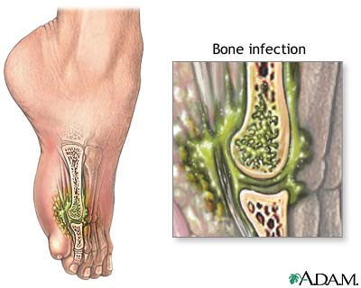
PYOGENIC OSTEOMYELITIS

Slide 13
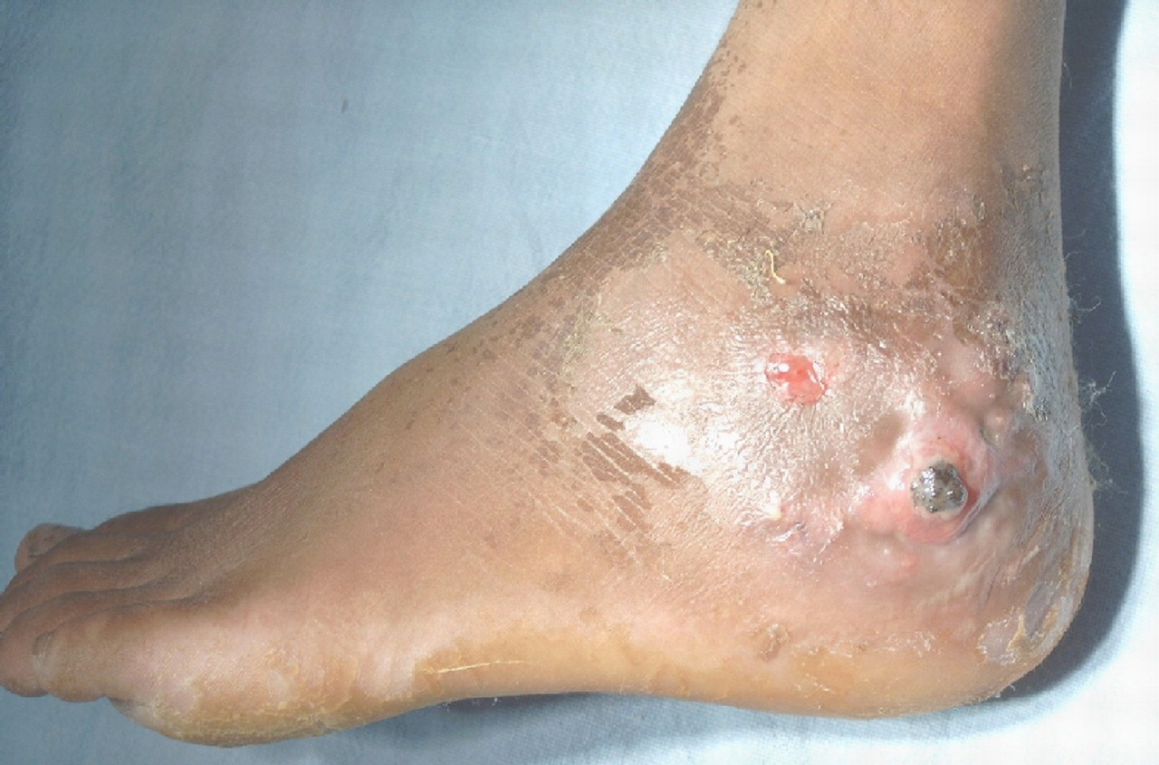

Slide 14
SEQUENCE OF INFECTION:
In infants epiphyseal infection may spread to the adjacent joint and causes septic or suppurative arthritis; may lead to permanent disability.

Slide 15
After the first week chronic inflammatory cells become more numerous with the release of cytokines and deposition of new bone formation at the periphery.
New bone may be deposited as a sleeve of living tissue known as the Involucrum.

Slide 16
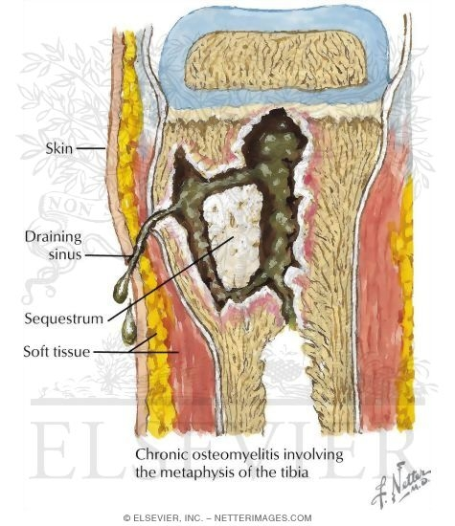
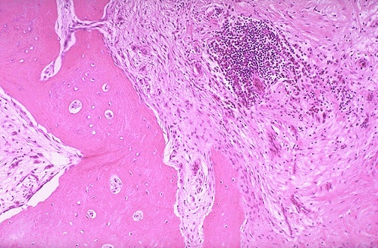
Brodie abscess:
is a small intraosseus abscess that frequently involves the cortex and is walled off reactive bone.

Slide 17
PYOGENIC OSTEOMYELITIS
Clinical Course:
Fever ,chills, malaise, marked to intense throbbing pain over the affected region.
Diagnosis;
Sign/symptoms.
X-ray
Blood cultures
biopsy

Slide 18
PYOGENIC OSTEOMYELITIS
Rx :
combination of antibiotics and surgical drainage.

Slide 19
Chronic Osteomylitis
Develop when there is:
delay in diagnosis
extensive bone necrosis
abbreviated antibiotic therapy
inadequate surgical debridement
weakened host defenses.

Slide 20
PYOGENIC OSTEOMYELITIS
Complications:
Pathologic fracture.
Secondary amyloidosis
Endocarditis
Sepsis
Squamous cell carcinoma.
Rarely sarcoma in the affected bone

Slide 22
Tuberculous osteomyelitis
Routes of entry;
Usually blood borne and originate from a focus of active visceral disease.
Direct extension (e.g. from a pulmonary focus into a rib or from tracheobronchial nodes into adjacent vertebrae) or spread via draining lymphatics.

Slide 23
Tuberculous osteomyelitis
The most common sites of skeletal involvement are:
thoracic and lumber vertebrae followed by the knees and hips
In patients with AIDS frequently multifocal.
Pott disease is the involvement of spine.
The infection breaks through the intervertebral discs and extends into the soft tissues forming abscesses.

Slide 24
Tuberculous osteomyelitis Pott’s disease

Slide 25
Tuberculous osteomyelitis
Clinical features and complications:
Pain
Fever
weight loss
May form an inguinal mass “ psoas abscess”.
Bone destruction.
Tuberculous arthritis.
sinus tract formation
amyloidosis

Slide 26
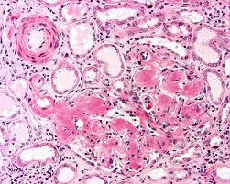

Slide 28
Infectious Arthritis (suppurative arthritis)
Infectious arthritis is serious because it can cause rapid joint destruction and permanent deformities.
Routes of infection:
hematogenous
direct inoculation
contiguous spread from osteomyelitis or a soft tissue abscess

Slide 29
Infectious Arthritis
Any bacteria can be causal:
Haemophilus influenzae predominates in children under age 2 years
S. aureus is the main causative agent in older children and adults
gonococcus is prevalent during late adolescence and young adulthood.
Individuals with sickle cell disease are prone to infection with Salmonella at any age.
Both genders are affected equally

Slide 30
Infectious Arthritis
The infection involves only a single joint
usually the knee-followed in order by hip, shoulder, elbow, wrist, and sternoclavicular joints.
Joint aspiration is typically purulent
Culture allows identification of the causal agent.

Slide 31
Infectious Arthritis
Clinical features:
sudden onset of pain
redness, and swelling of the joint with restricted range of motion.
Fever, leukocytosis, and elevated erythrocyte sedimentation rate

