Slide 1
MUSCULOSKELETAL BLOCK Pathology Disease of Joints
Jan 2012
Dr. Maha Arafah
Dr. Abdulmalik Alsheikh, MD, FRCPC

Slide 2
Objectives
Know the pathogenesis and clinicopathologic features of osteoarthritis and rheumatoid arthritis.

Slide 3
Contents
Osteoarthritis: Incidence, Primary and secondary types, pathogenesis and clinical features
Rheumatoid arthritis: definition, aetiology, pathological, clinical and major radiological features

Slide 4
JOINTS TYPES
Synovial joints: also called diarthroses
Nonsynovial joints: also called solid joint or synarthrosis

Slide 5
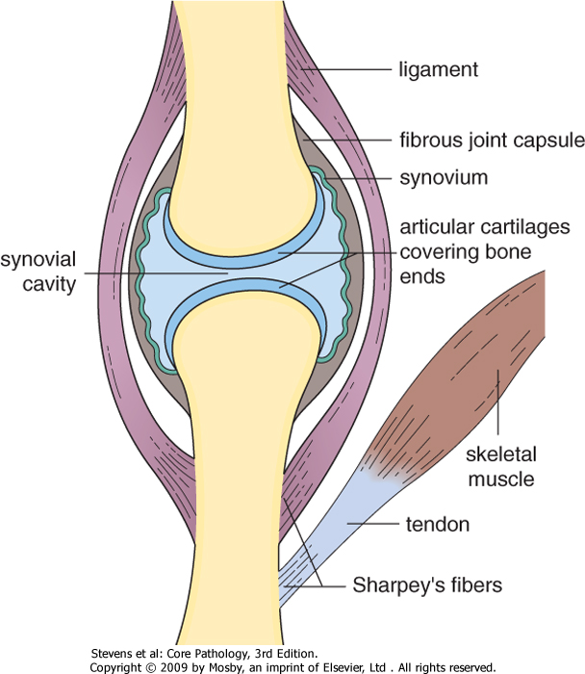
Synovial joints
Joint space bone ends are covered by hyaline cartilage
Strengthened by dense fibrous capsule continuous with periosteum of bones and an inner synovial membrane
This is reinforced by ligaments and muscles
Tha presence of joint space allows wide range of motion.

Slide 6
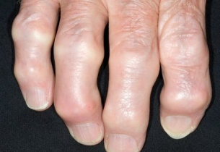
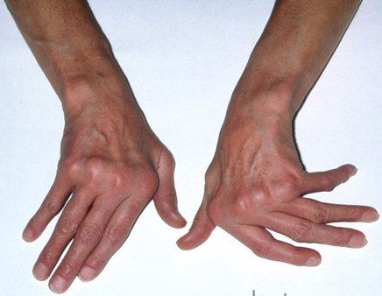
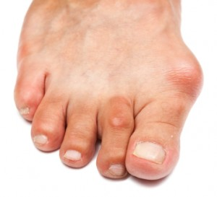
Inflammatory disease of joints (arthritis and synovitis)
has four main causes
Degeneration, e.g. osteoarthritis.
Autoimmity, e.g. rheumatoid arthritis, SLE, autoimmunity, rheumatic fever
Crystal deposition, e.g. gout and other crystalline arthropathies.
Infection, e.g. septic arthritis, tuberculous arthritis.

Slide 7
Osteoarthritis Definition and Incidence
Osteoarthritis is a nonneoplastic disorder of progressive erosion of articular cartilage.
Common and important degenerative disease, with both destructive and reparative components
Usually age 50+ years (present in 80% at age 65 years)

Slide 8
Osteoarthritis Aetiology
The main factors in the development of osteoarthritis are:
aging
abnormal load on joints
crystal deposition
inflammation of joints

Slide 9
Osteoarthritis
Pathogenesis
In general, osteoarthritis affects joints that are constantly exposed to wear and tear.
It is an important component of occupational joint disease
e.g. osteoarthritis of
the fingers in typists
the knee in professional footballers

Slide 10
Osteoarthritis Types
Primary osteoarthritis
Secondary osteoarthritis

Slide 11
Osteoarthritis Types
Primary osteoarthritis:
appears insidiously with age and without apparent initiating cause
usually affecting only a few joints
Secondary osteoarthritis

Slide 12
Osteoarthritis Types
Primary osteoarthritis:
Secondary osteoarthritis:
some predisposing condition, such as previous traumatic injury, developmental deformity, or underlying systemic disease such as diabetes, ochronosis, hemochromatosis, or marked obesity
Secondary osteoarthritis affect young
often involves one or several predisposed joints
less than 5% of cases

Slide 13
Osteoarthritis Common sites
usually one joint or same joint bilaterally
Gender has some influence; knees and hands are more commonly
affected in women,
whereas hips are more commonly affected in men.

Slide 14
Osteoarthritis
The pathological changes involve:
cartilage
bone
synovium
joint capsule
with secondary effects on muscle

Slide 15
Osteoarthritis Pathogenesis
The early change: destruction of articular cartilage, which splits (fibrillation), becomes eroded, and leads to narrowing of the joint space on radiography.
There is inflammation and thickening of the joint capsule and synovium

Slide 16
Osteoarthritis Pathogenesis
With time, there is thickening of subarticular bone caused by constant friction of bone surfaces, leading to a highly polished bony articular surface (eburnation).
Small cysts develop in the bone beneath the abnormal articular surface.
Osteophytes form around the periphery of the joint by irregular outgrowths of bone.
There may be reactive thickening of the synovium due to inflammation caused by bone and cartilage debris.
Atrophy of muscle is caused by disuse following immobility of the diseased joint.

Slide 17
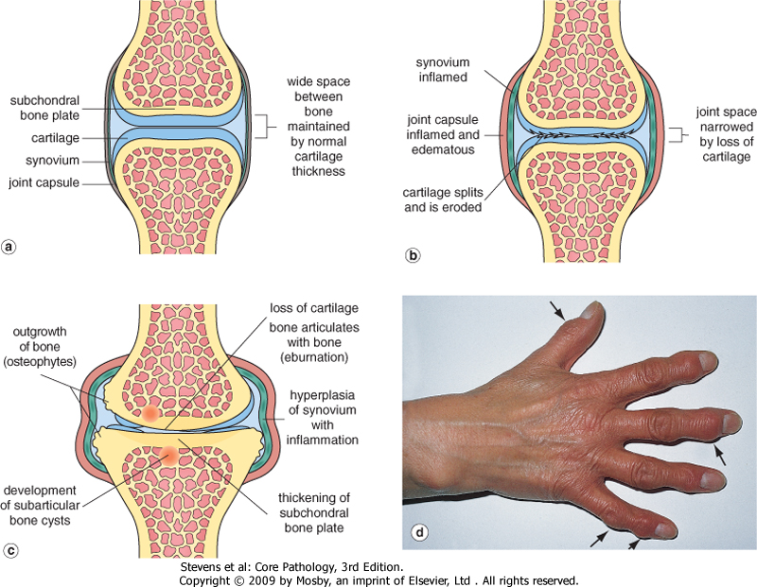
Pathological changes in osteoarthritis
a normal synovial joint
early change in osteoarthritis
Eburnation
'Heberden's nodes (osteophytes on the interphalangeal joints of the fingers)

Slide 18
Osteoarthritis. : Histologic demonstration of the characteristic fibrillation of the articular cartilage.

Slide 19
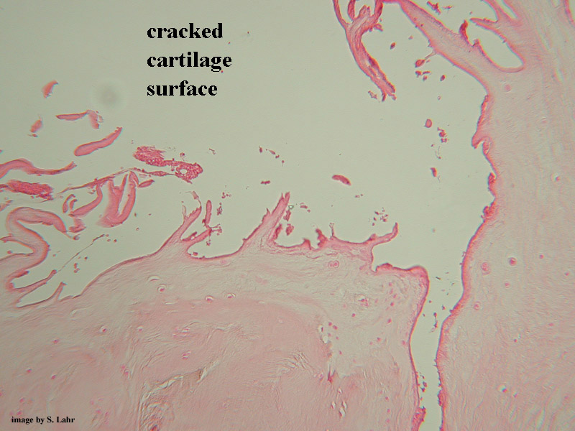
Cracking and fibrillation of cartilage

Slide 20
Severe osteoarthritis with 1, Eburnated articular surface exposing subchondral bone. 2, Subchondral cyst. 3, Residual articular cartilage.

Slide 21
Osteoarthritis Clinical features
An insidious disease predominantly affecting patients beginning in their 50s and 60s.
Characteristic symptoms include deep, aching pain exacerbated by use, morning stiffness and limited range of movement
Osteophyte impingement on spinal foramina can cause nerve root compression with radicular pain, muscle spasms, muscle atrophy, and neurologic deficits.
Heberden nodes in fingers of women only (osteophytes at DIP joints)
Loose bodies: may form if portion of articular cartilage breaks off

Slide 22
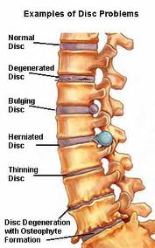
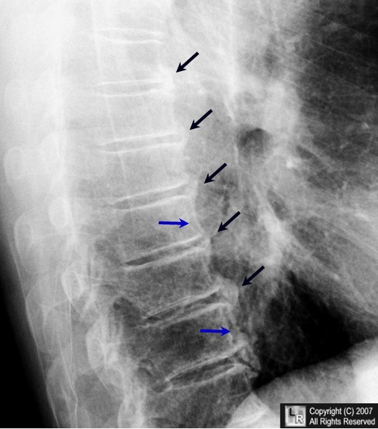
Osteophyte

Slide 23
Osteoarthritis Summary
Incidence: common after 50 year
Primary and secondary types: underlying conditions
Pathogenesis: erosion of articular cartilage
Clinical features: pain and limitation of function

Slide 25
Definition aetiology pathological features clinical features radiological features
Rheumatoid arthritis

Slide 26
Rheumatoid arthritis Definition
Chronic systemic inflammatory disorder affecting synovial lining of joints, bursae and tendon sheaths; also skin, blood vessels, heart, lungs, muscles
Produces nonsuppurative proliferative synovitis, may progress to destruction of articular cartilage and joint ankylosis
1% of adults, 75% are women, peaks at ages 10-29 years; also menopausal women

Slide 28
Rheumatoid arthritis Aetiology
The joint inflammation in RA is immunologically mediated
Genetic and environmental variables

Slide 29
Rheumatoid arthritis Aetiology
triggered by exposure of immunogenetically susceptible host to arthitogenic microbial antigen
autoimmune reaction then occurs with T helper activation and release of inflammatory mediators, TNF and cytokines, that destroys joints
circulating immune complexes deposit in cartilage, activate complement, cause cartilage damage
Parvovirus B19 may be important in pathogenesis.

Slide 30
Rheumatoid arthritis Aetiology
Genetics: HLA-DR4, DR1 (65%);
Laboratory: 80% have IgM autoantibodies to Fc portion of IgG (rheumatoid factor), which is not sensitive or specific; synovial fluid has increased neutrophils (particularly in acute stage) & protein
Other antibodies include antikeratin antibody (specific, not sensitive), antiperinuclear factor, anti-rheumatoid arthritis associated nuclear antigen (RANA)

Slide 32
Rheumatoid arthritis Pathologic Features
The affected joints show chronic synovitis: (1) synovial cell hyperplasia and proliferation
(2) dense perivascular inflammatory cell infiltrates (frequently forming lymphoid follicles) in the synovium composed of CD4+ T cells, plasma cells, and macrophages
(3) increased vascularity due to angiogenesis (4) neutrophils and aggregates of organizing fibrin on the synovial surface
(5) increased osteoclast activity in the underlying bone ➔ bone erosion.

Slide 34
Rheumatoid arthritis Pathologic Features
Pannus
formed by proliferating synovial-lining cells admixed with inflammatory cells, granulation tissue, and fibrous connective tissue
Eventually the pannus fills the joint space, and subsequent fibrosis and calcification may cause permanent ankylosis.

Slide 35
Rheumatoid arthritis Pathologic Features

Slide 36
Rheumatoid arthritis Clinical Feaures
morning stiffness, arthritis in 3+ joint areas
arthritis in hand joints,
symmetric arthritis,
rheumatoid nodules, rheumatoid factor, typical radiographic changes

Slide 37
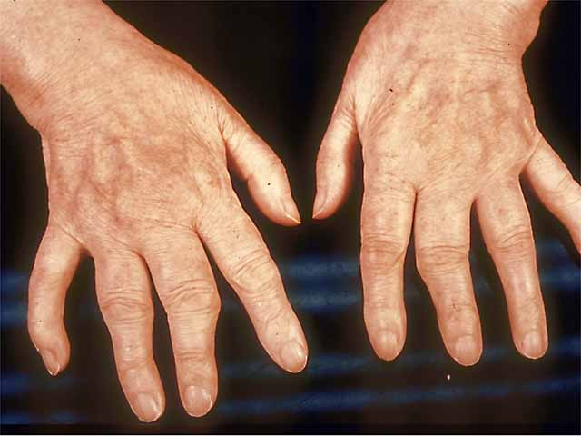

Slide 38
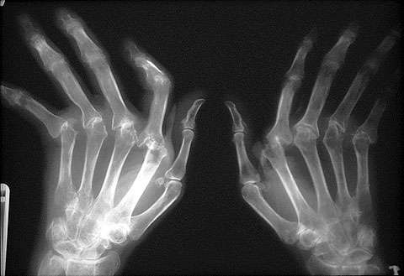
Rheumatoid arthritis X-ray:
joint effusions, juxta-articular osteopenia, erosions
narrowing of joint space; destruction of tendons, ligaments and joint capsules produce radial deviation of wrist, ulnar deviation of digits, swan neck finger abnormalities

Slide 39
Rheumatoid arthritis Clinical course:
variable; malaise, fatigue, musculoskeletal pain, then joint involvement;
joints are warm, swollen, painful, stiff in morning; 10% have acute onset of severe symptoms, but usually joint involvement occurs over months to years; 50% have spinal involvement

Slide 40
Rheumatoid arthritis Prognosis
Reduces life expectancy by 3-7 years
Death due to amyloidosis, vasculitis, GI bleeds from NSAIDs, infections from steroids.

Slide 41
Rheumatoid arthritis Summary
RA is a chronic inflammatory disease that affects mainly the joints, especially small joints, but can affect multiple tissues.
The disease is caused by an autoimmune response against an unknown self antigen(s)
This leads to T-cell reactions in the joint with production of cytokines that activate phagocytes that damage tissues and stimulate proliferation of synovial cells (synovitis).
The cytokine TNF plays a central role, and antagonists against TNF are of great benefit.

Slide 42
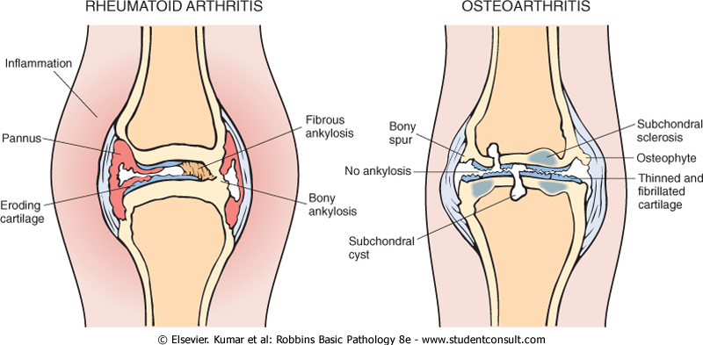
Comparison of the morphologic features of RA and osteoarthritis

