Slide 1
MUSCULOSKELETAL BLOCK Pathology Lecture 2: Congenital and developmental bone diseases
Dr. Maha Arafah
Dr. Abdulmalik Alsheikh, MD, FRCPC

Slide 2
Diseases of Bones
Objectives
Be aware of some important congenital and developmental bone diseases and their principal pathological features
Understand the etiology, pathogenesis and clinical features of osteoporosis

Slide 3
Diseases of Bones
Congenital
Acquired
Metabolic
Infections
Traumatic
Tumors

Slide 4
Congenital Diseases of Bones
Localized or entire skeleton
Dysostoses
dysplasias
Osteogenesis imperfecta
Achondroplasia
Osteopetrosis ( rare, defect in osteoclast function)

Slide 5
Congenital Diseases of Bones
Osteogenesis imperfecta
Brittle bone disease
Hereditary disorders
Defect in the synthesis of type I collagen
Extreme fragility of skeleton with susceptibility to fractures
Four main types with different clinical manifestations
Type 1: blue sclera in both eye, deformed teeth and hearing loss

Slide 6
Congenital Diseases of Bones
Achondroplasia
Dwarfism
Defect in the cartilage synthesis at growth plates
Mutation in Fibroblast growth factor receptor 3 (FGFR3) lead to inhibition of chondrocytes proliferation
Epiphyseal growth plate expansion is suppressed

Slide 7
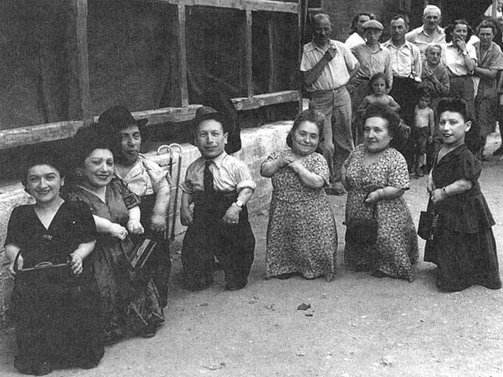

Slide 8
METABOLIC BONE DISESES

Slide 9
OSTEOPOROSIS
Is a term that denotes increased porosity of the skeleton resulting from reduction in the bone mass.
It may be localized →disuse osteoporosis of a limb.
or
may involve the entire skeleton, as a metabolic bone disease.

Slide 10
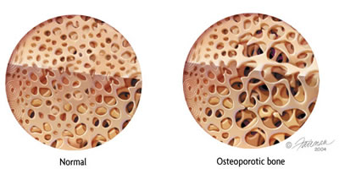

Slide 11
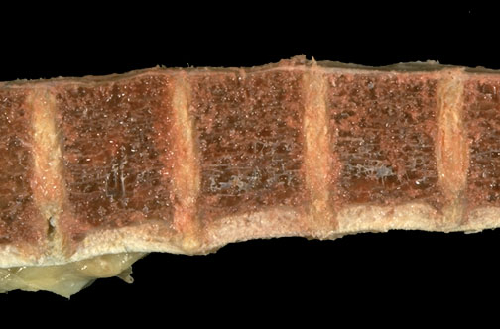
OSTEOPOROSIS

Slide 12
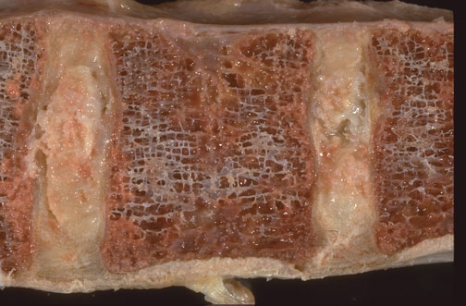

Slide 13
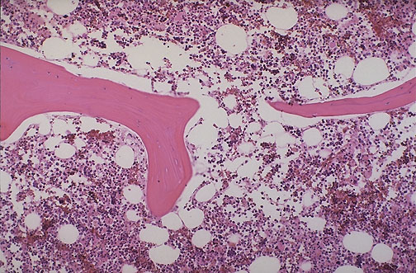
OSTEOPOROSIS
Notes:
Normal vertebral bone and marrow is demonstrated at low power microscopically. Note the size and number of bone spicules.

Slide 14
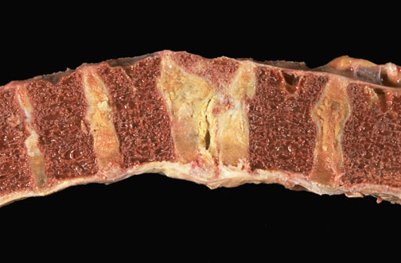
Vertebral bone with osteoporosis and a compression fracture

Slide 15
OSTEOPOROSIS
Primary
Secondary
PRIMARY: post menopausal
Senile

Slide 16
OSTEOPOROSIS
Secondary:
Endocrine Disorders
Gastrointestinal disorders
Neoplasia
Drugs
Table 21-1 page 804

Slide 17
OSTEOPOROSIS
Pathophysiology:
Occur when the balance between bone formation and resorption tilts in favor of resorption

Slide 18
OSTEOPOROSIS
Pathophysiology:
Genetic factors
Nutritional effects
Physical activity
Aging
Menopause

Slide 19
OSTEOPOROSIS
Pathophysiology:
AGING
↓ replicative activity of the osteoprogenitor cells
↓ synthetic activity of the osteoblasts.
↓ activity of the matrix bound growth factors.

Slide 20
OSTEOPOROSIS
Menopause:
↓ serum estrogen
↑ IL-1,IL-6 levels
↑ osteoclast activity

Slide 21
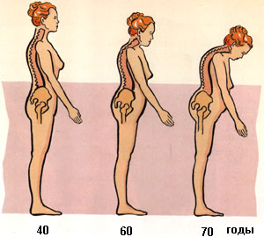

Slide 22
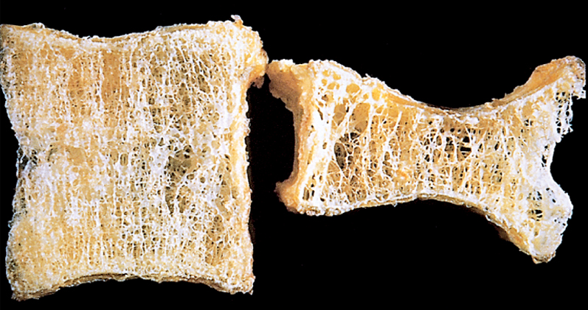

Slide 23
OSTEOPOROSIS
Clinical features
Difficult to diagnose
Remain asymptomatic ----fracture
Fractures
Vertebrae
Femoral neck
Bone density by radiographic measures

Slide 24
Diagnosis
Plain X ray: cannot detect osteoporosis until 30% to 40% of bone mass has already disappeared.
Dual-emission X-ray absorptiometry (DXA scan): is used primarily to evaluate bone mineral density, to diagnose and follow up pt. with osteoporosis.

Slide 25
Prognosis
Osteoporosis is rarely lethal.
Patients have an increased mortality rate due to the complications of fracture.
E.g. hip fractures can lead to decreased mobility and an additional risk of numerous complications: deep vein thrombosis, pulmonary embolism and pneumonia

Slide 26
OSTEOPOROSIS
Prevention Strategies
The best long-term approach to osteoporosis is prevention.
children and young adults, particularly women, with a good diet (with enough calcium and vitamin D) and get plenty of exercise, will build up and maintain bone mass.
This will provide a good reserve against bone loss later in life. Exercise places stress on bones that builds up bone mass

