Slide 1
Skeletal muscle relaxants
Ref: Katzung 2010
page 424-439
Alia AlShanawani
Medical College, KSU

Slide 2
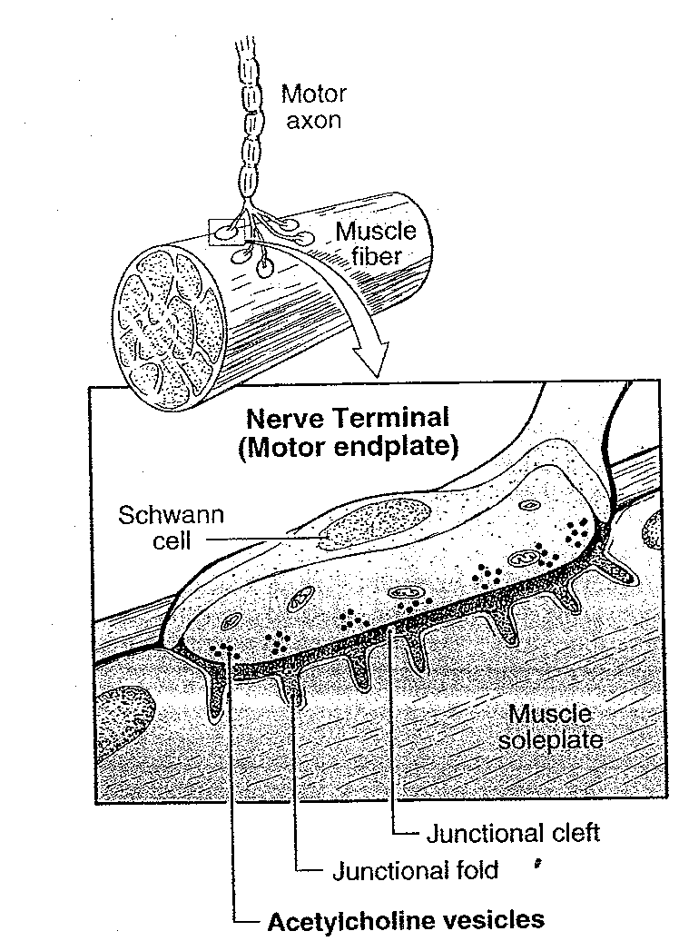
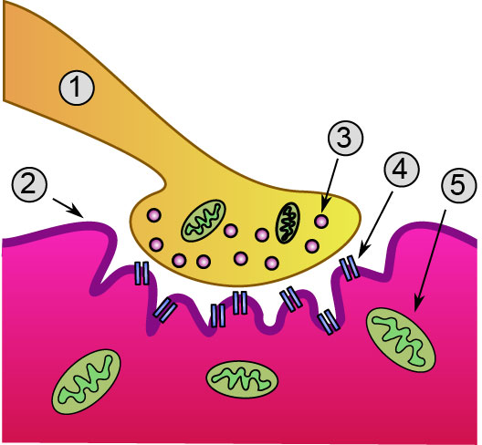
Neuromuscular Junction
1: Cholinergic motor neurone,2: motor end-plate, 3: vesicles, 4: N_{M}R, 5: mitochondrion

Slide 3
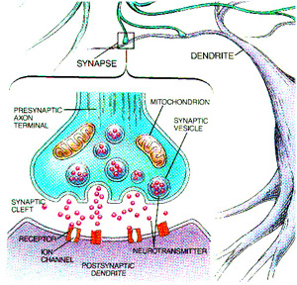
Neuromuscular junction/
Motor end plate (MEP)

Slide 5
Skeletal muscle contraction is evoked by nicotinic cholinergic transmission.
Blockade of this transmission is clinically useful in producing muscle relaxation.
This is required for surgical relaxation & control of ventilation.

Slide 6
Neuromuscular transmission
Ach causes an increase in ! permeability of ! sarcolemma Na⁺, Na⁺ influx depolarization of ! sarcolemma at ! MEP, this is called MEP potential (MEPP).
When MEPP reaches ! threshold (firing level) it propagates on both sides of MEP to excite ! Whole muscle fibers.

Slide 7
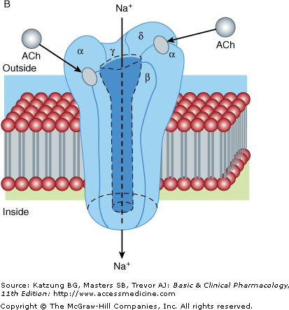
The structure & function of nicotinic receptors at MEP
Ach

Slide 8
Skeletal Muscle relaxants Classification:
Peripherally acting (Neuromuscular blockers): inhibit neuron transmission to muscle by blocking the nicotinic Ach Rs.
Centrally acting Sk M relaxants (Baclofen – Diazepam); used in spasticity
Direct acting Sk M relaxants (Dantrolene).

Slide 9
Drugs that inhibit ! neuromuscular transmission= neuromuscular blockers (NMBs):
interfere with transmission at ! NM end plate & lack CNS activity.
Because ! appropriate dose of NMB drug may paralyze muscles required for breathing (diaphragm), mechanical ventilation should be available to maintain adequate respiration.

Slide 10
Peripherally acting NMBs:
A) Presynaptic NMBs (not used clinically) : inhibit firing of Na⁺ channels
1) Inhibit Ach synthesis
Triethylacholine -hemicholinium
2) Inhibit Ach release
Mg2⁺, aminoglycosides,
botulinum toxin (BOTOX), tetrodotoxin are neurotoxins.
B) Postsynaptic NMBs
1) Competitive (non depolarizing blockers)
2) Depolarizing blockers.

Slide 11
A nondepolarizing blocker, competes with Ach for the binding sites & prevents the opening of the channel
A depolarizing blocker occupies the receptor & blocks the channel. They even can desensitize the end plate by causing persistent depolarization.

Slide 12
Postsynaptic NMBs: constitute the majority
<< Competitive NMBs
d-tubocurarine (prototype)
Gallamine
Atracurium
Pancuronium
Vecuronium
Alcuronium
Mivacurium.

Slide 13
! 2 major families of non-depolarizing blocking drugs are:
-- Isoquinoline derivatrives &
-- Steroid deriv.

Slide 14
Isoquinoline deriv -- e.g.
Tubocurarine
Atracurium
Doxacurium
Mivacurium (shortest duration)
Cisatracurium (fewer side effect)
Steroid deriv
Pancuronium
Vecuronium
Pipecuronium
Rocuronium.

Slide 15
d-tubocurarine (extract) is isolated from Curare (Flexidil curare). have paralysing effect.
D-tubocurarine can cause hypotension bec it blocks autonomic ganglia & causes histamine release.
MOA of non-depolarizing gp:
Compete with & prevent access of Ach to its nicotinic Rs at NMJ & therefore prevent depolarization. In this way contraction & relaxation of skeletal muscles is inhibited.

Slide 16
NOTE: their action can be overcome by increasing conc. of Ach in the synaptic gap by e.g. Neostigmine: cholinestrase inhibitors ( this inhibits choline estrase enz).
At High dose :these drugs block ion channel at the end plate and leads to further weakening of the transmission, and it becomes difficult to overcome the block by cholinestrase inhibitors.

Slide 17
<< Depolarizing NMBs
Succinylcholine (suxamethonium )
MOA:
Act as an agonist on nicotinic Rs of ! NMJ, stimulate first ! NM transmission (produces initially depolarization) muscular fasiculation then blockade & paralysis of ! muscle fibers due to continuous depolarization.
Duration of action is very short (5-10 min) is due to its rapid hydrolysis by cholineesterase.

Slide 18
Pharmacokinetics
All of NMBs are highly polar & inactive orally & must be given parenterally.
No cross placenta & CNS
Metabolism depend upon kidney or liver EXCEPT
atracurium -mivacurium (cholinesterase).

Slide 19
Uses of NMBs:
Primarily as adjuncts during general anesthesia to facilitate tracheal intubation & optimize surgical conditions while ensuring adequate ventilation.
To produce relaxation & paralysis, especially intra-abdominal & intra-thoracic surgeries & in ICU, can be conducted with fewer complications.
Relieve of tetanus (prolonged contraction of skeletal muscle fibers) & epileptic convulsion.
Facilitate endoscopy.

Slide 20
Therapeutic uses of succhinylcholine
When rapid endotracheal intubation is required
Electroconvulsive shock therapy

Slide 21
Pharmacological effects & side effects: (Competitive)
Bronchospasm & Hypotension (by mivacurium, tubocurarine, alcuronium, atracurium & metocurine)
Due to histamine release & blockade of nicotinic Rs (both sympathetic & paraS).
**Pretreatment with antihistamine.
12/19/11
21

Slide 22
Pharmacological effects & side effects:
Tachycardia, small increase in COP & increase BP (vagolytic effect on heart by pancuronium).
**Antidote: The cholineesterase inhibitors (as Neostigmine & pyridostigmine) effectively antagonize the NMB effects caused by nondepolarizing drugs. They increase Ach conc. on ! Rs at MEP.

Slide 23
Adverse effects of depolarizing blockade:
Succinylcholine: cardiac arrhythmia during halothane anesthesia (stimulate nicotinic & muscarinic Rs)
Malignant hyperthemia (due to increased Ca)
Hyperkalemia, may cause dysrhythmia or cardiac arrest.
Increase intraocular pressure
Increase intragastric pressure, which may lead to emesis and aspiration of gastric content
Muscle pain (Myalgia).

Slide 24
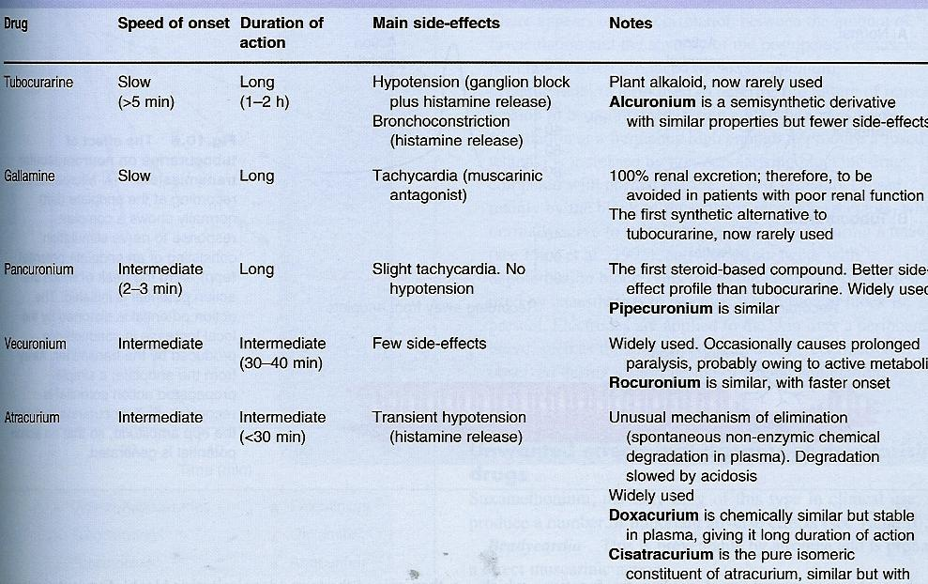
Tuboc-urarine
Gallamine
Panc-
uronium
Vec-uronium
Atrac-urium
Constituent of atracurium, similar but with fewer side effects.

Slide 25
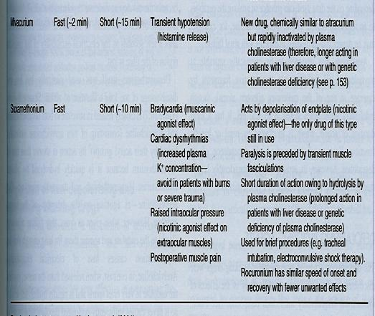
Mivac-urium
Succinyl choline

Slide 26
DDI
Anesthetics: Inhaled anesthetics (isoflurane, sevoflurane) potentiate NM blockade produced by nondepolarizing muscle relaxants.
Enhancement of NM blockade by antibiotics (aminoglycosides).

Slide 27
CENTRALY ACTING DRUGS
These spasmolytic drugs do not resemble A.Choline in structure or effect.
They act in CNS or in skeletal muscle cell
spasticity is characterized by increase in tonic stretch reflexes & flexor muscle spasm, muscle tone is increase, it is often associated with cerebral palsy, muscle sclerosis & stroke.

Slide 28
Spasticity
Tr:
Centrally acting drugs:
1- Diazepam: stimulate GABA Rs (increase K⁺ conductance & hyperpolarization) & reduce spasticity.
It is a drug of choice to overcome & abolish if the convulsion are continuous and persistent; such as in epilepsy
(anticonvulsant, anxiolytic, sedative, muscle relaxant & amnesic). Oral/ parenteral.
Disadvantage: sedation.

Slide 29
2- Baclofen: GABA agonist; oral spasmolytic drug + reduce pain in patients with spasticity.
- Less sedation.
- Gradually withdrawn in epileptic patients.

Slide 30
Dantrolene: direct action on sk muscle
Spasmolytic
Reduces sk muscle strength by interfering with excitation-contraction coupling in ! muscle fibers.
Inhibit Ca release from sarcoplasmic reticulum (SR)

Slide 31
Uses of dantrolene:
1- in malignant hyperthermia (rare heritable disorder, can triggered by volatile anesthetics, & NMBs as succinylcholine); rise in temp + massive muscle contraction due to impairment in ! ability of SR to sequester Ca.
2- spastic state (Iv/ oral).

