Slide 1
DIRECT CHOLINERGIC DRUGS
Prof. Alhaider Pharmacology Department | Prof. Hanan Hagar Pharmacology Department

Slide 2
By the end of this lecture the student should know
Classification of nervous system.
Describe the various steps in cholinergic transmission.
Mention the different types, locations and actions of cholinergic receptors.
Describe the effects of acetylcholine on major organs
Classify cholinomimetic drugs.
Describe the kinetics, actions and uses of direct and indirect-acting cholinomimetic drugs.

Slide 3
Nervous system
Peripheral nervous
system
Central nervous
system
Efferent Division
Afferent Division
Autonomic nervous
system
Somatic
system
Enteric nervous system
Parasympathetic nervous system
Sympathetic nervous system

Slide 4
What are the differences between the somatic and the autonomic nervous system?
Somatic N.S Autonomic N.S
Control skeletal muscles Control internal viscera
Voluntary Involuntary
Somatic nerve is one fiber autonomic nerve is two fibers (Preganglionic &
Postganglionic)

Slide 5
Autonomic nerve
Post-ganglionic fiber
ganglia
Pre-ganglionic fiber
Somatic nerve
One fiber

Slide 6
Division of Autonomic Nervous System
Sympathetic nervous system.
Parasympathetic nervous system.
Enteric nervous system.

Slide 7
Parasympathetic Nervous System
(craniosacral outflow)

Slide 8
Neurotransmitters
Neurotransmitter in parasympathetic or cholinergic system is acetylcholine and nerves are cholinergic

Slide 9
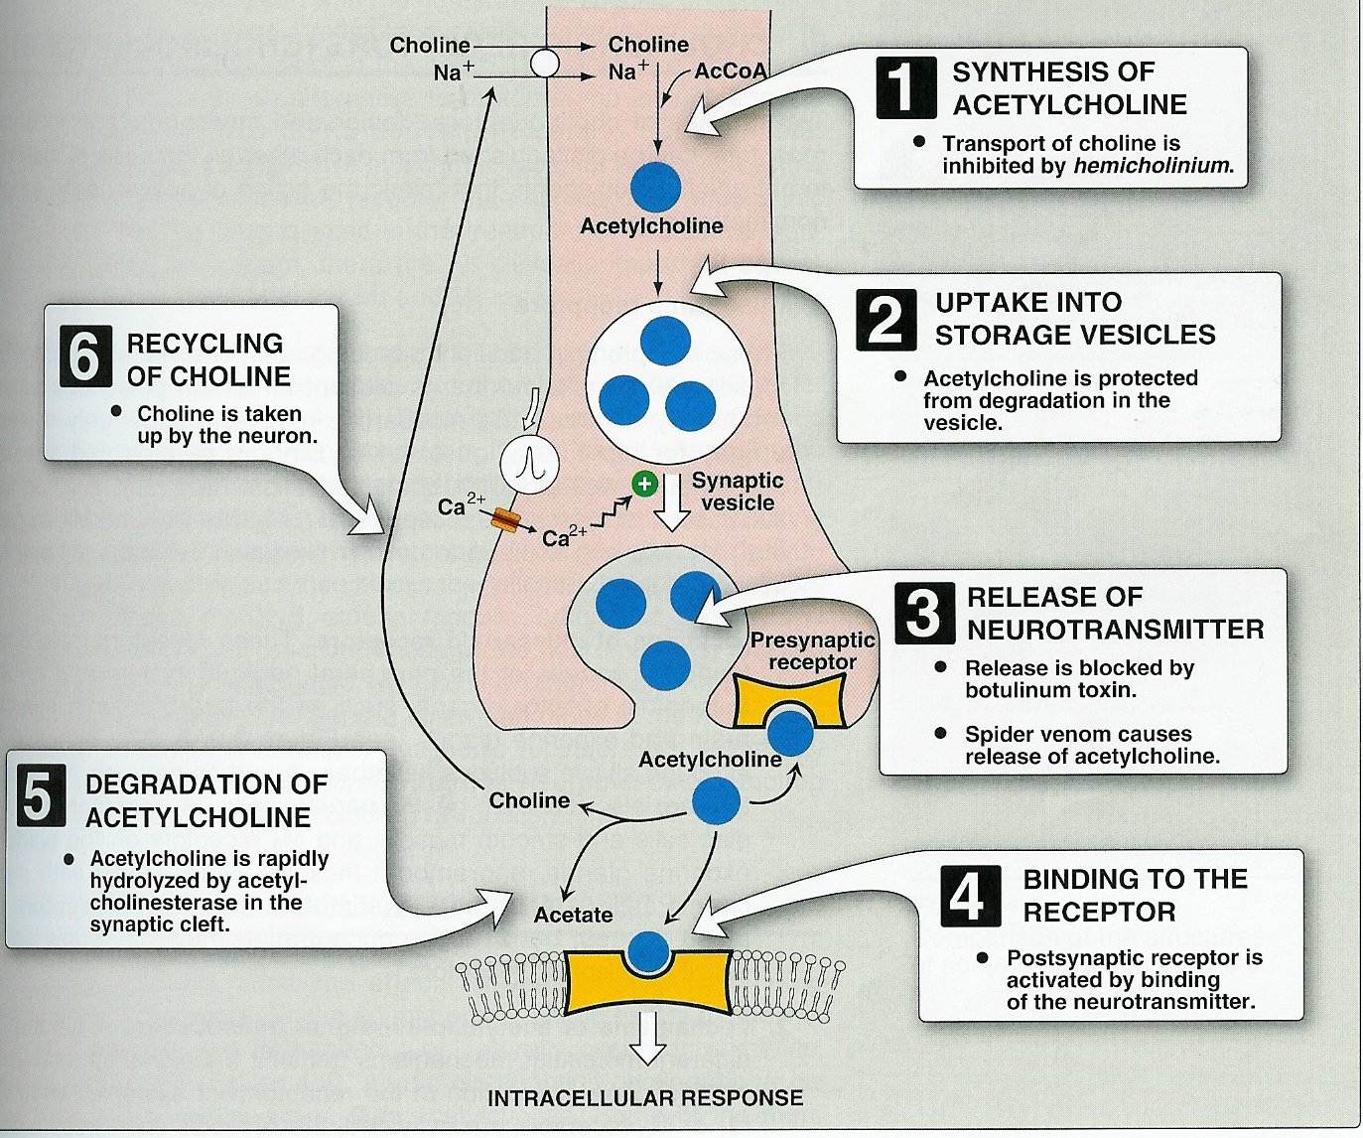
Cholinergic transmission

Slide 10
Cholinergic transmission
Synthesis
Storage
Release
Binding to receptors
Fate by acetylcholinesterase to give choline and acetate
Recycling of choline

Slide 11
Cholinergic transmission

Slide 12
Cholinergic or parasympathetic receptors
Nicotinic (N, central cholinergic ) receptors.
Muscarinic (M, peripheral cholinergic) receptors.
Central nicotinic receptor
Peripheral muscarinic receptor

Slide 13
Nicotinic receptors
Type I receptors : ion channel linked receptors
1. Autonomic ganglia (Nn).
2. Adrenal medulla (Nn).
3. CNS (Nn)
3.Neuromuscular junction (Nm)

Slide 14
Muscarinic receptors
Type II receptors : G-protein linked receptors
Five subclasses ; M1 - M5
M1, M3, M5 are excitatory in function (stimulation).
M2, M4 are inhibitory in function (inhibition).

Slide 15
Muscarinic receptors
Pharmacological actions | Locations | Receptor
CNS excitation Gastric acid secretion | CNS gastric parietal cells | M1 (Neural) Excitatory
Cardiac inhibition | Heart | M2 (Cardiac) Inhibitory
Secretion of glands Smooth muscle contraction Vasodilatation (via nitric oxide) | Exocrine glands Smooth muscles Vascular endothelium | M3 Glandular Excitatory

Slide 16
Muscarinic receptors Peripheral cholinoceptor | Nicotinic receptors Central cholinoceptor
G protein linked receptors | Ion channel linked receptors
On all peripheral organs that receive postganglionic parasympathetic fibers | Autonomic ganglia (sympathetic & parasympathetic) stimulation ( Nn )
Heart (M2) inhibition exocrine glands (M3) contraction | Adrenal medulla (Nn) release of catecholamines (Adrenaline & Noradrenaline)
Smooth muscles (GIT, urinary tract, bronchial muscles) (M3) contraction | Skeletal muscle (Neuromuscular junction) (Nm) Contraction
Excitatory or inhibitory | Almost excitatory

Slide 17
What are the actions of parasympathetic nervous system?

Slide 18
Skeletal muscles:
Low conc.→ muscle contraction
High conc. → persistent depolarization & paralysis.
Ganglia:
stimulation of sympathetic& parasympathetic ganglia.
Adrenal medulla
release of catecholamines (A & NA).
Nicotinic actions

Slide 19
Muscarinic actions
Cholinergic actions | Organs
Contraction of circular muscle of iris (miosis)(M3) Contraction of ciliary muscles for near vision (M3) Decrease in intraocular pressure | Eye
bradycardia ( heart rate ) (M2) Release of NO (EDRF) | Heart endothelium
Constriction of bronchial smooth muscles Increase bronchial secretion M3 | Lung
Increased motility (peristalsis) Increased secretion Relaxation of sphincter M3 | GIT
Contraction of muscles Relaxation of sphincter M3 | Urinary bladder
Increase of sweat, saliva, lacrimal, bronchial, intestinal secretions M3 | Exocrine glands

Slide 21
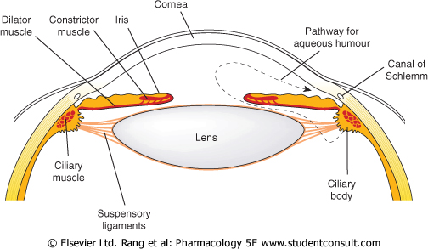

Slide 22
Cholinomimetics
Parasympathomimetics
Drugs that produce actions similar to stimulation of parasympathetic system (similar to Ach).

Slide 23
Types of cholinomimetics
Direct cholinomimetics
Act by direct stimulation of cholinergic receptors.
Indirect cholinomimetics (anticholinesterases)
They act indirectly by inhibiting acetylcholinesterase thus prevent the degradation of Ach and potentiate its action at cholinergic receptors .

Slide 24
Direct cholinomimetics
Acetylcholine (M,N)
Carbachol (M,N)
Bethanechol (M)
Pilocarpine (M)
Direct Cholinomimetics

Slide 25
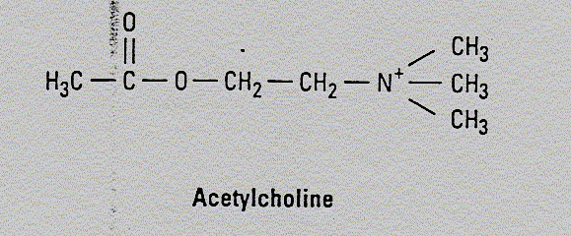
Acetylcholine (Ach)
Muscarinic and nicotinic agonist
Not used clinically because Ach
Is not selective (N, M)
Has short duration of action. Why?
Degradation by acetycholinesterase

Slide 26
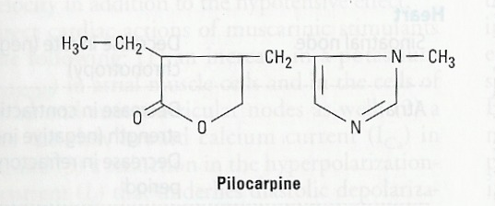
Pilocarpine
Natural alkaloids
Tertiary amine lipophilic
Pharmacokinetics
It is well absorbed
Good distribution
Can cross BBB (has central effects).
Long duration of action
Direct muscarinic agonist
(mainly on eye & secretion).

Slide 27
Pilocarpine
Adverse effects:
Profuse sweating
Salivation
CNS effects
Uses:
Xerostomia (dry mouth).
Drug of choice in emergency glaucoma
( open-angle & closed-angle) applied as eye drops.

Slide 28
Synthetic choline esters
Bethanechol, Carbachol
Quaternary ammonium compounds (polar)
Poor distribution
can not cross BBB (No CNS effects)
Not metabolized by cholinesterase.
Have longer duration of action than Ach.
Never given I.V. or I.M BUT S.C.

Slide 30
Carbachol
Orally-SC
Not metabolized by cholinesterases.
Longer duration of action than Ach
Muscarinic actions on Eye, GIT, UT.
Has nicotinic actions (what are these actions?).
Used for
Mainly in glaucoma
Urinary retention & paralytic ileus (rarely)

Slide 31
Bethanechol
Orally-SC
Prominent muscarinic actions on GIT, UT.
No nicotinic action
Not metabolized by cholinesterases.
Longer duration of action than Ach
Used for
In urinary retention (post-operative atony, neurogenic bladder, spinal cord injury)
In paralytic ileus

Slide 32
Pilocarpine | Bethanechol | Carbachol | ACh
Tertiary non polar | Quaternary Polar | Quaternary Polar | Quaternary Polar | Chemistry
Complete | better absorbed than Ach | better absorbed than Ach | NOT | Absorption
NOT hydrolyzed by cholinesterase | NOT hydrolyzed by cholinesterase | NOT hydrolyzed by cholinesterase | Hydrolyzed by cholinesterase | Metabolism
Longer (++) | Longer (++) | Longer (++) | Very short | Duration
oral, eye drops | Oral S.C. | Oral, eye drops S.C. | I.V. eye drops | Administ.

Slide 33
Pilocarpine | Bethanechol | Carbachol | ACh
Muscarinic | Muscarinic | Muscarinic Nicotinic | Muscarinic Nicotinic | Receptors
+++ | +++ | +++ | +++ | Muscarinic
More on eye, secretion | GIT, Urinary bladder | Eye, GIT Urinary bladder | NOT | Selectivity
NO | NO | +++ | +++ | Nicotinic
Glaucoma Xerostomia | Paralytic ileus Urinary retention | Glaucoma Paralytic ileus Urinary retention | NO | Uses

Slide 34
Cevimeline
Direct acting muscarinic agonist
Used for treatment of dry mouth symptom
associated with Sjogren's syndrome.

Slide 35
Contraindications of cholinomimetics
Bronchial asthma.
Peptic ulcer.
Angina pectoris
Incontinence
Intestinal obstruction

Slide 36
Thank you

