Slide 1
INDIRECT CHOLINOMIMETICS
Prof. Alhaider Pharmacology Department | Prof. Hanan Hagar Pharmacology Department

Slide 2
Indirect acting cholinomimetic drugs
What students should know:
Classification of indirect acting cholinomimetics
Mechanism of action, kinetics, dynamics and uses of
anticholinesterases
Adverse effects & contraindications of anticholinesterases
Symptoms and treatment of organphosphorous toxicity.

Slide 3
Indirect cholinomimetics
(anticholinesterases)
Mechanism of action:
Anticholinesterases inhibit action of acetylcholinesterase on Ach thus prevent hydrolysis of Ach and increases its concentration at the cholinergic receptors (both nicotinic and muscarinic).

Slide 4
Indirect cholinomimetics (anticholinesterases)
anticholinesterases
Nicotinic
&
Muscarinic
receptors
cholinesterase
Ach
Effects
Choline + Acetate

Slide 5
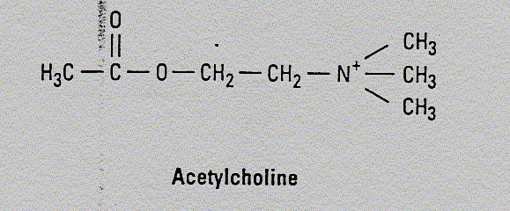
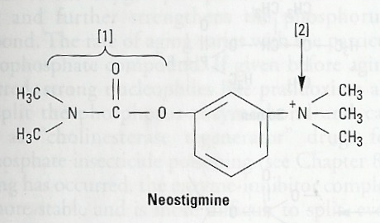
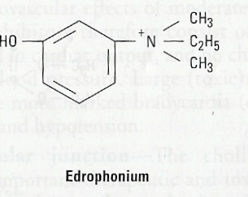
Anticholinesterases
Are similar in structure to Ach

Slide 6
Classification of anticholinesterases
Reversible anticholinesterases
Short acting (Alcohols) edrophonium
Intermediate acting (Carbamates esters)
Physostigmine, Neostigmine
Pyridostigmine, Ambenonium
Irreversible anticholinesterases
Phosphates esters (very stable covalent bond)
e.g. Ecothiophate & Isoflurophate

Slide 7
Classification of indirect cholinomimetics
I- Reversible indirect cholinomimetics
Quaternary alcohol
Edrophonium (short duration of action)
forms weak hydrogen bond with enzyme
Carbamates esters (intermediate duration)
binds to both sites of enzymes
All polar except physostigmine
Physostigmine, Pyridostigmine
Neostigmine, Ambenonium

Slide 8
II. Irreversible indirect cholinomimetics
Phosphate esters
e.g. Ecothiophate – Isoflurophate
very long duration of action
form very stable covalent bond with enzyme
All phosphates are lipid soluble except ecothiophate.

Slide 9
Pharmacological effects of anticholinesterases
ALL Anticholinesterases have muscarinic and nicotinic actions (N & M actions) and some have CNS effects.

Slide 10
Pharmacological effects of anticholinesterases
Muscarinic actions
Nicotinic actions
CNS actions:
Excitation, convulsion, respiratory failure, coma
only for lipid soluble anticholinesterases
physostigmine & phosphate ester except
Ecothiophate.

Slide 11
Muscarinic actions
Cholinergic actions | Organs
Contraction of circular muscle of iris (miosis)(M3) Contraction of ciliary muscles for near vision (M3) Decrease in intraocular pressure | Eye
bradycardia ( heart rate ) (M2) Release of NO (EDRF) | Heart endothelium
Constriction of bronchial smooth muscles Increase bronchial secretion M3 | Lung
Increased motility (peristalsis) Increased secretion Relaxation of sphincter M3 | GIT
Contraction of muscles Relaxation of sphincter M3 | Urinary bladder
Increase of sweat, saliva, lacrimal, bronchial, intestinal secretions M3 | Exocrine glands

Slide 12
Nicotinic actions
Neuromuscular junction
Therapeutic dose: muscle contraction
Toxic dose: persistent depolarization & paralysis.
Ganglia: stimulation of sympathetic and parasympathetic ganglia
Adrenal medulla release of catecholamines (A & NA).

Slide 13
Indirect Cholinomimetics
Edrophonium
Reversible anticholinesterase
alcohol
Polar
NOT absorbed orally (given by injection)
attach mainly to anionic site by weak hydrogen bond.
Has short duration of action (5-15 min.)
Used for diagnosis of myasthenia gravis

Slide 14
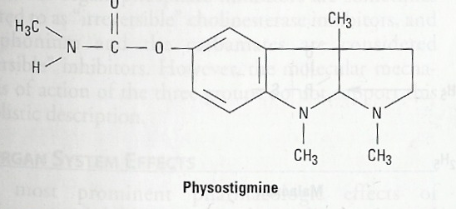
Physostigmine
Reversible anticholinesterase
Tertiary ammonium compound
Non polar (lipid soluble)
Good lipid solubility
Good oral absorption
cross BBB (has CNS effects)
Uses
Glaucoma
atropine toxicity

Slide 15
Neostigmine
Reversible anticholinesterase
Quaternary ammonium comp.
Polar compound
Can be used orally
No CNS effect
Has muscarinic & nicotinic actions
(prominent on GIT & urinary tract).
Uses
Treatment of myasthenia gravis
Paralytic ileus & Urinary retention
Curare intoxication

Slide 16
Carbamate esters
Uses | Kinetics | Actions | Drug
Myasthenia gravis treatment Paralytic ileus Urinary retention Curare toxicity | 0.5-2hr polar | Nicotinic & muscarinic | Neostigmine
Glaucoma atropine toxicity | 0.5-2hr Lipid soluble | Nicotinic muscarinic CNS | Physostigmine
Myasthenia gravis treatment | 3-6 polar | Nicotinic & muscarinic | Pyridostigmine
Myasthenia gravis treatment | 4-8 polar | Nicotinic & muscarinic | Ambenonium

Slide 17
Indirect Cholinomimetics
(Organophosphorous compounds)
Ecothiophate
Mechanism
Irreversible anticholinesterase
Binds to cholinesterase by strong covalent bond.
Have very long duration of action
Aging make bond extremely stable
All are highly lipid soluble except ecothiophate
Used for glaucoma.

Slide 18
Organophosphorous compounds toxicity
Sever bradycardia, hypotension.
bronchospasm.
Increased GIT motility → cramps & diarrhea.
CNS effects → convulsion, coma and respiratory failure.
Twitching of skeletal muscles → muscle weakness.

Slide 19
Treatment of organophosphate toxicity
Support respiration
Cholinesterase reactivators (Oximes)
Atropine ( to block muscarinic & central actions).

Slide 20
OXIMES
Pralidoxime (PAM)
cholinesterase reactivator
stimulates the hydrolytic regeneration of cholinesterase enzyme.
reactivates recently inhibited enzymes before aging.
Uses
I.V. → over 15-30 min for organophosphate intoxication.

Slide 21
Donepezil
Anticholinesterase drugs.
Given orally.
used for treatment of dementia of
Alzheimer’s disease.

Slide 22
Indirect Cholinomimetic
Diagnosis of Myasthenia gravis | Very Short 5-15 min, Polar | Edrophonium M, N
Myasthenia gravis treatment Paralytic ileus Urinary retention curare toxicity | Short 0.5-2hr polar | Neostigmine M, N
Glaucoma atropine toxicity | Short 0.5-2hr Lipid soluble | Physostigmine M,N, CNS
Myasthenia gravis treatment | Short 3-6, polar | Ambenonium Pyridostigmine M, N
Glaucoma. | Long 100hr, polar | Ecothiophate M, N
dementia of Alzheimer’s disease |  | Donepezil M, N

Slide 23
Summary for cholinomimetics & their uses
Eye : treatment of glaucoma
Pilocarpine (direct muscarinic agonist)
Physostigmine-Ecothiophate (indirect cholinomimetics)
Urinary retention and paralytic ileus
Bethanechol (direct)
Neostigmine (indirect)
Myasthenia gravis (only indirect cholinomimetics)
Pyridostigmine, Neostigmine, Ambenonium
Xerostomia
Pilocarpine –Cevimeline (Sjogren’s syndrome)
Alzheimer’s disease: Donepezil

Slide 24
Thank you Any Questions ?

