Slide 1
GOUT

Slide 2
By
Prof. Azza El-Medany
Dr. Osama Yousf

Slide 3
OBJECTIVES
At the end of lectures students should :
Define gout
Describe outlines of treatment
Describe treatment of acute gouty arthritis
Describe the mechanism of action , clinical uses & side effects of drugs used in acute attacks

Slide 4
OBJECTIVES ( continue)
Classify drugs used in chronic treatment
Define each group of drugs
Describe the mechanism of action, clinical uses & side effects & drug interactions for drugs used in chronic treatment

Slide 5
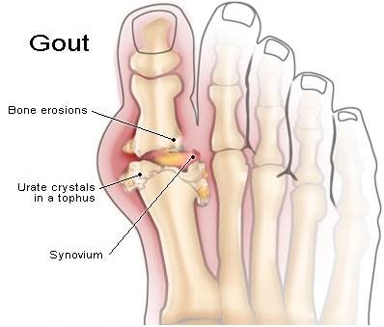
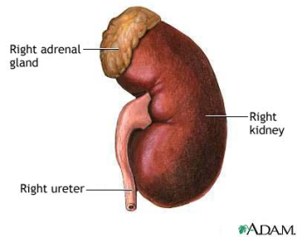

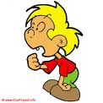
What is gout?
High blood uric acid level
Acute arthritis
monosodium urate stone in kidney
Familial metabolic disease
♂>♀
Breakdown of product of the body’s purine (nucleic acid) metabolism.

Slide 6
Aetiology of raised uric acid level
Idiopathic decrease in uric acid excretion
(75%)
Increase uric acid production due to increased cell turn over (tumors), increase uric acid synthesis
High dietary purine intake
Impaired uric acid excretion secondary to thiazide diuretics, chronic Renal failure

Slide 7
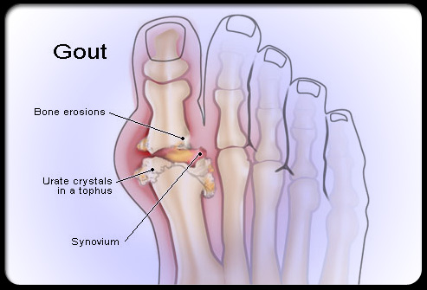

Slide 8
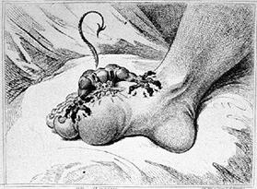

Slide 9
What is the treatment for gout ?

Slide 10
DRUGS USED IN TEATMENT OF GOUT
Most therapeutic strategies for gout involve lowering the uric acid level below the saturation point (<6 mg/dL), thus preventing the deposition of urate crystals.
This can be accomplished by:
interfering with uric acid synthesis with allopurinol
increasing uric acid excretion with probenecid or sulfinpyrazone, large doses of aspirin
inhibiting leukocyte entry into the affected joint with colchicine,
administration of NSAIDs

Slide 11
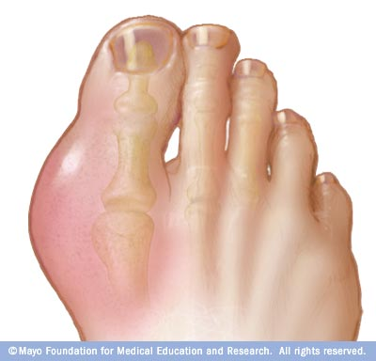
Aaarrrgghhh!!

Slide 12
1
Asymptomatic Stage
2
Acute stage
3
Intercritical stage
4
Chronic stage

Slide 13
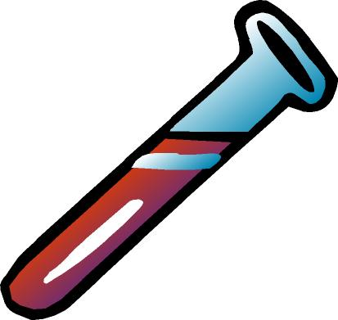
ASYMPTOMATIC STAGE
urate levels rise in the blood, but produces no symptoms

Slide 14
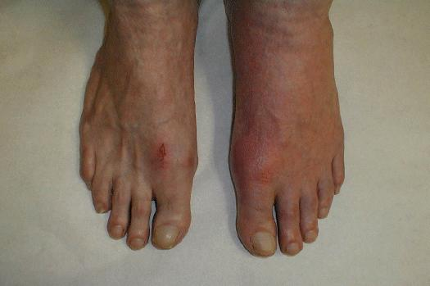
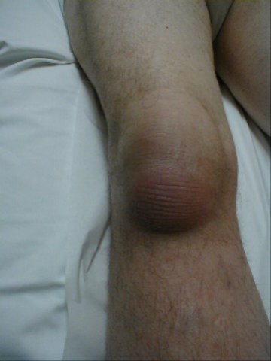
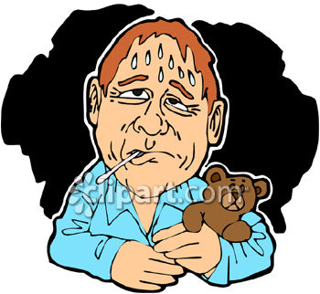
ACUTE STAGE

Slide 15
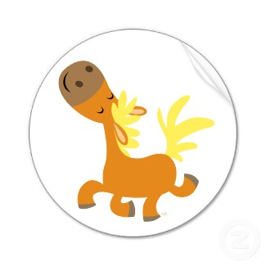
INTERCRITICAL STAGE
symptom-free intervals between gout episodes. Most people have a second attack from six months to two years, while others are symptom-free for five to 10 years.

Slide 16
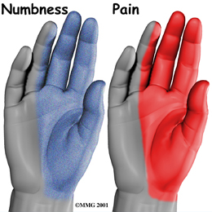
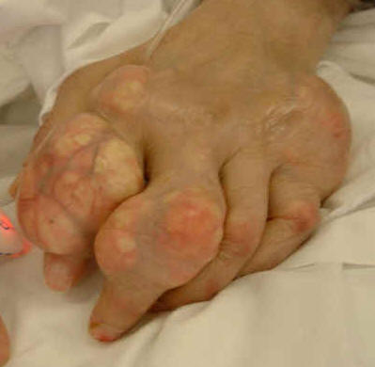
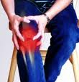
CHRONIC STAGE

Slide 17
Broad lines in treatment of gout
Non-pharmacologic
pharmacologic
Acute gouty arthritis
Prevention of recurrent attack

Slide 18
Non-pharmacologic
Therapy

Slide 19

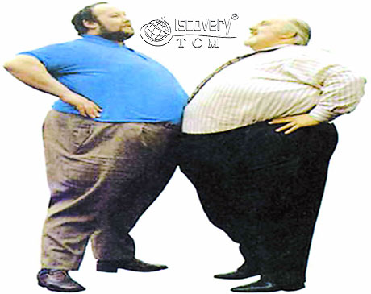
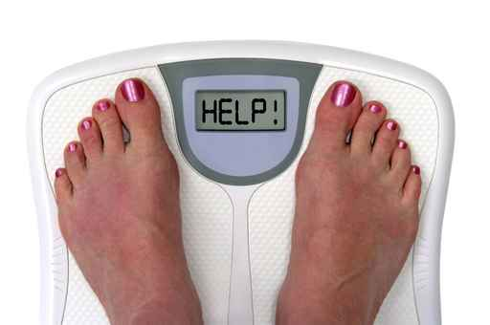

Slide 20
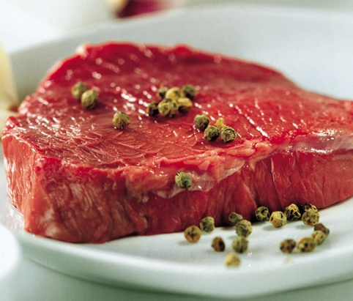
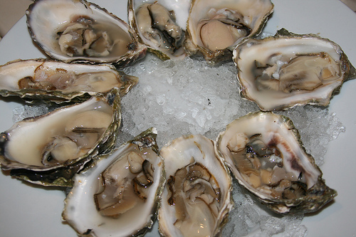

Slide 21
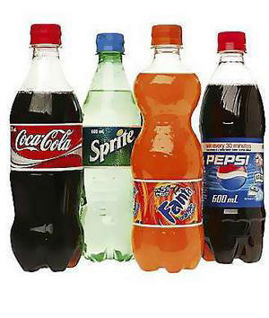


Slide 22
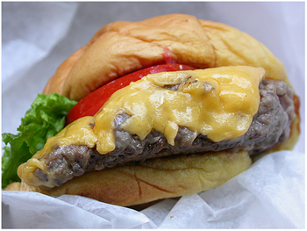
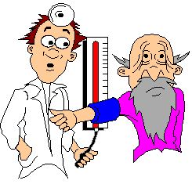
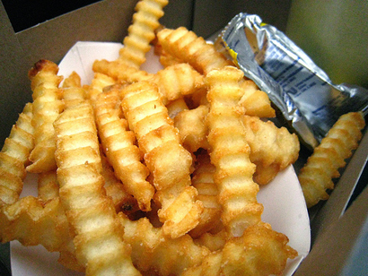
Control….

Slide 23
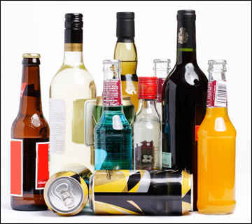

Slide 24
Acute gouty arthritis
NSAIDs
colchicine
corticosteroid

Slide 25
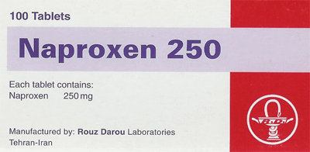
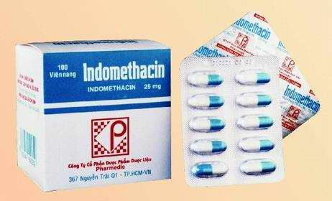
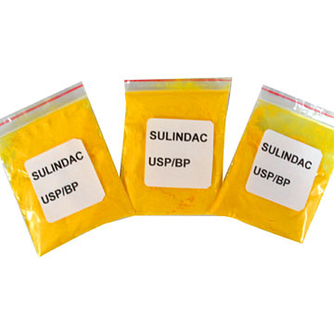
1. NSAIDs

Slide 26
NSAIDs (Selective or non- selective )
Inhibit pain & inflammation.
Inhibit urate crystal phagocytosis by decreasing the migration of granulocytes into the inflammatory area.
They are commonly used now& may replace colchicine .
( Except aspirin & paracetamol)

Slide 27
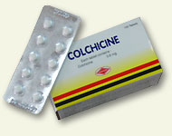
2. Colchicine

Slide 28
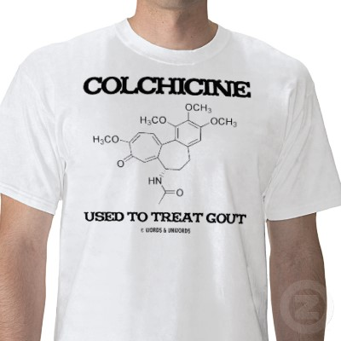

Basyir Bin Kamaruzaman (15)

Slide 29

OVERVIEW
A plant alkaloid
Used for the treatment of acute gouty arthritis only
Has no uricosuric or analgesic effects
Can be used as prophylactic drug to reduce the frequency of acute attacks

Slide 30
MECHANISM OF ACTIONS
Binds to tubulin (microtubular protein ) ➔disrupt cellular function , such as migration of granulocytes to affected area
Inhibits the synthesis and release of leukotrienes & TNF-α
Blocks cell division by binding to mitotic spindles

Slide 31
PHARMACOKINETICS
PHAPHARMACOKINETICS
Given orally, followed by rapid absorption from the GI tract
Reaches peak plasma levels within 2 hours
Also available combined with probenecid
Recycled in the bile and is excreted unchanged in the faeces or urine.
Should be used with caution in patients with renal dysfunction

Slide 32
THERAPEUTIC USES
The anti-inflammatory activity of colchicine is specific for gout, alleviating the pain of acute gout within 12 hours
Colchicine is currently used for prophylaxis of recurrent attacks and prevent the attacks in more than 80 percent of patients.
Treatment for Mediterranean Fever

Slide 33
Adverse effects
Diarrhea is a common adverse effect. May cause nausea,vomiting ,abdominal cramps.
Chronic use may cause, alopecia, bone marrow depression, peripheral neuritis, myopathy.

Slide 34
Acute intoxication
Burning throat pain.
Bloody diarrhea.
Shock.
Hematuria.
C.N.S.depression.

Slide 35
Contraindication & Precaution
Contraindicated in pregnancy
Should be used with caution in hepatic , renal or cardiovascular diseases.

Slide 36
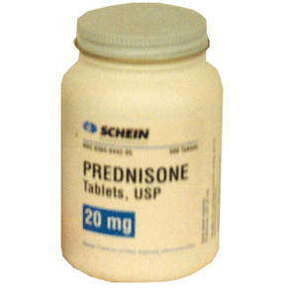
3. Corticosteroids

Slide 37
Prevention of recurrent attack
Inhibition of uric acid synthesis Allopurinol
Uricosuric drugs
- Probenacid
Sulfinpyrazone
Large doses of aspirin

Slide 38
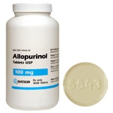
Inhibition of uric acid synthesis

Slide 39
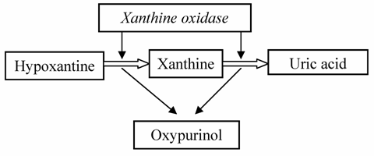
Mechanism of action

Slide 40
Pharmacokinetics
80% absorbed after oral administration.
Metabolized in the liver to active metabolite alloxanthine.
Given once daily.
Drug & its metabolite are excreted in the feces & urine.

Slide 41
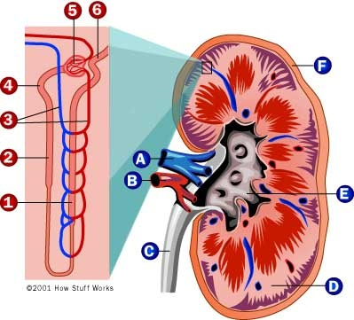
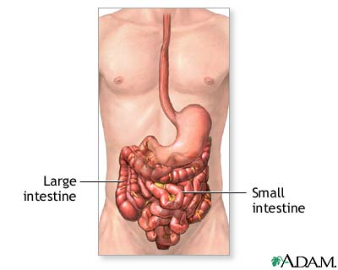
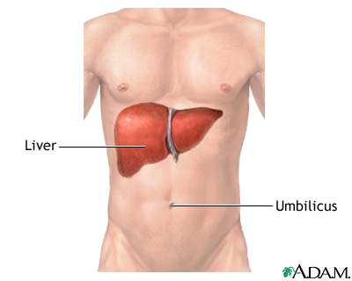
Pharmacokinetics

Slide 42
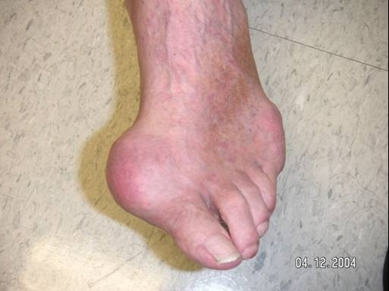
Therapeutic Uses
It is effective in the treatment of primary hyperuricemia

Slide 43
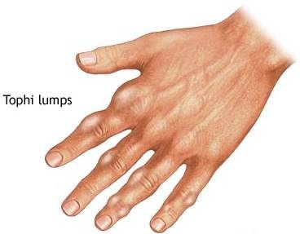

Hyperuricemia secondary to other conditions such as :

Slide 44
Impaired renal functions.

Slide 45
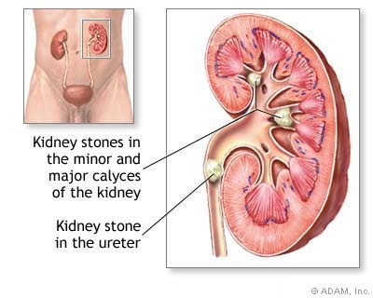
uric acid stones or nephropathy.

Slide 46
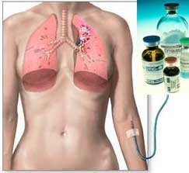

In patients receiving cancer chemotherapy

Slide 47
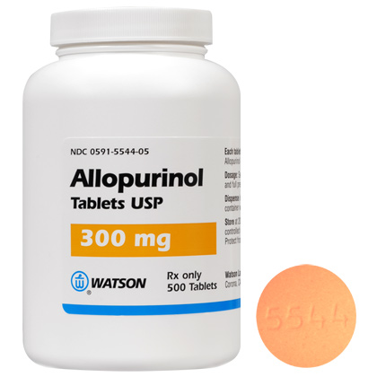
ALLOPURINOL
(SIDE EFFECTS AND
DRUG INTERACTIONS)

Slide 48
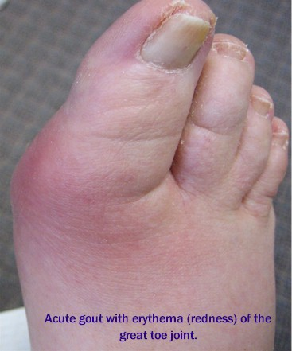
Side Effects (most common)
exacerbation of
an acute attack of gout

Slide 49
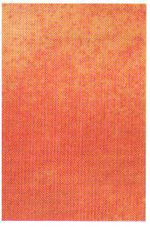
Maculopopular skin rash

Slide 50
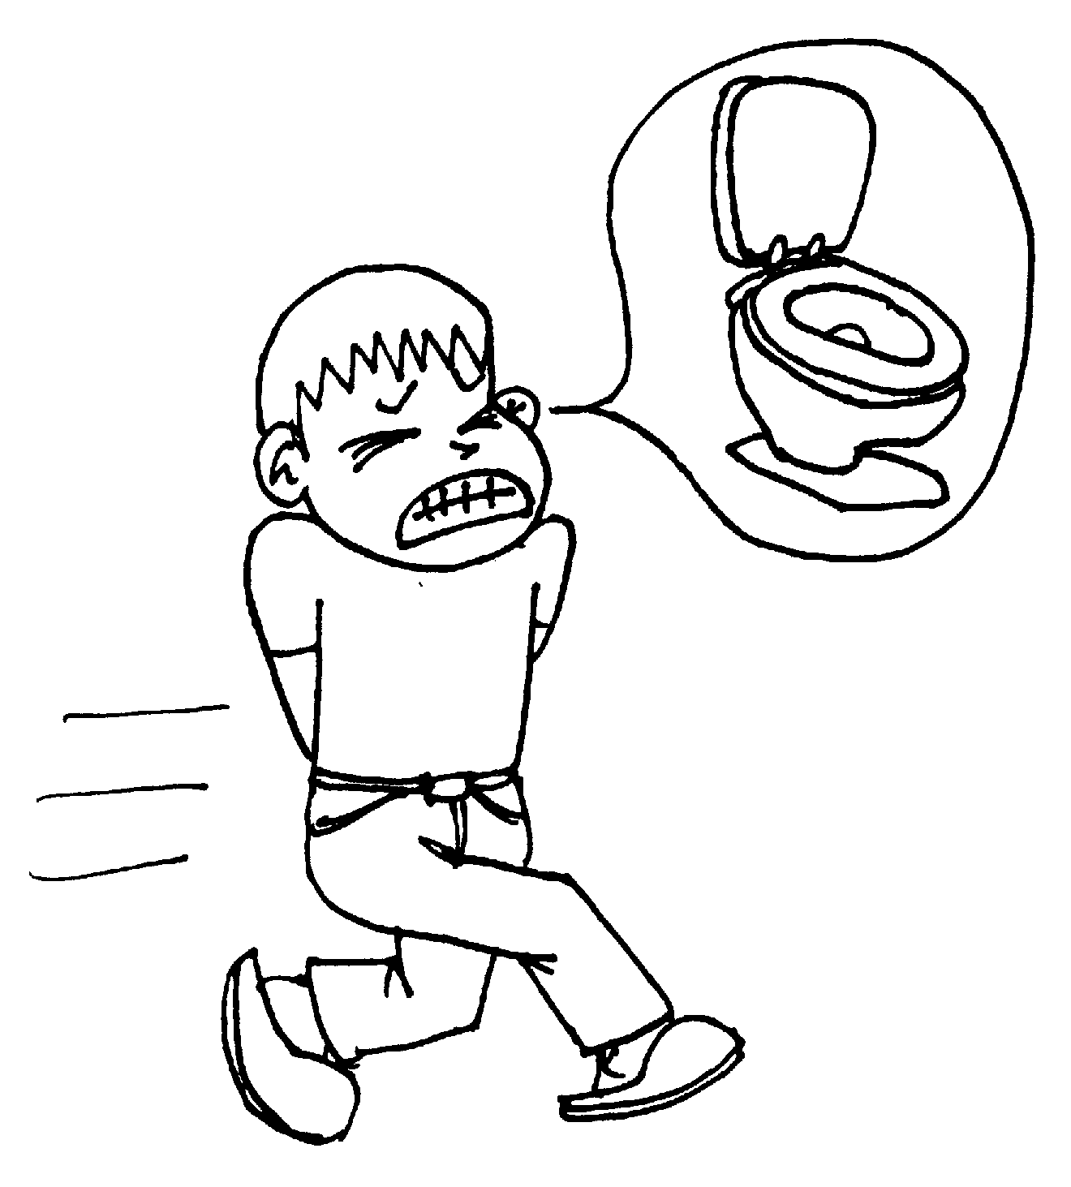
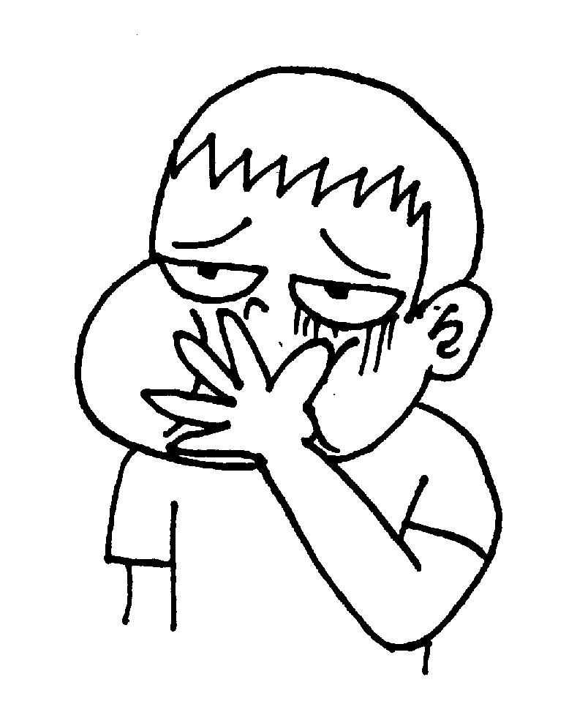
nausea, diarrhea

Slide 51
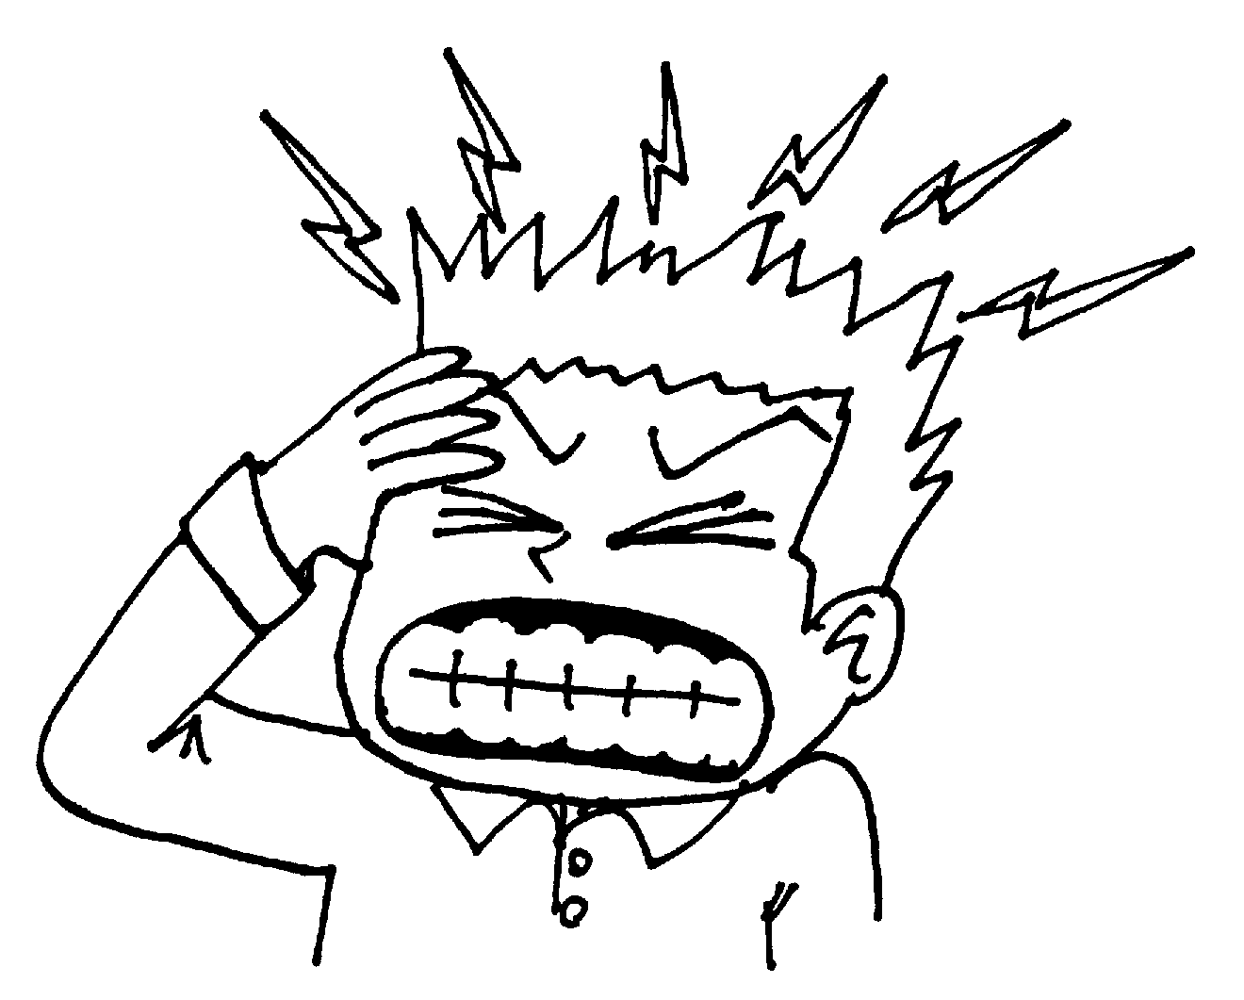
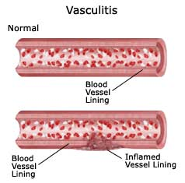
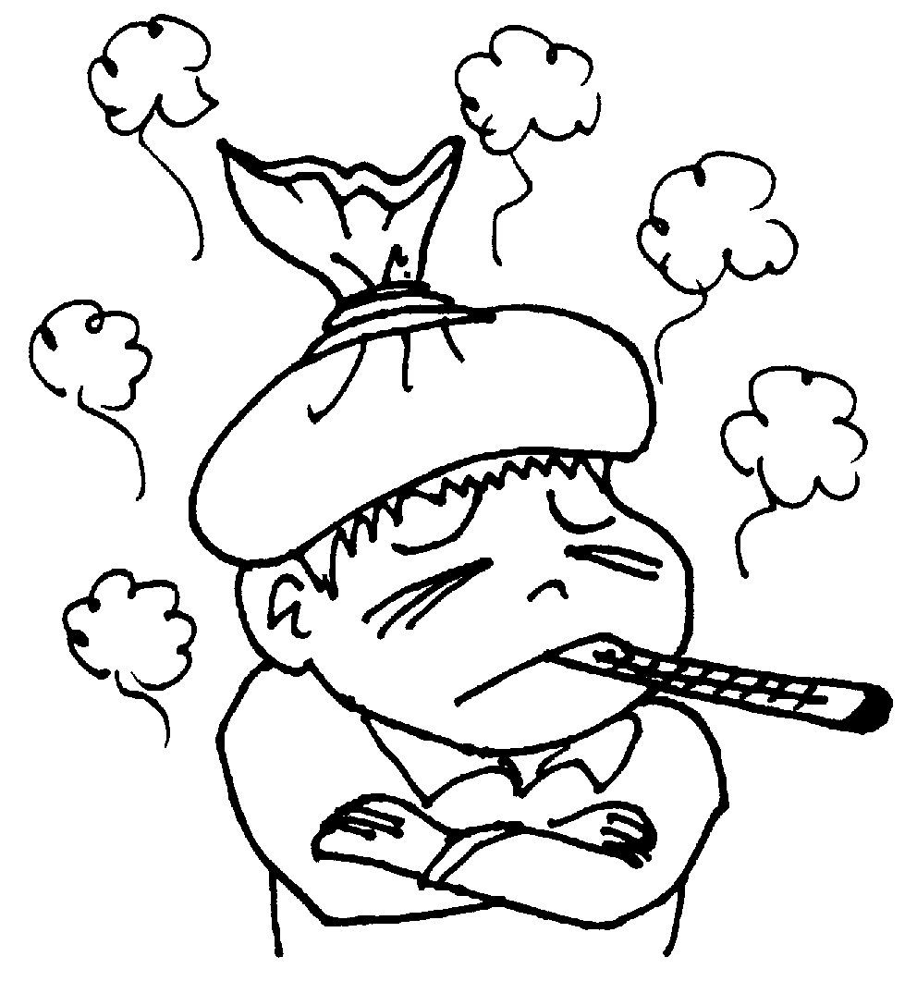
Side Effects (less common)
Body : fever, headache
CVS : vasculitis

Slide 52
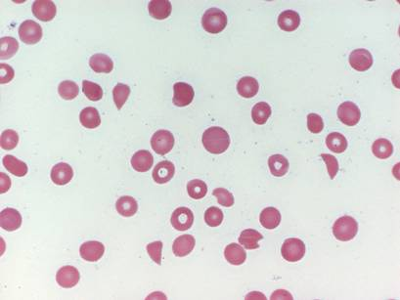
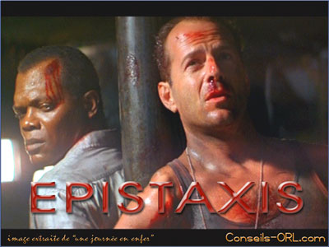

Thrombocytopenia
Epistaxis

Slide 53
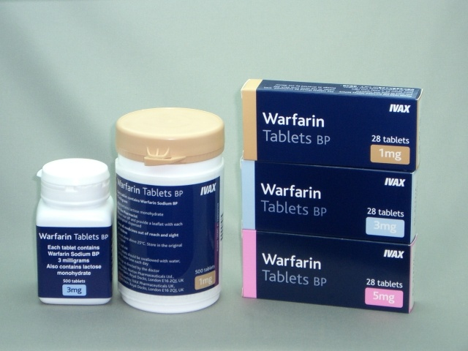
Drug Interactions
With oral anticoagulant:
Such as warfarin
Potentiates its action
through inhibition
Its metabolism

Slide 54
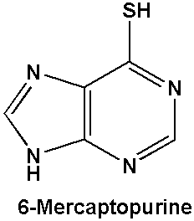

With anticancer :
6-mercaptopurine
and azathioprine
Allopurinol inhibits
their metabolism
So ,doses of anticancer
Must be reduced up to 75%

Slide 55



With ampicillin :
Increases frequency
of skin rash

Slide 56


Uricosuric drugs

Slide 57


Probenecid

Slide 58
Sulfinpyrazone
Sulfinpyrazone is a metabolite of phenylbutazone
Metabolized into an active metabolite in the liver.

Slide 59

Mechanism of action
Uricosuric drugs ( probenecid, sulfinpyrazone, large dose of aspirin) block the active transport sites of the proximal tubules(middle segment ) causing :
reduction of
Uric acid
reabsorption

Slide 60
Clinical uses
Chronic gout when plasma levels of uric acid are so high that may cause tissue damage
With some antibiotics as penicillin to increase their plasma levels

Slide 61
Warning
Urine volume should be maintained at a high level, and urinary pH kept alkaline .

Slide 62


DRUG INTERACTIONS
Probenecid prolong the action of some antibiotics as: penicillins and cephalosporins

Slide 63



Side effects
Acute attack of gout
Risk of uric acid stone
GIT upset
Allergic rash

Slide 64
Adverse effects ( continue)
Nephrotic syndrome ( probenecid)
Aplastic anemia ( not common )

Slide 65
Contraindications
History of urinary tract stone
Impaired renal function
Recent acute gouty attack
Administration of low doses of aspirin

Slide 66
THANK YOU

