Slide 1
Autonomic Nervous System
Prof. Alhaider 1433 H
Revision of Physiology and Anatomy
What is the peripheral Nervous System?
What is the differences between autonomic and somatic?
Why is Acetylcholine an important neurotransmitter?
Why ACH is not in clinical practice?

Slide 2
By the end of this lecture the student should know
Classification of nervous system.
Describe the various steps in cholinergic transmission.
Mention the different types, locations and actions of cholinergic receptors.
Describe the effects of acetylcholine on major organs
Classify cholinomimetic drugs.
Describe the kinetics, actions and uses of direct and indirect-acting cholinomimetic drugs.

Slide 3
Nervous system
Peripheral nervous
system
Central nervous
system
Efferent Division
Afferent Division
Autonomic nervous
system
Somatic
system
Enteric nervous system
Parasympathetic nervous system
Sympathetic nervous system

Slide 4
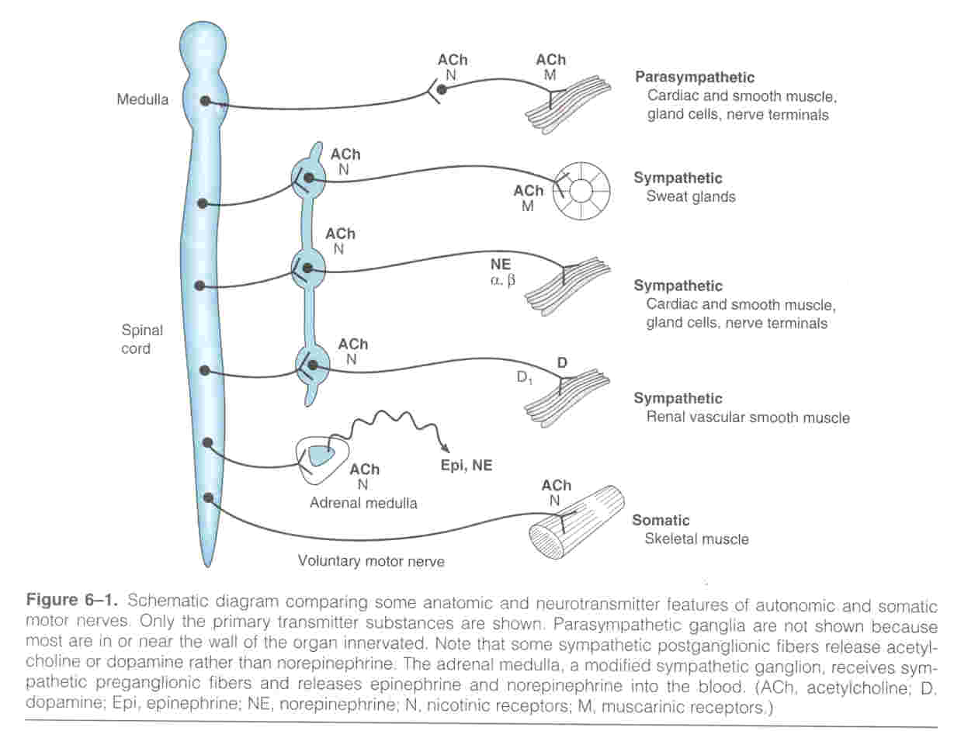

Slide 6
Biosynthesis and pathway of Acetylcholine
(Cholinergic Transmission)

Slide 7
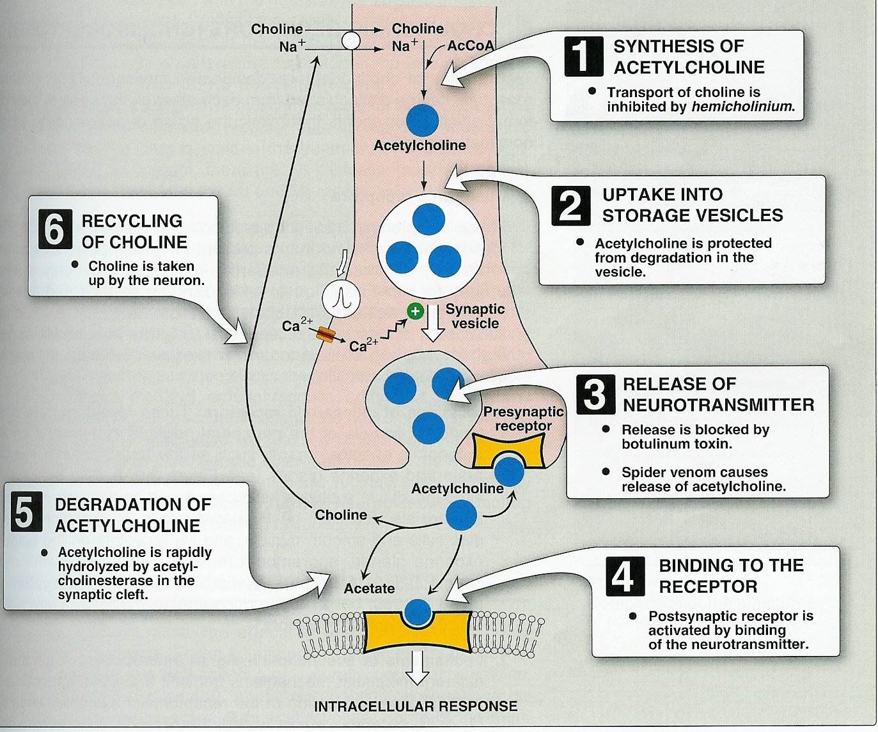
Cholinergic transmission

Slide 8
CHOLINOMIMETIC AGENTS (Parasympathomimetics)
Nerve Heart glands and
endothelium
Alkaloids “Reversible”
Muscarinic
Direct-acting Receptors Ach Indirect acting
drugs Drugs
Nicotinic
“Irreversible”
Choline esters
Neuromuscular Ganglionic

Slide 9
Subtypes and characteristics of Cholinergic Receptors
Postrecptor mechanism | Structural features | Location | Other Name | Receptor type
IP₃,DAG cascade | 7 transmembrane segments,G protein linked | Nerves | M_{1a} | M₁
Inhibition of cAMP production, activation of K channels | 7 transmembrane segment,Gprotein-linked | Heart, nerves, smooth muscle | M_{2a},cardiac _{M2} | M₂
IP₃,DAG casaded→cytosolic calcium →↑released | 7 transmembrane segment ,G-protein linked | Glands,smooth muscle,endothelium | M_{2b} glandular M2 | M₃
Inhibition of cAMP producation | 7membrane segment Gprotein linked | ? CNS |  | m₄
IP3 ,DAG,cascade | 7membrane segment Gprotein linked | ? CNS |  | m₅¹
Na⁺,K⁺depolarizing ion channel | Pentamer(αβδγ)² | Skeletal muscle neuromuscular junction | Muscle type,end plate receptor | N_{M}
Na⁺,K⁺depolarizing ion channel | αandβsubunitss only as α₂β₂α₃β₃ | Postganglionic cell body,dendrites | Neuronal type , ganglion receptor | N_{N}

Slide 10
Pharmacological actions | Locations | Receptor
CNS excitation Gastric acid secretion Activation of phospholipase C ↑ IP3 &DAG → ↑ Ca | CNS Autonomic ganglia gastric parietal cells | M1 (Neural) Excitatory
Cardiac inhibition Presynaptic inhibition Inhibition of adenyl cyclase (↓ cAMP) Opening of K channels | Heart Presynaptic cholinergic fibers | M2 (Cardiac) Inhibitory
Secretion of glands Smooth muscle contraction Vasodilatation (via NO) Activation of phospholipase C ↑ IP3 & DAG. | Exocrine glands Smooth muscles Vascular endothelium | M3 Glandular Excitatory

Slide 11
Muscarinic receptors Peripheral cholinoceptor | Nicotinic receptors Central cholinoceptor
G protein linked receptors | Ion channel linked receptors
On all peripheral organs that receive postganglionic parasympathetic fibers | Autonomic ganglia (sympathetic & parasympathetic) stimulation ( Nn )
Heart (M2) inhibition exocrine glands (M3) contraction | Adrenal medulla (Nn) release of catecholamines (Adrenaline & Noradrenaline)
Smooth muscles (GIT, urinary tract, bronchial muscles) (M3) contraction | Skeletal muscle (Neuromuscular junction) (Nm) Contraction
Excitatory or inhibitory | Almost excitatory

Slide 12
Based on the receptor type, Acetylcholine has two main effects:
1) Cholinergic (cholinomimetics) action
2) Nicotinic Action

Slide 13
Nicotinic Actions
Skeletal muscles:
Low conc.→ muscle contraction
High conc. → persistent depolarization & paralysis.
Ganglia: stimulation of sympathetic& parasympathetic ganglia.
Adrenal medulla release of catecholamines (A & NA).

Slide 14
Objective
Since Ach is not specific and easily destroyed by Cholinesterase, thus it is very essential to obtain Cholinergic Drug that has low nicotinic activity, high muscarenic selectivity but with low susceptibility to cholinesterase. (See Figure)
Which drug that has such features?

Slide 15
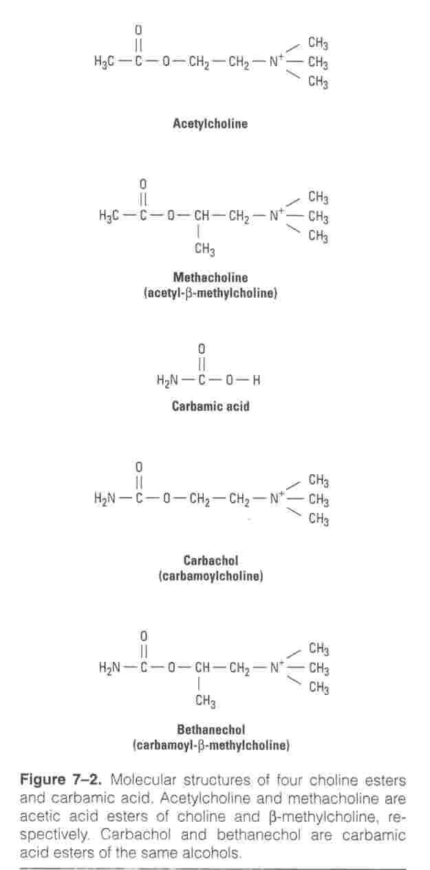

Slide 16
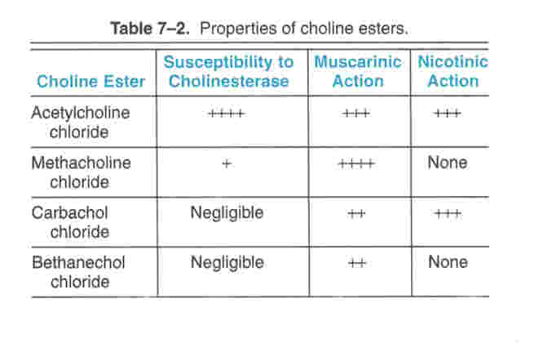

Slide 17
Bethanechol | Carbachol | Pilocarpine | ACh
Complete | Complete | Complete | NOT | Absorption
NOT hydrolyzed by cholinesterase | NOT hydrolyzed by cholinesterase | NOT hydrolyzed by cholinesterase | Hydrolyzed by cholinesterase | Metabolism
Longer (++) | Longer (++) | Longer (++) | Very short | Duration
Oral, S.C. | Oral, eye drops | oral, eye drops | I.V. | Administ.

Slide 18
(Pharmacological Actions of Cholinomimetic Agents)
Note: They are continuation of the physiological effects of
ACH.
Directly Acting Drugs
Effect on Eye (M3) (contraction of circular muscle leading
to miosis and contraction of ciliary muscle leading to accommodation for near vision). Both effects are
utilized in the Rx of Glaucoma to decrease intraocular pressure.
Effects on CVS: here remember the repolarizing
action mediated by stimulation of M₂ receptor.
AV and SA nodes: decrease rate of depolarization
and conduction in the nodes leading to bradycardia
at low doses.
What will happen if high concentration of Ach were given?

Slide 19
Muscarinic actions
Cholinergic actions | Organs
Contraction of circular muscle of iris (miosis)(M3) Contraction of ciliary muscles for near vision (M3) | Eye
bradycardia ( heart rate ) (M2) Release of NO (EDRF) | Heart endothelium
Constriction of bronchial smooth muscles Increase bronchial secretion M3 | Lung
Increased peristalsis Increased secretion Contraction of sphincter M3 | GIT
Contraction of muscles Relaxation of sphincter M3 | Urinary bladder
Increase of sweat, saliva, lacrimal, bronchial, intestinal secretions M3 | Exocrine glands

Slide 20
Atrail muscle: decrease conductivity and
contractility.
iii) Ventricles: no effect Why?
iv) Blood vessels (vasodilation How?).
Which one of the muscarinic drugs may produce vasoconstriction?
3) Effects on other smooth muscle;
Here remember EFFECTS that are mediated by stimulation of M₁ and M₃.
Lung: Bronchoconstriction
GIT: increase the tone and motility leading to diarrhea and cramps.
Bladder (destrusor (contraction) vs sphincher (Relaxation)
What are the clinical significant of such effects?
4) Effects on Glands (Exocrine) (M3)
5) Effects on CNS

Slide 21
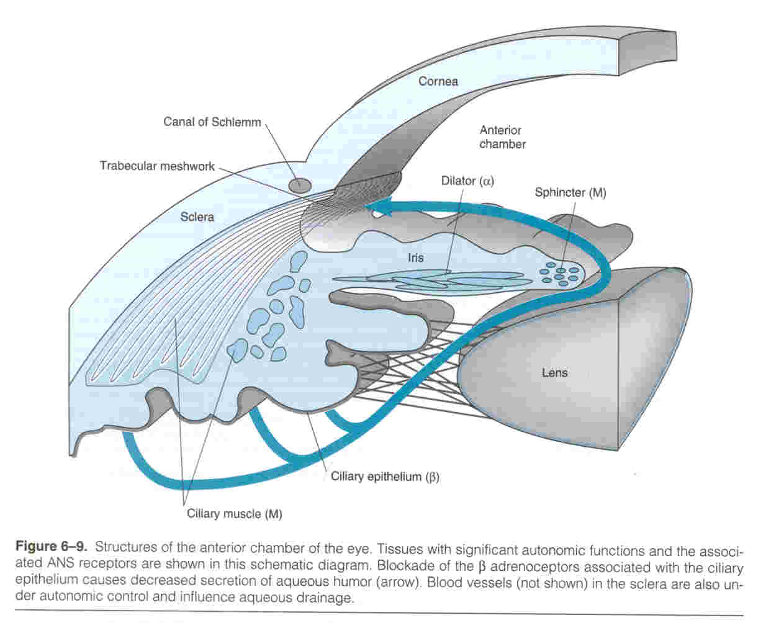

Slide 22
5) Effects on Neuromuscular Junction (Nicotinic Receptors)
Very important and related to the clinical uses.
What are the the naturally occuring alkaloids (e.g: Pilocarpine and Oxotremorine and Muscarine) ?
What is mushrooms poisoning?
What are the differences between pilocarpine and bethanechol?.

Slide 23
Bethanechol | Carbachol | Pilocarpine | ACh
Complete | Complete | Complete | NOT | Absorption
NOT hydrolyzed by cholinesterase | NOT hydrolyzed by cholinesterase | NOT hydrolyzed by cholinesterase | Hydrolyzed by cholinesterase | Metabolism
Longer (++) | Longer (++) | Longer (++) | Very short | Duration
Oral, S.C. | Oral, eye drops | oral, eye drops | I.V. | Administ.

Slide 24
Bethanechol | Carbachol | Pilocarpine | ACh
Muscarinic | Muscarinic Nicotinic | Muscarinic | Muscarinic Nicotinic | Receptors
+++ | +++ | +++ | +++ | Muscarinic
GIT, Urinary bladder | Eye, GIT Urinary bladder | More on eye, secretion | NOT | Selectivity
NO | +++ | NO | +++ | Nicotinic
Urinary retention Paralytic ileus | Glaucoma Urinary retention Paralytic ileus | Xerostomia Glaucoma | NO | Uses

Slide 25
New Drugs
Cevimeline
Direct acting cholinomimetics
A muscarinic agonist, with particular effect on M3
receptors
It is given orally.
Increased salivation.
Used for treatment of dry mouth symptom associated with Sjogren's syndrome.

Slide 27
New Uses of Cholinergic Drugs:
Donepezil : for improving memory (Cognitive Function) in Alzheimer disease.
Cevimeline: dryness of the mouth caused by radiation therapy for head and neck cancer and also indicated for dry eye.
How does it work?

