Slide 1
Muscle and nerve physiology

Slide 2
Introduction
Muscle & nerve are called excitable tissues because they respond to chemical, mechanical, or electrical stimuli
A stimulus produces change in membrane permeability which lead to movement of ions across the cell membrane, then action potential well result

Slide 3
Morphology
Neurones:
      Cell body
      Dendrites
      Axon
      Myelin
      Node of Ranvier
      Schwan cell

Slide 4
Introduction (Cont.)
Main mechanisms of :
Resting membrane potentials (RMP)
Action potential (AP)
Neuromuscular transmission
Muscle contraction

Slide 5
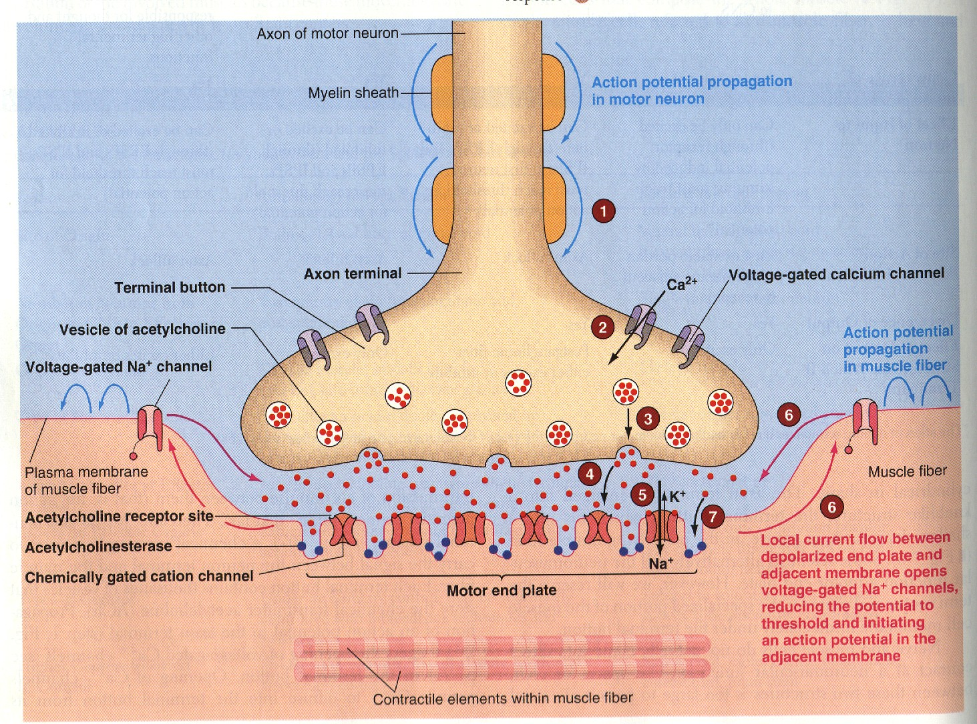
Neuromuscular transmission

Slide 6
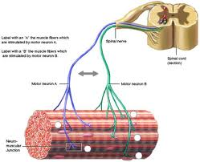
Motor Unit
Motor neuron (anterior Horn cell) & all muscle fiber supplied by it

Slide 8
Synaptic transmission ***
Synapse is the junction between two neurones where electrical activity of one neurone is transmitted to the other

Slide 9
Neuromuscular Junction

Slide 10
Axon terminal
Synaptic cleft
Synaptic gutter ((motor end plate))

Slide 12
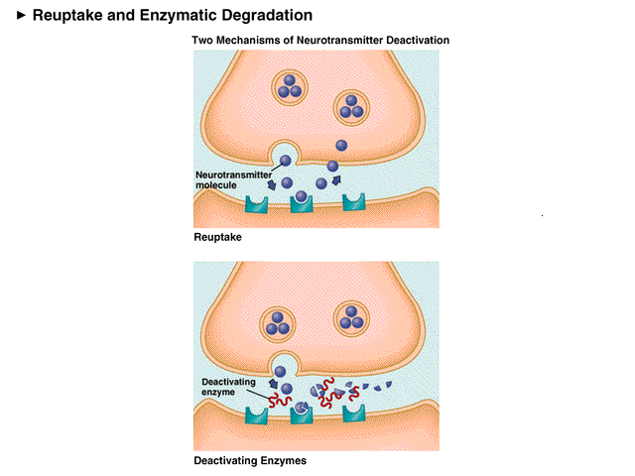
Neuromuscular Junction
Ach synthesized
locally in the
cytoplasm of the
nerve terminal
stored into vesicles
(10,000 Ach molecule)

Slide 13
Steps involved:
Nerve impulse reach the nerve terminal
AP at the synaptic knob -----» Ca channels open (increase Ca permeability) -----»
Ca diffuses from the ECF into the axon terminal
release of neurotransmitter (Ach) from synaptic knob to synaptic cleft -----»
Ach combines with specific receptors on the other membrane -----» end plate potential-----» AP will result

Slide 15
Neuromuscular transmission

Slide 16
One nerve impulse can release 125 Ach vesicles
The quantity of Ach release by one nerve impulse is more than enough to produce one End-Plate potential
AP spread on the membrane -----» muscle contraction

Slide 17
Ach combine with the post-junctional receptors
Na channel open
Local depolarization (EPP) end plate potential
((50-70mV)
Muscle action potential will be triggers

Slide 18
Ach act on receptors
Ach will be hydrolyzed by ((acetychlenstreas into acetate & Choline
Choline is actively reabsorbed into te nerve terminal to be used again to form Ach
THE WHOLE PROCESS (RELEASE, ACTION & DESTRUCTION0 takes around 5-10ms

Slide 19
MYASTHENIA GRAVIS

Slide 20
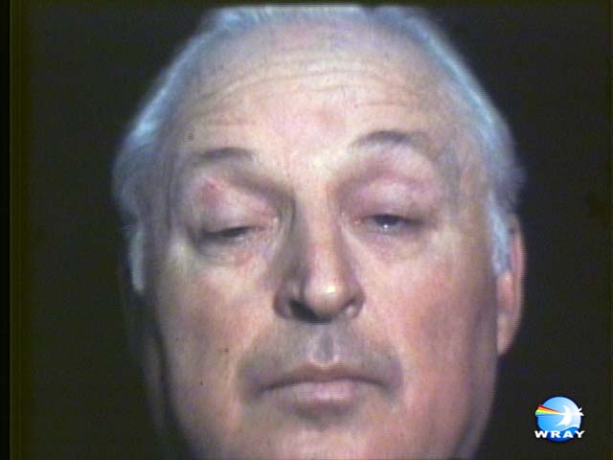

Slide 21
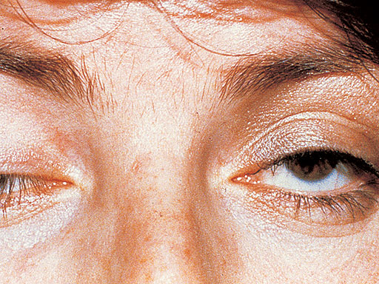

Slide 22
Auto-immune disease
Antibodies against Ach receptors
Receptors destruction
Decrease in EEP
Weakness or paralysis of muscles (depending on the severity of the disease)
Death can result due to paralysis of respiratory muscles
Anti-cholinstrease drugs
Inactivation of the chalinstrease enzyme

Slide 24
Physiology of Skeletal Muscle & Muscle contraction

Slide 25
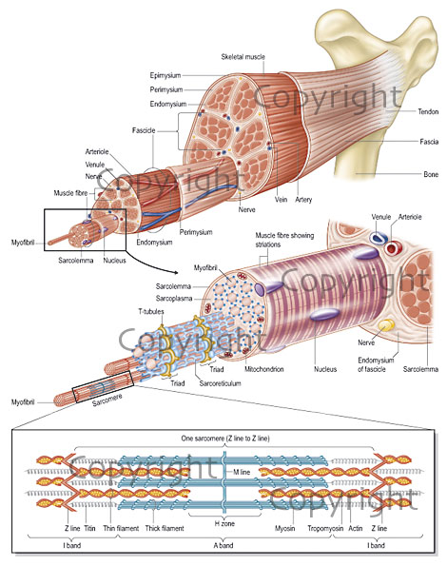

Slide 26
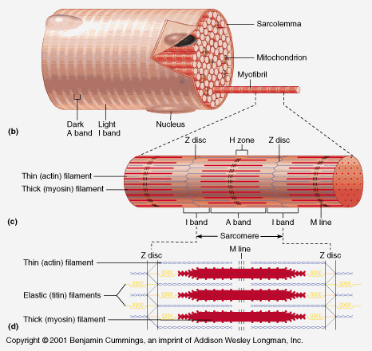

Slide 27
Molecular basis of muscle contraction ***
Anatomical consideration:
  Muscle fibre
  Sarcomere
  Myosin (thick filament):
        Cross-bridge
  Actin (thin filament)
      Regulatory protein: (Troponin,Tropomyosin)
      Actin

Slide 28
4 important muscle protiens:
Two contractile protiens (slidon each other during comtraction)
Actin
Myosin
--------------------------------------------------------------
Two regulatory proteins:
Troponin (excitatory to contraction)
Tropomyosin (Inhibitory to muscle contraction)

Slide 30
MUSCLE RMP = -90 Mv (same as in the nerve)
Duration of AP = 1-5 ms (longer than nerve)

Slide 31
Actin filament : consist of Globular G-protein molecules (attached together to form the chain)
Similar to double helix (each 2 chains wind together)
Actine protein has binding site for myosin head (actin active sites)
Which is covered by tropoysine

Slide 32
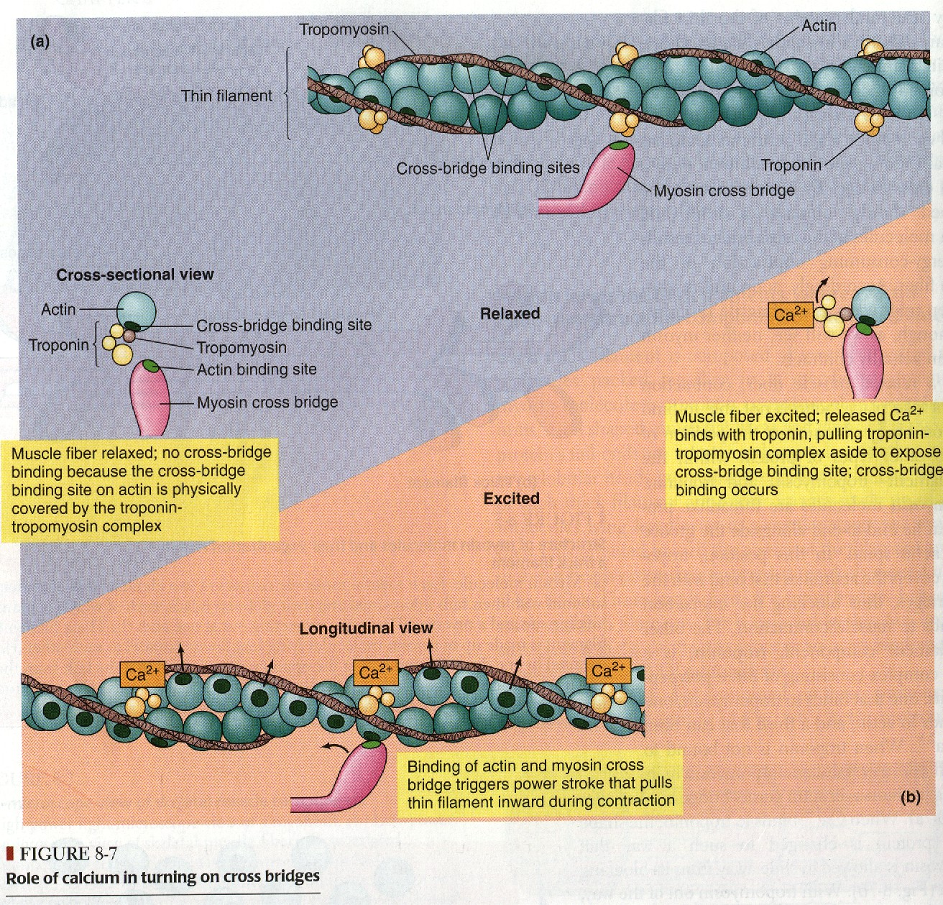

Slide 34
Events of muscle contraction: ***
Acetylcholine released by motor nerve »»»»» EPP »»»»» depolarization of CM (muscle AP) »»»»»
Spread of AP into sarcoplasmic reticulum »»»»»release of Ca into the cytoplasm
»»»»» Ca combines with troponin »»»»» troponin pull tropomyosin sideway »»»»» exposing the active site on actin »»»»» myosin heads with ATP on them, attached to actin active site
»»»»» Resulting in formation of high energy actin-myosin complex »»»»» activation of ATP ase (on myosin heads) »»»»» energy released, which is used for sliding of actin & myosin

Slide 35
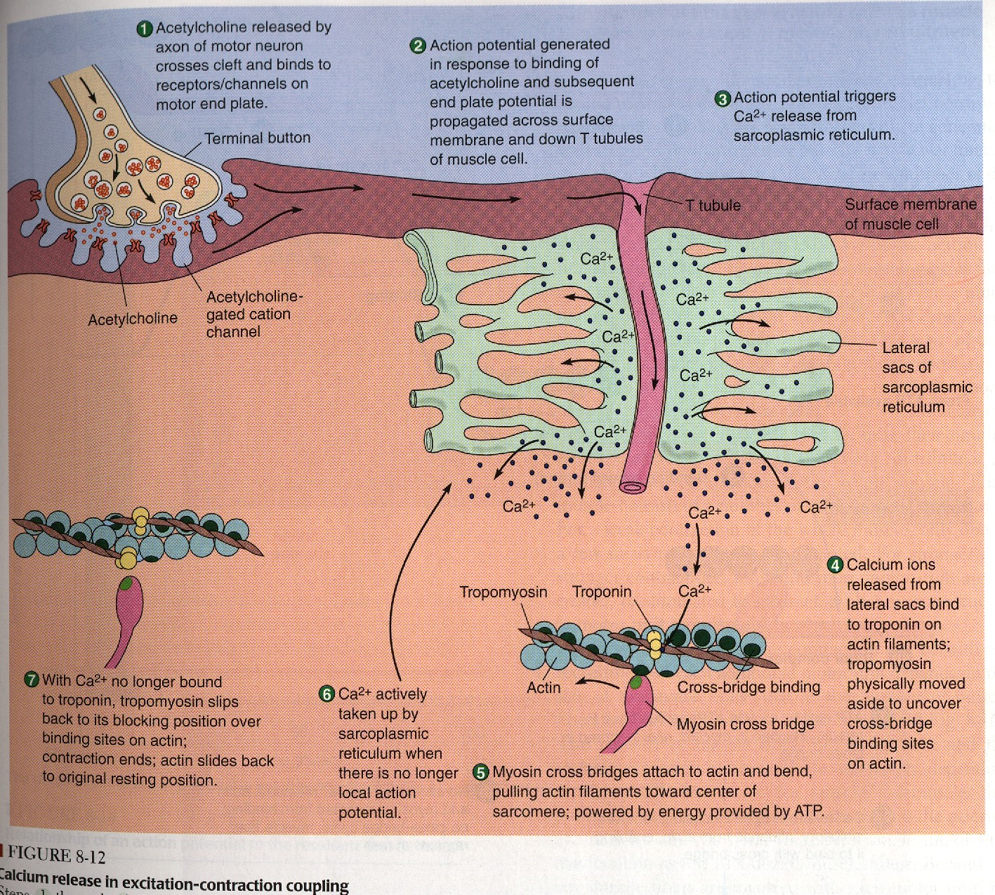

Slide 37
Events of muscle contraction:
When a new ATP occupies the vacant site on the myosin head, this triggers detachment of myosin from actin
The free myosin swings back to its original position, & attached to another actin, & the cycle repeat its self

Slide 38
Events of muscle contraction:
When ca is pumped back into sarcoplasmic reticulum
»»»»» ca detached from troponin »»»»» tropomyosin return to its original position
»»»»» covering active sit on actin »»»»» prevent formation of cross bridge »»»»» relaxation

Slide 42
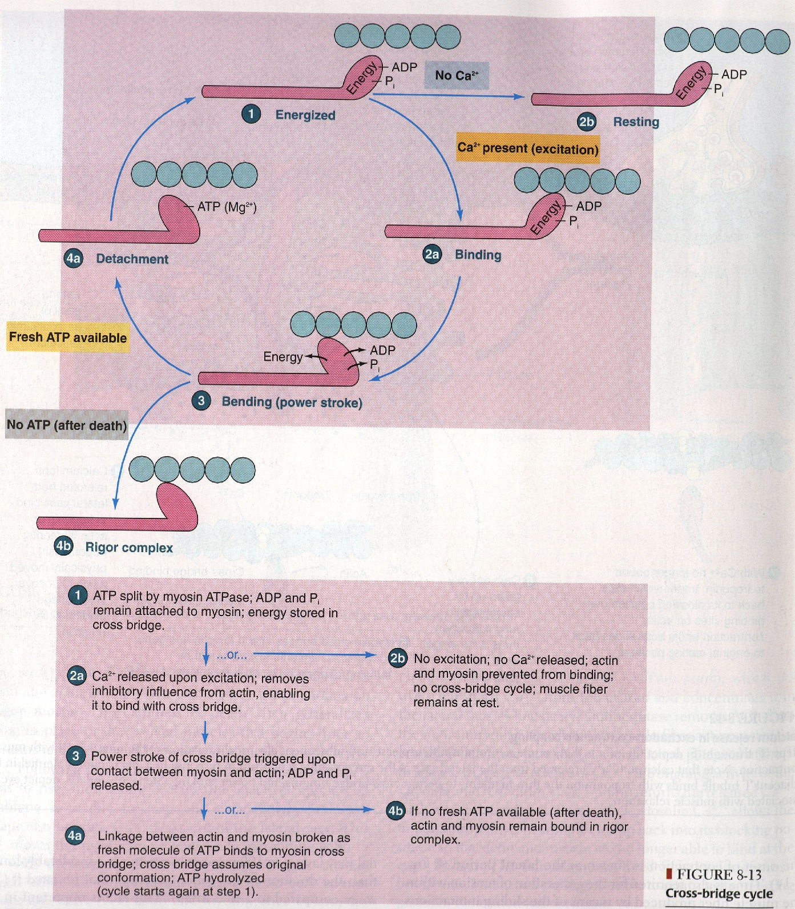

Slide 43
Muscle contraction ****
1- simple muscle twitch:
      The mechanical response (contraction) to single AP (single stimulus)
2- Summation of contraction:
      Spatial summation:
        the response of single motor unites are added together to produce a strong muscle contraction
      Temporal summation:
        when frequency of stimulation increased (on the same motor unite), the degree of summation increased, producing stronger contraction

Slide 44
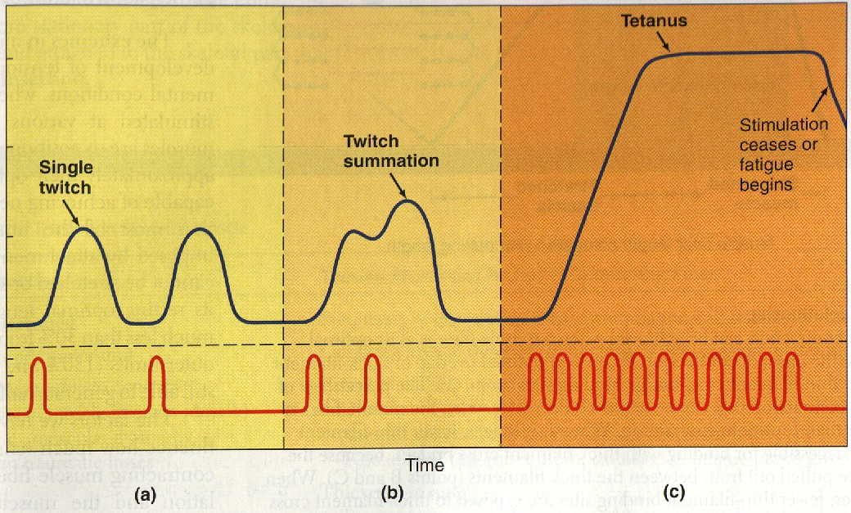

Slide 45
Types of muscle contraction:
1- Isometric contraction:
    No change in muscle length, but increase in muscle tension (e.g. standing)
2- Isotonic contraction:
    Constant tension, with change in muscle length (e.g. lifting a loud)

Slide 46
Duchenne Muscular Dystrophy
Inherited (mutation in Xp21 region of the X chromosome)
Affect boys
Girls are carriers
By 5 years old great weakness (Gowes sign)
No cure
Severly Disabled by 10
Death at teens (usaully due to involvement of the respiratory and heart muscles)

Slide 47
Muscle: absence of dystrophin (protien)
Muscle biobsy: hypertrophic, atrophic muscle fibers
Fiber nicrosis
Fat and connective tissue deposition

