Slide 1
Development of Respiratory System
Dr. Sanaa Alshaarawy
&
Dr. Saeed Vohra

Slide 2
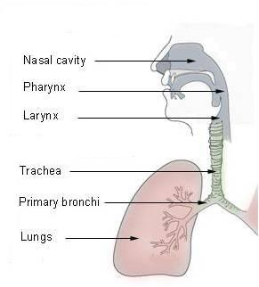
Respiratory System
Upper respiratory tract:
Nose
Nasal cavity & paranasal sinuses
Pharynx
Lower respiratory tract:
Larynx
Trachea
Bronchi
Lungs

Slide 3
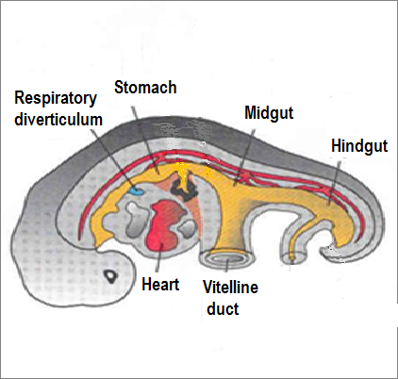
Development of the Lower Respiratory Tract
Begins to form during the 4th week of development
Begins as a median outgrowth (laryngotracheal groove) from the caudal part of the ventral wall of the primitive pharynx
The groove envaginates and forms the laryngotracheal (respiratory) diverticulum

Slide 4
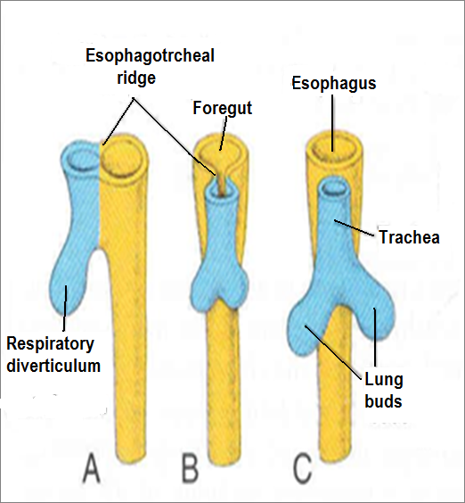
A longitudinal tracheo-esophageal septum develops and divides the diverticulum into a:
Dorsal portion: primordium of the oropharynx and esophagus
Ventral portion: primordium of larynx, trachea, bronchi and lungs

Slide 5
The proximal part of the respiratory diverticulum remains tubular and forms trachea
The distal end of the diverticulum dilates to form lung bud, which divides to give rise to 2 lung buds (primary bronchial buds)

Slide 6
The endoderm lining the laryngotracheal diverticulum gives rise to the:
Epithelium & Glands of the respiratory tract
The surrounding splanchnic mesoderm gives rise to the:
Connective tissue, Cartilage & Smooth muscles of the respiratory tract

Slide 7
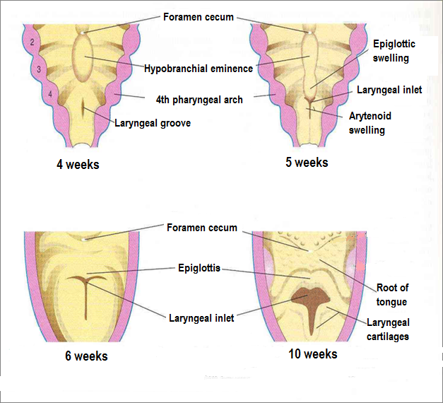
Development of the Larynx
The opening of the laryngotracheal diverticulum into the primitive foregut becomes the laryngeal orifice.
The epithelium & glands are derived from endoderm.
Laryngeal muscles & the cartilages of the larynx except Epiglottis, develop from the mesoderm of 4th & 6th pairs of pharyngeal arches.

Slide 8
Epiglottis
It develops from the caudal part of the hypopharyngeal eminence, a swelling formed by the proliferation of mesoderm in the floor of the pharynx.
Growth of the larynx and epiglottis is rapid during the first three years after birth. By this time the epiglottis has reached its adult form.

Slide 9
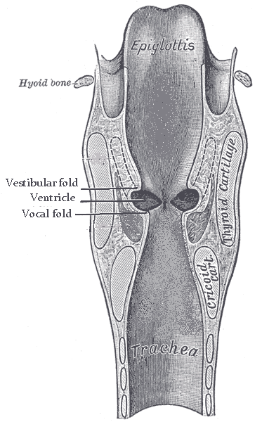
The laryngeal epithelium proliferates rapidly resulting in temporary occlusion of the laryngeal lumen
Recanalization of larynx normally occurs by the 10th week
Laryngeal ventricles, vocal folds and vestibular folds are formed during recanalization.

Slide 10
Development of the Trachea
The endodermal lining of the laryngotracheal tube distal to the larynx differentiates into the epithelium and glands of the trachea and pulmonary epithelium
The cartilages, connective tissue, and muscles of the trachea are derived from the mesoderm.

Slide 11
Development of the Bronchi & Lungs
The 2 primary bronchial buds grow laterally into the pericardioperitoneal canals (part of the intraembryonic celome), the primordia of pleural cavities
Bronchial buds divide and redivide to give the bronchial tree.

Slide 12
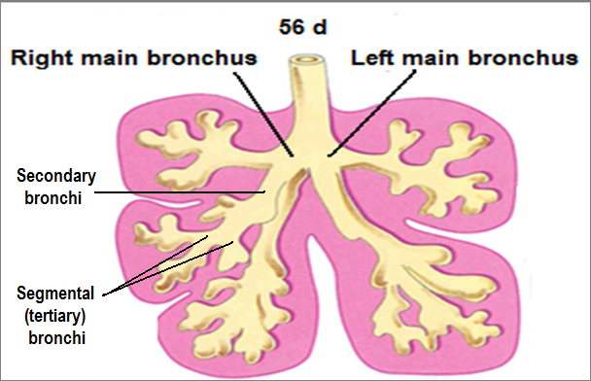
The right main bronchus is slightly larger than the left one and is oriented more vertically
The embryonic relationship persists in the adult.
The main bronchi subdivide into secondary and tertiary (segmental) bronchi which give rise to further branches.

Slide 13
The segmental bronchi, 10 in right lung and 8 or 9 in the left lung begin to form by the 7th week
The surrounding mesenchyme also divides.
Each segmental bronchus with its surrounding mass of mesenchyme is the primordium of a bronchopulmonary segment.

Slide 14
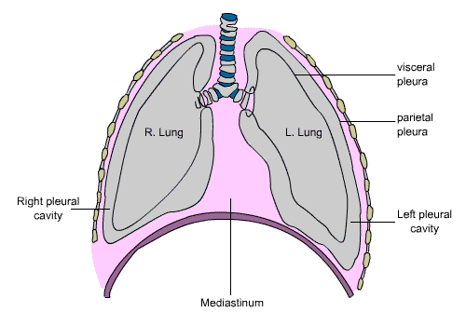
By 24 weeks, about 17 orders of branches have formed and respiratory bronchioles have developed.
An additional seven orders of airways develop after birth.
As the lungs develop they acquire a layer of visceral pleura from splanchnic mesenchyme.
The thoracic body wall becomes lined by a layer of parietal pleura derived from the somatic mesoderm.

Slide 15
Maturation of the Lungs
Maturation of lung is divided into 4 periods:
Pseudoglandular (5 - 17 weeks)
Canalicular (16 - 25 weeks)
Terminal sac (24 weeks - birth)
Alveolar (late fetal period - childhood)
These periods overlap each other because the cranial segments of the lungs mature faster than the caudal ones.

Slide 16
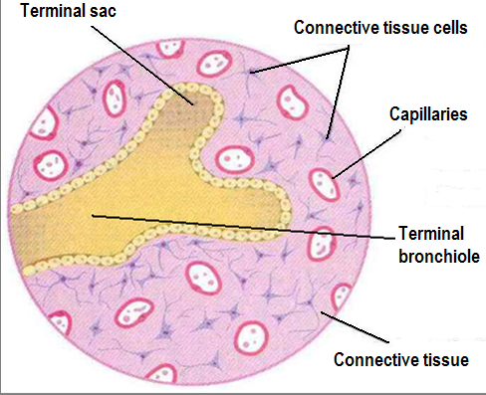
Pseudoglandular Period (5-17 weeks)
Developing lungs somewhat resembles an exocrine gland during this period.
By 17 weeks all major elements of the lung have formed except those involved with gas exchange.
Respiration is NOT possible
Fetuses born during this period are unable to survive.

Slide 17
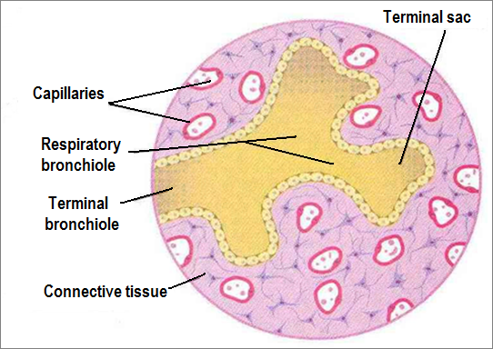
Canalicular Period (16-25 weeks)
Lung tissue becomes highly vascular.
Lumina of bronchi and terminal bronchioles become larger.
By 24 weeks each terminal bronchiole has given rise to two or more respiratory bronchioles
The respiratory bronchioles divide into 3 to 6 tubular passages called alveolar ducts.
Some thin-walled terminal sacs (primordial alveoli) develope at the end of respiratory bronchioles.
Respiration is possible at the end of this period.
Fetus born at the end of this period may survive if given intensive care (but usually die because of the immaturity of respiratory as well as other systems)

Slide 18
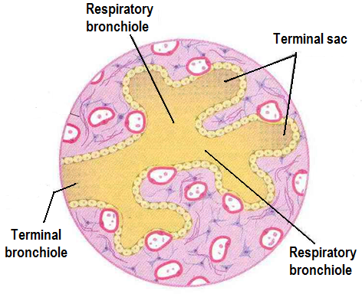
Terminal Sac Period (24 weeks - birth)
Many more terminal sacs develop.
Their epithelium becomes very thin.
Capillaries begin to bulge into developing alveoli.
The epithelial cells of the alveoli and the endothelial cells of the capillaries come in intimate contact and establish the blood-air barrier.
Adequate gas exchange can occur which allows the prematurely born fetus to survive

Slide 19
By 24 weeks, the terminal sacs are lined by:
Squamous type I pneumocytes and
Rounded secretory, type II pneumocytes, that secrete a mixture of phospholipids called surfactant.
Surfactant production begins by 20 weeks and increases during the terminal stages of pregnancy.
Sufficient terminal sacs, pulmonary vasculature and surfactant are present to permit survival of a prematurely born infants
Fetuses born prematurely at 24-26 weeks may suffer from respiratory distress due to surfactant deficiency but may survive if given intensive care.

Slide 20
Alveolar Period (32 weeks – 8 years)
At the beginning of the alveolar period, each respiratory bronchiole terminates in a cluster of thin-walled terminal saccules, separated from one another by loose connective tissue.
These terminal saccules represent future alveolar sacs.
The epithelial lining of the terminal sacs attenuates to an extremely thin squamous epithelial layer.

Slide 21
Characteristic mature alveoli do not form until after birth. 95% of alveoli develop postnatally.
About 50 million alveoli, one sixth of the adult number are present in the lungs of a full-term newborn infant.
Most increase in the size of the lungs results from an increase in the number of respiratory bronchioles and primordial alveoli. rather than from an increase in the size of the alveoli.
From 3-8 year or so, the number of immature alveoli continues to increase. Unlike mature alveoli, immature alveoli have the potential for forming additional primordial alveoli.
By about the eighth year, the adult complement of 300 million alveoli is present.

Slide 22
Breathing Movements
Occur before birth, are not continuous and increase as the time of delivery approaches.
Help in conditioning the respiratory muscles.
Stimulate lung development and are essential for normal lung development.
Lungs at birth
The lungs are half filled with fluid derived from the amniotic fluid and from the lungs & tracheal glands.
This fluid in the lungs is cleared at birth: by:
Pressure on the fetal thorax during delivery.
Absorption into the pulmonary capillaries and lymphatics.
Lungs of a Newborn
Fresh healthy lung always contains some air (lungs float in water). Diseased lung may contain some fluid and may not float (may sink). Lungs of a stillborn infant are firm, contain fluid and may sink in water.

Slide 23
Developmental anomalies
Laryngeal tresia.
Tracheoesophageal fistula.
Tracheal stenosis & atresia.
Congenital lung cysts.
Agenesis of lungs.
Lung hypoplasia.
Accessory lungs.
Factors important for
normal lung development
Adequate thoracic space for lung growth.
Fetal breathing movements.
Adequate amniotic fluid volume.

Slide 24
Tracheoesophageal Fistula
An abnormal passage between the trachea and esophagus.
Results from incomplete division of the cranial part of the foregut into respiratory and esophageal parts.
Occurs once in 3000 to 4500 live births.
Most affected infants are males.
In more than 85% of cases, the fistula is associated with esophageal atresia.

Slide 25
Thank You & Good Luck

