Slide 1
The Larynx
Trachea & Bronchi
Prof. Saeed Abuel Makarem
&
Dr. Zeenat Zaidi

Slide 2
Objectives
At the end of the lecture, the students should be able to:
Describe the Extent, structure and functions of the larynx.
Describe the Extent, structure and functions of the Trachea.
Describe the bronchi and branching of the brochial tree. Describe the functions of bronchi and their divisions.

Slide 3
The Larynx
Is the portion of the respiratory tract containing the vocal cords
A 2-inch-long, tube-shaped organ:
opens into the laryngeal part of the pharynx above
is continuous with the trachea below
Functions in:
Deglutition (swallowing)
Respiration (breathing)
Phonation (voice production)

Slide 4
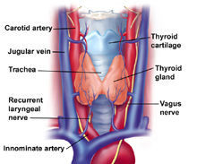
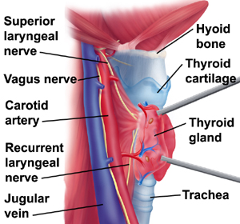
Relations
The larynx is related to major critical structures:
Carotid arteries , jugular veins, and vagus nerve
Superior and inferior thyroid arteries
Superior and recurrent laryngeal nerves

Slide 5
Structure
The larynx consists of four basic components:
A cartilaginous skeleton
Membranes and ligaments
Intrinsic and extrinsic muscles
Mucosal lining

Slide 6
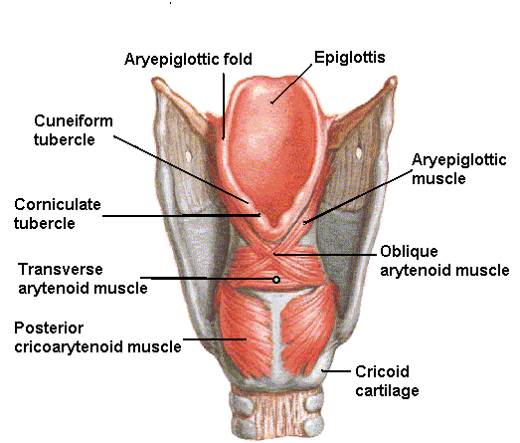
The Cartilages
3
3
The cartilaginous skeleton is comprised of :
Thyroid
Cricoid Single
Epiglottis
Arytenoid
Corniculate Paired
Cuneiform
All the cartilages, except the epiglottis, are of hyaline type.
Epiglottis is formed of elastic cartilage
The cartilages are:
Connected by joints, membranes & ligaments
Moved by muscles
1
1
4
4
2
2
6
5

Slide 7
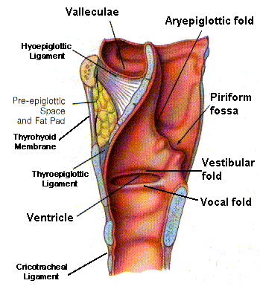
Membranes & Ligaments
Thyrohoid membrane, median & lateral thyrohoid ligaments
Median cricothyroid ligament
Cricotracheal membrane
Hyoepiglottic ligament
Thyroepiglottic ligament

Slide 8
Quadrangular membrane:
Extends between the epiglottis and the arytenoid cartilages
Its lower free margin forms the vestibular ligament that lies within the vestibular fold
Cricothyroid membrane (conus elasticus):
Lower margin is attached to upper border of cricoid cartilage
Upper free margin forms vocal ligament that lies within the vocal fold
Vestibular & vocal folds form prominent projections on the lateral wall of the laryngeal cavity

Slide 9
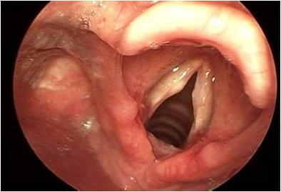
Laryngeal Inlet
It is the upper opening of the larynx, faces backward and upward and opens into the laryngeal part of the pharynx
Bounded:
Anteriorly: by the upper margin of epiglottis
Posteriorly & below by arytenoid cartilages (A)
Laterally by aryepiglottic folds
Epiglottis
Vocal fold
CU
Vocal fold
CO
Aryepiglottic fold
A
A

Slide 10
Laryngeal Cavity
Extends from laryngeal inlet to lower border of the cricoid cartilage
Narrow in the region of the vestibular folds (rima vestibuli)
Narrowest in the region of the vocal folds (rima glottidis)
Divided into three parts:
Supraglottic part, the part above the vestibular folds, is called the vestibule
The part between the vestibular & the vocal folds, is called the ventricle
Infraglottic part, the part below the vocal folds
*
*
A
B
C

Slide 11
Mucous Membrane
The cavity is lined with ciliated columnar epithelium
The surface of vocal folds, because of exposure to continuous trauma during phonation, is covered with stratified squamous epithelium
Contains many mucous glands, more numerous in the saccule (for lubrication of vocal folds)
Muscles
Divided into two groups:
Extrinsic muscles: divided into two groups
Elevators of the larynx
Depressors of the larynx
Intrinsic muscles: divided into three groups
Muscles controlling the laryngeal inlet
Muscle controlling the length & tension of vocal cords
Muscles controlling the movements of the vocal cords

Slide 12
Elevators of the Larynx
The Suprahyoid Muscles
Digastric
Stylohyoid
Mylohyoid
Geniohyoid
The Longitudinal Muscles of the Pharynx
Stylopharyngeus
Salpingopharyngeus
Palatopharyngeus
Depressors of the Larynx
The Infrahyoid Muscles
Sternohyoid
Sternothyroid
Omohyoid

Slide 13
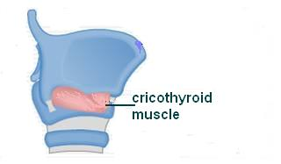
Muscle increasing the Length & Tension of Vocal Cords
Cricothyroid
Muscle decreasing the Length & Tension of Vocal Cords
Thyroarytenoid (vocalis)
Muscles controlling the Laryngeal Inlet
Oblique arytenoid
Aryepiglottic muscle

Slide 14
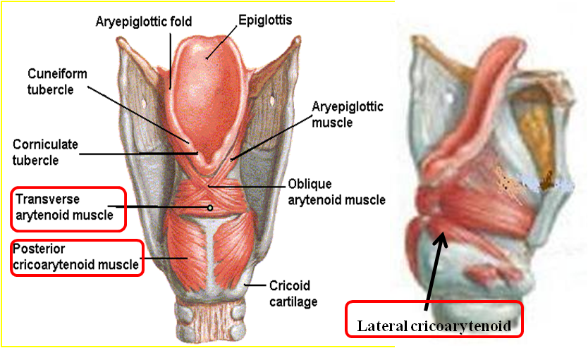
Movements of the Vocal Cords
Muscles controlling the Movement of Vocal Cords
Adduction
Abduction
Adductors
Lateral cricoarytenoid
Transverse arytenoid
Abductor
Posterior cricoarytenoid

Slide 15
Blood Supply
Arteries:
Upper half: Superior laryngeal artery, branch of superior thyroid artery
Lower half: Inferior laryngeal artery, branch of inferior thyroid artery
Veins:
Accompany the corresponding arteries
Lymphatics:
The lymph vessels drain into the deep cervical lymph nodes
Nerve Supply
Sensory
Above the vocal cords: Internal laryngeal nerve, branch of the superior laryngeal branch of the vagus nerve
Below the vocal cords: Recurrent laryngeal nerve, branch of the vagus nerve
Motor
All intrinsic muscles, except cricothyroid, supplied by the recurrent laryngeal nerve
The cricothyroid muscle is supplied by the external laryngeal nerve, a branch of the superior laryngeal branch of vagus nerve

Slide 16
Trachea (windpipe)
Mobile, fibrocartilginous tube, 5 inches long, 1 inch in diameter
Begins: In the neck below the cricoid cartilage of the larynx (level of body of C6). Ends: below in the thorax at the level of sternal angle (lower border of T4), by dividing into right and left principal (main, primary) bronchi
The ridge at the bifurcation is called carina. It is the most sensitive part of the tract and is associated with the cough reflex

Slide 17
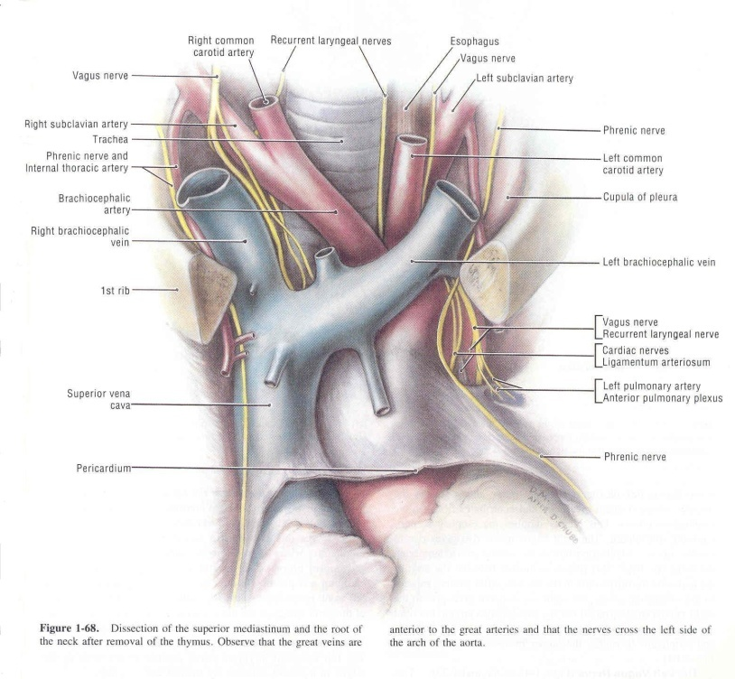
Relations in the Superior Mediastinum
Anterior
Sternum
Thymus
Left brachiocephalic vein
Origin of brachiocephalic and
left common carotid arteries
Arch of aorta
Left side
Arch of aorta
Left common carotid and
left subclavian arteries
Left vagus & left phrenic nerves
Pleura
Right side
Azygos vein
Right vagus nerve
Pleura
Posterior
Esophagus
Left recurrent laryngeal nerve

Slide 18
Nerve Supply
Branches of the vagus nerve and the recurrent laryngeal nerve (branch of vagus) supply sensory fibers to the mucous membrane
Branches from the sympathetic trunks supply the trachealis muscle and the blood vessels
Blood Supply
Arteries: Branches from the inferior thyroid and bronchial arteries
Veins: Drain to inferior thyroid veins
Lymphatic Drainage
Drain into the pre- and paratracheal lymph nodes

Slide 19
Right Principal Bronchus
About one inch long
Wider, shorter and more vertical than the left
Gives superior lobar bronchus before entering the hilum of the right lung
On entering the hilum it divides into middle and inferior lobar bronchi
Left Principal Bronchus
About two inches long
Narrower, longer and more horizontal than the right
Passes to the left below the arch of aorta and in front of esophagus
On entering the hilum of the left lung it divides into superior and inferior lobar bronchi

Slide 20
Bronchial Divisions
Within the lung each bronchus divides into number of branches that can be divided into two groups:
Conduction zone branches
Primary (main) bronchi
Secondary (lobar) bronchi
Tertiary (segmental) bronchi (supply the bronchopulmonary segment)
Smaller bronchi
Bronchioles
Terminal bronchioles
Respiratory zone branches
Respiratory bronchioles
Alveolar ducts
Alveolar sacs
Alveoli

Slide 21
Thank You
&
Good Luck

