Slide 1
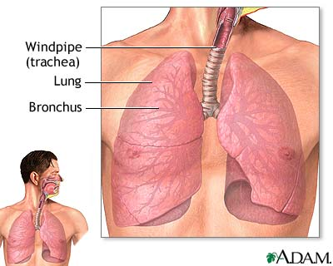
Pleura and Lung
By Prof. Saeed Abuel Makarem &
Dr. Sanaa Al Sharawi

Slide 2
Objectives
By the end of the lecture, the student should be able to :
Describe the anatomy of the pleura: (subdivisions into parietal & visceral pleurae, nerve supply).
List the parts of parietal pleura and its recesses.
Describe the surface anatomy of both pleurae and lungs.
Describe the anatomy of lungs : (shape, surfaces, relations, nerve supply, blood supply and lymphatic drainage.
Describe the difference between right & left lungs.
Describe the formation of bronchopulmonary segments and its main characteristics.

Slide 3
SUFACE ANATOMY OF PLEURA
Apex: lies one inch above the medial 1/3 of the clavicle.
Left pleura: The anterior margin extends from sternoclavicular joint to the level of 4th costal cartilage, then deviates for about 1 inch to left at 6th costal cartilage to form cardiac notch
Right pleura: The anterior margin extends vertically from sternoclavicular joint to 6th costal cartilage.
Inferior margin : passes round chest wall, on the 8th rib in midclavicular line, 10th rib in mid-axillary line and finally reaching to the last thoracic spine.
Posterior margin : along the vertebral column from the apex to the inferior margin.

Slide 4
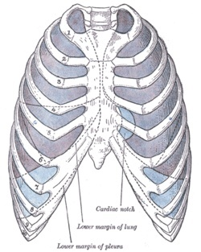
SURFACE ANATOMY OF LUNG
Apex, anterior border and posterior border correspond nearly to the lines of pleura but are slightly away from the median plane.
Inferior margin : as the pleura but more horizontal and finally reaching to the 10th thoracic spine.
Oblique fissue : represented by a line extending from 3rd thoracic spine, obliquely ending at 6th costal cartilage.
Transverse fissure only in right lung: represented by a line extending from 4th right costal cartilage to meet the oblique fissure.

Slide 5
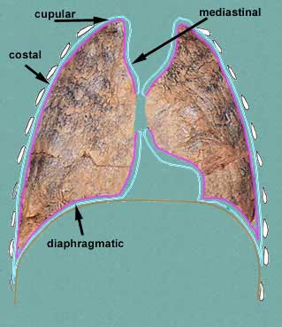
PLEURA
It is a closed serous sac which surrounds the lung and invaginated from the medial side by the root of lung.
It has 2 – layers : parietal pleura which lines the thoracic cavity. & visceral pleura which surrounds the lung, separated by a pleural cavity.
Pleural space contains 5-10 ml. of serous fluid which lubricates both sufaces and allows the lungs to move free during respiration.

Slide 6
Divisions of parietal pleura
1-Cervical pleura: It is part of parietal pleura which protrudes up into the root of the neck.
2-Costal pleura: It lines inner surface of ribs, costal cartilages, intercostal muscles and back of sternum.
3-Diaphragmatic pleura: It covers upper surface of diaphragm.
4-Mediastinal pleura:
It covers mediastinal surface of the lung.

Slide 7
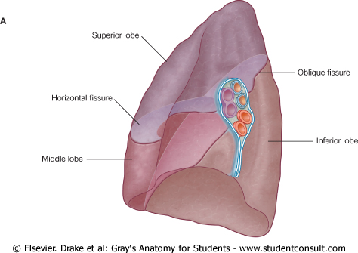
Visceral Pleura
firmly covers outer surfaces of lung and extends into its fissures.
The 2- layers (mediastinal parietal pleura & visceral pleura) are continuous with each other to form a tubular sheath (pleural cuff) that surrounding root of lung (vessels, nerves & bronchi) in the hilum of lung.
On the lower surface of root of lung, Pleural cuff hangs down as a fold called pulmonary ligament.

Slide 8
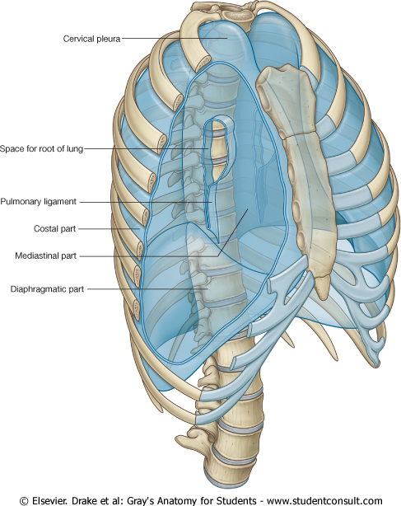
Pleural Recesses
Costodiaphragmatic recess : lies between Costal & diaphragmatic parietal pleura.
Costomediastinal recess : lies between costal & mediastinal parietal pleura.

Slide 9
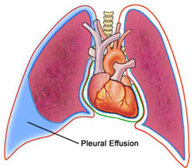
Pleural Effusion
It is abnormal accumulation of pleural fluid about 300 ml, in the Costodiaphragmatic recess , (normally 5-10 ml of clear fluid)
Causes : inflammation, TB, malignancy, congestive heart disease.
The lung is compressed & the bronchi are narrowed.
Auscultation would reveal only faint & decreased breath sounds over compressed or collapsed lung.
Dullness on percussion over the effusion.

Slide 10
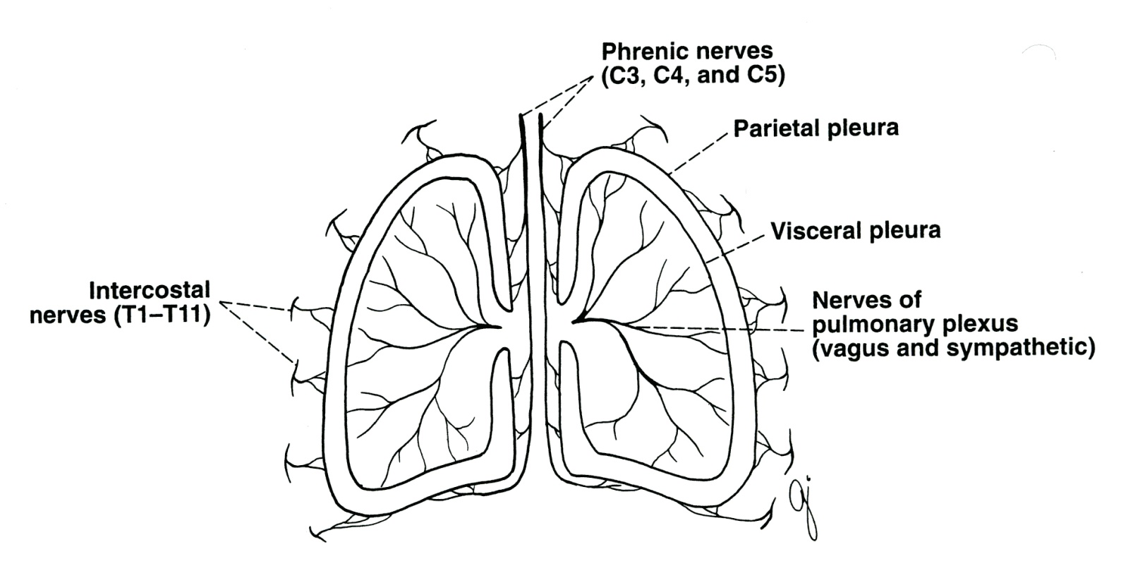
Nerve Supply of Pleura
Parietal pleura….
Costal P.P….by intercostal nerves.
Mediastinal P.P….by phrenic nerve.
Diaphragmatic P.P.: 1-Medially by phrenic nerve. 2-Peripheral part….. by lower 6 intercostal nerves.
Visceral pleura… sympathetic N.S. from pulmonary plexus.

Slide 11
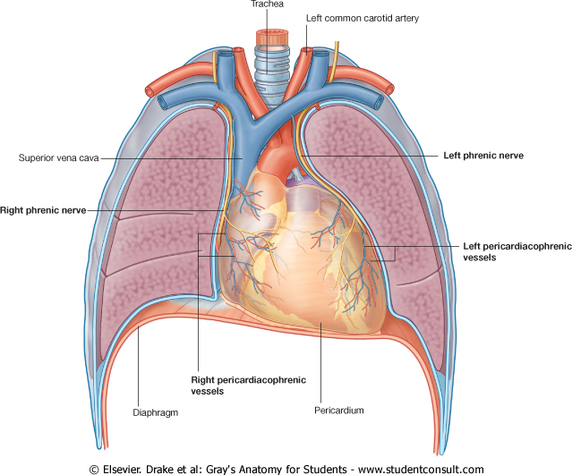
Blood supply of Pleura
Parietal pleura… by intercostal, internal thoracic & musculophrenic vessles.
Visceral pleura ….by bronchial vessles.
Lymphatic Drainage :
Parietal pleura : into intercostal,, mediastinal & diaphragmatic Lymph Nodes.
Visceral pleura : into broncho-pulmonary Lymph Nodes in the hilum of lung.

Slide 12
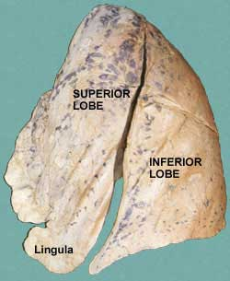
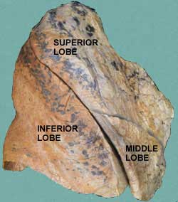
LUNGS
Each lung has the following features:
It is conical in shape.
It has an apex, a base and 2 surfaces.
The costal surface of each lung borders the ribs (front and back).
On the medial (mediastinal) surface, the bronchi, blood vessels, and lymphatic vessels enter the lung at the hilum.

Slide 13
LUNGS
Apex: projects into root of neck (1 inch above medial 1/3 of clavicle). It is covered by cervical pleura.
It is grooved anteriorly by subclavian artery.
Base: (inferior diaphragmatic surface) is concave and sits on the diaphragm.

Slide 14
Borders: Anterior & Posterior
Anterior border : is sharp, thin and overlaps the heart.
Anterior border of left lung presents a cardiac notch at its lower end + thin projection called the lingula below the cardiac notch.
Posterior border : is rounded, thick and lies beside the vertebral column.

Slide 15
Surfaces: Costal & Mediastinal
Costal surface:
Convex.
Covered by costal pleura which separates lung from: ribs, costal cartilages & intercostal muscles.
Medial surface:
It is divided into 2 parts:
Anterior (mediastinal) part:
Contains a hilum in the middle (it is a depression in which bronchi, vessels, & nerves forming the root of lung).
Posterior (vertebral) part:
It is related to: bodies of thoracic vertebrae, intervertebral discs, posterior intercostal vessels & sympathetic trunk.
Lateral & medial surfaces of right lung

Slide 16
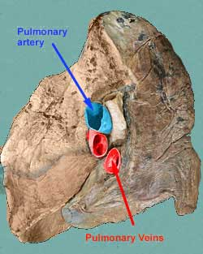
RIGHT LUNG ROOT
2 bronchi lie posterior.
Pulmonary artery is superior
2 Pulmonary veins are inferior and anterior.

Slide 17
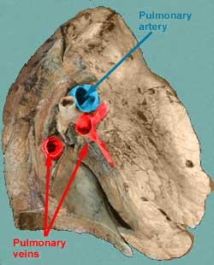
LEFT LUNG ROOT
One bronchus lies posterior
Pulmonary artery is superior
2 Pulmonary veins are inferior and anterior.

Slide 18
Right lung
Larger & shorter than left lung.
Divided by 2 fissures (oblique & horisontal) into 3 lobes (upper, middle and lower lobes).

Slide 19
Left Lung
Divided by one oblique fissure into -2 lobes, Upper and lower.
There is No horizontal fissure.
It has a cardiac notch at lower part of its anterior border.

Slide 20
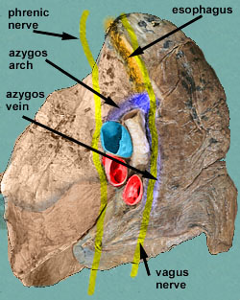
Mediastinal surface of right lung
On the mediastinal surface of the right lung, you find these structures:
Azygos vein and its arch (posterior and over the root of the lung).
Vagus nerve posterior to the root.
Esophagus posterior to the root.
Phrenic nerve anterior to the root.
Cardiac impression: related to right atrium.
Below hilum and in front of pulmonary ligament:
Groove for I.V.C.
Cardiac impression

Slide 21
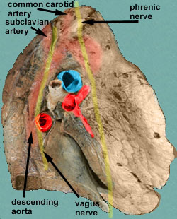
Mediastinal surface of left lung
On the mediastinal surface of the left lung, you will find these structures:
Descending aorta posterior to the root.
Vagus nerve posterior to the root.
Arch of the aorta over the root.
Groove for left common carotid artery.
Groove for left subclavian artery.
Phrenic nerve anterior to the root.
Cardiac impression : related to left ventricle.
Cardiac impression

Slide 22
Blood supply of lung
Bronchial arteries (branches of descending thoracic aorta)….. supply oxygenated blood to bronchi , lung tissue & visceral pleura.
Bronchial veins : drain into azygos & hemiazygos veins.
Pulmonary artery which carries non-oxygenated blood from right ventricle to the lung alveoli.
2 pulmonary veins : carry oxygenated blood from lung alveoli to the left atrium.

Slide 23
Nerve Supply of the lung
Pulmonary plexus :
at the root of lung….is formed of autonomic N.S. from sympathetic & parasympathetic fibres.
1- Sympathetic F. from … sympathetic trunk… broncho-dilatation /and vasoconstriction.
2- Parasympathetic F. from…..Vagus nerve …. Broncho-constriction and secretomotor to bronchial glands /and vasodilatation.

Slide 24
Lymph drainage of the lungs
There are 2 lymphatic plexuses…. superficial & deep plexuses.
Superficial plexus (subpleural) : lies under the visceral pleura and drain into bronchopulmonary nodes in the hilum of lung.
Deep plexus : lies along bronchial tree & pulmonary blood vessels and drain into the pulmonary nodes within the lung substance.
Then into bronchopulmnary nodes in the hilum of lung.
Then into tracheo-bronchial nodes at the bifurcation of trachea , and finally into broncho-mediastinal lymph trunks to end in thoracic duct (left) or in right lymphtic duct (right).

Slide 25
Bronchi
The trachea divides into 2 main bronchi:
Right main bronchus: It divides before entering the hilum, it gives off superior lobar (secondary) bronchus. On entering hilum, it divides into middle & inferior lobar bronchi.
Left main bronchus: On entering hilum, it divides into superior & inferior lobar bronchi.

Slide 26
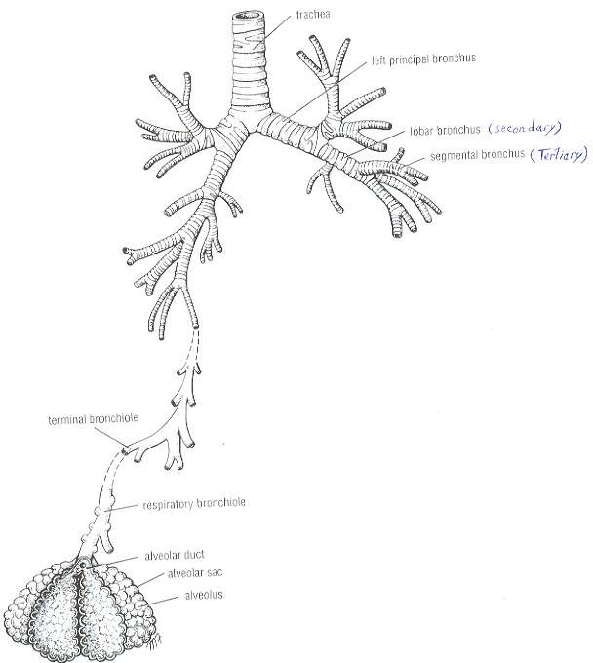
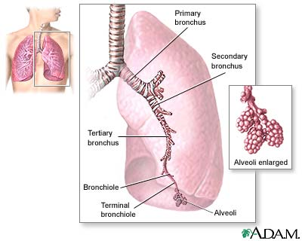
Bronchopulmonary segments
They are the anatomic, functional, and surgical units of the lungs.
Each lobar (secondary) bronchus gives off segmental (tertiary) bronchi.
Each segmental bronchus divides repeatedly into bronchioles.
Bronchioles divide into terminal bronchioles, which show delicate outpouchings ‘the respiratory bronchioles’.

Slide 27
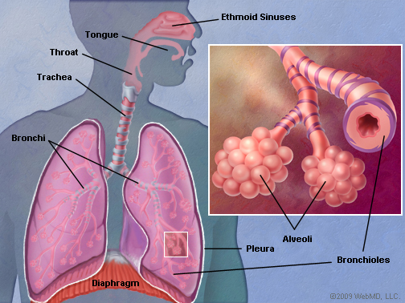
Bronchopulmonary segments
The respiratory bronchioles end by branching into alveolar ducts, which lead into alveolar sacs.
The alveolar sacs consist of several alveoli, each alveolus is surrounded by a network of blood capillaries for gase exchange.

Slide 28
Characteristics of Bronchopulmonary segments
It is a subdivision of a lung lobe.
It is pyramidal in shaped, its apex lies toward the root, while its base lies on the lung surface.
It is surrounded by connective tissue septa.
It has a segmental bronchus, a segmental artery, lymph vessels, and autonomic nerves.
The segmental vein lies in the inter- segmental C.T. septa between the segments.
A diseased segment can be removed surgically, because it is a structural unit.

Slide 29
THANK YOU

