Slide 1
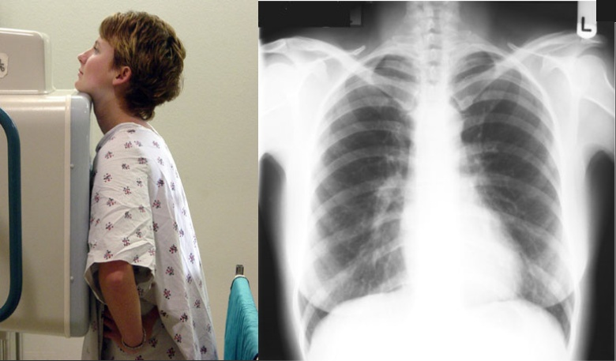
Radiological Anatomy of Thorax
Dr. Jamila Elmedany &
Prof. Saeed Abuel Makarem

Slide 2
Indications for Chest x -Ray
A chest x-ray may be used to diagnose and plan treatment for various conditions, including:
Diseases / Fractures of the bones of the chest (ribs, sternum, clavicle and the vertebrae).
Lung disorders.
Heart disorders.
Chest radiographs are also used to screen for job-related lung disease in industries such as mining where workers are exposed to dust, e.g. asbestos.

Slide 3
Different views of the chest can be obtained by changing the position of the body of the patient and the direction of the x-ray beams.
The most common views are Posteroanterior (PA), Anteroposterior (AP),
& lateral (L).
Posteroanterior (PA) view:
The x-rays enter through the posterior aspect of the chest, and exit through the anterior aspect where they are detected by an x-ray film.
PA view gives a good assessment of the Cardiac Size.
As it avoids magnification of the heart as the film is close to the anterior chest wall.
It is identified by the presence of the fundal gas bubble in the stomach and the absence of the scapulae in the lung fields.

Slide 4
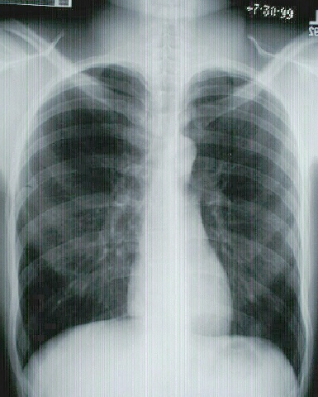
Anteroposterior (AP) view:
The x-rays enter through the anterior aspect and exit through the posterior aspect of the chest.
AP chest x-rays are done where it is difficult for the patient to obtain a normal chest x-ray, such as when the patient cannot get out of bed.
Lateral view
Indicated only for further interpretation

Slide 5
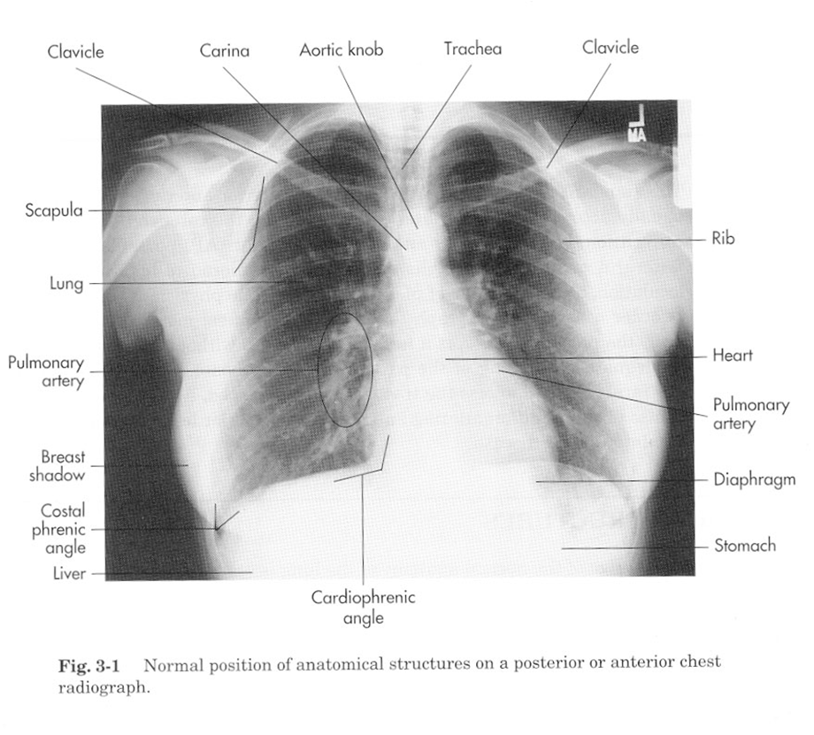
In a (PA) radiograph the following structures must be examined:
Superficial soft tissues:
Nipples in both sexes & Breast in (females) are seen superimposed on the lung fields.
Bones of thoracic cage.
Diaphragm .
Lungs and Bronchi.
Heart & Great Vessels.

Slide 6
Bones
The Thoracic Vertebrae are imperfectly seen.
The Costotransverse joints and each Rib should be examined in order from above downward and compared to their fellows of the opposite side .
The Costal Cartilages are not usually seen, but if calcified, they will be visible.
The Clavicles are seen clearly crossing the upper part of each lung field.
The medial borders of the Scapulae may overlap the periphery of each lung field.
C
V
S
R

Slide 7
Diaphragm
The diaphragm shows Dome-shaped shadows on each side.
The right dome is slightly higher than the left dome.
Beneath the right dome is the homogeneous, dense shadow of the liver.
Beneath the left dome a gas bubble may be seen in the fundus of the stomach.
RD
LD
Gas bubble in the fundus of stomach

Slide 8
Costo-diaphragmatic (costo-phrenic) Angles
They are at the sites where the diaphragm meets the thoracic wall.
The angles become blunt or obscured in case of presence of pleural fluid or fibrosis.

Slide 9
Trachea
The radiotranslucent, air-filled shadow of the trachea is seen in the midline of the neck as a dark area.
It is superimposed on the lower cervical and upper thoracic vertebrae.

Slide 10
Tracheal shift
Tracheal air column is seen shifted to right on X-ray chest PA view.
It indicates:
A loss of volume of the right upper lobe of the lung, either due to collapse or fibrosis.
OR
A massive pleural effusion on the left side. (But no pleural effusion is seen on the left)

Slide 11
Lungs
Lung Roots: Relatively dense shadows caused by the presence of the blood-filled pulmonary and bronchial vessels, the large bronchi, and the lymph nodes.

Slide 12
The lung fields, by virtue of the air they contain, readily permit the passage of x-rays. For this reason, the lungs are more translucent on full inspiration than on expiration.
The pulmonary blood vessels are seen as a series of small, round, white shadows radiating from the lung root.
The large bronchi, also cast similar rounded shadows. The smaller bronchi are not seen
H
B
H
PV

Slide 13
Bronchography
Bronchography is a special study of the bronchial tree by means of introduction of a contrast medium into a particular bronchus usually under fluoroscopic control. The contrast media are nonirritating and sufficiently radiopaque to allow good visualization of the bronchi. After the radiographic examination is completed, the patient is asked to cough and expectorate the contrast medium.
T
B
Posteroanterior Bronchogram

Slide 14
Mediastinum
The shadow is produced by the various structures within the mediastinum, superimposed one on the other
Note the outline of the heart and great vessels.

Slide 15
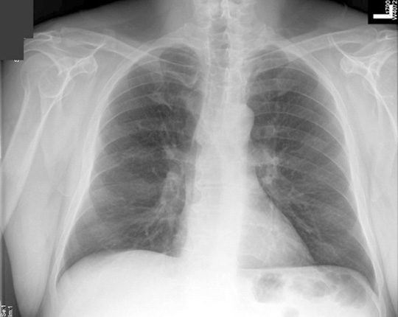
The Right Border from above downward consists of:
Right brachiocephalic vein, Superior vena cava, Right atrium, and sometimes the Inferior vena cava.
The Left Border consists of:
A prominence, the Aortic knuckle, caused by the aortic arch;
Left margin of the Pulmonary Trunk, the Left Auricle, and the Left Ventricle.
Right brachiocephalic vein
Aortic knuckle
Superior vena cava
Left pulmonary artery
Right pulmonary artery
Left auricle
Right atrium
Left ventricle
Apex of heart

Slide 16
The inferior border (lower border of the heart) blends with the diaphragm and liver shadow.
Note the cardiophrenic angles.

Slide 17
Heart
The Transverse Diameter of the heart should not exceed half the width of the thoracic cage.
On deep inspiration, when the diaphragm descends, the vertical length of the heart increases and the transverse diameter is narrowed.
In infants, the heart is always wider and more globular in shape than in adults.

Slide 18
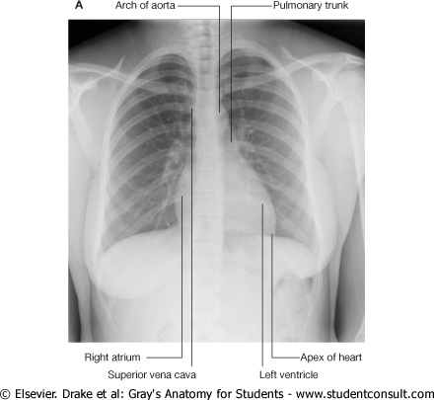
HEART
PA

Slide 19
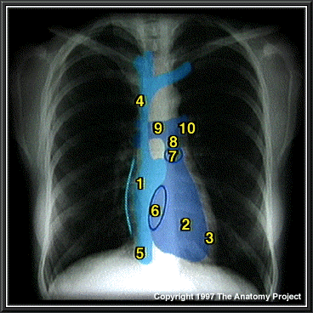
Cardiac shadow
R Atrium
R Ventricle
3. Apex of L Ventricle
Superior Vena Cava
Inferior Vena Cava
6. Tricuspid Valve
Pulmonary Valve
Pulmonary Trunk
9. R PA 10. L PA

Slide 20
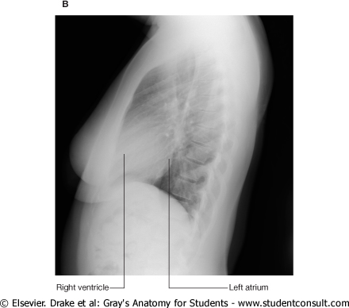
LV

Slide 21
Coronary Angiogram (an X-ray with radio-opaque contrast in the coronary arteries)
Right coronary
Left coronary

Slide 22
Contrast Visualization of the Esophagus
Esophagus
Left lateral radiograph of the chest of a normal adult man after a barium swallow.

