Slide 1
Nose, Nasal cavity, Paranasal Sinuses & Pharynx
Dr. Zeenat Zaidi Dr. Essam Eldin Salama
Anatomy Department

Slide 2
Objectives
At the end of the lecture, the students should be able to:
Describe the boundaries of the nasal cavity.
Describe the nasal conchae and meati.
Demonstrate the openings in each meatus.
Describe the paranasal sinuses and their functions
Describe the pharynx and its parts

Slide 3
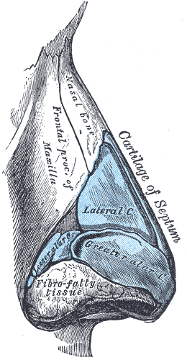
Nose
Nose, is the only visible part of the respiratory system and serves as the entrance to the respiratory tract
The nose has two cavities, separated from one another by a wall called the nasal septum.
The external openings, known as external (anterior) nares or nostrils, lead to the nasal cavities.
root
tip
ala
septum
external nares
Formed:
above by bony skeleton &
below by plates of hyaline cartilage.

Slide 4
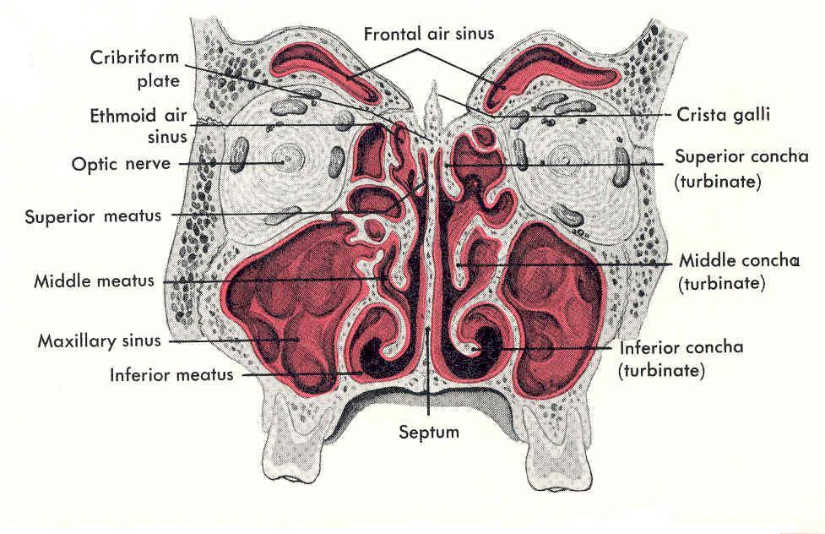
Nasal Cavity
Extends from the external (anterior) nares to the posterior nares (choanae).
Divided into right & left halves by the nasal septum.
Each half has a:
Roof
Lateral wall
Medial wall (septum)
Floor

Slide 5
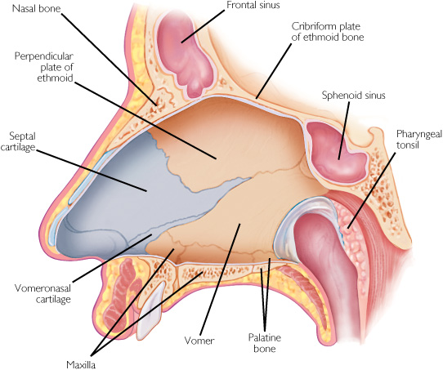
Roof
Narrow & formed (from behind forward) by the:
Body of sphenoid.
Cribriform plate of ethmoid bone.
Frontal bone.
Nasal bone & cartilage
Medial Wall (Nasal Septum)
Osteo-cartilaginous partition.
Formed by:
Perpendicular plate of ethmoid bone.
Vomer.
Septal cartilage.
3
2
4
1
Floor
Formed by the hard (bony) palate.
Separates it from the oral cavity.

Slide 6
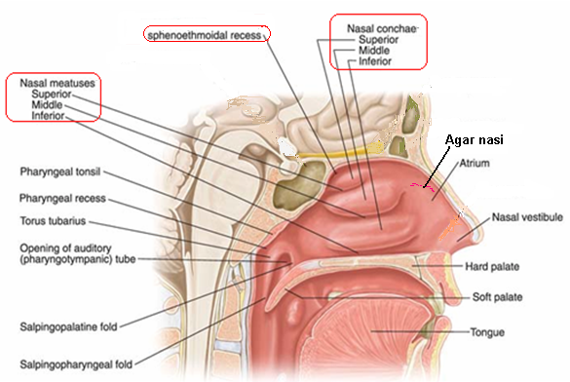
Lateral Wall
Shows three horizontal bony projections, the superior, middle & inferior conchae.
The cavity below each concha is called a meatus and are named as superior, middle & inferior corresponding to the conchae.
The small space above the superior concha is the sphenoethmoidal recess.
The conchae are covered by respiratory epithelium and thus increase the surface area of the nasal cavity.

Slide 7
The recess & meati receive the openings of the:
Paranasal sinuses.
Nasolacrimal duct.
Spheno ethmoidal recess | sphenoidal sinus
Superior meatus | posterior ethmoidal sinus
Middle meatus | middle ethmoidal, maxillary, frontal & the anterior ethmoidal sinuses
Inferior meatus | nasolacrimal duct.

Slide 8
Nerve Supply
Olfactory nerves.
Ophthalmic &
Maxillary divisions.
Autonomic fibers.
Arterial Supply:
Branches of the
Maxillary,
Facial &
Ophthalmic arteries.
Venous Drainage:
Facial,
Ophthalmic
Spheno-palatine veins.
Lymphatic Drainage: The lymphatics from the:
The submandibular lymph nodes.
The upper deep cervical lymph nodes.

Slide 9
Paranasal Sinuses
Air filled cavities located in the bones around the nasal cavity: ethmoid, sphenoid, frontal bones & maxillae.
Lined by respiratory mucosa which is continuous with the mucosa of the nasal cavity.
Drain into the nasal cavity.
Functions
Lighten the skull.
Act as resonant chambers for speech.
Air conditioning: The respiratory mucosal lining helps in warming, cleaning and moistening the incoming air.

Slide 10
Pharynx
Muscular tube lying behind the nasal cavity, oral cavity & larynx.
Extends from the base of the skull to level of the 6th cervical vertebra, where it is continuous with the esophagus
Divided into three parts:
Nasopharynx:
Superior part, communicates with the nasal cavity through posterior nasal apertures.
Oropharynx:
Middle part, communicates with the oral cavity through the oro-pharyngeal isthmus.
Laryngopharynx:
Inferior part, communicates with the larynx through the laryngeal inlet.
Nasal cavity
Naso-
pharynx
*
Oral cavity
Oro-
pharynx
*
Laryngo-
pharynx
larynx
Esophagus

Slide 11
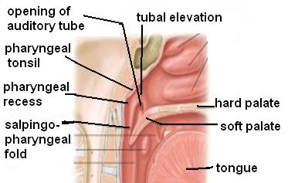
Nasopharynx
Extends from the base of skull to the soft palate.
Contains Pharyngeal tonsils (adenoides) in its roof.
Lateral wall shows:
Opening of auditory tube.
Tubal elevation (produced by posterior margin of the auditory tube).
Tubal tonsil.
Salpingopharyngeal fold (raised by salpingo-pharyngeus muscle).

Slide 12
Oropharynx
Extends from soft palate to upper border of epiglottis.
Lateral wall shows:
Palatopharyngeal folds.
Palatpglossal fold
Palatine tonsil located between them in a depression called the ‘tonsillar fossa’.
Palatoglossal fold
Palato-pharyngeal fold
Tonsillar fossa

Slide 13
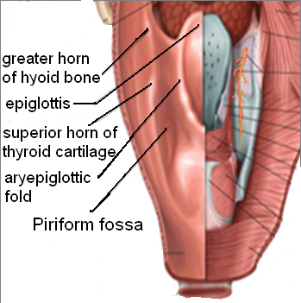
Laryngopharynx
Extends from upper border of epiglottis to lower border of cricoid cartilage.
A small depression situated on either side of the laryngeal inlet is called ‘piriform fossa’.
It is a common site for the lodging of foreign bodies.
Branches of internal laryngeal (& recurrent laryngeal) nerve lie deep to the mucous membrane of the fossa and are vulnerable to injury during removal of a foreign body.

Slide 14
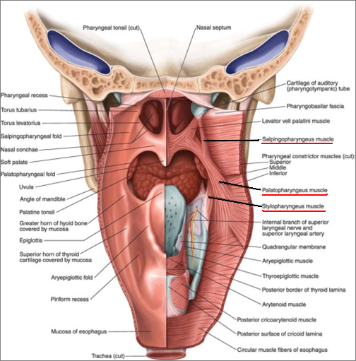
Muscles of Pharynx
The muscles of the pharynx are arranged in circular and longitudinal layers
Circular (Constrictor)
Three muscles, overlap each other: Superior, Middle & Inferior
Propel the bolus of food down into the esophagus
Longitudinal Muscles
Three muscles:
Stylopharyngeus
Salpingopharyngeus
Palatpharyngeous
Elevate the larynx & pharynx during swallowing
S
M
I

Slide 15
Nerve Supply
Sensory:
Nasopharynx: Maxillary nerve
Oropharynx: Glossopharyngeal nerve
Laryngopharynx: Vagus nerve
Motor Nerve Supply:
All the muscles of pharynx, except the stylopharyngeus, supplied by the pharyngeal plexus.
Stylopharyngeus is supplied by the glossopharyngeal nerve
Arterial supply: From branches of:
Ascending pharyngeal artery
Ascending palatine artery
Facial artery
Maxillary artery
Lingual artery
The Veins drain into pharyngeal venous plexus, which drains into the internal jugular vein
The lymphatics drain into
The deep cervical lymph node
Rretropharyngeal ,
Paratracheal lymph nodes

Slide 16
Thank You & Good Luck

