Slide 1
Electron Transport Chain
(Respiratory Chain)
Dr. Sumbul Fatma
1 Lecture
Respiratory Block

Slide 2
Electron Transport Chain (ETC)
A system of electron transport that uses respiratory O₂ to finally produce ATP (energy)
Electrons from food metabolism are transported to O₂
Final common pathway of metabolism
Located in the inner mitochondrial membrane
Uses maximum amount of body’s oxygen

Slide 3
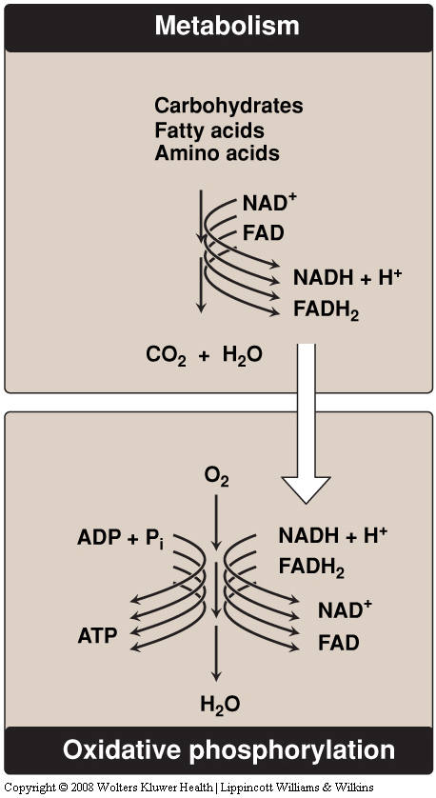
Metabolic breakdown of energy-yielding molecules
Energy-rich reduced
coenzymes
Electrons
(e⁻) lose their free energy
Excess energy generates heat

Slide 4
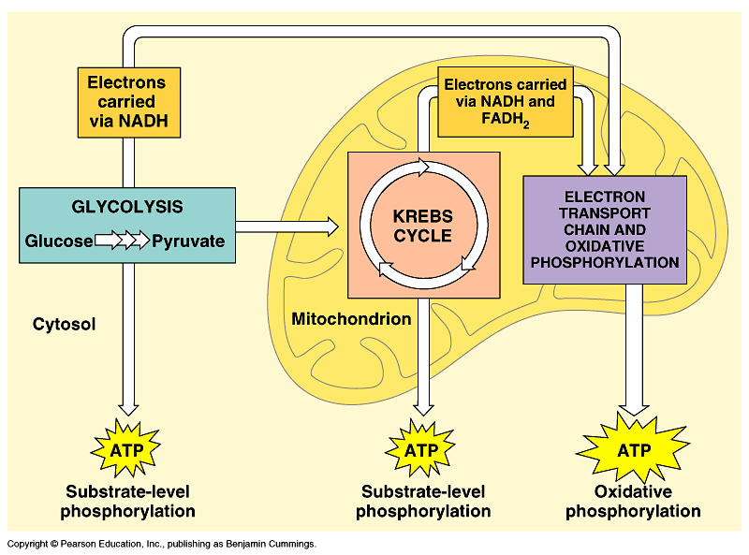
Cellular Respiration

Slide 5
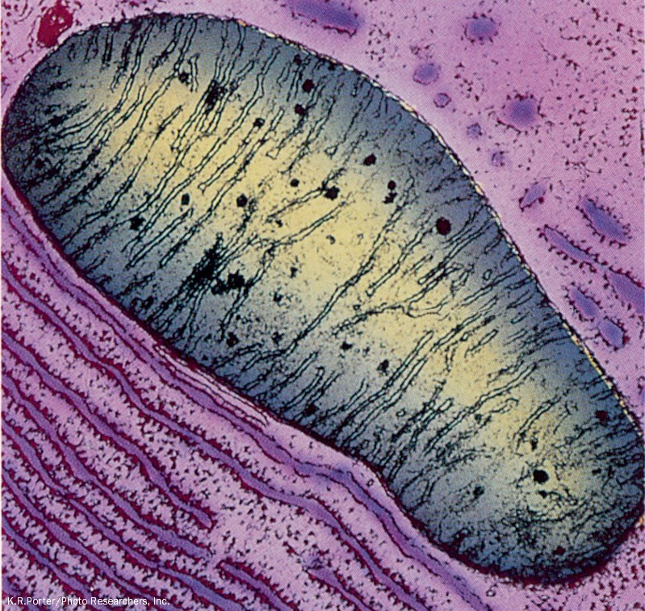
An electron micrograph of an animal mitochondrion
Page 799

Slide 6
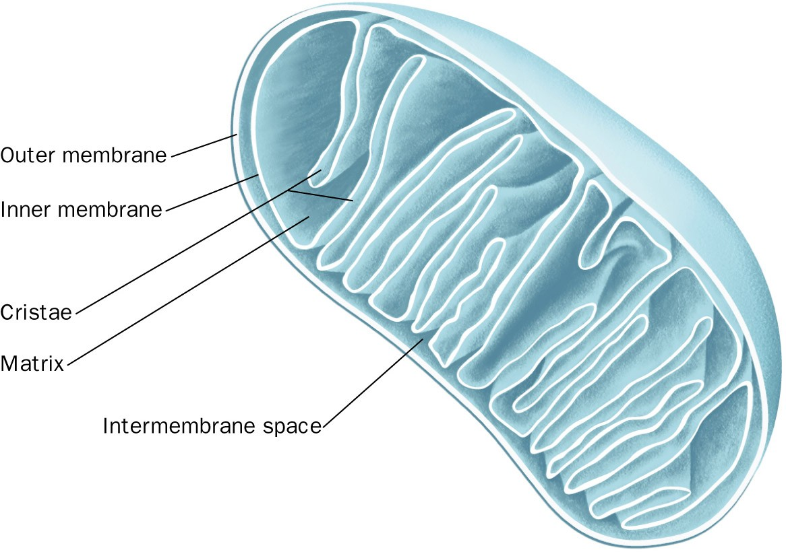
Cutaway diagram of a mitochondrion
Page 799

Slide 7
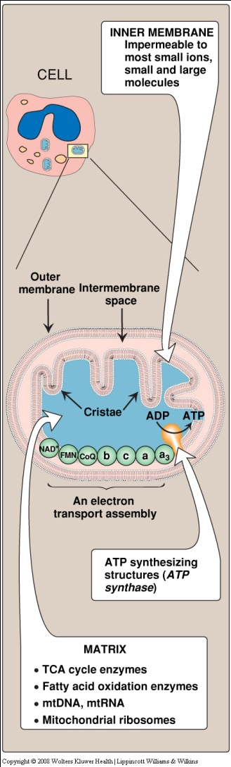
Mitochondrion
Cristae increase the surface area

Slide 8
Components of ETC
All members/components are located in the inner mitochondrial membrane (IMM)
IMM contains 5 complexes:
  Complex I, II, III, IV (part of ETC)
  Mobile electron carriers
    CoQ
    Cytochrome c
  Complex V (ATP synthase, not a component of ETC)

Slide 9
Organization of ETC
Each complex accepts or donates electrons to mobile carriers
Carriers accept electrons from donors and then donate to the next carrier in chain
Electrons finally combine with oxygen and protons to form water
Oxygen is required as a final acceptor (respiratory chain)

Slide 10
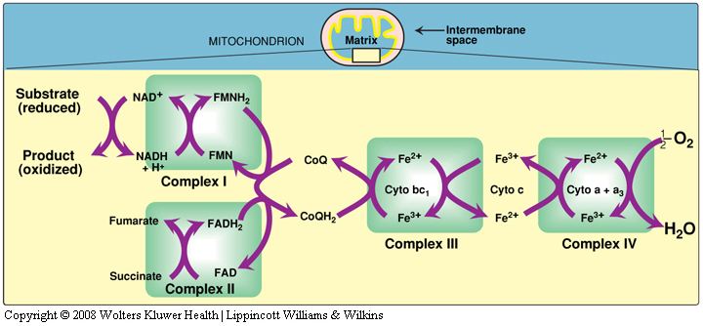
Electron Transport Chain

Slide 11
Complex I – NADH Dehydrogenase
This complex collects the pair of electrons from NADH and passes them to CoQ

Slide 12
Electron Transport Chain

Slide 13
Complex II – Succinate dehydrogenase
It is also a part of the TCA cycle
Transfers electrons to CoQ

Slide 14
Electron Transport Chain

Slide 15
Coenzyme Q (CoQ)
Also called ubiquinone (ubiquitous in biological systems)
A non-protein member of the ETC
Lipid soluble and mobile

Slide 16
Cytochromes
Each cytochrome is a protein that contains
  Heme group (porphyrin ring + iron in Fe³⁺ state)
When cytochromes accept electron
  Fe³⁺ is converted to Fe²⁺
  Fe²⁺ is reoxidized to Fe³⁺ when it donates electrons to the next carrier

Slide 17
Complex III and IV
Complex III: Cytochrome bc1
Complex IV: Cytochrome a + a₃
Electrons flow from:
CoQ → Complex III → Cyt. c → Complex IV

Slide 18
Electron Transport Chain

Slide 19
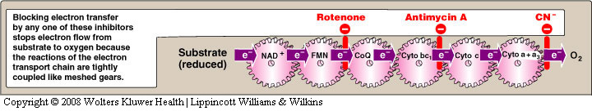
Site-specific inhibitors of ETC

Slide 20
ETC is coupled to proton transport for ATP synthesis
The energy of electron transfer is used to drive the protons out of the matrix
It is done by complexes I, III and IV (proton pumps)
This creates a proton gradient across the IMM to synthesize ATP

Slide 21
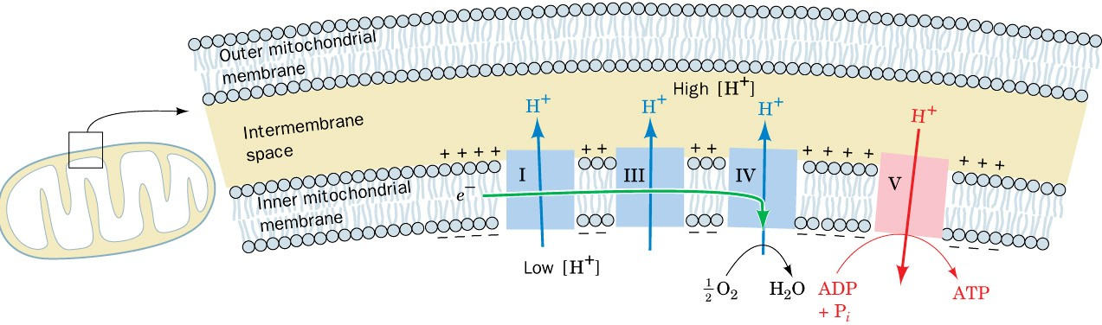
Coupling of electron transport (green arrow) and ATP synthesis
Page 821

Slide 22
ATP synthase
ATP synthase (Complex V) synthesizes ATP
Consists of two domains:
  F₀ – membrane spanning domain
  F₁ – extramembranous domain

Slide 23
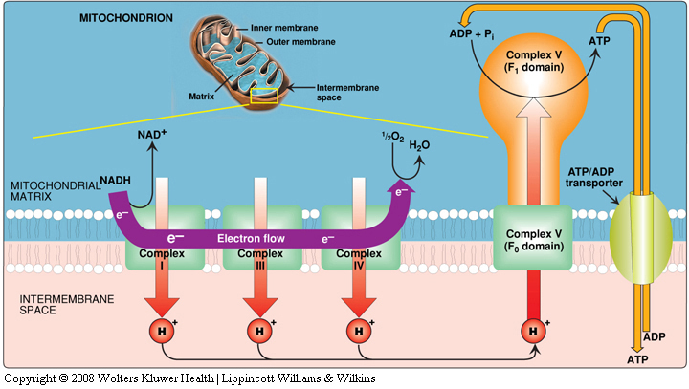
Transport of protons

Slide 24
Energetics of ATP synthesis
The energy required for phosphorylation of ADP to ATP = 7.3kcal/mol
Energy produced from the transport of a pair of electrons from NADH to O₂ = 52.58 kcal
No. of ATP molecules produced is 3 (NADH to O₂)
Excess energy is used for other reactions or released as heat

Slide 25
P:O ratio
ATP made per O atom reduced
  For NADH
    P:O = 3:1
  For FADH2
    P:O = 2:1

Slide 26
Inhibitors of ATP synthesis
Oligomycin:
  Binds to F₀ domain of ATP synthase and closes the H⁺ channel
Uncoupling proteins (UCPs):
  Create proton leaks (allow protons to reenter the matrix without ATP synthesis)
  Energy is released as heat (nonshivering thermogenesis)

Slide 27
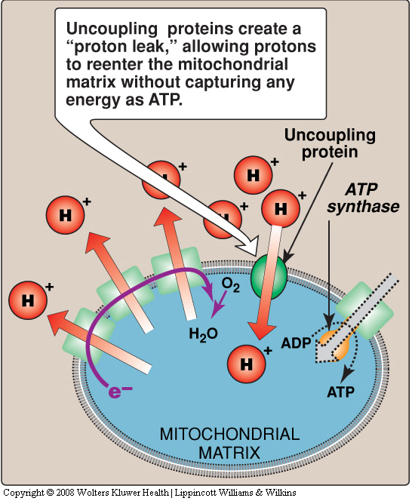

Slide 28
References
Lippincott’s Illustrated Reviews : Biochemistry

