Slide 1
Histology of the Upper Respiratory Tract (Nasal cavity, Paranasal sinuses and Larynx)
RESPIRATORY SYSTEM ( I )

Slide 2
Objectives:
By the end of this lecture the student should be able to describe the microscopic structures of:
Vestibule of the nasal cavity.
Respiratory mucosa of the nasal cavity.
Nasal septum.
Olfactory mucosa of the nasal cavity.
Mucosa of the paranasal sinuses.
Larynx.

Slide 3
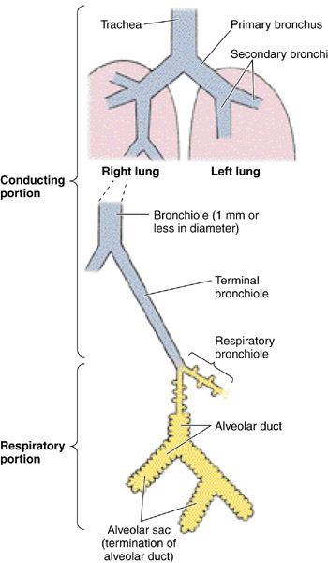
RESPIRATORY SYSTEM
Conducting portion :
1- Nasal cavity.
2- Nasopharynx.
3- Larynx.
4- Trachea.
5- Primary bronchi (extrapulmonary bronchi).
6- Intrapulmonary bronchi:
- 2ry bronchi (lobar bronchi).
- 3ry bronchi (segmental bronchi).
7- Primary bronchioles (preterminal bronchioles).
8- Terminal bronchioles.
Respiratory portion:
1- Respiratory bronchioles.
2- Alveolar ducts .
3- Alveolar sacs.
4- Pulmonary alveoli.

Slide 4
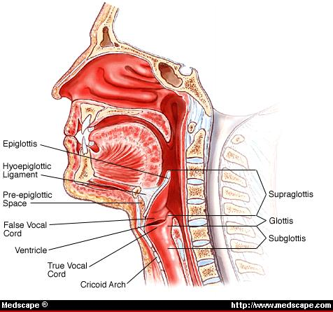
NASAL CAVITY (N.C.)
Anterior portion of N.C.:
Vestibule.
Posterior portion of N.C.:
a- Respiratory region.
b- Olfactory region.
N.B. The nasal septum divides the nasal cavity into two halves (right and left).

Slide 5
VESTIBULE OF N.C.
Lining: is lined with thin skin.
1- Epidermis: (Keratinized stratified Squamous epithelium).
2- Dermis.
Contents: 1- Vibrissae: stiff hairs.
2- Sebaceous glands.
3- Sweat glands.
Wall:
1- Hyaline cartilage.
2- Cancellous (spongy) bone.

Slide 6
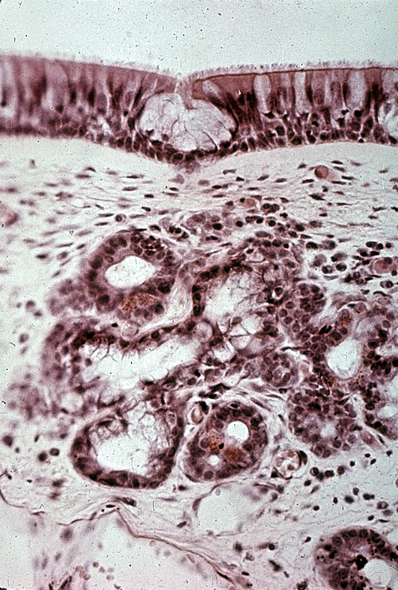
RESPIRATORY REGION (AREA) OF NASAL CAVITY
MUCOSA (MUCOUS MEMBRANE):
(A) Epithelium:
Pseudo-stratified ciliated columnar epithelium with goblet cells (Respiratory epithelium).
(B) Lamina propria ( Sub-epithelial C.T.):
contains:
1- Large arterial plexuses &
venous sinuses
(Highly vascularized C.T.)
3- Many seromucous glands (acini).
4- Abundant lymphoid elements:
Including occasional lymphoid nodules,
plasma cells & mast cells.

Slide 7
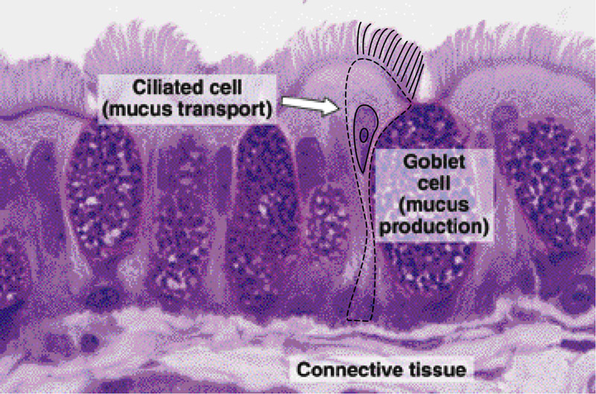
PARANASAL SINUSES
Lining: 1- Respiratory epith. (Mention…….)
2- Lamina propria.
CLINICAL APPLICATION:
Sinusitis.

Slide 8
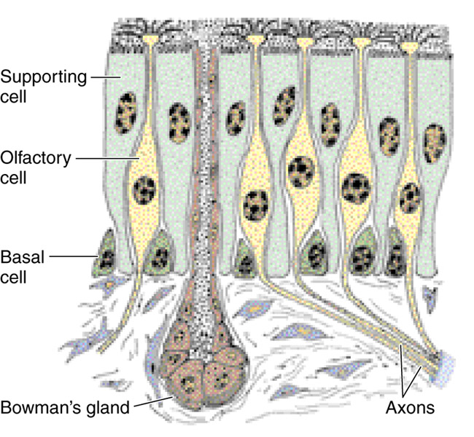
OLFACTORY REGION (AREA) OF NASAL CAVITY (OLFACTORY MUCOSA)
Site: 1-Roof of nasal cavity.
2-Upper part of nasal septum.
3-over superior concha.
Structure:
Olfactory epithelium:
Pseudo-stratified columnar epithelium.
1- Olfactory cells (olfactory nerve cells)
2- Sustentacular (supporting) cells.
3- Basal cells: Pyramidal in shape, basal in
position and act as stem cells.
(B) Lamina propria: contains:
1- Highly (richly) vascularized loose to dense C.T.
2- Contents:
a) Bowman’s glands ( olfactory glands) : are serous acini.
b) Bundles of unmyelinated nerve fibers:
Are axons of olfactory nerve cells + Schwann-like cells (glial cells).
c) Rich vascular plexus.
d) Numerous lymphoid elements.

Slide 9
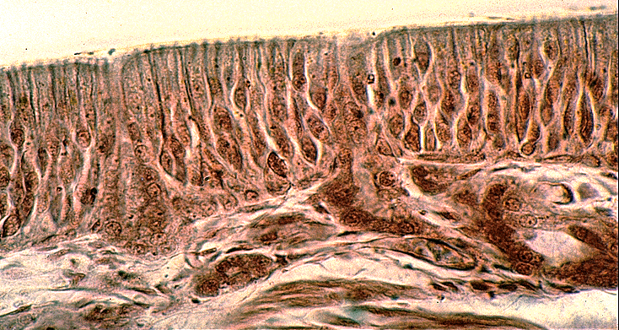
OLFACTORY EPITHELIUM
1- Olfactory cells:
Are bipolar neurons
Dendrite has olfactory vesicle that has nonmotile cilia.
Axons are unmyelinated with Schwann-like cells.
Axons will collect in the lamina propria to form
bundles of nerve fibers.
Bundles will collect to form
the olfactory nerve.
2- Sustentacular (supporting) cells:
Are columnar cells.
Function:
Physical support and nourishment for olfactory cells.

Slide 10
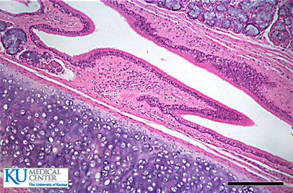
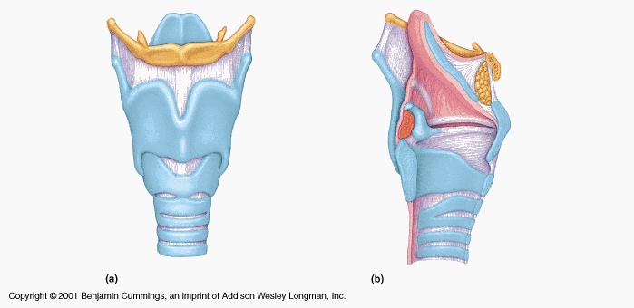
LARYNX
Mucosa (Mucous membrane ):
1- Epithelium.
2- Lamina propria.
(B) Cartilages.
(C) Extrinsic and intrinsic muscles: all are skeletal.
(D) Ligaments.

Slide 11
LARYNX
Mucosa:
1- Epithelium: (2 types)
a- Respiratory epithelium:
Pseudostratified ciliated columnar epithelium
with goblet cells.
b- Non keratinized stratified squamous epithelium:
In: -Vocal folds.
- Superior surface of epiglottuis
2- Lamina propria.

Slide 12
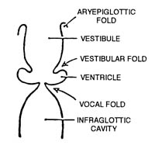
LARYNX
Mucosa (cont.):
There are 2 pairs of shelf-like mucosal folds:
1- Vestibular folds:
Are immovable.
L/M: a- Respiratory epithelium.
b- Lamina propria:
Loose C.T. with seromucous glands
lymphoid elements & adipose cells.
2- VOCAL FOLDS (CORDS): have:
a- Epithelium: non keratinized stratified squamous.
b- Lamina propria: C.T. containing bundles of elastic fibers and skeletal muscle .
N.B. No lymphoid nodules,
No seromucous glands.

Slide 13
(B) Cartilages:
1- Hyaline cartilages:
e.g. Thyroid cartilage.
2- Elastic cartilages:
Epiglottis.
(C) Muscles: all are skeletal.
(D) Ligaments.

Slide 14
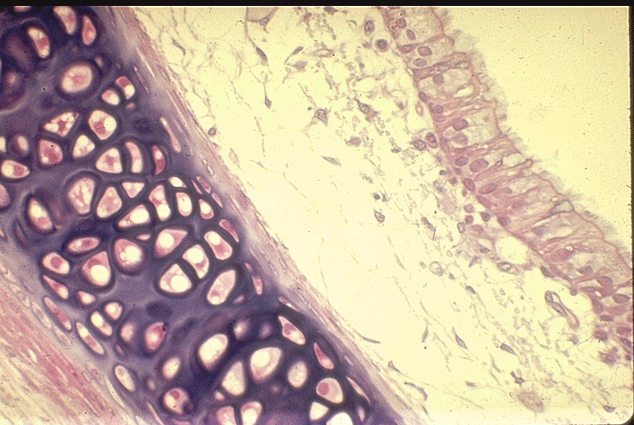
RESPIRATORY EPITHELIUM
Pseudo-stratified ciliated columnar epithelium with goblet cells.
Main Types of cells ( all touch the basement membrane)
1- Ciliated columnar cells.
2- Goblet cells.
3- Basal cells: are stem cells.
4- DNES cells: e.g. serotonin.

Slide 15
THANK YOU

