Slide 1
Immunology of tuberculosis .
Immunology Unit ,
Dept . Of Pathology .
College Of Medicine & KKUH .

Slide 2
Introduction :
The different manifestations of infection with Mycobacterium tuberculosis reflect the balance between :
the bacillus and host defense mechanisms

Slide 3
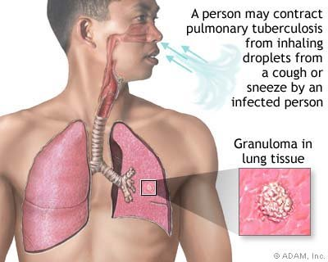
.
Mycobacterium tuberculosis is inhaled on droplet nuclei into the lungs and deposits in the :
terminal bronchioles and distal alveoli.

Slide 4
After inhalation of M. tuberculosis (MTB) several scenarios may follow :
1.Mycobacteria may be destroyed by alveolar
macrophages, (no infection ).
alternatively,
2.M. tuberculosis may not be immediately killed, and so a primary complex will develop.

Slide 5
3.In a minority of cases
active disease develops (primary tuberculosis). [TB]
4.Months or years afterwards,
usually under conditions of failing immune surveillance, latent infection may reactivate (postprimary TB).

Slide 6
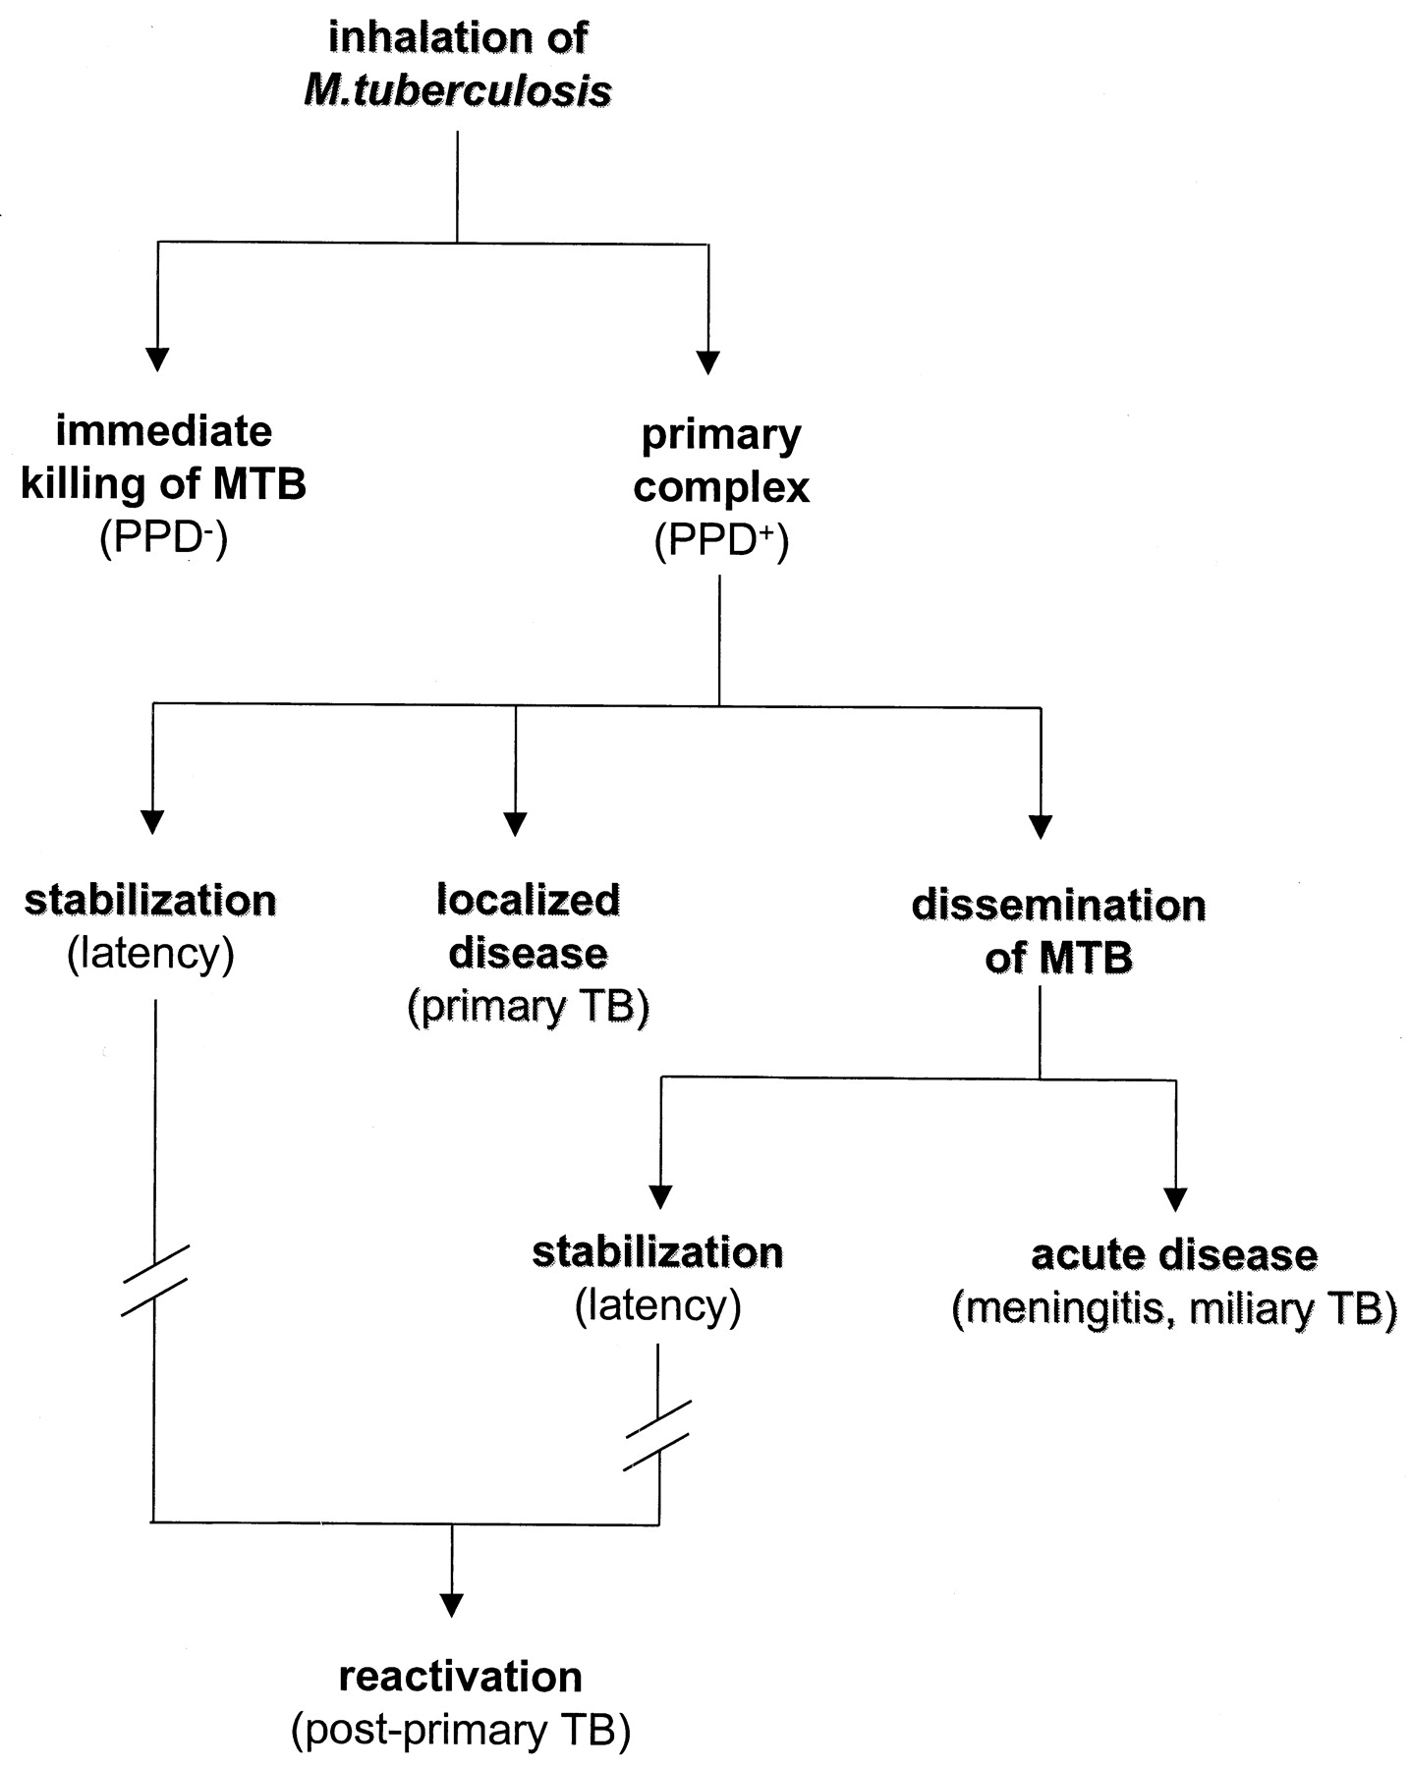
Chronological events after inhalation of M. tuberculosis.
Notes:
Chronological events after inhalation of M. tuberculosis. After inhalation of M. tuberculosis (MTB) droplet nuclei, several scenarios may follow. Mycobacteria may be destroyed by alveolar macrophages, in which case no real infection will take place. Alternatively, M. tuberculosis may not be immediately killed, and so a primary complex consisting of a small infiltrate and a draining lymph node will develop. Small calcifications may be seen on radiographic examination and the PPD skin test, as a marker of an M. tuberculosis-specific T-cell response, becomes positive. Most often, infection is stabilized at this point. In a minority of cases active disease now develops (primary tuberculosis [TB]), either in the lungs or anywhere else after hematogenous dissemination of M. tuberculosis. Months or years afterwards, usually under conditions of failing immune surveillance, latent infection may reactivate (postprimary TB).

Slide 7
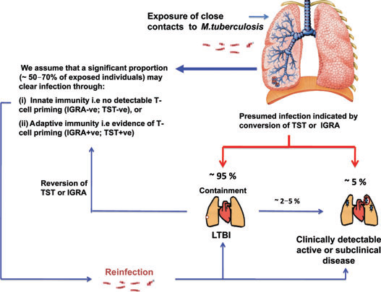

Slide 8
outcome of primary infection :
In most patients ( 90%), primary infection heal to
to leave a small visible scar on radiograph.
the PPD skin test (mantoux), as a marker of T-cell response, becomes positive.
the Ghon ( or primary ) complex .
Most often, infection is stabilized at this point.

Slide 9
The Gohn complex consist of :
The lung lesions ( tubercles –small granulomas )
plus the enlarged lymph nodes .
tubercles may become fibrotic or calcified.
and persist as such for a lifetime.
show up on chest x- ray as radio-opaque nodules.

Slide 11
PHAGOCYTOSIS OF M. TUBERCULOSIS
Alveolar resident macrophages are the primary cell type involved in the initial uptake of M. tuberculosis.
After this first encounter,
dendritic cells and monocyte-derived macrophages also take part in the phagocytic process.

Slide 12
Various receptors have been identified for phagocyosis of M. tuberculosis (MTB) by macrophages and dendritic cells:
1.complement receptors are primarily responsible for uptake of opsonized M. tuberculosis;
2.mannose and scavenger receptors for uptake of nonopsonized M. tuberculosis.
3.TLRs play a central role in immune recognition of M. tuberculosis.

Slide 13
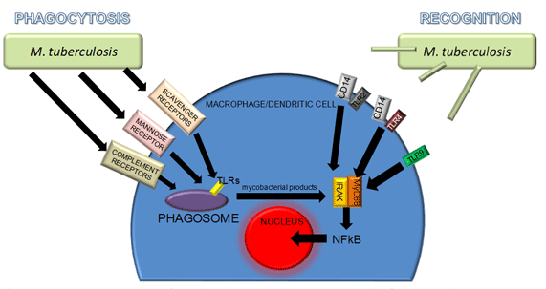
Phagocytosis and immune recognition of M. tuberculosis.

Slide 14
phagocytosis of M. tuberculosis. is followed by:
an inflammatory response with a crucial role for cytokine
production, most important are :
-tumor necrosis factor (TNF- a).
-interferon-gamma (INF-g ).

Slide 15
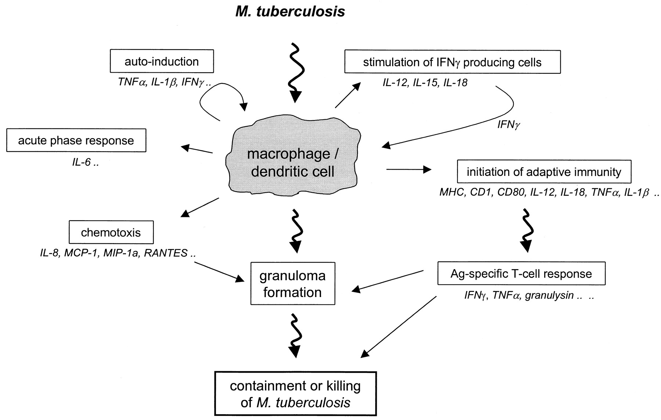
Inflammatory response of phagocytic cells upon activation with M. tuberculosis.
Notes:
Inflammatory response of phagocytic cells upon activation with M. tuberculosis. Immune recognition of M. tuberculosis by macrophages and dendritic cells is followed by an inflammatory response with a crucial role for cytokine production. Initial events in this cellular response include nonspecific host defense mechanisms, which may lead to early killing or containment of infection. In addition, various cellular products, including cytokines and cell surface markers, are involved in these processes as depicted in the figure (in italics). The anti-inflammatory cytokines (see text [“Anti-Inflammatory Cytokines”]) are not represented in this picture.

Slide 16
TNF-α.(tumor necrosis factor)
a proinflammatory cytokine. plays a key role in:
1. granuloma formation,
2.induces macrophage activation,
3. immunoregulatory properties.
4. induction of apoptosis

Slide 17
IFN-γ.(interferon-gamma)
The protective role of IFN-γ in tuberculosis is well established primarily in the context of antigen- specific T-cell immunity .
IFN-γ production in vitro can be used as a marker of infection with M. tuberculosis

Slide 18
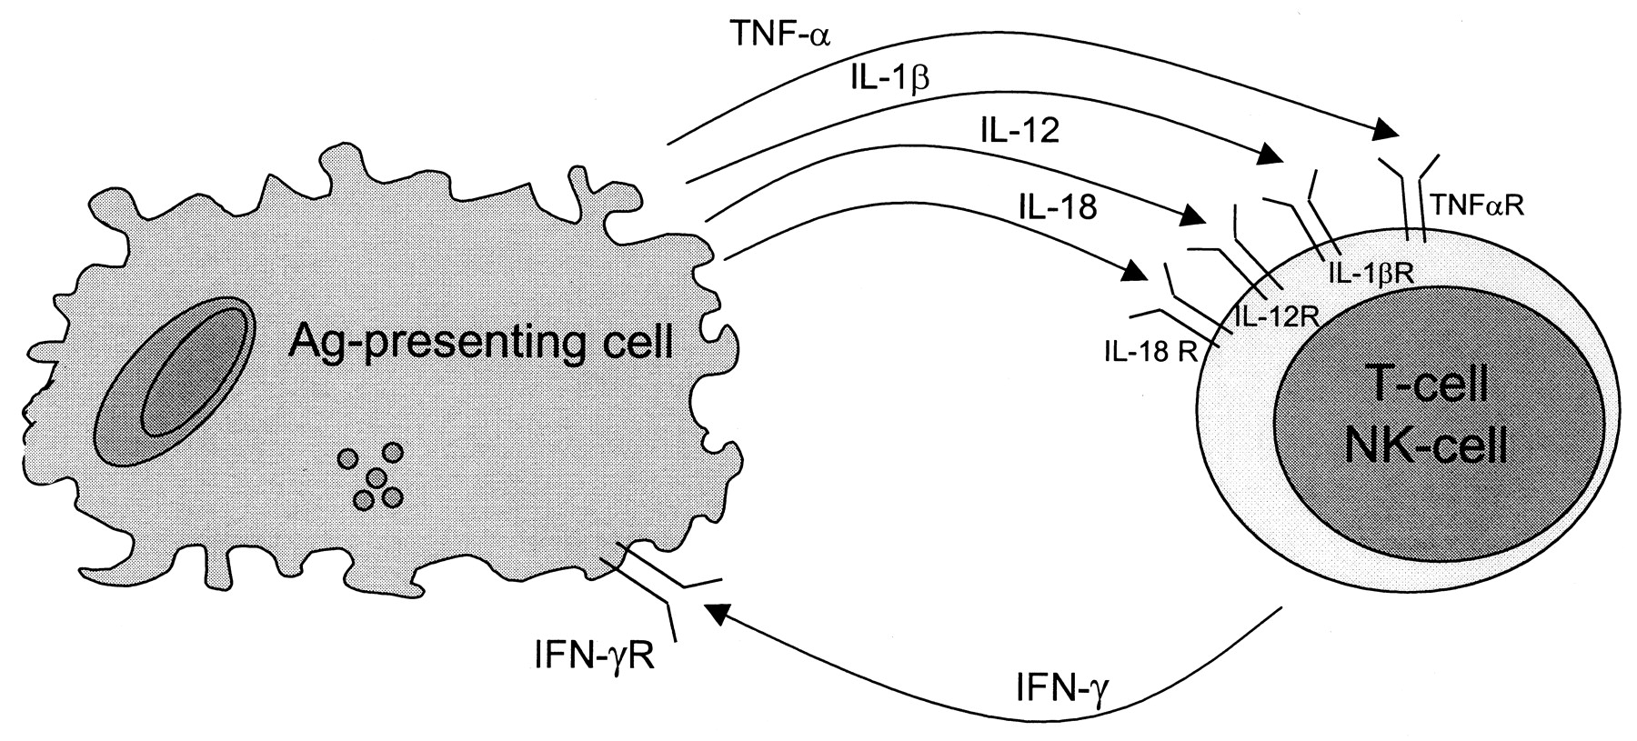
EFFECTOR MECHANISMS FOR KILLING OF M. TUBERCULOSIS
1.Macrophages are the main effector cells involved in killing of M. tuberculosis.
Activated by :
-IFN-γ,
-TNF-α.
-vitamin D.

Slide 19
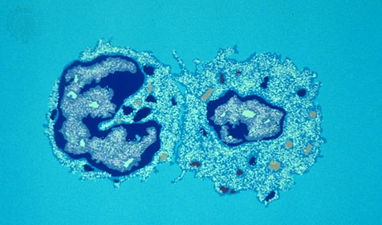
2. CD8 cytolytic T lymphocytes (CTL)
secrete :
granulysin, granzymes and perforins to kill mycobacteria-infected cells.

Slide 20
3.Apoptosis of phagocytic cells:
Apoptosis may constitute another effector mechanism for the infected host to limit outgrowth of M. tuberculosis .
Apoptosis may prevent dissemination of infection

Slide 21
M. tuberculosis resist killing by macrophages
by many mechanisms :
1.delay or inhibit fusion of phagosomes and lysosomes .
2.prevents phagosomal maturation and acidification of phagosomes,
3. catalase enzyme prevent the respiratory burst .

Slide 22
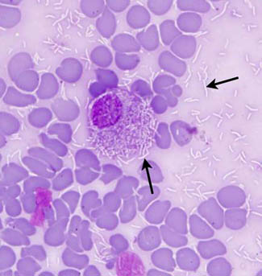
Numerous Mycobacteria sp. visualized as negative rod-shaped images with a Romanowsky stain (arrows).
Organisms are both free in the background and within a macrophage.

Slide 23
INITIATION OF ADAPTIVE IMMUNITY TO M. TUBERCULOSIS.
Excessive activation of cell-mediated immunity due to persistence of mycobacteria in macrophages.
DTH reactions in tuberculosis.

Slide 24
DTH reactions in tuberculosis :
Chronic DTH reactions develop when the TH 1
response activates macrophages but fails to eradicate phagocytosed microbes .
this will lead to :
granulomatous inflammation which is a form
of DTH reactions to the bacilli .

Slide 25
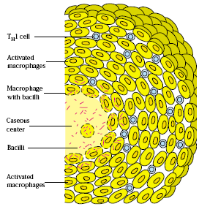
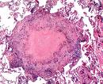
Tuberculous granuloma .

Slide 26
Outcome of T.B.In individuals with defective IMMUNITY ( immunodeficiency :
mild I.D. Severe I.D.
lead to reactivation , leads to more widespread
usually in the apices infection beyond the
of the lung . Lungs .

Slide 27
In patients with excessive TNF production , lesions break down leading to open T.B.
In a small proportion of young patients ,
widespread primary T.B. may occur.
and present as :
miliary T.B.
( or) tuberculous meningitis .

Slide 28
Reactivation is a consequence of impaired immune function which may result from :
1. malnutrition .
2. infections (e.g. AIDS ).
3. chemotherapy.
4. corticosteroids.

Slide 29
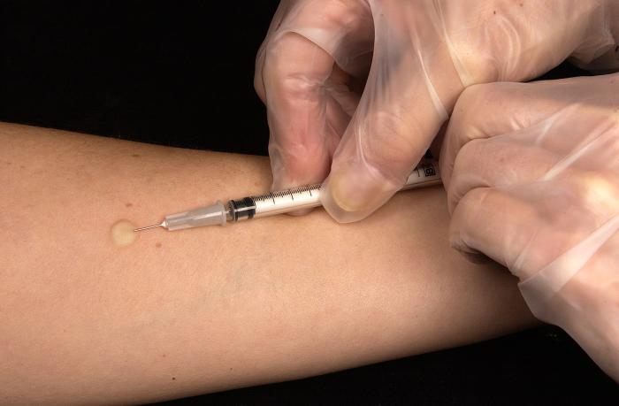
Test for immunity against T.B.
delayed hypersensitivity skin test
Tuberculin test, or ( Mantoux )
Intradermal injection of PPD.
( purified protein derivative ).

Slide 30
Tuberculin test reading after 48hours (delayed type IV). measure diameter of induration. .

Slide 31
Blood test for T.B. exposure .
measures interferon – gamma
secreted in response to mycobacterial antigen .
- mycobacterial peptides are added to the patients
blood which is then incubated for 12 hours .
- the amount of (IFN) produced is then measured
by ELISA test .

Slide 32
Prevention :
1.Immunoprophylaxis .
vaccination (BCG).
2. Chemoprophylaxis .
anti- tuberculous drugs .

Slide 33
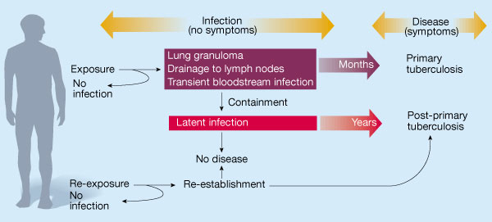

Slide 34
Summary :
1.The interplay between M. tuberculosis and host
immunity determines the outcome after infection.
2.With respect to the human host, both innate and adaptive defense mechanisms are involved.
3.At many stages in the host response, M. tuberculosis has developed mechanisms to circumvent or antagonize protective immunity.

